Slide 1
Rheumatic Conditions Related To Inflammatory Back Pain
Keri Geinosky SPT – Capstone Presentation

Slide 2
Objectives
By the end of this lecture, student's will be able to:
Recognize common signs and symptoms of rheumatic conditions, particularly spondyloarthropathies and inflammatory arthritis.
Differentiate the presentation and treatment of inflammatory back pain from mechanical back pain and apply similar principles to other rheumatic conditions.
Support the role of physical therapy when examining and treating individuals with rheumatic conditions, particularly inflammatory back pain and inflammatory arthritis.

Slide 3
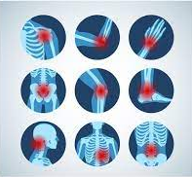
Rheumatology – What is It?¹
A branch of medicine devoted to the diagnosis and treatment of musculoskeletal disease and systemic autoimmune conditions (rheumatic diseases)
Affecting joints, muscles, and bones, and leading to pain, swelling, stiffness, and potentially joint deformities.
Notes:
Picture
https://www.news-medical.net/health/What-is-a-Rheumatologist.aspx

Slide 4
Arthritis²
Defined as painful inflammation and stiffness of the joints
Two categories:
Inflammatory Arthritis
Non-inflammatory Arthritis

Slide 5
Inflammatory Arthritis²
Common Symptoms
Joint pain
Joint swelling
Joint warmth
Joint tenderness
Morning stiffness >1 hour
Skin rashes
Eye inflammation
Hair loss
Dry mouth
Fever
Common Conditions
Rheumatoid arthritis
Gout
Ankylosing spondylitis
Psoriatic arthritis
Reactive arthritis

Slide 6
Importance of Recognizing Rheumatic Conditions³
Prevention of Complications: rheumatic conditions can lead to system-wide effects and irreversible joint damage
Early Intervention: many rheumatic conditions are chronic and progressive
Appropriate Treatment: conditions that are inflammatory by nature often require a different treatment approach than mechanical conditions (i.e., need for medication which can only be administered by MD)
Referral to Specialist: if you’re recognizing signs of a rheumatic condition (i.e., fatigue, fever, skin changes, extraarticular symptoms) or your patient is not responding to PT, refer patient back to PCP to discuss a rheumatologist referral

Slide 7
Inflammatory vs Mechanical Back Pain

Slide 8
Mechanical Back Pain (MBP) “Lumbago”^{4,5,6}
An injury or change of an anatomic structure, arising intrinsically from the spine, intervertebral discs, and/or surrounding soft tissues
Ex: muscle strain, facet sprain, SI joints, hypermobility
Clinical Presentation:
Onset: occurs at any age, typically acute, precipitating event or insidious
Symptoms: low back pain, may radiate into buttock/thigh
Aggs: movement - such as lifting, walking long distances, running, repetitive bending
Eases: rest, lying down, changing position

Slide 9
Inflammatory Back Pain (IBP)^{4,6}
Pain that results from an underlying systemic inflammatory condition
Ex: Ankylosing Spondylitis, Psoriatic Arthritis, Reactive Arthritis, Inflammatory Bowel Disease (IBD)
Clinical Presentation:
Onset: age <45, typically chronic (>3 months), insidious
Symptoms: low back pain, >30 min morning stiffness
Aggs: periods of inactivity (rest)
Eases: movement

Slide 10
MBP vs IBP Summary^{4,5,6,7}
Mechanical Back Pain | Inflammatory Back Pain
Occurs at any age | Age of onset <45 years
More acute onset | Pain duration >3 months
Onset varies – may be insidious, may have precipitating event | Insidious onset
May worsen with movement/exercise | Improves with movement/exercise
Improves with rest | Does not improve with rest
Little or no morning stiffness | Early morning stiffness lasting >30 minutes
 | Pain at night, which may wake patient

Slide 11
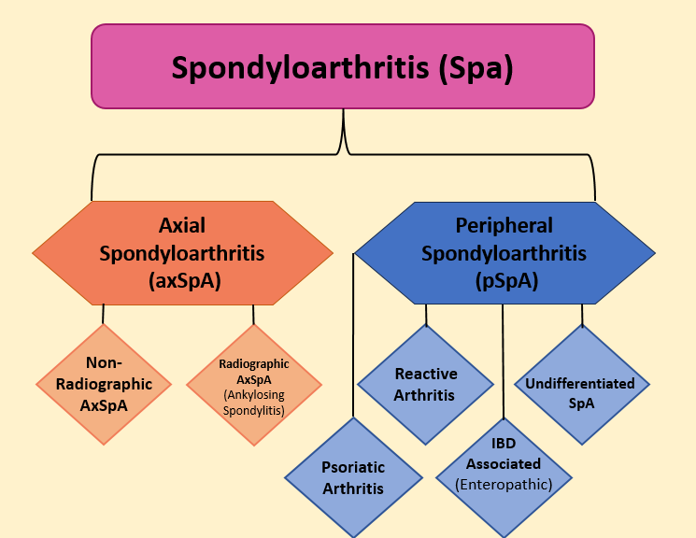
Spondyloarthritis (aka Spondyloarthropathy)⁸
A group of diseases characterized by inflammatory arthritis that are further categorized by what part of the skeleton they predominantly affect:
Predominantly affecting the spine (axial)
Predominantly causing pain and swelling in large joints and tendons of the upper and lower extremities (peripheral)
There can be overlap in axial and peripheral symptoms

Slide 12
Axial Spondylarthritis Overview^{8,9,10}
Predominantly affecting the spine
Radiographic axSpA – Ankylosing Spondylitis
Non-Radiographic axSpA –
nr-axSpA
Characterized by the modified New York criteria
Evidence of typical bone changes of the SIJ on conventional radiographs
No evidence of bone changes of SIJ on conventional radiographs
Manifests as a spectrum of spondylarthritis signs
Inflammation of the SIJ in MRI

Slide 13
Peripheral Spondylarthritis Overview^{11,12,13,14}
Predominantly affects joints of arms, legs, heels, fingers, toes
Psoriatic Arthritis (PsA) | Often associated with psoriasis
Reactive Arthritis (ReA) | Triggered by an infection of the intestines, genitals, or urinary tract
Undifferentiated Spondylarthritis | Term used to describe clinical presentation of spondylitis in someone who does not meet Ankylosing Spondylitis criteria
Enteropathic Arthritis (EnA) | Arthritis associated with inflammatory bowel disease (IBD) - i.e., Chron's Disease and Ulcerative Colitis

Slide 14
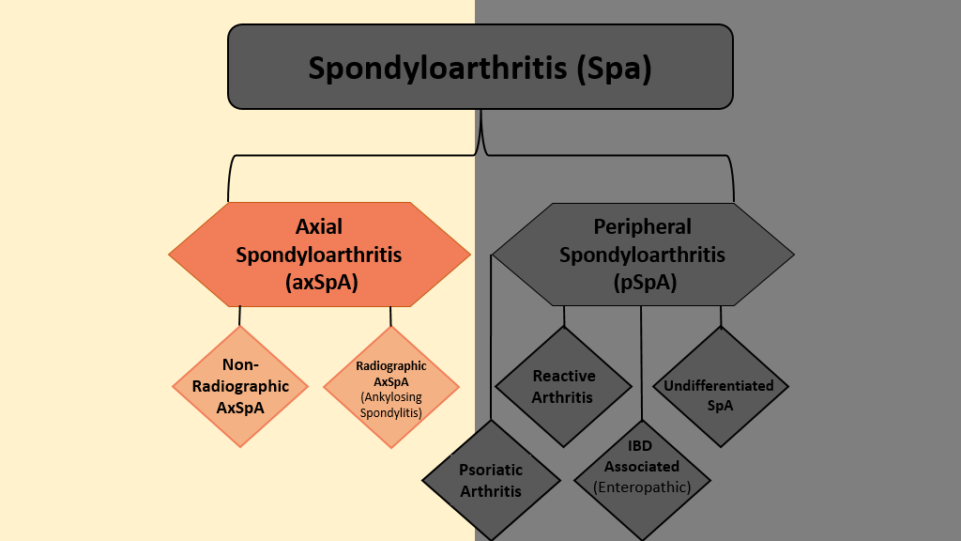
Ankylosing Spondylitis (AS) - (Axial Spondyloarthritis)

Slide 15
Modified New York Criteria¹⁵
Notes:
Picture:
MNYC - https://www.researchgate.net/figure/Modified-New-York-Criteria-for-Ankylosing-Spondylitis_tbl1_260647474

Slide 16
ASAS Criteria for Axial Spondyloarthritis^{16, 17}
Notes:
Picture:
Rudwaleit - https://ard-bmj-com.libproxy.lib.unc.edu/content/68/6/777

Slide 17
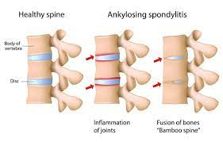
AS – Overview^{8,10}
Ankylosing spondylitis - Chronic inflammatory arthritis affecting the axial skeleton that can result in irreversible fusion of the spine
Ankylosis – abnormal stiffening and immobility due to fusion of bone
Spondylitis – inflammation of the spine
Notes:
Picture:
https://medlineplus.gov/genetics/condition/ankylosing-spondylitis/

Slide 18
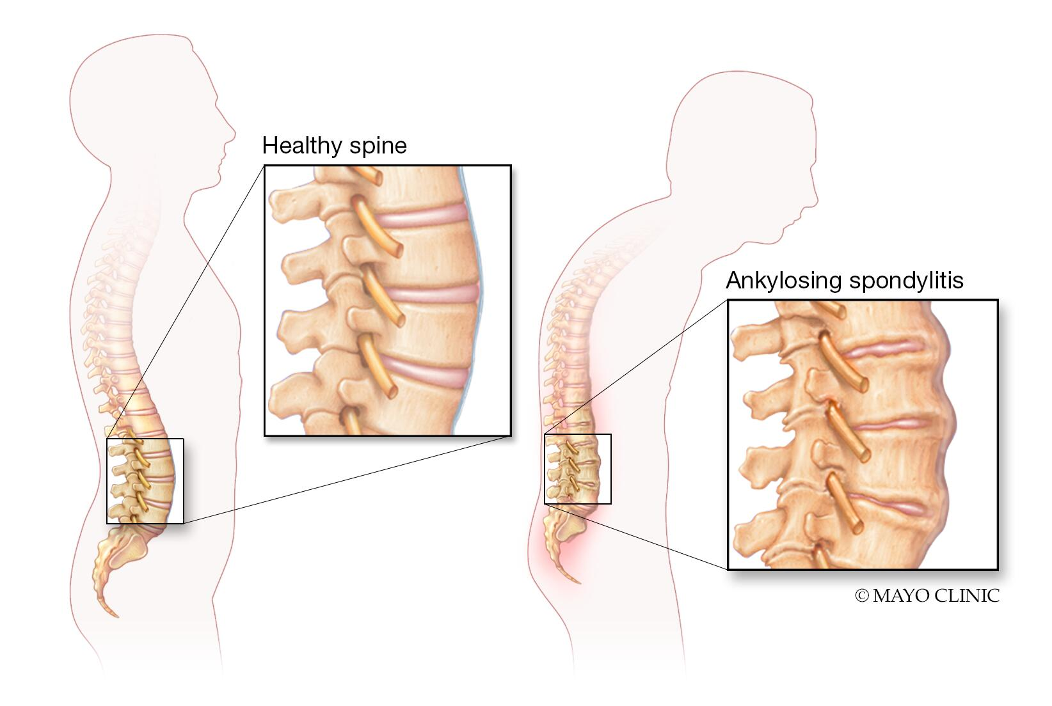
AS – Clinically Relevant Anatomy & Common Structural Characteristics¹⁸
Typically starts in SI joints and progresses cephalad
SI joints (erosion, bone formation, sclerosis, fat infiltration)
Vertebrae and spinal ligaments (syndesmophyte formation leading to eventual fusion)
Peripheral Joints and Tendons (enthesitis)
Notes:
Picture –
https://www.mayoclinic.org/diseases-conditions/ankylosing-spondylitis/symptoms-causes/syc-20354808

Slide 19
AS –Epidemiology/Etiology¹⁹⁻²⁴
Affects 0.05-.1% of the population
M:F = classically 2:1, research indicating closer to 1:1
Age at onset: 20-40 years old
Etiology not fully understood but related factors include:
HLA-B27 gene (occurs in 90-95% of patients w/ AS)
Environmental factors (i.e., mechanical stress)
Microbial infection
Endocrinal abnormalities

Slide 20
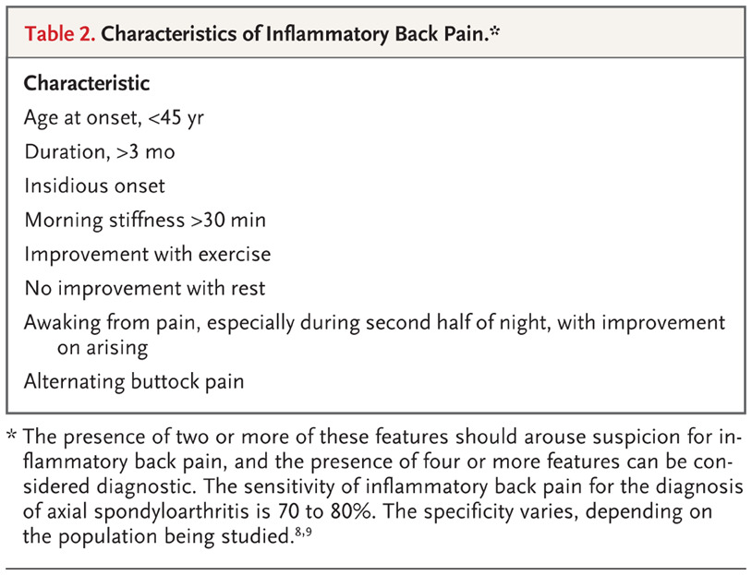
AS – Clinical Presentation²⁵
Inflammatory back pain →
Pain can also occur in the ribs, shoulders, hips, knees, and heels
Heel pain (enthesitis)
Notes:
Picture:
J Taurog - https://www.nejm.org/doi/full/10.1056/NEJMra1406182

Slide 21
AS – Complications/Comorbidities^{21,25,26}
Uveitis
Inflammatory Bowel Disease (i.e., Crohn’s and ulcerative colitis)
Osteoporosis (and vertebral fractures)
Cardiovascular disease (hypertension, stroke, aortic insufficiency, coronary artery disease)
Fatigue
Depression

Slide 22
AS – Differential Diagnosis
Mechanical low back pain
Spinal Stenosis
Degenerative Disc/Joint Disease
Rheumatoid Arthritis
Psoriatic Arthritis
Osteoarthritis

Slide 23
AS – Diagnosis^{8,9,10}
Clinical Presentation
Inflammatory back pain (<40 yo, insidious onset, improvement with exercise, no improvement with rest, pain at night)
Lab Testing
HLA-B27 +
↑ C-reactive protein (CRP)
↑ Erythrocyte sedimentation rate (ESR)
Imaging
X-ray
MRI
Modified New York Criteria
ASAS Criteria
Notes:
Notes:
HLA-B27 positive in ~90% of AS patients
CRP (1/2 of patients) and ESR (1/3 of patients) – both inflammatory markers
Imagining:
Of the lumbar spine/SIJ/Pelvis
AS - Evidence of typical bone changes of the SIJ on conventional radiographs
NR-axSpa - No evidence of bone changes of SIJ on conventional radiographs but show inflammation of the SIJ in MRI
References:
Levitova - https://arthritis-research.biomedcentral.com/articles/10.1186/s13075-016-1180-1
Ward - https://www.ncbi.nlm.nih.gov/pmc/articles/PMC6764857/
https://spondylitis.org/about-spondylitis/overview-of-spondyloarthritis/

Slide 24
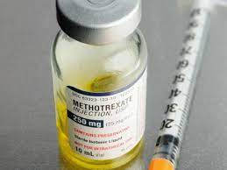
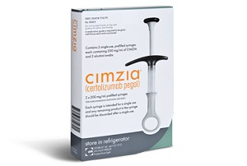
AS – Medical Management²⁷
First-Line Treatments
NSAIDs
Second-Line Treatments
Corticosteroids – typically not recommended long term because of ↓BMD
Disease Modifying Anti-Rheumatic Drugs (DMARDs) – can be conventional or biologic
Other Common Biologics
Tumor Necrosis Factor Inhibitors (TNF-Is)
Ex: Adalimumab, infliximab, Intercept
Notes:
Picture:
https://www.medicalnewstoday.com/articles/methotrexate-self-injectable-solution
https://www.americaninfusioncenters.com/therapies/cimzia/

Slide 25
AS - Physical Therapy Role

Slide 26
AS – Subjective Assessment^{28,29}
Medical Hx
IBP: May report comorbidities such as uveitis, IBD, etc.
MBP: May report comorbidities but likely unrelated
Hx of Present Illness/Pain
IBP: Expecting chronic LBP, >30 min morning stiffness, worse w/ rest, better w/ movement
MBP: Expecting acute LBP, <30 min morning stiffness, better w/ rest, worse w/ movement
Social Hx
Ask about current exercise, function/ADLs, smoking history
Medication
If known diagnosis of AS, may see DMARDs, TNFI's, etc.

Slide 27
AS – Objective Assessment^{28,29}
Gait
Looking for deviations, antalgic pattern, etc.
Posture
Advanced AS: marked ↓ of lumbar lordosis and ↑ in thoracic kyphosis and cervical hyperextension
Palpation
SI Joints

Slide 28
AS – Objective Assessment^{28,29}
Range of Motion
All planes should be measured A/PROM including spine, shoulders, hips, knees, and ankles as appropriate
IBP: expect to see decrease in spinal mobility
Tests
Modified Schober
Chest Expansion
SIJ Cluster

Slide 29
Modified Schober Method³⁰
Purpose: assess lumbar spinal mobility
Start Position
Patient standing w/ feet ~ 1 foot apart in line.
Examiner marks 1st point midway between the PSIS, 2nd point marked 10cm above 1st point, 3rd point marked 5cm below 1st point (gives a 15cm line
Method
Patient flexes forward from the waist until knees fully extended
Examiner measures the distance between uppermost and lowermost points
Interpretation
<5cm increase in length considered positive
Notes:
Picture
chrome-extension://efaidnbmnnnibpcajpcglclefindmkaj/https://www.asas-group.org/wp-content/uploads/2020/07/ASAS-handbook.pdf

Slide 30
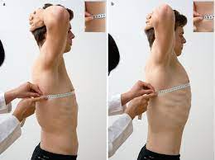
Chest Expansion²⁸
Purpose: assess throacic mobility
Start Position
Therapist locates patient's 4th interocstal space
Patient places their hands on their head
Method
Wrap the tape measure around patient's thorax in line with 4th intercoastal space
Patient fully exhales – therapist measures
Patient fully inhales – therapist measures
Interpretation
Difference between maximal forced expiration and maximal forced inspiration
<5cm difference indicates impariment
Notes:
Picture
Andreas roth - https://link.springer.com/chapter/10.1007/978-3-662-53147-1_1

Slide 31
AS – Objective Assessment^{28,29}
Strength
Driven by subjective
AS: expect to see limited strength in regions of the spine, hip, and shoulder

Slide 32
AS – Objective Assessment^{28,29}
Neurological
Advanced AS: may develop cauda equina
Vertebral fractures can lead to neurological complications
Balance
Poor posture, decreased ROM and pain may lead to impaired balance

Slide 33
AS – PT Assessment Summary^{28,29}
Subjective
Medical Hx | May report comorbidities such as uveitis, IBD, etc.
Hx of Present Illness and Pain | Symptoms/aggs/eases, etc. - chronic LBP/stiffness, worse w/ rest, better w/ movement; VAS; Pain may wake pt from sleep; worse with rest and better with movement.
Social Hx | Freq of exercise, any difficulty with ADLs, smoking history
Medication | May see NSAIDs or biologics
Objective
Gait | Looking for deviations, antalgic pattern
Posture | In advanced AS – marked ↓ of lumbar lordosis and ↑ in thoracic kyphosis; cervical hyperextension
Palpation | SI Joints and facet joint tenderness expected
Strength | Subjective driven – likely trunk flexors/extensors, hip flexors/extensors and shoulders
ROM | Utilize Schober for measuring spinal ROM - lack of spinal mobility is hallmark of AS; Chest expansion; Consider peripheral joints such as shoulders, hips, knees, ankles.
Neurological | In advanced AS – may see development of cauda equina syndrome
Balance | May have impaired balance d/t poor posture, decreased ROM, and pain

Slide 34
AS – Specific Outcome Measures^{10,28,31}
Bath Ankylosing Spondylitis Disease Activity Index (BASDAI)
Bath Ankylosing Spondylitis Functional Index (BASFI)
Bath Ankylosing Spondylitis Metrology Index (BASMI)
Ankylosing Spondylitis Disease Activity Score (ASDAS)
AS Quality of Life (ASQoL)
Notes:
Bath Ankylosing Spondylitis Disease Activity Index (BASDAI): BASDAI is a self-reported questionnaire that assesses disease activity. It includes questions about fatigue, spinal pain, joint pain/swelling, enthesitis, and morning stiffness. It is scored on a scale from 0 to 10, with higher scores indicating greater disease activity.
Bath Ankylosing Spondylitis Functional Index (BASFI): BASFI (patient reported) measures the impact of AS on a patient's functional ability. It assesses aspects like dressing, bending, reaching, and mobility. BASFI is scored on a scale from 0 to 10, with higher scores indicating worse functional status.
Bath Ankylosing Spondylitis Metrology Index (BASMI): BASMI (performance based) is used to assess spinal mobility and involves measuring the range of motion in the cervical and lumbar spine, the tragus-to-wall distance, and lateral lumbar flexion. Higher scores indicate reduced spinal mobility.
Ankylosing Spondylitis Disease Activity Score (ASDAS): ASDAS is a composite score that combines patient-reported outcomes, such as BASDAI, and measures of inflammation, such as CRP (C-reactive protein) or ESR (erythrocyte sedimentation rate). It provides a more comprehensive evaluation of disease activity
AS Quality of Life (ASQoL): ASQoL is a questionnaire that assesses the quality of life in individuals with AS. It covers various aspects of daily life and well-being and is scored on a 0-18 scale, with higher scores indicating worse quality of life.

Slide 35
AS – Treatment^{9,19,27,32}
PT plays a vital role in AS management
Recommended by the American College of Rheumatology (ACR) clinical practice guidelines.
Exercise has been shown to improve mobility, decease disease activity, and reduce inflammation in patients with AS
Goals of PT:
Alleviate/manage pain
Improve spinal mobility
Manage postural deformities
Improve flexibility and reduce morning stiffness

Slide 36
AS - PT Treatment Initial/Acute Phase/"Flare" ^{32,33}
Primary limitation: morning stiffness and pain in spine
PT Goals:
Control pain secondary to joint stiffness
Recover proprioception and normal postural patterns
Maintain mobility of pelvis and spine to enable good respiratory function
Interventions:
P/AROM: spine and hips (i.e., hips and shoulders)
Postural re-education
Aquatic therapy
Modalities: hot packs, electrotherapy (US/TENS/IFT)
Manual: Mobilizations (Grade I & II), myofascial release, muscle energy techniques

Slide 37
AS - PT Treatment Remission Phase^{32,33}
Primary limitation: pain and restricted mobility of spine (and possibly peripheral joints)
PT Goals:
Improve body function and reduce pain
Improve ADLs and QOL
Interventions:
Aerobic conditioning
Strength Training: emphasis on core and posterior chain (erector spinae, glutes, latissimus dorsi, etc.)
Pilates/Yoga

Slide 38
AS - PT Treatment Chronic Phase^{32,33}
Primary limitation: formation of ankylose (fusion) resulting in total rigidity of the spine
PT Goals:
Enable patient to maintain residual function
Improve ADLs
Interventions:
Function activities: training in ADLs
Home Exercise Program: progressive strengthening, ROM, flexibility/stretching
Sporting activities for aerobic fitness: jogging, cycling, swimming
Education: importances of maintaining an active lifestyle

Slide 39
AS – Considerations³²
Upper Cervical Instability
Manual therapy – can be beneficial to patients with AS, but if there is evidence of spinal fusion HVLA techniques are contraindicated
Fatigue – allow for adequate periods of rest
Immunocompromised

Slide 40
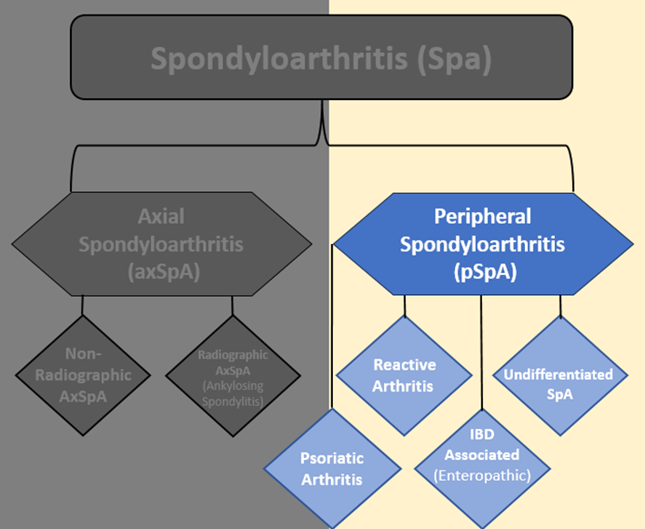
Psoriatic Arthritis (PsA) - (Peripheral Spondyloarthritis)

Slide 41
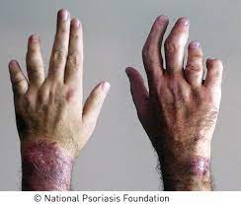
PsA – Overview^{11, 34}
Psoriatic Arthritis: a chronic, progressive, inflammatory joint disease typically associated with psoriasis
Affects both peripheral joints and axial skeleton causing pain, stiffness, swelling, and joint destruction
Notes:
Picture:
https://www.medcentral.com/pain/chronic/new-research-psoriatic-arthritis

Slide 42
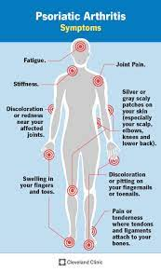
PsA – Clinically Relevant Anatomy³⁵
Fingers and toes (dactylitis)
Distal interphalangeal joints
Peripheral tendons (enthesitis)
Skin (psoriasis)
SI Joints (sacroiliitis)
Notes:
Picture:
https://my.clevelandclinic.org/health/diseases/13286-psoriatic-arthritis

Slide 43
PsA –Epidemiology/Etiology³⁴
Affects 0.05%-0.25% in general population
Affects 6%-41% in patients with psoriasis
Age at onset: 30-55 years old
Etiology
Genetics
Trauma and infection
Diagnosis of psoriasis

Slide 44
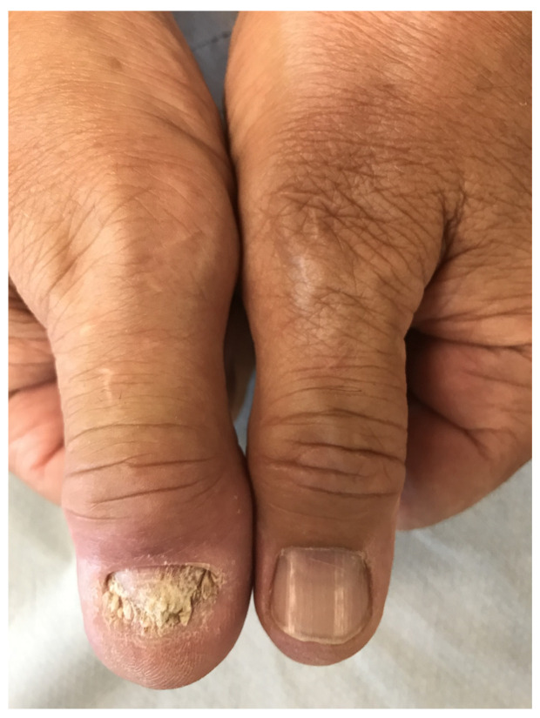
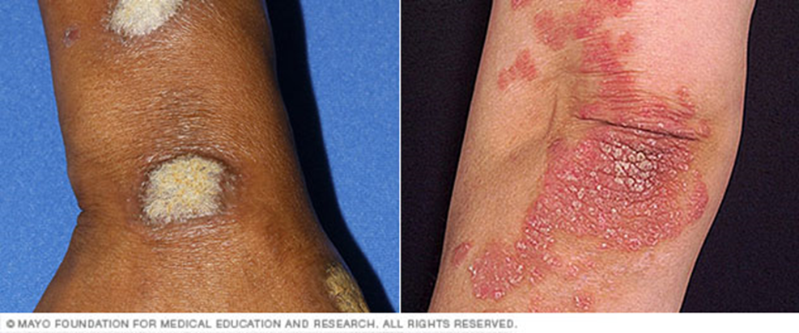
PsA – Clinical Presentation³⁴
Inflammation, pain, stiffness, and swelling in joints
Dactylitis “sausage fingers”
Enthesitis
Nail changes (dents, crumbling, separation from nail bed)
Skin lesions (dry, red patches, gray scales)
Inflammatory back pain
Notes:
Pictures:
https://www.ncbi.nlm.nih.gov/pmc/articles/PMC8231617/

Slide 45
PsA – Subtypes³⁴
Oligoarticular – asymmetric and involves less than 5 small or large joints
Polyarticular – usually symmetric and involves more than 5 small or large joints
Distal – prominent involvement of the distal interphalangeal joints
Arthritis mutilans – severe destructive joint disease with deformities, especially in the hands and feet
Spondylitis – affecting the spine

Slide 46
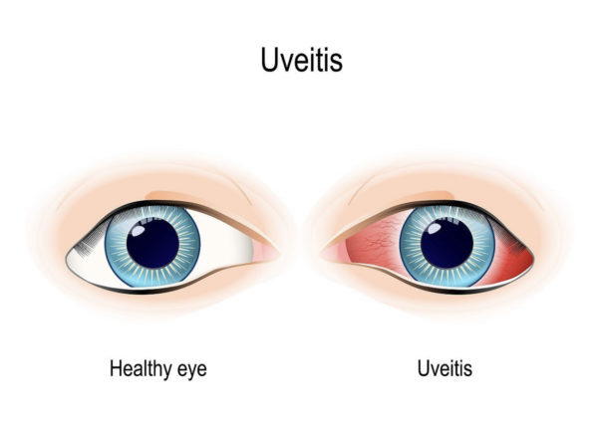
PsA – Complications/Comorbidities^{11, 34}
Permanent joint deformity (especially in fingers)
Uveitis
Hypertension
Metabolic syndrome (i.e., diabetes)
Cardiovascular disease
Notes:
Picture:
https://flei.com/uveitis-overview/

Slide 47
PsA – Differential Diagnosis³⁴
Rheumatoid arthritis
Reactive arthritis
Ankylosing spondylitis
AS – earlier onset; SI involvement usually symmetric
PsA – SI involvement usually asymmetric

Slide 48
PsA – Diagnosis^{11,34}
Clinical Presentation
Joint swelling, tenderness
Fingernail pitting, flaking, other abnormalities
Enthesitis at the heel (Achilles)
Lab Testing
Rheumatoid Factor (RF) – can help differentiate PsA from RA
Joint Fluid Tests – uric acid crystals would indicate gout vs PsA
CRP and ESR – may be elevated
Imaging
X-ray
MRI
CASPAR Criteria

Slide 49
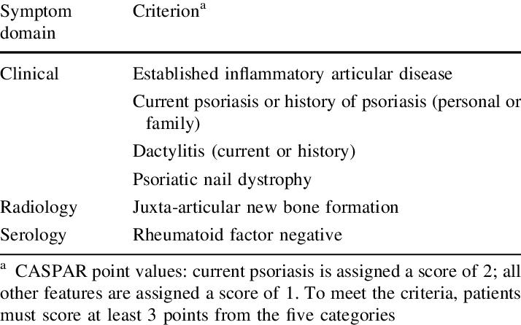
CASPAR Criteria³⁶
Notes:
Picture:
https://www.researchgate.net/figure/Classification-Criteria-for-Psoriatic-Arthritis-CASPAR-90_tbl3_260378953

Slide 50
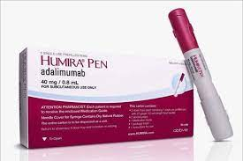
PsA – Medical Management³⁷
Mild Disease
NSAIDs
Local Corticosteroid Injection
Moderate to Severe Disease
DMARDs
Biologic Agents (TNFI's)
Notes:
Picture:
https://www.medicalnewstoday.com/articles/methotrexate-self-injectable-solution
https://americanpregnancy.org/healthy-pregnancy/medication/humira-during-pregnancy/

Slide 51
Reactive Arthritis (ReA) - (Peripheral Spondylarthritis)

Slide 52
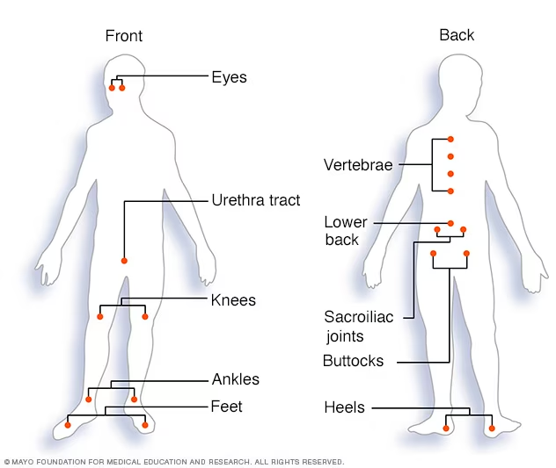
ReA – Overview^{12,38}
Reactive Arthritis is an inflammatory arthritis that appears several days/weeks after a gastrointestinal or genitourinary infection
Notes:
Picture:
https://www.mayoclinic.org/diseases-conditions/reactive-arthritis/symptoms-causes/syc-20354838

Slide 53
ReA – Clinically Relevant Anatomy³⁸
Not limited to joints
Affects many systems including:
Ophthalmological
Genitourinary
Dermatological
Musculoskeletal
Gastrointestinal

Slide 54
ReA – Epidemiology/Etiology^{12,38}
Relatively rare
Age: occurs most frequently between ages 20 and 40
Etiology
Triggered by a bacterial infection – genitourinary (i.e., chlamydia) or gastrointestinal (i.e., salmonella, C. diff)
Genetics

Slide 55
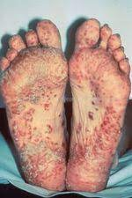
ReA – Clinical Presentation^{12,38}
Asymmetric oligoarthritis
Most commonly knees, ankles, and feet
Can also occur in SI joints and
Urethritis, cervicitis, genital ulcers
Conjunctivitis or iritis
GI Distress
Acute diarrhea
Skin Lesions
Mouth sores
Rash on the soles of feet and palms of hands
Inflammatory Back Pain
Notes:
Picture:
https://www.physio-pedia.com/Reactive_Arthritis

Slide 56
ReA – Complications/Comorbidities³⁸
Recurrent arthritis (15% to 50%)
Chronic arthritis or sacroiliitis
Ankylosing spondylitis (↑ risk if HLA-B27–positive)
Urethral stricture
Aortic root necrosis
Cataracts
Cystoid macular edema

Slide 57
ReA – Differential Diagnosis³⁸
Gonococcal arthritis
Gouty arthritis
Septic Arthritis
Rheumatic Fever
Psoriatic Arthritis
Ankylosing Spondylitis
Rheumatoid Arthritis
Notes:
Gonococcal – bacterial arthritis that results from gonorrhoeae (ReA other STI’s like chlamydia)
Gouty – excess uric acid; usually affects big toe; usually diet related
Septic – infection in the synovial fluid (ReA is infection elsewhere in the body)
Rheumatic fever – inflammatory condition that develops if strep throat not treated properly; rash is typically on the trunk

Slide 58
ReA – Diagnosis^{12,38}
Lab Testing
Blood
Evidence of current infection
↑ CRP and ESR
RF testing – to rule out RA
Joint Fluid Tests
WBC count – increase may indicate infection
Bacteria – to rule out septic arthritis
Uric acid crystals – to rule out gout
Imaging
X-ray
Clinical Presentation

Slide 59
ReA – Clinical Diagnosis
Sausage shaped finger, toe, or heel pain
Asymmetric oligoarthritis
Conjunctivitis or iritis
Urethritis or genital ulcers
Acute diarrhea or cervicitis with 4 weeks of arthritis onset
2 or more of the signs plus involvement of skeletal system establishes diagnosis

Slide 60
ReA – Medical Management
Acute Treatments
Antibiotics – if infectious agent identified as trigger
NSAIDs
Steroids – glucocorticoid injections
DMARDs
Chronic Treatments
DMARDs
TNFIs (biologics)

Slide 61
Peripheral Spondylarthritis – Physical Therapy Role

Slide 62
PsA and ReA – PT Assessment
If patient comes in with known diagnosis of PsA or ReA with referral to treat →
Complete exam as usual
If patient coming in for LBP w/ no hx of PsA or ReA but clinical findings in exam suggest possible dx of PsA or ReA →
Refer back to PCP to discuss possible referral to rheumatologist
Treat functional deficits

Slide 63
PsA and ReA – PT Treatment^{38,39}
Patient Education
Promote joint protection and proper body mechanics
Avoid overuse especially in the acute phase
Smoking cessation
Sleep hygiene
Range of Motion
To prevent stiffness, improve flexibility, and prevent deformities
Resistance Training
Important in prevention of atrophy
Aerobic Exercise
Swimming, walking, recumbent bike
Modalities
UV therapy, cryotherapy, paraffin baths, splinting to prevent deformity (especially in fingers)
Aquatic Therapy
Keep in mind – open wounds and infections are contraindications

Slide 64
PsA and ReA – Considerations^{38,39}
Peripheral spondylarthritis can still present with axial symptoms (inflammatory back pain)
You may not be seeing these patients for their condition, it may be a comorbidity
Avoid over exertion during exercise
Open skin lesions are a contraindication to aquatic therapy

Slide 65
Summary
Differentiating between inflammatory and mechanical back pain is important because inflammatory back pain can indicate rheumatic conditions
Identifying rheumatic conditions is important because it allows for appropriate treatment and can help in preventing progression of disease, irreversible joint deformations, and associated complications
If you’re recognizing signs of an undiagnosed rheumatic condition (i.e., fatigue, fever, skin changes, extraarticular symptoms) refer patient back to PCP to discuss a rheumatologist referral and continue to treat for functional limitations

Slide 66
Resources
When working with rheumatic conditions, especially ones you are not familiar with, it’s important to be able to locate and understand information to guide your treatment.
Link to American College of Rheumatology (ACR) CPG’s:
https://rheumatology.org/clinical-practice-guidelines
Link to European Alliance of Associations for Rheumatology (EULAR) recommendations:
https://www.eular.org/recommendations-management

Slide 67
References
1. What is a Rheumatologist. Accessed February 12, 2024. https://rheumatology.org/rheumatologist
2. Poudel P, Goyal A, Lappin SL. Inflammatory Arthritis. In: StatPearls. StatPearls Publishing; 2024.
3. Mauro D, Forte G, Poddubnyy D, Ciccia F. The role of early treatment in the management of axial spondyloarthritis: challenges and opportunities. Rheumatol Ther. 2024;11(1):19-34. doi:10.1007/s40744-023-00627-0
4. Europe PMC Europe PMC. Accessed March 7, 2024. https://europepmc.org/article/med/29019640
5. Will JS, Bury DC, Miller JA. Mechanical low back pain. Am Fam Physician. 2018;98(7):421-428.
6. Walker BF, Williamson OD. Mechanical or inflammatory low back pain. What are the potential signs and symptoms? Man Ther. 2009;14(3):314-320. doi:10.1016/j.math.2008.04.003
7. Harris C. Differentiating Inflammatory and Mechanical Back Pain. NASS. April 2018.
8. Overview of Spondyloarthritis What You Need to Know | SPONDYLITIS.ORG. Accessed February 8, 2024. https://spondylitis.org/about-spondylitis/overview-of-spondyloarthritis/
9. Levitova A, Hulejova H, Spiritovic M, Pavelka K, Senolt L, Husakova M. Clinical improvement and reduction in serum calprotectin levels after an intensive exercise programme for patients with ankylosing spondylitis and non-radiographic axial spondyloarthritis. Arthritis Res Ther. 2016;18(1):275. doi:10.1186/s13075-016-1180-1
10. Ward MM, Deodhar A, Gensler LS. 2019 Update of the American College of Rheumatology/ Spondylitis Association of America/Spondyloarthritis Research and Treatment Network Recommendations for the Treatment of Ankylosing Spondylitis and Nonradiographic Axial Spondyloarthritis. Arthritis and Rheumatology. 2019;71(10):1599-1613.
11. Psoriatic arthritis - Symptoms & causes - Mayo Clinic. Accessed February 5, 2024. https://www.mayoclinic.org/diseases-conditions/psoriatic-arthritis/symptoms-causes/syc-20354076
12. Reactive arthritis - Symptoms & causes - Mayo Clinic. Accessed February 5, 2024. https://www.mayoclinic.org/diseases-conditions/reactive-arthritis/symptoms-causes/syc-20354838
13. Complete List of Undifferentiated Spondyloarthritis Symptoms | SPONDYLITIS.ORG. Accessed February 5, 2024. https://spondylitis.org/about-spondylitis/overview-of-spondyloarthritis/undifferentiated-spondyloarthritis/symptoms/
14. Enteropathic Arthritis: Symptoms, Causes & Treatment. Accessed February 5, 2024. https://my.clevelandclinic.org/health/diseases/23166-enteropathic-arthritis#symptoms-and-causes
15. van der Linden S, Valkenburg HA, Cats A. Evaluation of diagnostic criteria for ankylosing spondylitis. A proposal for modification of the New York criteria. Arthritis Rheum. 1984;27(4):361-368. doi:10.1002/art.1780270401
16. Rudwaleit M, van der Heijde D, Landewé R, et al. The development of Assessment of SpondyloArthritis international Society classification criteria for axial spondyloarthritis (part II): validation and final selection. Ann Rheum Dis. 2009;68(6):777-783. doi:10.1136/ard.2009.108233
17. van Tubergen A, Weber U. Diagnosis and classification in spondyloarthritis: identifying a chameleon. Nat Rev Rheumatol. 2012;8(5):253-261. doi:10.1038/nrrheum.2012.33
18. Mandl P, Navarro-Compán V, Terslev L, et al. EULAR recommendations for the use of imaging in the diagnosis and management of spondyloarthritis in clinical practice. Ann Rheum Dis. 2015;74(7):1327-1339. doi:10.1136/annrheumdis-2014-206971
19. Ward MM, Deodhar A, Gensler LS. 2019 Update of the American College of Rheumatology/ Spondylitis Association of America/Spondyloarthritis Research and Treatment Network Recommendations for the Treatment of Ankylosing Spondylitis and Nonradiographic Axial Spondyloarthritis. Arthritis and Rheumatology. 2019;71(10):1599-1613.
20. Watad A, Bridgewood C, Russell T, Marzo-Ortega H, Cuthbert R, McGonagle D. The early phases of ankylosing spondylitis: emerging insights from clinical and basic science. Front Immunol. 2018;9:2668. doi:10.3389/fimmu.2018.02668

Slide 68
References (cont)
21. Zhu W, He X, Cheng K, et al. Ankylosing spondylitis: etiology, pathogenesis, and treatments. Bone Res. 2019;7:22. doi:10.1038/s41413-019-0057-8
22. Sieper J, Poddubnyy D. Axial spondyloarthritis. Lancet. 2017;390(10089):73-84. doi:10.1016/S0140-6736(16)31591-4
23. Dean LE, Jones GT, MacDonald AG, Downham C, Sturrock RD, Macfarlane GJ. Global prevalence of ankylosing spondylitis. Rheumatology (Oxford). 2014;53(4):650-657. doi:10.1093/rheumatology/ket387
24. Wright GC, Kaine J, Deodhar A. Understanding differences between men and women with axial spondyloarthritis. Semin Arthritis Rheum. 2020;50(4):687-694. doi:10.1016/j.semarthrit.2020.05.005
25. Taurog JD, Chhabra A, Colbert RA. Ankylosing spondylitis and axial spondyloarthritis. N Engl J Med. 2016;374(26):2563-2574. doi:10.1056/NEJMra1406182
26. Gökşenoğlu G, Buğdaycı D, Paker N, Yıldırım MA, Etli Ö. The prevalence of comorbidity and predictors in ankylosing spondylitis. Turk J Phys Med Rehabil. 2019;65(2):132-138. doi:10.5606/tftrd.2019.2822
27. Wenker KJ, Quint JM. Ankylosing Spondylitis. In: StatPearls. StatPearls Publishing; 2024.
28. Shannon K. Standard of Care: Ankylosing Spondylitis. Bringham and Women’s Hospital Department of Rehabiltation Services. 2007.
29. Reiman MP, ed. Orthopedic Clinical Examination. Human Kinetics.; 2016:496-497.
30. Members of the AStretch Committee. Ankylosing Spondylitis - The Bath Indices . National Ankylosing Spondylitis Society. February 2016.
31. Zochling J. Measures of symptoms and disease status in ankylosing spondylitis: Ankylosing Spondylitis Disease Activity Score (ASDAS), Ankylosing Spondylitis Quality of Life Scale (ASQoL), Bath Ankylosing Spondylitis Disease Activity Index (BASDAI), Bath Ankylosing Spondylitis Functional Index (BASFI), Bath Ankylosing Spondylitis Global Score (BAS-G), Bath Ankylosing Spondylitis Metrology Index (BASMI), Dougados Functional Index (DFI), and Health Assessment Questionnaire for the Spondylarthropathies (HAQ-S). Arthritis Care Res (Hoboken). 2011;63 Suppl 11:S47-58. doi:10.1002/acr.20575
32. Nava T. Physiotherapy rehabilitation in patients with ankylosing spondylitis. Beyond Rheumatol. 2019;1(2):37-46. doi:10.4081/br.2019.6
33. Sharan D, Rajkumar JS. Physiotherapy for ankylosing spondylitis: systematic review and a proposed rehabilitation protocol. Curr Rheumatol Rev. 2017;13(2):121-125. doi:10.2174/1573397112666161025112750
34. Tiwari V, Brent LH. Psoriatic Arthritis. In: StatPearls. StatPearls Publishing; 2024.
35. Psoriatic Arthritis: Symptoms and Treatments. Accessed February 19, 2024. https://my.clevelandclinic.org/health/diseases/13286-psoriatic-arthritis
36. Taylor W, Gladman D, Helliwell P, et al. Classification criteria for psoriatic arthritis: development of new criteria from a large international study. Arthritis Rheum. 2006;54(8):2665-2673. doi:10.1002/art.21972
37. Waldron N. Care and support of patients with psoriatic arthritis. Nurs Stand. 2012;26(52):35-39. doi:10.7748/ns2012.08.26.52.35.c9247
38. Cheeti A, Chakraborty RK, Ramphul K. Reactive Arthritis. In: StatPearls. StatPearls Publishing; 2024.
39. Perrotta FM, Scriffignano S, Benfaremo D, Ronga M, Luchetti MM, Lubrano E. New insights in physical therapy and rehabilitation in psoriatic arthritis: A review. Rheumatol Ther. 2021;8(2):639-649. doi:10.1007/s40744-021-00298-9

Slide 69
Thank you to my committee!
Jeff O’Laughlin DPT, OCS, FAAOMPT
Louise Thoma DPT, PhD
Joel Thompson DPT, MA, CLT, CPhT
Ben Williams DPT, OCS

