Slide 1
Oxygen Cost of Over-Ground Walking in Persons with Mild to Moderate Parkinson’s Disease
Brynne Gould, SPT

Slide 2
Background - Who, What, and Why?
Research Question
Methods
Results
Strengths and Limitations
Clinical Application & Future Research
Questions
Notes:
This is an overview of our discussion today
Before we start I want to quickly summarize the article for those that were unable to read it.
This article was published in 2020 and investigated the oxygen cost of walking in people with PD compared to age and sex matched controls. Essentially, the researchers were trying to understand if people with PD had worse walking economy compared to healthy individuals. The main finding of this study was that people with mild to moderate PD had significantly higher oxygen cost of walking (or worse walking economy) compared to controls and this was associated with shorter stride length.

Slide 3
Background

Slide 4
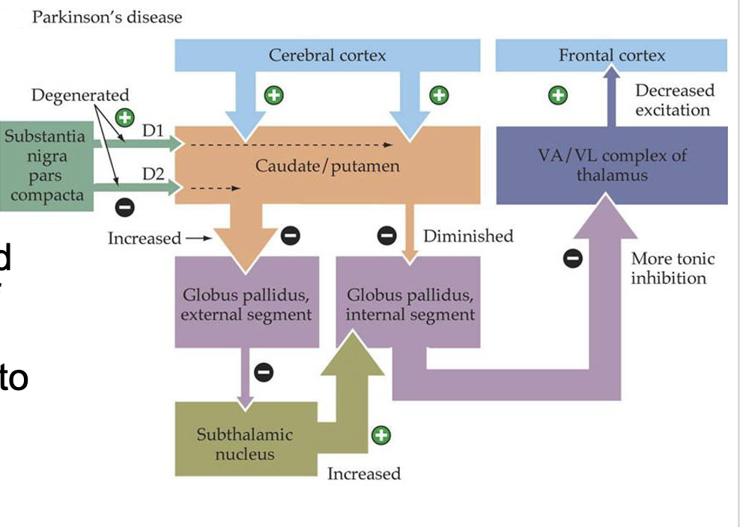
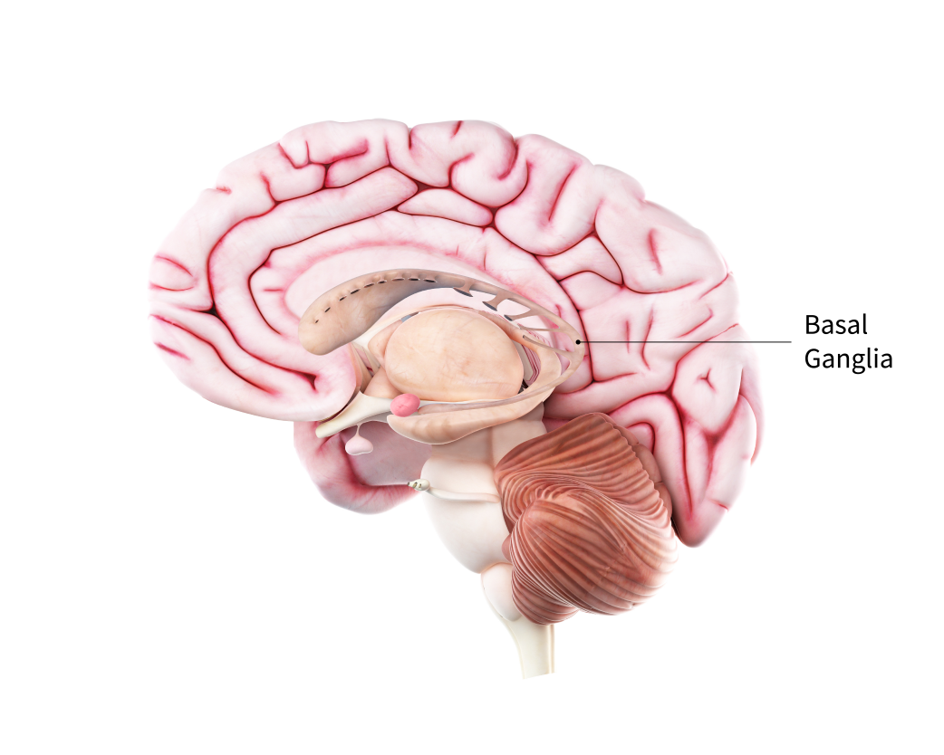
What is Parkinson’s Disease?
Notes:
First we need to address WHO this article is targeting and that is individuals with Parkinson’s Disease.
Parkinson’s Disease (PD) is a neurodegenerative condition and in order to understand PD I need to discuss the components of the basal ganglia.
The basal ganglia is a group of nuclei in the cerebral hemispheres. The major nuclei include:
the caudate and putamen → Striatum
the substantia nigra pars compacta
the subthalamic nucleus
And the globus pallidus
In PD there is degeneration of the dopamine neurons in the substantia nigra pars compacta. This loss of dopamine neurons leads to increased inhibition of the thalamus and decreased excitation of the frontal cortex.
The basal ganglia plays a role in movement planning, movement initiation, movement sequence, and force production so all of these things are impacted in people with PD.
Symptoms characteristic of PD include tremor, bradykinesia (slow movement), rigidity, and impaired posture.
Pertinent to our discussion of this article the classic gait impairments in PD are:
decreased gait speed
increased cadence (faster steps)
decreased step length
decreased arm swing
postural instability (balance deficits)
increased risk for falls
Individuals with PD could also have freezing of gait

Slide 5
What is mild to moderate PD?
Stage | Hoehn and Yahr Scale | Modified Hoehn and Yahr Scale
1 | Unilateral involvement (little to no functional disability) | Unilateral involvement only
1.5 |  | Unilateral and axial involvement
2 | Bilateral or midline involvement without impaired balance | Bilateral involvement without impaired balance
2.5 |  | Mild bilateral disease with recovery on the pull test
3 | bilateral disease; mild to moderate disability with impaired postural reflexes; physically independent | Mild to moderate disease, some postural instability, physically independent
4 | severely disabling disease; still able to walk or stand unassisted | Severe disability; still able to walk or stand unassisted
5 | Confined to bed or wheelchair unless aided | wheelchair bound or bedridden unless aided
Notes:
The present study included individuals with “Mild to Moderate Parkinson’s Disease” so I want to take some time to discuss what this means.
The purpose of the Hoehn and Yahr Scale is to classify functional disability in people with PD (allows us to measure severity and STAGE of PD).
This scale is commonly seen in PD research
The article we read includes participants with a Hoehn and Yahr Scale score of 2-3 → no use of assistive device for ambulation, bilateral involvement
The researchers also assessed the motor examination component of the Unified Parkinson’s Disease Rating Scale (UPDRS) and found a mean score of 28 which is considered to be mild-to-moderate disability severity.

Slide 6
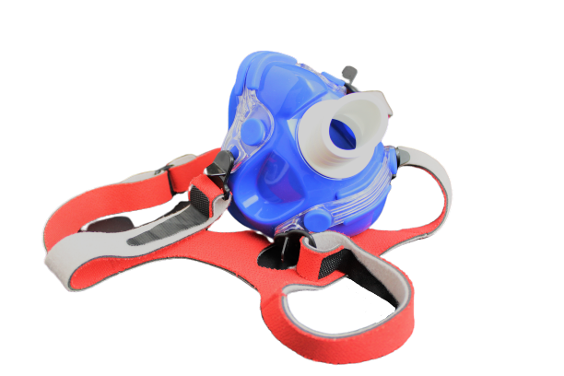
What is oxygen cost?
Oxygen Cost of Walking = volume of oxygen consumed (VO2) per kg of body weight / distance traveled
Notes:
We talked about WHO, now I want to comment on WHAT the researchers are measuring.
The primary outcome of the study was Oxygen Cost of Walking
Oxygen cost of walking is equal to the volume of oxygen consumed per kg of body weight per distance traveled (essentially how much oxygen is consumed per kg of body weight per meter travelled).
We would expect to see a HIGHER oxygen cost of walking in people who are less efficient.
Research has shown that higher oxygen cost of walking reflects walking dysfunction and is associated with pathological gait abnormalities
O2 cost of walking is associated with body composition, health, and well-being
As someone becomes more aerobically fit their oxygen cost of walking goes down.
Oxygen cost is often measured with the Hans Rudolph Face Mask. The composition of expired air is determined by oxygen and carbon dioxide analyzers. A baseline measure is typically taken for 5 minutes in sitting before taking measurements during a period of walking.

Slide 7
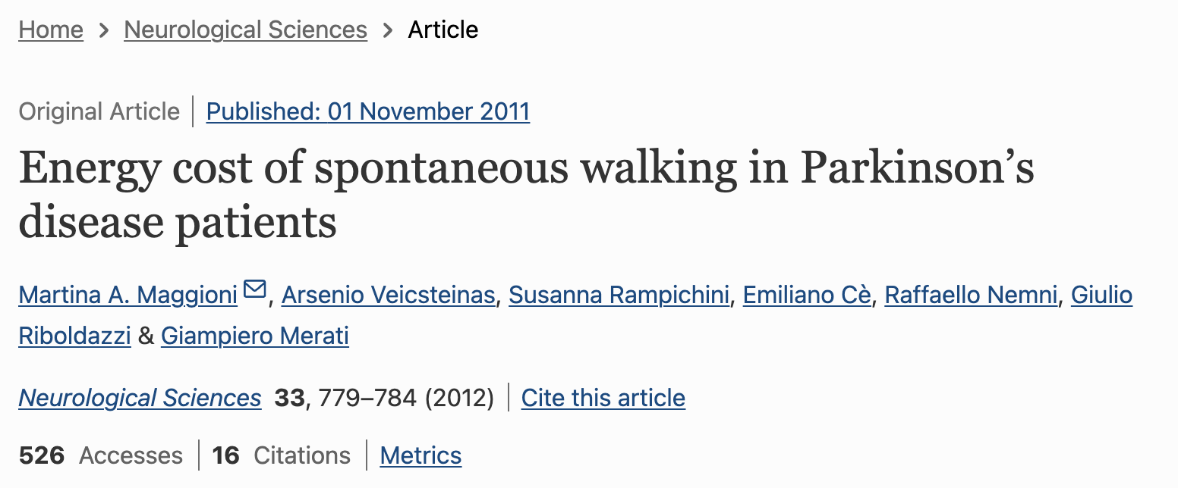
Background Research
No significant difference was found in energy cost at self-selected OR maximal speeds in people with PD compared to age-matched control subjects (during over-ground walking).
Notes:
Next we need to talk about WHY the researchers are doing this study.
There is limited research on how PD influences oxygen cost of walking.
Previous literature has shown that higher O2 cost of walking is associated with neurological disability, inactivity, and fatigue in people with MS.
This study by Maggioni et al found that in people with PD:
There was no significant difference in energy cost at self-selected speeds OR maximal speeds in people with PD compared to age-matched control subjects during over-ground walking
These findings that found no significant difference between groups may be due to the fact that the participants were not sex-matched

Slide 8
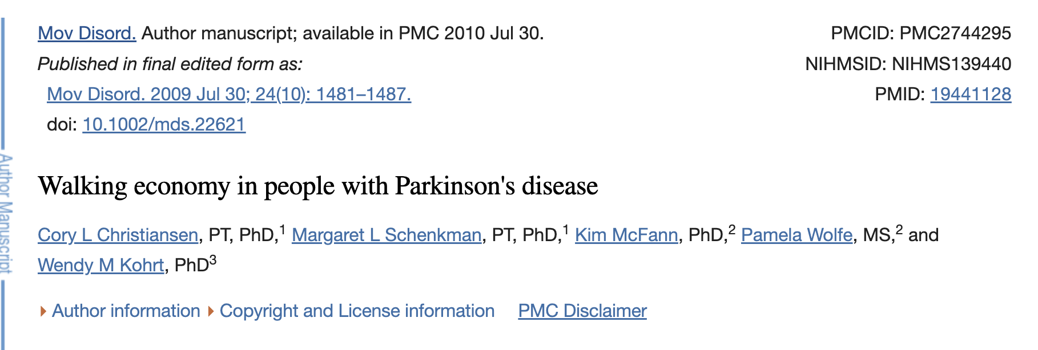
Background Research
People with PD had a significantly higher O2 cost of walking (worse walking economy) compared to age and sex-matched controls during treadmill walking at increasing speeds.
Notes:
This study found that people with PD had a significantly higher O2 cost of walking compared to age and sex-matched controls during treadmill walking at increased speeds.
Ultimately, the researchers of the current article found a need for more research to be done
specifically in people with PD
to measure overground walking (not treadmill walking) because overground walking is more similar to everyday activity and everyday walking economy
and to control for age AND sex

Slide 9
Research Question
Does O2 cost of walking differ between people with PD and age and sex-matched controls?
Notes:
So that leads us to this articles’ research question:
Does O2 cost of walking differ between people with PD and age and sex-matched controls?
The researchers hypothesized three things:
There would be slower walking speeds but higher oxygen consumption in people with PD
Higher oxygen cost of walking in people with PD
And people with worse gait alterations would have higher oxygen cost of walking

Slide 10
Methods

Slide 11
Participants
Inclusion and Exclusion Criteria
Inclusion criteria for PD group:
diagnosis of idiopathic PD
age 50-74 years old
H&Y Stage 2 - 3
Ability to walk independently without assistive device
Inclusion criteria for control group:
age 50-74 years old
Healthy (no cardiovascular, neuromuscular, and/or pulmonary disease)
Ability to walk independently without assistive device
Exclusion criteria:
People with PD who were not responsive to dopaminergic medication or had motor impairments due to stroke or neuroleptic medication
Presence of metabolic disorder such as diabetes
31 individuals with mild to moderate PD
31 age and sex-matched healthy controls
Notes:
Participants:
31 people with mild to moderate PD
31 age and sex-matched healthy controls
Inclusion criteria for PD group:
diagnosis of idiopathic PD (presence of bradykinesia, rigidity and/or resting tremor
age 50-74 years old
H&Y stage 2-3
Ability to walk independently without the use of an assistive device
*assessed when they had taken their medications for symptom management
Inclusion criteria for controls:
age 50-74
Healthy (absence of major cardiovascular, neuromuscular, and/or pulmonary disease)
Ability to walk independently without an assistive device
*Controls were matched by age (within 5 years) and sex
Exclusion criteria for both groups:
People with PD who were not responsive to dopaminergic medication or had motor impairments due to stroke or neuroleptic medication
Both people with PD and controls were excluded if they had a disorder affecting metabolism (example: diabetes)
What do you think of the inclusion and exclusion criteria?

Slide 12
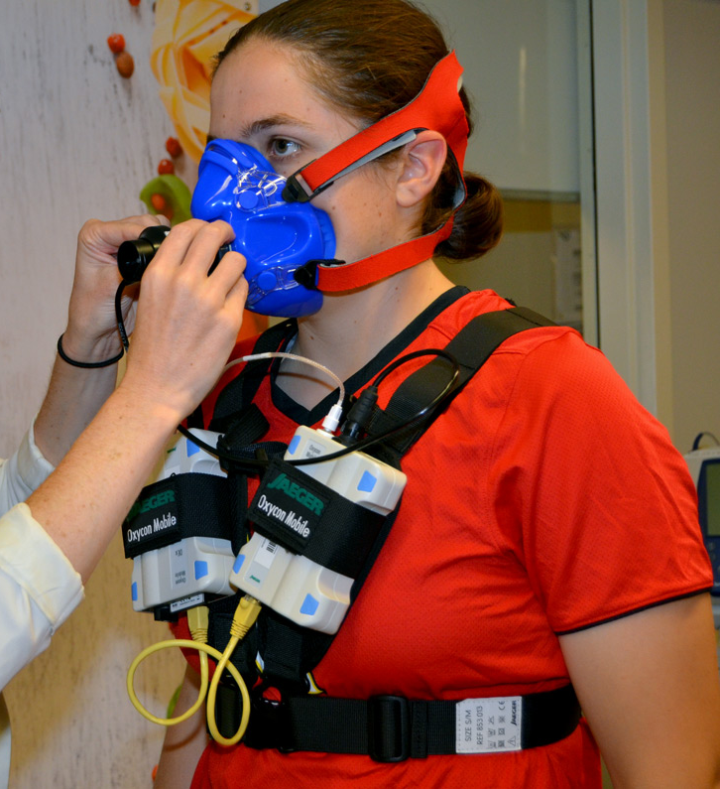
Measures
Baseline oxygen consumption (VO2) for 5 minutes in sitting
Steady state VO2 = (VO2 in last 3 minutes of walking - resting VO2)
O2 cost of walking using the OXYCON Mobile = net steady state VO2 / kg / speed (ml / kg / m)
Walking speed (meters / minute)
Stride length
Cadence
Notes:
The primary measures include
Baseline oxygen consumption (VO2) was taken in sitting for 5 minutes
Steady state VO2 was calculated by taking oxygen consumption in the last 3 minutes of walking - resting VO2
O2 cost of walking was measured using the OXYCON Mobile and calculated using net O2 consumption, kg of bw, and speed
Walking speed was measured by taking the distance traveled / 6 minutes
Stride length was measured by taking distance traveled / stride counts
Cadence was measured by taking the numbers of strides x 2 and then dividing by 6 (steps per minute)

Slide 13
Statistical Analysis
2 x 12 mixed-factor ANOVA on VO2 for 12 30-second time points
Independent samples t-test for walking speed, stride length, cadence, distance, resting VO2, steady state VO2, and O2 cost of walking between groups
Pearson product-moment correlations for O2 cost of walking, stride length, and cadence
Notes:
2 x 12 mixed-factor ANOVA on VO2 for 12 30-second time points → this was used to test for differences in oxygen consumption between the two groups
Independent samples t-test for walking speed, stride length, cadence, distance, resting VO2, steady state VO2, and O2 cost of walking between groups → this was used to determine if the means between the two groups were significantly different for each of these measures
Pearson product-moment correlations for O2 cost of walking, stride length, and cadence → this was done to assess whether certain gait parameters were associated with oxygen cost of walking

Slide 14
Procedure
All data was completed in a single visit
Informed consent
Demographic and clinical information
Physical Activity Readiness Questionnaire
BP measurement at rest
Motor Examination of the Unified Parkinson’s Disease Rating Scale
Height and weight measurement
Measurement of resting metabolic rate
6 minute walking bout at normal comfortable pace
Notes:
All data was completed in a single visit
Informed consent
Demographic and clinical information was taken
Physical Activity Readiness Questionnaire
BP measurement at rest
Motor Examination of the Unified Parkinson’s Disease Rating Scale and Hoehn and Yahr scale
Height and weight measurement
Measurement of resting metabolic rate
6 minute walking bout at normal comfortable pace

Slide 15
Results

Slide 16
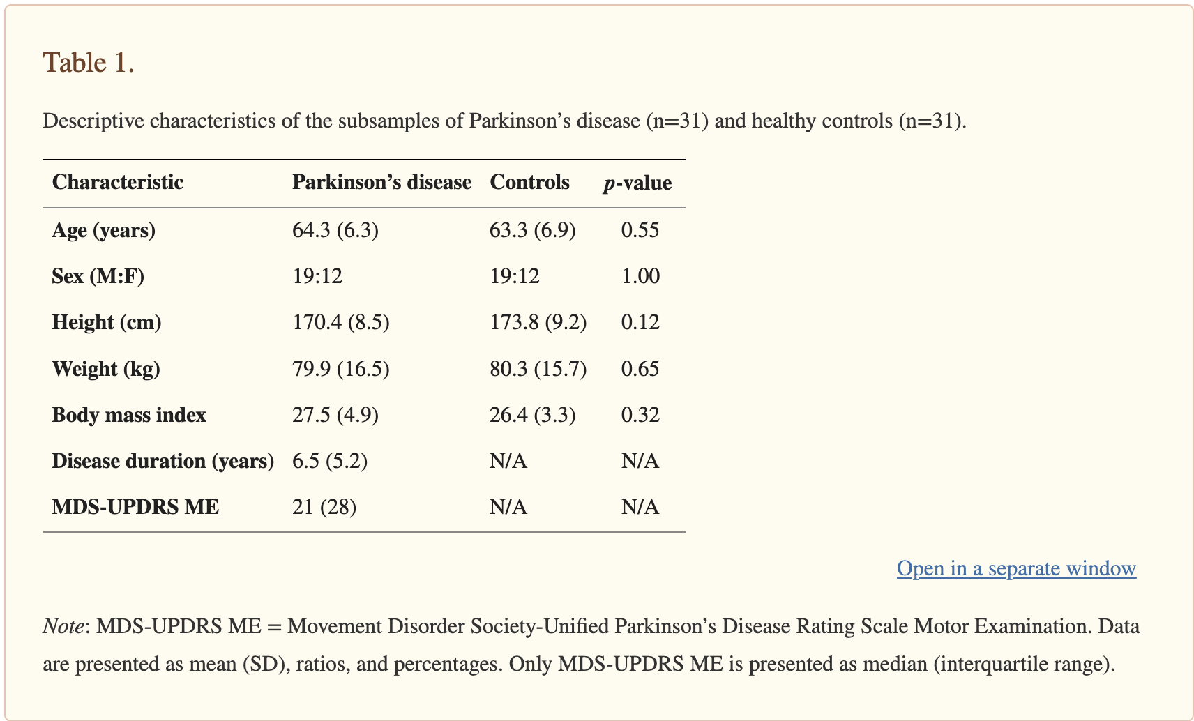
Notes:
There was no significant differences between groups in age, sex, height, and weight → Looking for the p-value to be greater than 0.05
This is a good thing because we don’t want the groups to be different at baseline.

Slide 17
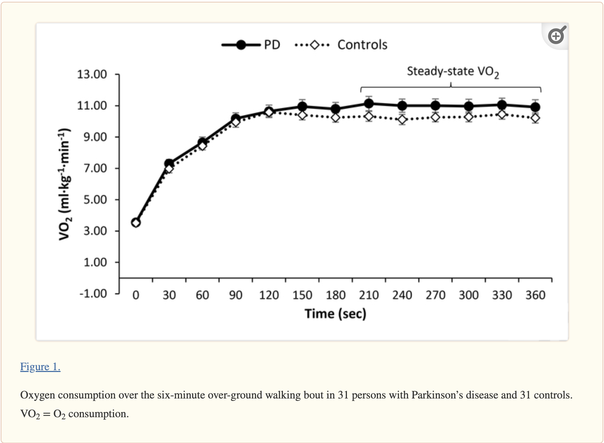
~ 160 seconds
Or 2.7 minutes
Notes:
Both groups had a steep increase in VO2 when starting the walking bout and then achieved and maintained steady-state VO2 in the last 3 minutes of the exercise bout.
According to a journal article from the American Heart Association, if exercise is mild or moderate, VO2 usually reaches a steady state within 3 minutes, → so this result is expected because the participants were doing walking at a comfortable speed.
but if the work rate causes increased blood lactate, like for harder activity, VO2 continues to increase beyond 3 minutes
What do you notice about this graph?
looks like the biggest difference in O2 consumption between PD and control groups is during steady-state walking (after approximately 2.7 minutes)
There was no significant difference in VO2 between the PD group and control group but the PD group generally had HIGHER oxygen consumption levels
Based on some other similar studies it seems that 11 was an accurate VO2 for comfortable walking
researchers commented that VO2 may differ significantly in later stages of the disease
Researchers also commented that a steeper slope in VO2 may indicate worse walking economy due to inefficient metabolic systems

Slide 18
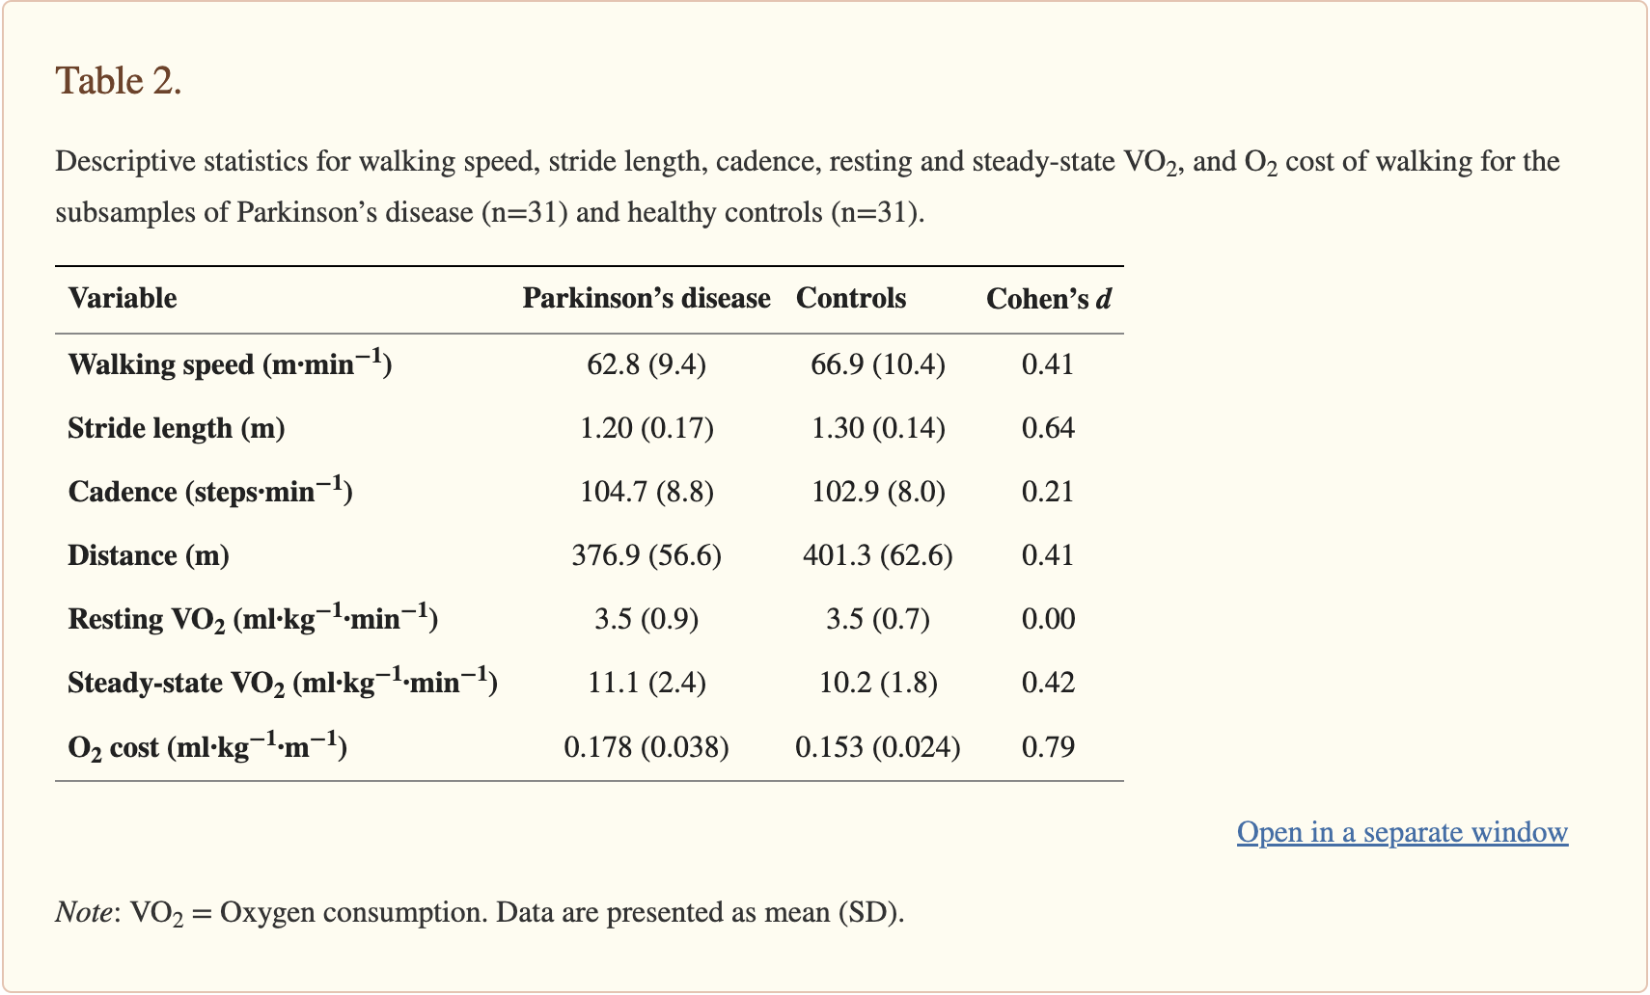
Notes:
There were no significant differences in walking speed, distance walked, resting VO2, or steady state VO2 between the PD group and the healthy controls group. While there was no significant difference between walking speed and distance traveled, the PD group still had decreased distances and speeds overall.
There was a significant difference in stride length between groups. The PD group had shorter stride lengths.
There was no significant difference between steady-state oxygen consumption between the PD group and control group. Like I said earlier, the researchers comment that this may not be seen until later stages of disease progression.
Lastly, there was a significant difference in O2 cost of walking between the PD group and healthy controls group - the PD had higher O2 cost of walking or worse walking economy compared to controls
To summarize, the major findings in this study were that people with PD have a higher O2 cost of walking compared to age and sex-matched controls AND people with PD had significantly smaller stride length.
Researchers hypothesize that the the higher O2 cost of walking in people with PD may have something to do with the slightly increased steady state oxygen consumption + the slower walking speeds in the PD group.
Cohens d - takes the difference between two means and expresses it in standard deviation units.

Slide 19
Notes:
This table assesses bivariate correlations with O2 cost of walking.
In people with PD → stride length was associated with O2 cost of walking, but cadence was not associated with O2 cost of walking.
In controls → neither cadence nor stride length were associated with O2 cost of walking
In summary, this means that higher O2 cost of walking in people with PD may be associated with their decreased stride length.
Individuals with shorter stride length (worse gait parameters) may have higher values of O2 cost of walking.

Slide 20
Strengths and Limitations

Slide 21
Limitations
Generalizability - population is limited to ambulatory individuals with PD H&Y stage 2 - 3
Medications - ON vs OFF
What is clinically meaningful change in O2 cost of walking?
Limited background research on O2 cost of walking in people with PD
Potential confounding variables (physical inactivity)
Effect on O2 cost of walking at various walking speeds?
Notes:
What limitations did you guys notice in this article?
The population studied was limited to ambulatory individuals with PD that did not use an assistive device and had H&Y stage 2-3 - this may not represent everyone with PD
Measures were taken while individuals were on their medication so we don’t know how L-dopa influences metabolic cost of walking
There is limited background research in this area/population so we don’t know what the clinically meaningful change is in the clinical setting. How should we set goals for our patients?
The researchers did not include or measure potential confounding variables such as physical fitness level/physical inactivity
The researchers only measured comfortable walking speed

Slide 22
Strengths
Novel research
Controlled for age and sex with control subjects
Exclusion of individuals with metabolic conditions
Notes:
What did you guys pick out as some strengths in this article?
This is some of the first research of its kind
This study controlled for age and sex to better understand how O2 cost of walking is different in people with PD compared to healthy controls
Researchers excluded individuals with metabolic conditions such as diabetes which is appropriate because metabolic conditions impact metabolic cost (the way energy is used in the body)

Slide 23
Clinical Application & Future Research

Slide 24
Future Research
Effect of medication on O2 cost of walking?
To what extent does reduced aerobic capacity, muscular weakness, or impaired balance impact O2 cost of walking?
What other gait parameters are associated with higher O2 cost of walking in people with PD?
Notes:
If you were given unlimited money…. What would you change or manipulate in this study?
I would want to look at how O2 cost of walking changes ON vs OFF medication
I would want to know how specific impairments such as deconditioning, weakness, or postural instability contribute to increased O2 cost of walking
This study determined that decreased stride length in people with PD was associated with increased O2 cost of walking (worse walking economy). What other gait parameters are associated with higher O2 cost of walking? → this would help guide physical therapy interventions!

Slide 25
Clinical Application
People with PD have shorter stride length which is associated with with higher O2 cost of walking → this allows us to target stride length in interventions
Worse walking economy may lead to declines in physical activity levels and reduced community participation → how do we intervene at the right time or with targeted interventions?
Notes:
What are the clinical implications of this study?
This research gives us an idea on how to intervene in the clinic → improving stride length with interventions
If we are able to select specific gait parameters to improve that are associated with higher O2 cost of walking → we could improve walking economy, delay disease progression, and allow individuals to participate in community activities for longer.

Slide 26
Questions?

Slide 27
References
Jeng B, Cederberg KLJ, Lai B, Sasaki JE, Bamman MM, Motl RW. Oxygen cost of over-ground walking in persons with mild-to-moderate Parkinson's disease. Gait Posture. 2020;82:1-5. doi:10.1016/j.gaitpost.2020.08.108
Maggioni MA, Veicsteinas A, Rampichini S, et al. Energy cost of spontaneous walking in Parkinson's disease patients. Neurol Sci. 2012;33(4):779-784. doi:10.1007/s10072-011-0827-6
Christiansen CL, Schenkman ML, McFann K, Wolfe P, Kohrt WM. Walking economy in people with Parkinson's disease. Mov Disord. 2009;24(10):1481-1487. doi:10.1002/mds.22621
Rooney S, McWilliam G, Wood L, Moffat F, Paul L. Oxygen Cost of Walking in People With Multiple Sclerosis and Its Association With Fatigue: A Systematic Review and Meta-analysis. Int J MS Care. 2022;24(2):74-80. doi:10.7224/1537-2073.2020-128
2019 ACC/AHA guideline on the primary prevention of cardiovascular ... Accessed November 5, 2023. https://www.ahajournals.org/doi/full/10.1161/CIR.0000000000000677.

