Slide 1
Exercise Education for Adults with Rheumatoid Arthritis as Part of the PREVAIL Study
Stephanie Marvin, SPT
**This is a website mockup that is best viewed in slideshow format. Please click on the titles in the side tab to progress the slides and wait for auto-scroll to view website functionality**

Slide 2
EXERCISE GUIDANCE
Home
About Rheumatoid
Arthritis
Rheumatoid Arthritis
& Exercise
Video Library
Other Resources
How Was Our
Model Developed?
PREVAIL
PREserving Valued Activities in Life

Slide 3
EXERCISE GUIDANCE
Home
About Rheumatoid
Arthritis
Rheumatoid Arthritis
& Exercise
Video Library
Other Resources
How Was Our
Model Developed?
ABOUT RHEUMATOID ARTHRITIS
WHAT IS RHEUMATOID ARTHRITIS (RA)?
Rheumatoid arthritis is an autoimmune condition where your body attacks your joints. As a result, you may have swelling, pain, and stiffness of joints. Typically, you will have symptoms in the same joint on both sides of your body with the most common places being the hands, knees, or ankles.
COMMON SIGNS & SYMPTOMS
In more than one joint AND in the same joint on both sides of the body… you may have pain or aching, stiffness, tenderness and swelling.
You may also experience:
-Fatigue
-Weakness
-Weight loss
There may be times when your symptoms get worse (flares), and times when your symptoms are better (remission).
HOW DO I MANAGE RHEUMATOID ARTHRITIS?
Current recommendations for management include the early initiation of medication, especially Disease Modifying Anti-Rheumatic Drugs (DMARDs), exercise, orthotics for your hands or feet to prevent or slow deformities, and a multi-disciplinary treatment team.
Your multi-disciplinary team may include a rheumatologist, nurse, physical therapist, occupational therapist, and psychological support when appropriate.

Slide 4
EXERCISE GUIDANCE
Home
About Rheumatoid
Arthritis
Rheumatoid Arthritis
& Exercise
*Why does it matter?
*Exercise Introduction
*Recommendations
*See a Provider
*Definitions
Video Library
Other Resources
How Was Our
Model Developed?
WHY DOES EXERCISE MATTER?
Exercise is good for your overall health, but can also help manage your RA symptoms!
HOW RA IMPACTS HEALTH
EXERCISE CAN HELP!
HEART & LUNGS
Adults with rheumatoid arthritis have an increased risk of developing heart disease including heart attack and stroke.
Participating in regular physical activity or exercise strengthens your heart, improves lung function, reduces the risk of heart attack, and decreases the risk of developing heart disease.
METABOLIC SYSTEM
Rheumatoid arthritis can increase your risk for conditions such as insulin resistance, high blood pressure, high blood glucose, and obesity. All of these conditions can lead to increased risk of heart disease.
Participating in regular physical activity and exercise can lower blood glucose and blood pressure, and decrease insulin resistance. It can also promote weight loss and prevent weight gain.
Long-term use of common medications used to treat rheumatoid arthritis can lead to loss of bone density, resulting in weaker and brittle bones. This is a condition known as osteoporosis, which increases your risk of fracture.
Weight-bearing exercise can prevent bone density loss. It may even improve your bone density!
BONES
MUSCLES
Adults with rheumatoid arthritis are at increased risk of developing sarcopenia, a condition that causes a loss of muscle mass and strength.
A combination of aerobic and strength exercise can increase muscle strength, muscle mass, and physical function.

Slide 5
EXERCISE GUIDANCE
Home
About Rheumatoid
Arthritis
Rheumatoid Arthritis
& Exercise
*Why does it matter?
*Exercise Introduction
*Recommendations
*See a Provider
*Definitions
Video Library
Other Resources
How Was Our
Model Developed?
EXERCISE INTRODUCTION
IS EXERCISE SAFE FOR ME?
Clinical guidelines recommend a combination of muscle strengthening and aerobic training, also known as cardio, for all people living with rheumatoid arthritis. If you have difficulty with balance or mobility, balance exercises and stretching exercises may also be helpful.
WHAT EXERCISES SHOULD I DO?
MUSCLE STRENGTHENING + AEROBIC EXERCISE (CARDIO)
In general, all adults should perform a combination of muscle strengthening and aerobic exercise. If you have difficulty with balance or mobility, balance exercises and stretching exercises may also be included in your workout routine.
There is no one size fits all formula for deciding what exercises to do and when. Many exercises may fit into “muscle strengthening” and “aerobic exercise” categories. Remember, the best exercises are ones that you enjoy doing and feel good to your body! It may take some trial and error to decide which exercises you like most.
Remember, you may modify exercise to fit your preferences and symptoms. For example, you may attend an exercise class and decide to ask the instructor for alternatives to all jumping exercises.
For more in-depth exercise recommendations, please visit the Recommendations page.
HOW DO I GET STARTED?
Starting exercise may feel difficult and intimidating with rheumatoid arthritis. The first step is to decide what exercise you want to do. There are many options including walking, yoga, weight lifting, hiking, biking, swimming, exercise classes, or many more.
Some exercise is better than no exercise. Even small amounts of exercise may have a health benefit!
The most important part of starting an exercise program is to start “low and slow.” This means you should begin an exercise by doing a little bit for not too long. For example, if you are starting to walk, this means walking at a slow or normal pace for an amount of time that feels comfortable, this may be 5 to 10 minutes. Walk this amount of time for a week or so before slowly increasing this total time by 2-5 minutes until you reach 30 minutes total. Remember, as you increase the time by 2-5 minutes, the exercise may become harder at first.
As you keep practicing, walking for this amount of time will begin to feel easier. That is your body adapting and getting stronger! When the exercise becomes easy, that is when you will know you can make it harder, in this case adding another 2 -5 minutes of walking.

Slide 6
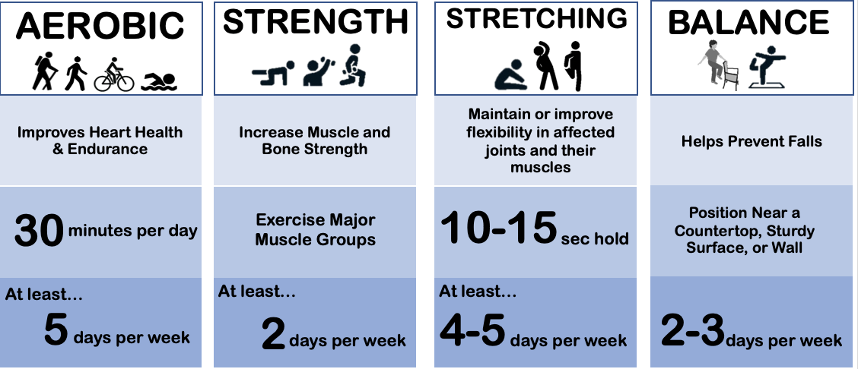
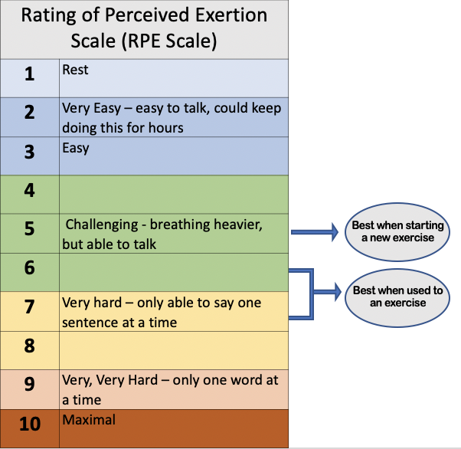
EXERCISE GUIDANCE
Home
About Rheumatoid
Arthritis
Rheumatoid Arthritis
& Exercise
*Why does it matter?
*Exercise Introduction
*Recommendations
*See a Provider
*Definitions
Video Library
Other Resources
How Was Our
Model Developed?
EXERCISE RECOMMENDATIONS
INTRODUCTION
Clinical guidelines recommend a combination of muscle strengthening and aerobic training, also known as cardio, for all people living with rheumatoid arthritis. If you have difficulty with balance or mobility, balance exercises and stretching may also be helpful.
HOW HARD SHOULD THE EXERCISE FEEL?
The Rating of Perceived Exertion Scale is a way to determine how hard an exercise should feel. In general, when first starting an exercise, it is best to begin with a lower intensity. When beginning an aerobic or muscle strength exercise, it should feel like 5/10 on the Rating of Perceived Exertion Scale meaning that you should still be able to speak, but you will also be taking heavy breaths. As you become more comfortable with aerobic and muscle strengthening, you may increase the intensity to 6-7/10 on the Rating of Perceived Exertion Scale meaning you are able to speak, but it may only be a sentence or two at a time.

Slide 7
EXERCISE GUIDANCE
Home
About Rheumatoid
Arthritis
Rheumatoid Arthritis
& Exercise
*Why does it matter?
*Exercise Introduction
*Recommendations
*See a Provider
*Definitions
Video Library
Other Resources
How Was Our
Model Developed?
SHOULD I SEE A HEALTHCARE PROVIDER?
RHEUMATOLOGY
Contact your rheumatologist if you experience worsening joint symptoms including more pain, swelling, more joints involved, redness, stiffness, or decreased function.
Always check with your rheumatologist before beginning an exercise program.
Find a rheumatologist near you!
PHYSICAL THERAPY
Contact a physical therapist if you are…
-Unable to perform physical tasks you need to complete your day, such as walking to the grocery store
-Experience a decrease in your usual function
-Have pain or fatigue that is limiting your daily activities
-Have balance concerns
Find a physical therapist near you!
OCCUPATIONAL THERAPY
Contact an occupational therapist if have difficulty…
-Using your hands for tasks like opening or turning, such as with jars or doors -Putting on or taking off your clothing
-Showering

Slide 8
EXERCISE GUIDANCE
Home
About Rheumatoid
Arthritis
Rheumatoid Arthritis
& Exercise
*Why does it matter?
*Exercise Introduction
*Recommendations
*See a Provider
*Definitions
Video Library
Other Resources
How Was Our
Model Developed?
DEFINITIONS
Aerobic Exercise:
Also known as cardio. This exercise makes your heart beat faster and makes you breathe heavier. Aerobic exercise is good for heart health and increasing your endurance.
High Impact Exercise:
Exercises that put more stress on your joints. These usually involve exercise where you must land on one or both feet. Examples include running and jumping.
Intensity:
This is how hard an exercise feels. The Rating of Perceived Exertion Scale is one way to do this and is included on the Recommendations page.
Low Impact Exercise:
Exercises that put less stress on your joints. Examples include walking, cycling, elliptical, swimming, weight-lifting, yoga, and more.
Metabolic System:
Chemical processes that create energy from food.
Osteoporosis:
Weak or brittle bones. People with osteoporosis have a higher risk of breaking bones.
Repetition:
The number of times you do an exercise in a row.
Sarcopenia:
Results in a loss of muscle strength and size. This may occur naturally with aging or due to decreased activity. Regular strength training may slow the process or reverse this process, depending on the cause.
Sets:
The number of times you perform a certain number of repetitions. Exercises are often written with both sets and repetitions. The typical notation is:
(Sets) x (Repetitions)
For example, an exercise program may write: squats 3 x 10. This means you should do 10 squats, take a break, do 10 more squats, take a break, and then do 10 more squats.
Weight-bearing Exercise:
Any exercise that involves the working against gravity. Weight-bearing exercise makes your muscles and bones stronger. Examples include weight-lifting, stair climbing, running, planks, and more.

Slide 9
EXERCISE GUIDANCE
VIDEO LIBRARY
Home
About Rheumatoid
Arthritis
Rheumatoid Arthritis
& Exercise
Video Library
Other Resources
How Was Our
Model Developed?
HAND EXERCISES
Rheumatoid Arthritis Hand Exercises: Stretching and strengthening exercises led by physical therapist. Education and review of research from 0:00 – 1:59, exercise demonstration at 2:00
Helpful Hand Exercises for Rheumatoid Arthritis: A Beginner Hand Workout: 7 beginner hand exercises to improve function, strength, and mobility
Rheumatoid Arthritis Hand Exercises / Real Patient Demonstration: Hand exercises with demonstration from adult living with RA
STRENGTH EXERCISES
Fit at Home: Large Muscle Groups: Strength training at home using items around the house like dumbbells, resistance bands, or even bottles of water!
Rheumatoid Arthritis Workout: Upper and lower body muscle strengthening exercise demonstrations that reduce load on hands and feet
AEROBIC EXERCISES
Low Impact Cardio Workout: 20 minute low impact, no equipment cardio workout
One Mile Walk at Home Party: Walk one mile at home with fun moves and lots of education
BALANCE EXERCISES
5 Minute Balance workout at home for beginners: Short beginner balance exercise routine
Balance Workout to Prevent Falls for Seniors, Beginner Exercises: 10 minute balance workout with demonstration from mother and daughter duo
Intermediate Balance / Progression of Beginner Video: Balance progression led by a physical therapist
LOW-IMPACT EXERCISES
Pilates for Rheumatoid Arthritis / 15 Minute Gentle Routine: 15 minute gentle pilates for adults with rheumatoid arthritis
Morning Exercise Tips for Rheumatoid Arthritis: Short morning routine to help with morning stiffness to prepare you for the day!

Slide 10
EXERCISE GUIDANCE
OTHER RESOURCES
Home
About Rheumatoid
Arthritis
Rheumatoid Arthritis
& Exercise
Video Library
Other Resources
How Was Our
Model Developed?
UP TO DATE INFORMATION ABOUT RHEUMATOID ARTHRITIS
American College of Rheumatology
Arthritis Foundation
Centers for Disease Control and Prevention
National Institute of Arthritis and Musculoskeletal and Skin Diseases
HEALTH RESOURCES AND LOCAL PROGRAMS
Walk with Ease: 6-week self-directed walking program to improve overall health appropriate for those who can stand for at least 10 minutes. Program includes how to safely incorporate physical activity, a walking schedule, and motivational tools.
Self-Management Education: Educational materials offered in face-face small groups, virtual online small groups, mailed tool kits with weekly phone calls, and asynchronous groups. Covers topics such as chronic disease and chronic pain self-management. Offered in English and Spanish.
Durham Center for Senior Life: Promotes health and active lifestyle through free services, resources, classes, events, and more for adults 55 and older. Available to Durham County residents 55 and older.
Thrive Health: Provides free, evidence-based exercise resources about the basics of starting exercise and how to progress them safely.
CONNECT WITH OTHERS WITH RHEUMATOID ARTHRITIS
Arthritis Foundation Connect Groups: National, online support group for people living with rheumatoid arthritis that offers connect, education, and events.
The Mighty: Multiple online support groups for specific topics related to living with rheumatoid arthritis including pain, life hacks, depression, anxiety, self-care, and more.
PHONE APPS
Bezzy RA: Rheumatoid Arthritis: Free phone app for people living with rheumatoid arthritis to join a judgement-free community where people share their experiences and advice.
RA Monitor: Allows you to track and monitor your daily symptoms, connect with others, and get tips and inspiration for self-management strategies.
Bearable – Symptom Tracker: This is a phone app that is not specific to rheumatoid arthritis. Allows you to track symptoms and daily habits so you have a better picture of how your daily activities may affect your symptoms.

Slide 11
EXERCISE GUIDANCE
Home
About Rheumatoid
Arthritis
Rheumatoid Arthritis
& Exercise
Video Library
Other Resources
How Was Our
Model Developed?
*Patient Input
*Literature Review
*Evidence- Based Resources
*Health Literacy
*Feedback
HOW WAS OUR MODEL DEVELOPED?
The creation of this website was guided by many factors. The input from adults living with rheumatoid arthritis, literature review, and additional evidence-based resources helped create the first draft of these materials. Health literacy and feedback from adults living with rheumatoid arthritis will help guide our education in a feed-forward method to ensure the information provided is updated, relevant, and applicable.

Slide 12
EXERCISE GUIDANCE
Home
About Rheumatoid
Arthritis
Rheumatoid Arthritis
& Exercise
Video Library
Other Resources
How Was Our
Model Developed?
*Patient Input
*Literature Review
*Evidence- Based Resources
*Health Literacy
*Feedback
HOW WAS OUR MODEL DEVELOPED?
Input from Adults Living with Rheumatoid Arthritis
Adults with rheumatoid arthritis from the UNC Health System were selected to participate in a 60-90 minute interview about their experiences with rheumatoid arthritis as part of the PREVAIL study (IRB 21-2200, 22-3194). Participants were chosen to ensure a variety of experiences including disease duration, disability level, personal characteristics, and experience with rehabilitation.
The participants were asked about their exercise experience, past or present barriers and facilitators to exercise, and suggestions of tools to promote exercise. Common themes emerged among participants during the interview analysis, some of which included: managing symptoms requires increased self-awareness, symptoms may require change/modification in previous exercise routine and daily life, and there was little exposure/information provided about exercise and rehabilitation during rheumatology care (especially early after diagnosis).
Interview Quotes:
“My brain tells me that I CAN do it, but then my body tells me you need to sit down…So, you know, it leaves me excluded from a lot of activities sometimes.”
“Early on it was really, really difficult, both physically, emotionally and mentally.”
“When I'm making the bed, sometimes I have to do part of it and rest and do the rest of it later.”

Slide 13
EXERCISE GUIDANCE
Home
About Rheumatoid
Arthritis
Rheumatoid Arthritis
& Exercise
Video Library
Other Resources
How Was Our
Model Developed?
*Patient Input
*Literature Review
*Evidence- Based Resources
*Health Literacy
*Feedback
HOW WAS OUR MODEL DEVELOPED?
Literature Review
The literature review focused on clinical practice guidelines and systematic reviews specific to rheumatoid arthritis. Relevant exercise prescription and patient education guidelines were extracted from the clinical practice guidelines including those provided by the American College of Rheumatology (ACR), European Alliance of Associations for Rheumatology (EULAR), and Royal Dutch Society for Physical Therapy.
The Cochrane Database was used to find relevant systematic reviews that guided exercise videos including hand exercises, aerobic exercises, muscle strengthening, and balance exercises.

Slide 14
EXERCISE GUIDANCE
Home
About Rheumatoid
Arthritis
Rheumatoid Arthritis
& Exercise
Video Library
Other Resources
How Was Our
Model Developed?
*Patient Input
*Literature Review
*Evidence- Based Resources
*Health Literacy
*Feedback
HOW WAS OUR MODEL DEVELOPED?
Evidence Based Resources
Other evidence-based research was performed guided by themes mentioned in the patient interviews. This resulted in the inclusion of informative websites, community resources, and exercise videos.
Prior to use of the videos in the larger clinical trial, the exercise video library will be further expanded by other PREVAIL lab members. Each source will be reviewed by two physical therapists and determined to be consistent with evidence-based practice.

Slide 15
EXERCISE GUIDANCE
Home
About Rheumatoid
Arthritis
Rheumatoid Arthritis
& Exercise
Video Library
Other Resources
How Was Our
Model Developed?
*Patient Input
*Literature Review
*Evidence- Based Resources
*Health Literacy
*Feedback
HOW WAS OUR MODEL DEVELOPED?
Health Literacy
Health literacy is the ability to find, read, understand, and apply health information to maintain good health. Often, health information may be difficult or confusing to understand for many people, which can lead to health inequity.
The UNC Health Science Library has many resources to encourage health literacy for patient education materials, including the Inclusive Language Guide and Readability Calculators. These tools were used during the development of this resource to ensure the use of simple language at the average American reading level and promote inclusive language.
The “Definitions” page is included to improve health literacy and increase understanding of exercise and medical terms that may appear during care for rheumatoid arthritis.

Slide 16
EXERCISE GUIDANCE
Home
About Rheumatoid
Arthritis
Rheumatoid Arthritis
& Exercise
Video Library
Other Resources
How Was Our
Model Developed?
*Patient Input
*Literature Review
*Evidence- Based Resources
*Health Literacy
*Feedback
HOW WAS OUR MODEL DEVELOPED?
Feedback from Adults Living with Rheumatoid Arthritis
This website is being used as a patient education material as part of the PREVAIL Clinical Trial. These patient participants will provide feedback on the relevance, ease of understanding, subsequent confidence in using information to help manage their rheumatoid arthritis, and if there are any additional concerns that were not addressed on the website.
The website will be updated based on the feedback provided by patients.

Slide 17
References:
Exercise & Arthritis. American College of Rheumatology. April 2023. Accessed April 10, 2024. https://rheumatology.org/exercise-and-arthritis
Peter WF, Swart NM, Meerhoff GA, Vliet Vlieland TPM. Clinical practice guideline for physical therapist management of people with rheumatoid arthritis. Phys Ther. 2021;101(8). doi:10.1093/ptj/pzab127
Rausch Osthoff A, Niedermann K, Braun J, et al. 2018 EULAR recommendations for physical activity in people with inflammatory arthritis and osteoarthritis. Annals of the Rheumatic Diseases 2018;77:1251-1260.
England BR, Smith BJ, Baker NA, et al. 2022 american college of rheumatology guideline for exercise, rehabilitation, diet, and additional integrative interventions for rheumatoid arthritis. Arthritis Care Res (Hoboken). 2023;75(8):1603-1615. doi:10.1002/acr.25117
Rheumatoid Arthritis: Symptoms, Diagnosis, and Treatment | Arthritis Foundation. Arthritis Foundation. October 15, 2021. Accessed April 10, 2024. https://www.arthritis.org/diseases/rheumatoid-arthritis
Physical Activity and Your Heart - Benefits | NHLBI, NIH. National Heart, Lung, and Blood Institute. March 24, 2022. Accessed April 10, 2024. https://www.nhlbi.nih.gov/health/heart/physical-activity/benefits
Moschou D, Krikelis M, Georgakopoulos C, et al. Sarcopenia in Rheumatoid arthritis. A narrative review. J Frailty Sarcopenia Falls. 2023;8(1):44-52. doi:10.22540/JFSF-08-044
Giles JT. Extra-articular Manifestations and Comorbidity in Rheumatoid Arthritis: Potential Impact of Pre-Rheumatoid Arthritis Prevention. Clin Ther. 2019;41(7):1246-1255. doi:10.1016/j.clinthera.2019.04.018
Garber CE. The health benefits of exercise in overweight and obese patients. Curr Sports Med Rep. 2019;18(8):287-291. doi:10.1249/JSR.0000000000000619
Hegde SM, Solomon SD. Influence of physical activity on hypertension and cardiac structure and function. Curr Hypertens Rep. 2015;17(10):77. doi:10.1007/s11906-015-0588-3
Wu D, Luo Y, Li T, et al. Systemic complications of rheumatoid arthritis: Focus on pathogenesis and treatment. Front Immunol. 2022;13:1051082. doi:10.3389/fimmu.2022.1051082
Borg Rating Of Perceived Exertion. Physiopedia. Accessed April 10, 2024. https://www.physio-pedia.com/Borg_Rating_Of_Perceived_Exertion
Shiel Jr WC. Rheumatoid Arthritis: 17 Signs of Serious Complications. September 16, 2022. Accessed April 10, 2024. https://www.medicinenet.com/rheumatoid_arthritis_when_do_i_call_the_doctor/views.htm
Conley B, Bunzli S, Bullen J, et al. What are the core recommendations for rheumatoid arthritis care? Systematic review of clinical practice guidelines. Clin Rheumatol. June 9, 2023. doi:10.1007/s10067-023-06654-0
Rheumatoid Arthritis. Centers for Disease Control and Pevention. April 7, 2022. Accessed April 10, 2024. https://www.cdc.gov/arthritis/types/rheumatoid-arthritis.html
Pictures:
CleanPNG. Accessed April 10, 2024. https://www.cleanpng.com
Weinhouse B. 10 Symptoms of Osteoarthritis You Might Be Ignoring. May 14, 2019. Accessed April 10, 2024. https://creakyjoints.org/about-arthritis/osteoarthritis/oa-symptoms/osteoarthritis-symptoms/
iStock by Getty Images. Accessed April 10, 2024. https://www.istockphoto.com

