Slide 1
Hearing and Balance in Older Adults
Gregory Rinn Capstone 2024

Slide 2
Objectives
Review contributors to balance, and how changes in these systems commonly lead to balance impairments in older adults.
Discuss existing literature that informs the study of the relationship between hearing and balance in older adults.
Understand the role of the current study in investigating the mechanisms behind the effect of hearing loss on balance.
Discuss the implications of hearing loss and balance performance on clinical practice.

Slide 3
Review of Balance Systems^{1,2}
Visual
Somatosensory
Vestibular
Notes:
- These three systems work together to create a sense of equilibrium, maintain upright posture, and allow for controlled motion of the center of mass. Input from each is compared and contrasted. Disagreements in input (such as moving visual environment while standing still) can contribute to feelings of motion sickness.
- Remember that input from each of these systems goes to a myriad of destinations throughout the nervous system. Visual and somatosensory information in particular have a number of destinations within the central nervous system

Slide 4
Visual Contributions
Visual Receptors
Somatosensory Receptors
Vestibular Receptors
Utilizes visual input from eyes
Optic flow³
Sense of verticality
Input is processed slower compared to other two systems
Cerebellum
Vestibular Nuclei
Integration
Perception
Action
Notes:
Visual – use of visual input from eyes to establish position in space and verticality
Visual input is commonly thought of for creating the perception of vision, but the input is also projected to the cerebellum and the vestibular nuclei for contributing to a sense of equilibrium and reacting to changes in balance
Optic flow refers to the idea that one of the mechanisms by which we maintain our balance is through reaction to change in our visual environment. Direction and speed of motion in our environment can help to inform how our body is moving so that we can make corrections as necessary
Postural reaction to visual input occurs (comparatively) slowly compared to the other two systems. Individuals with heavy reliance on the visual system for balance often have increased postural instability^{20neubal}.
Output from balance information integration impacts eye motion. The main example of this is the vestibular ocular reflex, which directs eye motion based upon head positioning to maintain gaze stability

Slide 5
Somatosensory Contributions
Visual Receptors
Somatosensory Receptors
Vestibular Receptors
Utilizes proprioceptive input from the musculoskeletal system
Muscle spindles
Golgi tendon organs
Touch receptors
Kinesthetic awareness
Cerebellum
Vestibular Nuclei
Integration
Perception
Action
Notes:
Somatosensory – use of sensory input from throughout the body, such as the feet, golgi tendon organs, and more to determine position in space, change in position, etc.
Output to the musculoskeletal system from balance information integration is primary seen in automatic postural reactions, where muscles are activated in response to changes in body positioning to maintain upright posture
Somatosensory input is processed the fastest

Slide 6
Vestibular Contributions
Visual Receptors
Somatosensory Receptors
Vestibular Receptors
Utilizes input from the semicircular canals, utricle, and saccule
Sense of verticality
Head position and kinematic awareness
Cerebellum
Vestibular Nuclei
Integration
Perception
Action
Notes:
Vestibular – use of input from vestibular labyrinth to determine verticality, as well as acceleration and direction of movement based on head positioning.
-especially important in situations of conflicting input from other systems or decreased input (standing on compliant surfaces and/or eyes closed)

Slide 7
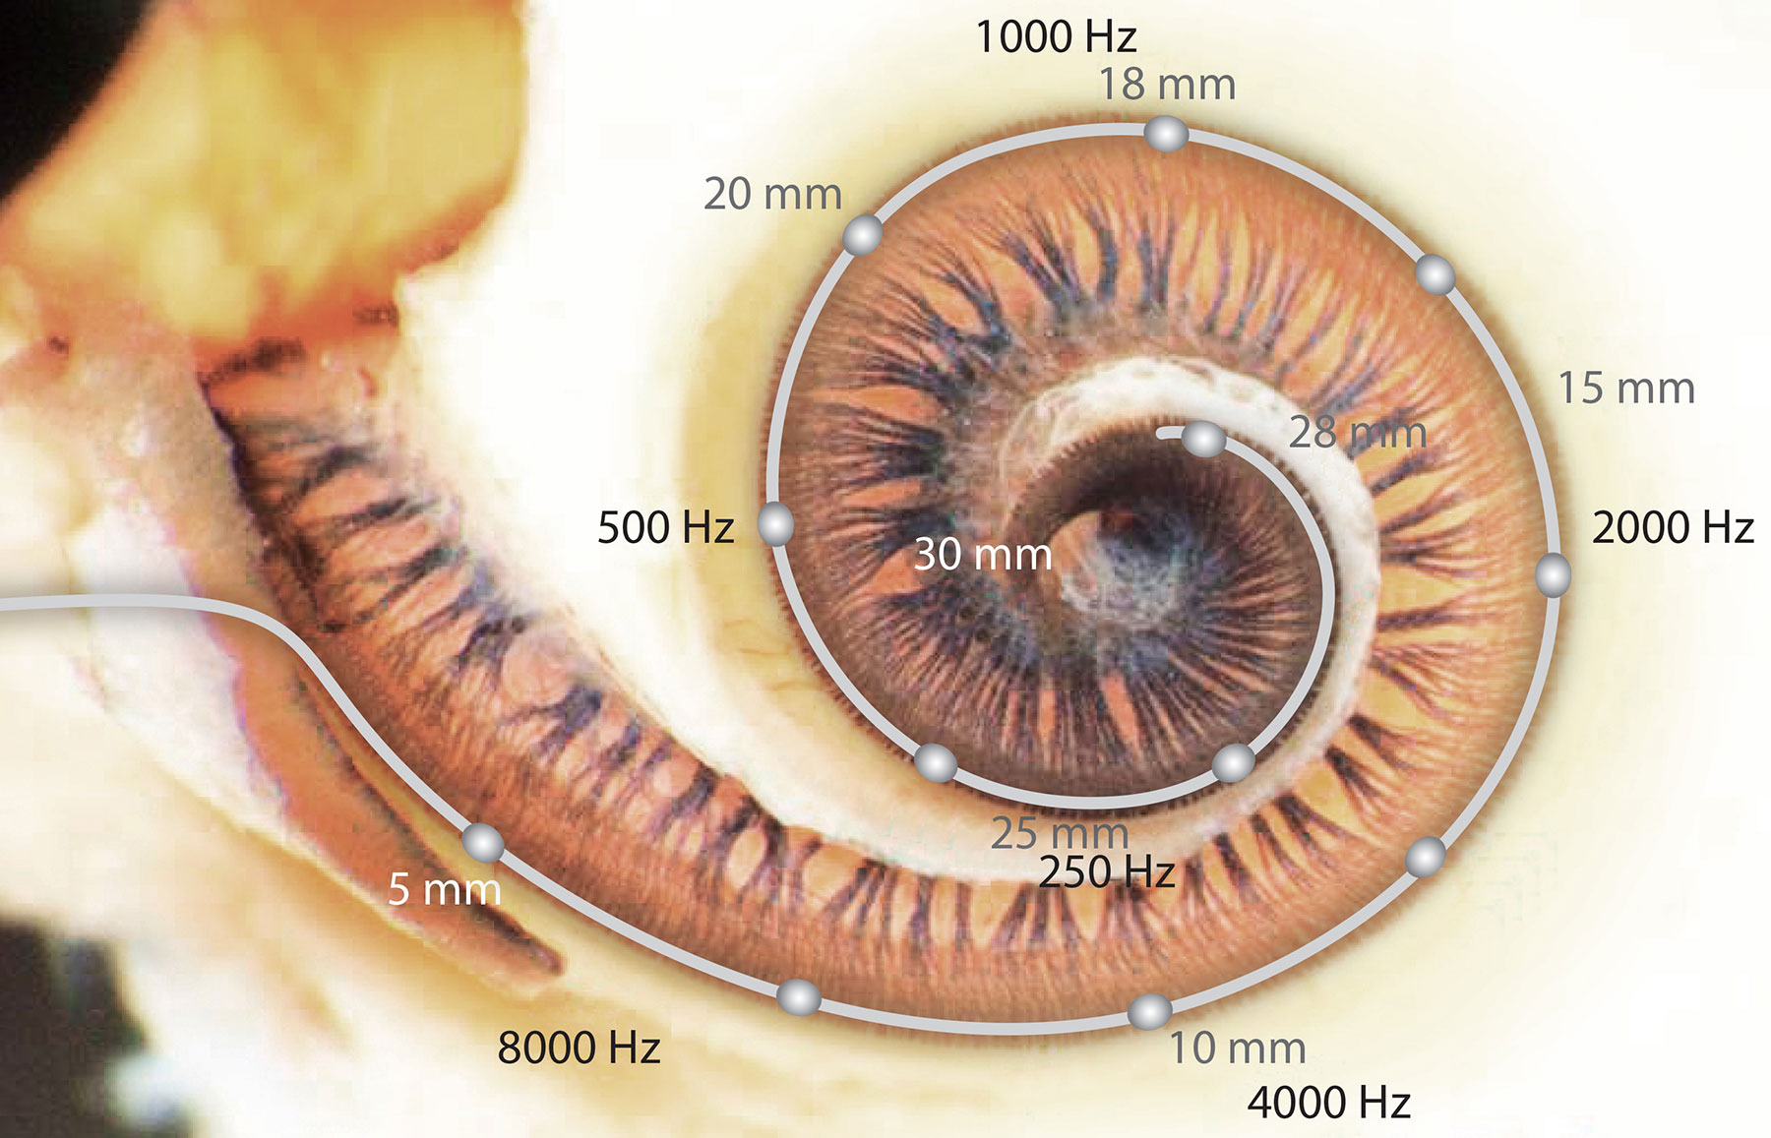
Overview of Auditory System⁴
Sound waves travel to eardrum, which translates sound via 3 ossicle bones to the cochlea
Cochlea is filled with fluid (endolymph) and hair cells attached to sensory receptors
Waves travel through the fluid, moving the hair cells and activating the sensory receptors
This input is translated as sound
Notes:
https://blogs.cdn.medel.com/blog.medel.com/uploads/20180628145811/how-the-ear-hears-sound-tonotopy-2.jpg
Before we discuss the relationship of hearing to falls, we also need to get a basic understanding of how hearing normally functions
One thing to note is that different regions of the cochlea respond better to different frequencies. The further along the cochlea, the lower frequencies the cells respond to

Slide 8
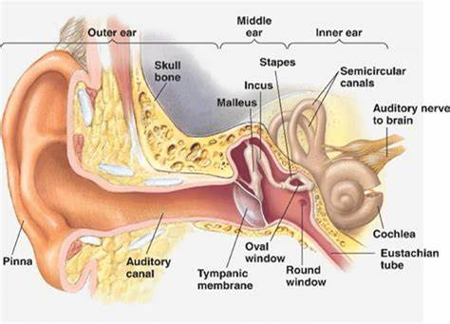
Notes:
https://www.researchgate.net/figure/The-anatomy-of-the-auditory-system-of-human-ear_fig1_344278403
Note how close the cochlea and the vestibular labyrinth are to one another. They share a common source for circulation of the endolymph fluid within them

Slide 9
Relevant Age-Related Changes in Older Adults^{5,6}
Decreased Visual Acuity
Decreased nerve conduction speed and number of cells
Decreased blood flow to inner ear
- Decreased reliability of visual input
- Impacts nutrition circulation to vestibular labyrinth and cochlea
- Decreased efficiency of all related systems
Notes:
Decreased nerve conduction means signals from receptors will not be processed as fast, so individuals will not be able to respond to stimuli as quickly
Decreased visual acuity means that the reliability of the input will be decreased for use in spatial awareness
Decreased circulation within the inner ear means that the receptors and related structures of each part of the inner ear is more prone to damage over time. When receptor cells of the inner ear die, they do not grow back. These changes can affect either the vestibular system, the auditory system, or both depending on the underlying cause
For the vestibular system, this means that the individual is more prone to develop vestibular issues, such as BPPV or hypofunction
For the auditory system, this means that the individual is more likely to develop hearing loss, most commonly in high frequencies
These changes to the balance systems create part of the complex picture that is increased rates of falls in older adults

Slide 10
What does hearing have to do with falls?
Notes:
The overarching goal of this presentation is to answer this question

Slide 11
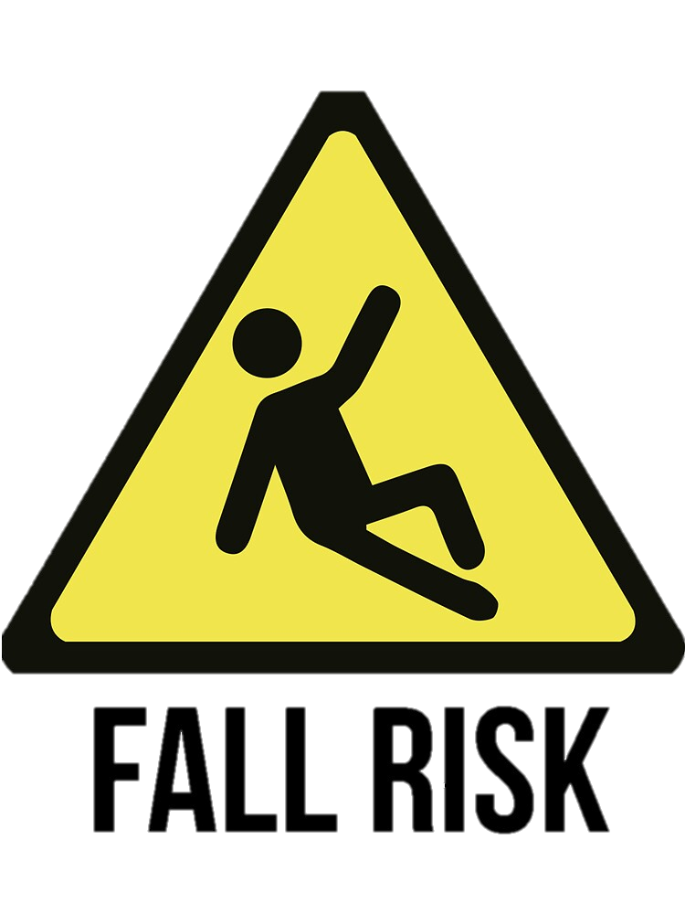
Background of Hearing and Falls
Falls continue to be a common cause of adverse health outcomes in older adults
Over 3 million older adults are admitted to the emergency room annually for fall related injuries⁷
Falls are typically caused by tripping due to declines in strength and balance attributed to older age
Hearing loss has been identified as a risk factor for falling, but the mechanism remains unclear^{8,9}
Notes:
Falls continue to be a common cause of adverse health outcomes in older adults
Over 3 million older adults are admitted to the emergency room annually for fall related injuries⁷
Falls are typically caused by tripping due to declines in strength and balance attributed to older age
This is why identifying risk factors for falls is a research priority for the physical therapy profession
Hearing loss has been identified as a risk factor for falling, but the mechanism remains unclear^{8,9}

Slide 12
Foundational Research
Potential link between hearing loss and balance first described by Gerson et al in a 1989 study¹⁰
Further studies have used various methods to examine this trend
Purchase- Helzner et al¹¹: hearing screen followed by longitudinal fall monitoring – no association
Baloh et al¹²: hearing screen followed by longitudinal fall monitoring – weak association
Viljanen et al¹³: twin study involving hearing screen, balance measures, COP analysis and longitudinal fall monitoring – moderate association, not explained by other examined factors
Notes:
Potential link between hearing loss and balance first described by Gerson et al in a 1989 study¹⁰
Gerson study: interview of 977 older adults asking a variety of questions to determine associations between frequent fallers
Further studies have used various methods to examine this trend. Not all studies have confirmed this link, but the consensus supports a small impact of hearing loss on falls
Helzner et al (2003) – 6480 older adult women, followed an average of 6.7 years
Baloh et al (2004)– 59 older adults, followed 8-10 years
Viljanen et al (2009) – 417 female older adult twin pairs, followed one year with daily log

Slide 13
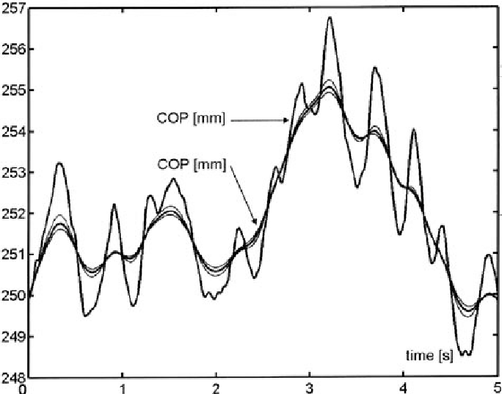
Center of Pressure (COP)
COP
COP is the point of the application of the ground reaction force
Movement of the COP reflects the body’s reaction to change in the Center of mass (COM)
Average COP velocity is a measure of postural sway in quiet standing¹⁵
COM
Notes:
Center of Pressure (COP) data is a measure of postural stability¹⁴. It involves having the participant stand as still as possible on a force plate for a determined period of time, during which the plate collects data on the movement of the COP.
From this, there are a number of variables you can assess. One of the most common is the average velocity of the change in center of pressure, as this has been identified as more reliable for measuring postural sway¹⁵. Higher average velocities indicate greater postural sway, meaning that lower values indicate the individual likely had greater postural stability during that period.
Typically measurements are calculated as:
Medial/Lateral velocity - indicates action of the hip
Anterior/posterior velocity - more indicative of action occurring at the ankle
Total – global picture of the motion occurring
I bring up COP as it will come up again later on….

Slide 14
Exploring the Connection
More recent studies have looked further into this association
Rumalla et al¹⁶: Demonstrated that the use of hearing aids improves balance performance in older adults with hearing loss
Kamil et al¹⁸: demonstrated that fall risk increases with progressive hearing loss
Many studies hint at possible mechanisms, but demonstrating a mechanism is challenging
Notes:
Recent studies have looked further into this association
Rumalla et al (2015): Demonstrated that the use of hearing aids improves balance performance in older adults
- also demonstrated by Negahban et al¹⁷
Kamil et al (2016): demonstrated that fall risk increases with progressive hearing loss
- used national health survey data from 2109 individuals to examine relationships between frailty, hearing loss, and falls
- also found that hearing loss increases risk for frailty

Slide 15
Why Does This Matter?¹⁹
40-60% of adults over the age of 60 have hearing loss
Odds of falling in the next 12 months increases 1.4x for every 10 decibel hearing loss
Hearing loss is also implicated in frailty, cognition, and social participation
You will see these patients
Notes:
Hearing loss is not a niche condition. It is common in older adults and has implications for mobility. Knowing this enables you to have a more complete understanding of falls risk and have discussions with patients of this population about the importance of caring for their hearing.
The Foster et al article was a 2022 meta-analysis, one of the most current works on this topic. It concluded hearing loss has significant effects on not just fall risk, but also postural stability, frailty, cognition, and social participation. This contributes to the idea of the multidimensional nature of hearing loss, and furthers the confusion in identifying a specific mechanism between hearing loss and balance.

Slide 16
^{Current Theories19,20}
There are four current explanations for connecting hearing loss to balance
Cochlear proximity to vestibular labyrinth
Social isolation
Increased cognitive demand
Spatial localization
Notes:
So we know that hearing is connected to falls, and balance is connected to falls, so how does hearing connect to balance?
The cochlea is in close proximity to the vestibular organs, so age-related changes of the cochlea may also implicate deficits in the vestibular organs
Hearing loss contributes to increased social isolation, making an individual more likely to remain at home and decrease physical activity as a result. This in turn leads to balance difficulties due to weakness
Decreased auditory input requires that the individual divert additional attention to sound, decreasing attention devoted to balance
Auditory input allows for spatial localization, which is the idea that the sounds around you assist in determining your position in space, and loss of this can lead to a deficit in balance.
- This theory is the focus of the current study

Slide 17
Studies on Possible Mechanisms
Cochlear Proximity
Gabriel et al²¹ – demonstrated mild changes to vestibular function in adults with age related hearing loss
Social Isolation
Shukla et al²² – systematic review demonstrating increased social isolation in individuals with hearing loss
Cognitive Demand
Bruce et al²³ – hearing loss group had disproportionate dual task performance decrease in noise conditions*
Spatial Localization
Vitkovic et al²⁰ – preliminary evidence that postural sway is reduced in conditions where sound cues are present
Notes:
Gabriel et al (2022) – 23 older adults with normal hearing, and 23 with hearing loss. Used COP data while standing on platform that translated slightly in various directions to determine the threshold for vestibular response
Shukla et al (2020) – 14 studies, not all used objective hearing assessment. Isolation effects more profound among women
Bruce et al (2017) – 29 younger adults, 26 normal hearing older adults, and 32 age related hearing loss adults performed number recall task on platform giving random perturbations in noise vs quiet conditions
*found that noise condition decreased dual task performance across the board, which would work against spatial localization
Vitkovic et al (2016) – 50 normal hearing subjects, 28 hearing loss, 19 vestibular dysfunction. Looked at postural sway using COP and auditory cues vs silence. Found bigger difference between conditions in the vestibular group
- Studies finding results in multiple theories, possibly indicating mulitmodal effects?
- Limited by small effect sizes, number of potential confounders

Slide 18
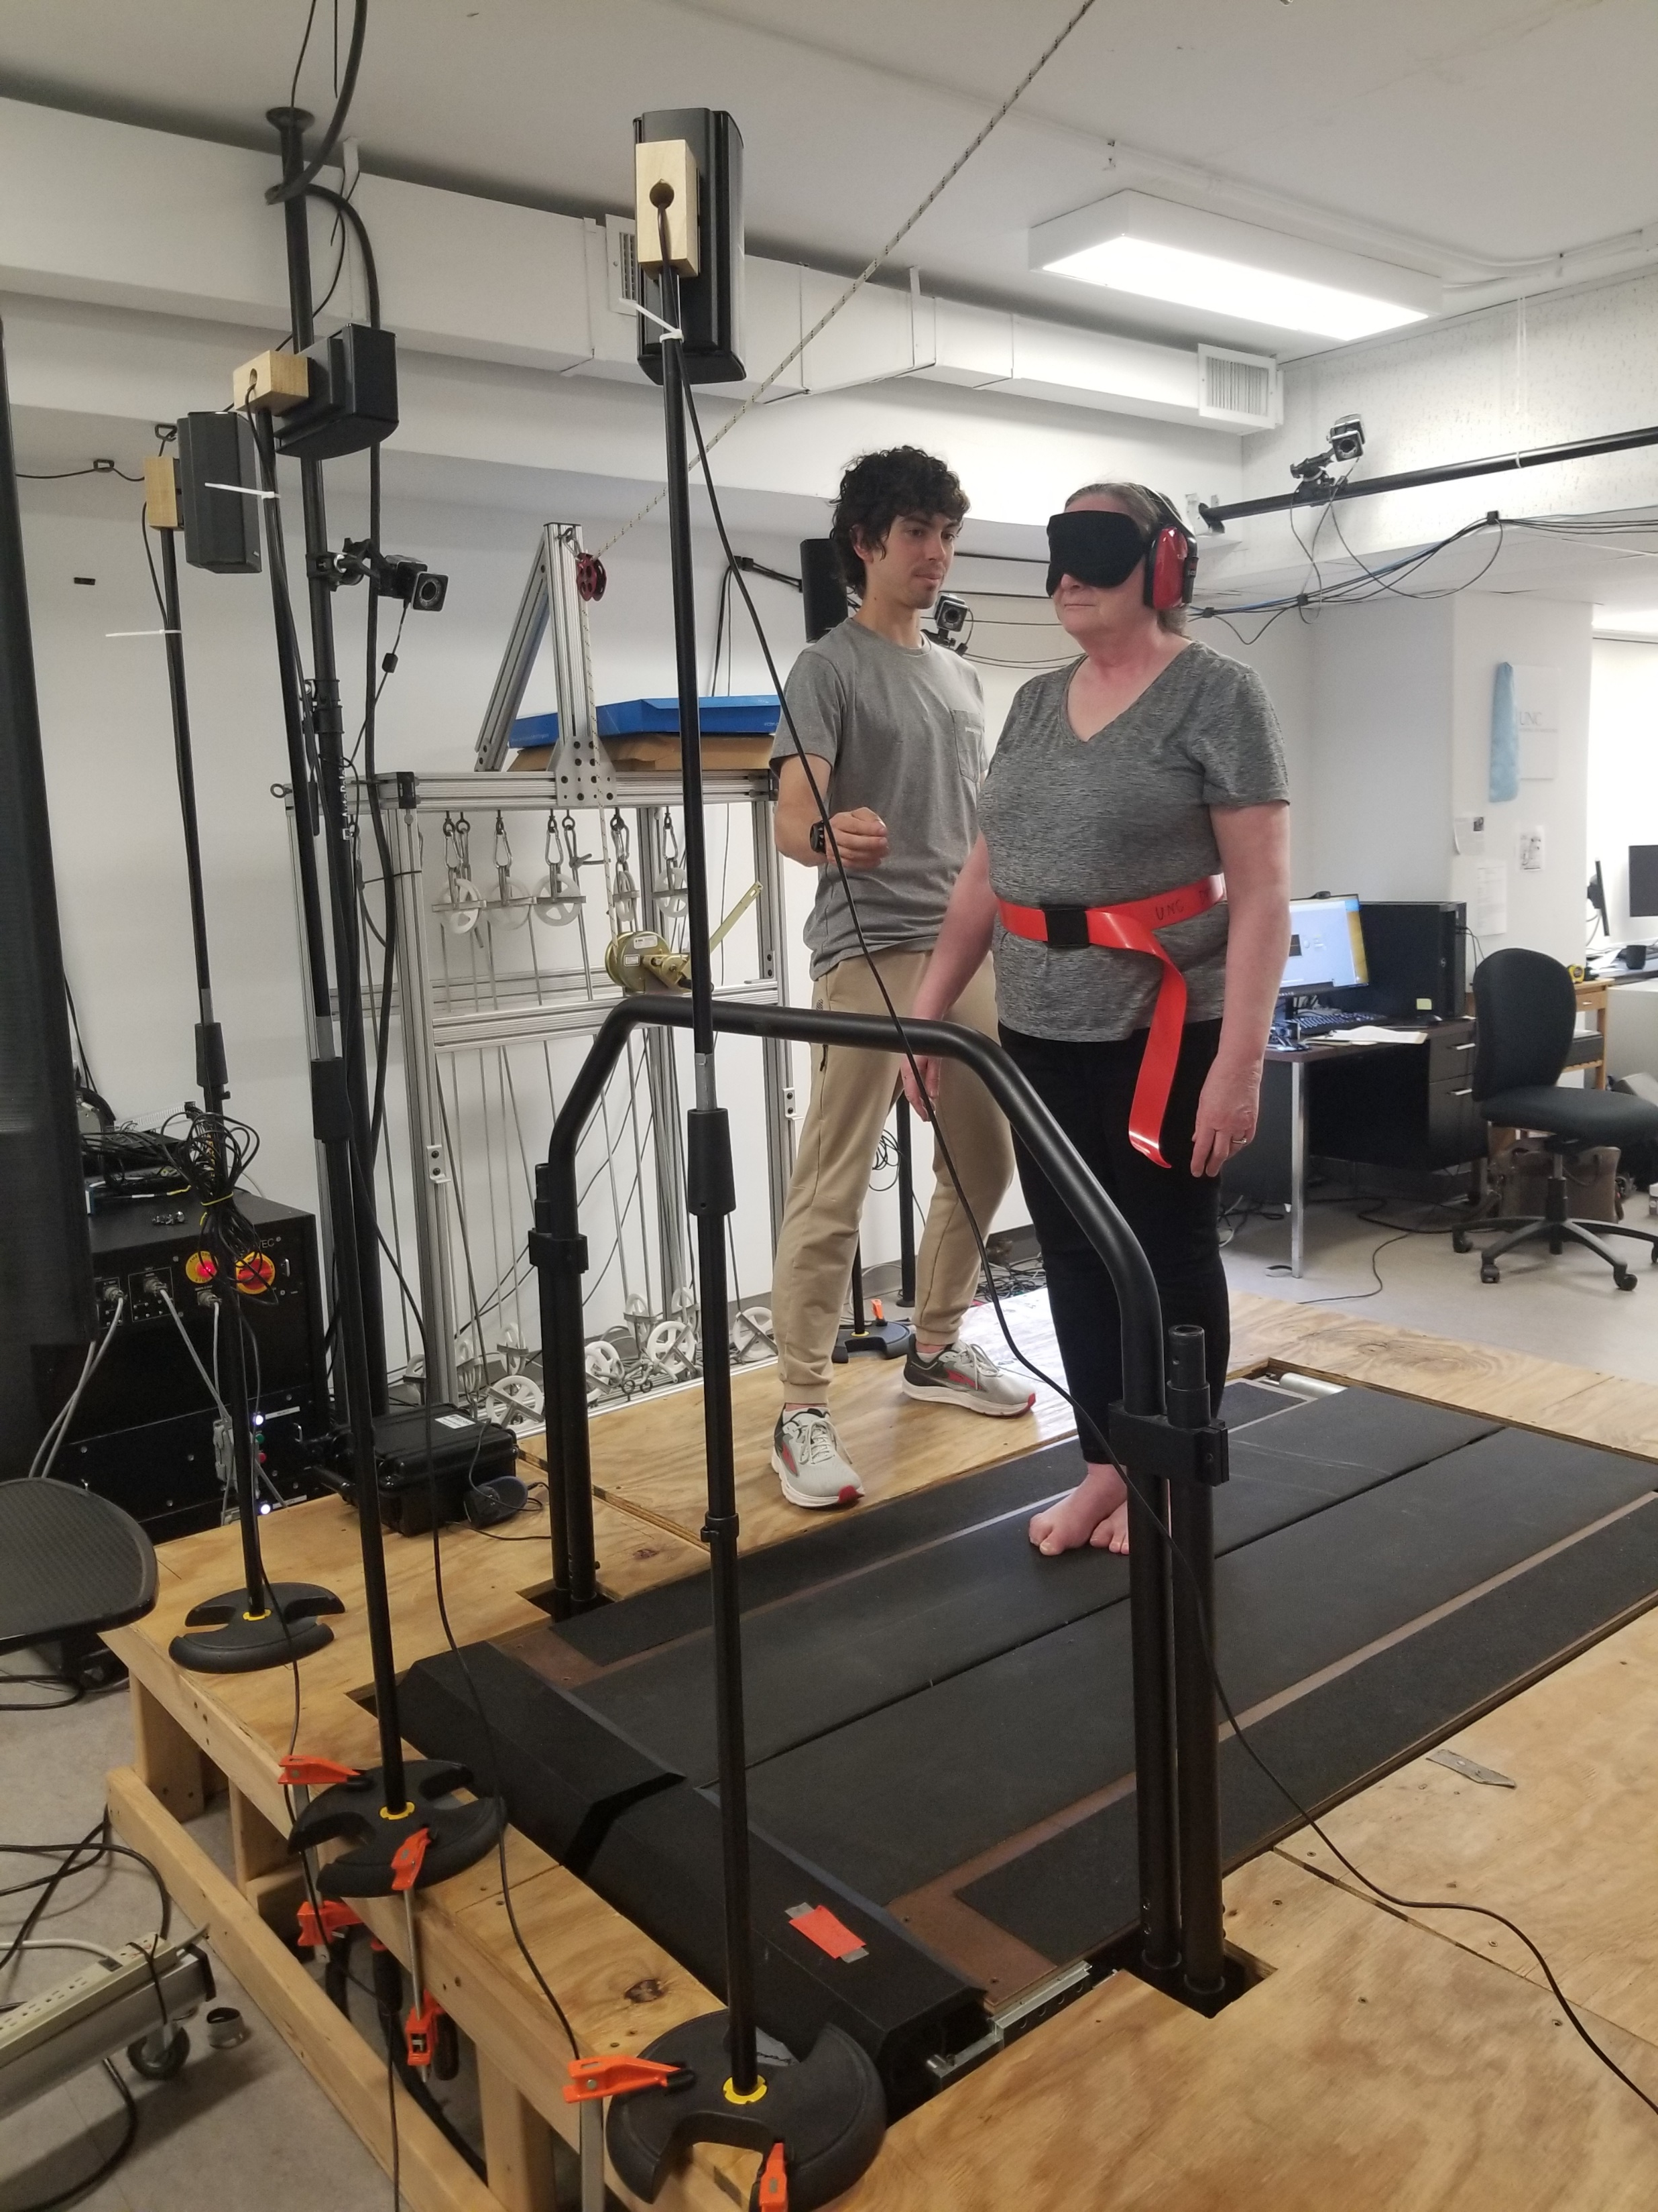
Current Study: Hearing and Balance Project
Notes:
The current study, conducted by Dr. Vicki Mercer, PT, PhD, is looking into the relationship between hearing and balance in older adults. This study uses COP data and different hearing conditions with the idea of teasing out the possibility of the spatial localization theory.
Picture of the COP data collection in the study protocol. The participant is standing in a semi-tandem position on a force plate underneath the treadmill belt during the ‘no sound’ condition. The speakers set up around them are utilized for the sound conditions.
A photo release was obtained for this participant prior to taking the pictures.

Slide 19
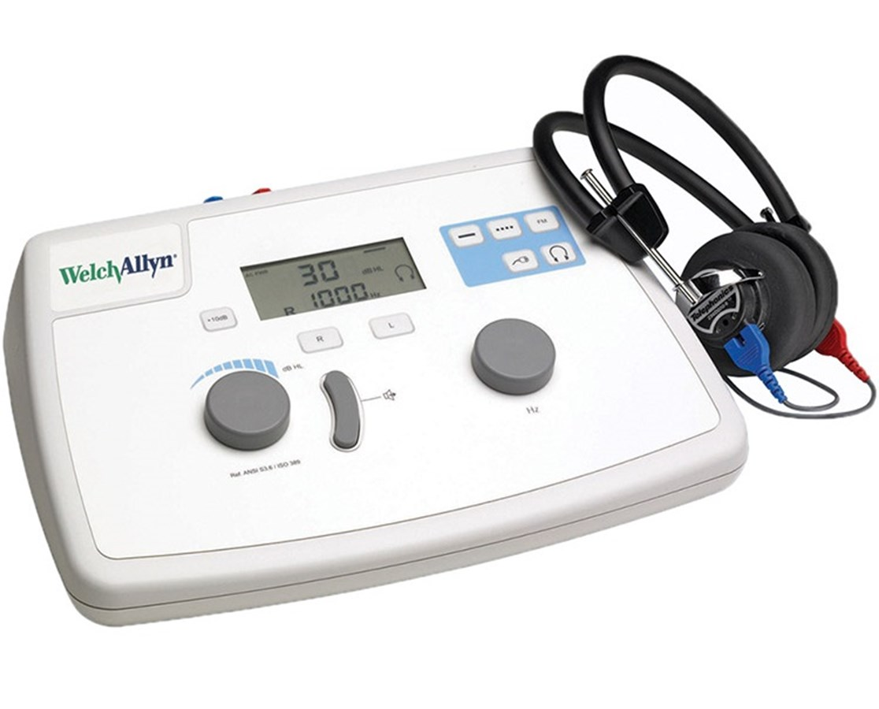
Methods
Recruitment:
Older adults with and without hearing loss
Must have no vestibular or other neurological conditions
Protocol
Within subject and between subject design
Standing on force plate in semi-tandem stance under 3 different noise conditions (no sound, quiet sound, loud sound)
Notes:
Recruitment
Individuals with hearing loss must have diagnosed sensorineural hearing loss, and it equally in each ear. Additionally, their hearing loss must fall in certain decibel ranges, which change depending on the frequency
For individuals without hearing loss, to get into the ‘normal hearing’ group they must pass a hearing screen using a portable audiometer. Many people who thought they had normal hearing actually had mild (or sometimes moderate) hearing loss that was undiagnosed, making them ineligible for the study.
Participants also must be able to walk without pain or assistive device, and have protective sensation in their feet, have a MoCA score of at least 18/22
Participants were recruited through the use of flyers posted at various community locations, email sent to university staff, and referrals from an audiology office
- Hypothesis was that sound conditions would reduce postural sway, and that individuals with hearing loss would have increased postural sway.

Slide 20
Example Audiogram
Notes:
Example of an audiogram for an individual with hearing loss, but not one that would qualify for the study.
Audiograms are the collected results of a hearing test, usually conducted by audiologists. They show what decibel levels an individual is able to hear at various frequencies. Normal hearing would have relatively consistent results across all tested frequencies, with the individual able to hear all tones at a volume of 20 decibels between 250-8000 Hz.
Older adults tend to lose high frequency hearing as a normal part of ageing, so our inclusion criteria for normal hearing has slightly looser criteria at 2000 and 4000 Hz.
Individuals in the hearing loss group need to have their decibel threshold in specific ranges that the example audiogram does not meet, as this individual has normal hearing in the low frequency ranges.

Slide 21
Tests and Measures
Average COP velocity in three different conditions
MiniBEST test
CHAMPS activity questionnaire
Notes:
Collection of the additional measures allows for drawing connections between other constructs of balance and theories of hearing’ relationship to balance.
The MiniBEST is a clinical measure of balance. Previous studies have shown mixed results on the relationship between postural sway and balance performance, so utilization of the MiniBEST would contribute to the research base on that topic.
The CHAMPS questionnaire is a measure of time and frequency doing various activities such as social events, house work, and physical activity. Higher scores on various dimensions of the questionnaire in the normal hearing vs hearing loss groups could indicate ties between hearing loss and social/physical engagement.
Looking at the COP data: the figure on the left shows a trial with relatively little postural sway. Notice the scale of the velocity changes in each axis. The figure on the right shows a trial where the individual had several near losses of balance.

Slide 22
Initial Data
COP data on 10 individuals with normal hearing
Hearing Loss Participants
Notes:
Collected data on 19 (COP data on 10) individuals with normal hearing, and 2 with hearing loss
No significant differences between conditions at this time
Medial/Lateral and Anterior/Posterior mean velocities are as expected for the project setup. There is more room to sway in the A/P direction when in a semi-tandem position
As a reminder, lower values in mean velocity indicate less postural sway
Red dots indicate averages for the two individuals with hearing loss

Slide 23
Takeaways
Hearing loss is common in older adults and is a risk factor for falls and other poor outcomes
Fall risk is a multifactorial problem, and hearing loss is just one piece of the larger puzzle
Several theories exist for explaining this relationship
When assessing your patients for fall risk, ask about existing hearing loss
For those with undiagnosed complaints, refer to an audiologist
For patients with hearing aids, ask to ensure they work and that the patient is familiar with proper care
Educate patients with hearing loss on the relationship of hearing to balance.
Caring for hearing is caring for balance!
Notes:
- As a multifactorial problem, addressing a fall risk factor can’t fully eliminate risk, but it can mitigate it
- Be sure to ask about hearing when working with older adult patients. If they feel like their hearing has declined, suggest seeking out an audiologist, and educate on the fact that hearing has a role in their balance.

Slide 24
Literature Referenced
1. Balance Disorders. NIH Institute on Deafness. https://www.nidcd.nih.gov/health/balance-disorders#d Accessed April 7, 2024.
2. The neuroscience of balance - The Physiological Society. Accessed April 17, 2024. https://www.physoc.org/magazine-articles/the-neuroscience-of-balance/
3. Lappe M. Optic Flow. In: Binder MD, Hirokawa N, Windhorst U, eds. Encyclopedia of Neuroscience. Springer Berlin Heidelberg; 2009:3035-3039. doi:10.1007/978-3-540-29678-2_4245
4. Peterson DC, Reddy V, Launico MV, et al. Neuroanatomy, Auditory Pathway. [Updated 2023 Oct 24]. In: StatPearls [Internet]. Treasure Island (FL): StatPearls Publishing; 2024 Jan-. Available from: https://www.ncbi.nlm.nih.gov/books/NBK532311/
5. Osoba MY, Rao AK, Agrawal SK, Lalwani AK. Balance and gait in the elderly: A contemporary review. Laryngoscope Investig Otolaryngol. 2019;4(1):143-153. Published 2019 Feb 4. doi:10.1002/lio2.252
6. Balance & Aging - Vestibular Disorders Association. Accessed April 17, 2024. https://vestibular.org/article/coping-support/living-with-a-vestibular-disorder/age-related-dizziness-and-imbalance/balance-aging/
7. CDC Injury Center. Important Facts about Falls. Centers for Disease Control and Prevention 2017. Available at: https://www.cdc.gov/falls/facts.html. Accessed March 5, 2024.
8. Pluijm SMF, Smit JH, Tromp EAM, et al. A risk profile for identifying community-dwelling elderly with a high risk of recurrent falling: results of a 3-year prospective study. Osteoporos. Int. 2006;17(3):417-425. doi:10.1007/s00198-005-0002-0.
9. Carpenter, M. G., & Campos, J. L. (2020). The Effects of Hearing Loss on Balance: A Critical Review. Ear and hearing, 41 Suppl 1, 107S–119S. https://doi.org/10.1097/AUD.0000000000000929

Slide 25
Literature Referenced (cont.)
10. Gerson, L. W., Jarjoura, D., & McCord, G. (1989). Risk of imbalance in elderly people with impaired hearing or vision. Age and ageing, 18(1), 31–34. https://doi.org/10.1093/ageing/18.1.31
11. Purchase-Helzner, E. L., Cauley, J. A., Faulkner, K. A., Pratt, S., Zmuda, J. M., Talbott, E. O., Hochberg, M. C., Stone, K., & Newman, A. (2004). Hearing sensitivity and the risk of incident falls and fracture in older women: the study of osteoporotic fractures. Annals of epidemiology, 14(5), 311–318.
12. Baloh, R. W., Ying, S. H., & Jacobson, K. M. (2003). A longitudinal study of gait and balance dysfunction in normal older people. Archives of neurology, 60(6), 835–839. https://doi.org/10.1001/archneur.60.6.835
13. Viljanen A, Kaprio J, Pyykkö I, et al. Hearing as a predictor of falls and postural balance in older female twins. J. Gerontol. A. Biol. Sci. Med. Sci. 2009;64(2):312-317. doi:10.1093/gerona/gln015.
14. Harro CC, Garascia C. Reliability and validity of computerized force platform measures of balance function in healthy older adults. J Geriatr Phys Ther 2019;42(3):E57-E66. doi:10.1519/JPT.0000000000000175.
15. Raymakers, J. A., Samson, M. M., & Verhaar, H. J. (2005). The assessment of body sway and the choice of the stability parameter(s). Gait & posture, 21(1), 48–58. https://doi.org/10.1016/j.gaitpost.2003.11.006
16. Rumalla K, Karim AM, Hullar TE. The effect of hearing aids on postural stability. Laryngoscope 2015;125(3):720-723. doi:10.1002/lary.24974
17. Negahban H, Bavarsad Cheshmeh Ali M, Nassadj G. Effect of hearing aids on static balance function in elderly with hearing loss. Gait Posture 2017;58:126-129. doi:10.1016/j.gaitpost.2017.07.112.
18. Kamil RJ, Betz J, Powers BB, et al. Association of hearing impairment with incident frailty and falls in older adults. J Aging Health 2016;28(4):644-660. doi:10.1177/0898264315608730.

Slide 26
Literature Referenced (cont.)
19. Foster JI, Williams KL, Timmer BHB, Brauer SG. The Association between Hearing Impairment and Postural Stability in Older Adults: A Systematic Review and Meta-analysis. Trends Hear. 2022;26:23312165221144155. doi:10.1177/23312165221144155
20. Vitkovic J, Le C, Lee S-L, Clark RA. The contribution of hearing and hearing loss to balance control. Audiol Neurootol 2016;21(4):195-202. doi:10.1159/000445100.
21. Gabriel, G. A., Harris, L. R., Gnanasegaram, J. J., Cushing, S. L., Gordon, K. A., Haycock, B. C., Pichora-Fuller, M. K., & Campos, J. L. (2022). Vestibular Perceptual Thresholds in Older Adults With and Without Age-related Hearing Loss. Ear and hearing, 43(2), 420–435. https://doi.org/10.1097/AUD.0000000000001118
22. Shukla, A., Harper, M., Pedersen, E., Goman, A., Suen, J. J., Price, C., Applebaum, J., Hoyer, M., Lin, F. R., & Reed, N. S. (2020). Hearing Loss, Loneliness, and Social Isolation: A Systematic Review. Otolaryngology--head and neck surgery : official journal of American Academy of Otolaryngology-Head and Neck Surgery, 162(5), 622–633. https://doi.org/10.1177/0194599820910377
23. Bruce H, Aponte D, St-Onge N, Phillips N, Gagné JP, Li KZH. The Effects of Age and Hearing Loss on Dual-Task Balance and Listening. J Gerontol B Psychol Sci Soc Sci. 2019;74(2):275-283. doi:10.1093/geronb/gbx047

Slide 27
Image References
https://www.hearingsol.com/help/hearing-loss/mixed/ Accessed April 7, 2024
Treatment Center for Women & Teen Girls | Timberline Knolls Accessed April 7, 2024
https://www.redbubble.com/i/sticker/Fall-Risk-by-lightfixtures/42561673.EJUG5 Accessed April 7, 2024
https://www.hear.com/resources/hearing-loss/what-is-audiogram-how-to-read-it/ Accessed April 7, 2024
https://image.tigermedical.com/Products/LargeImages/WEL28200.jpg, Accessed April 7, 2024
https://www.researchgate.net/figure/Center-of-pressure-COP-vs-reconstructed-center-of-mass-COM-for-different-values-of_fig10_8390359 Accessed April 17, 2024

