Slide 1
Depression, Delirium, & Dementia
Screening, Interventions, and Referral as it applies to the Acute Care Therapist
Presented by: Karolyne Hill
Notes:
Good afternoon everyone. Today we will be discussing depression, delirium, and dementia and their implications on you as an acute care therapist.

Slide 2
Learning Objectives
By the end of the presentation, viewers should be able to the following:
Identify and recognize predisposing and precipitating risk factors for depression, delirium, and depression as they relate to acute care
Recognize the symptoms and clinical presentation of each syndrome
Distinguish between the three syndromes and differentiate between the signs of delirium and dementia
Perform a basic screening for each syndrome within the acute care setting
Provide physical therapy interventions tailored to combat symptoms and functional limitations with each of these syndromes
Determine the need for referral for additional medical management in the acute care setting
Notes:
These are the learning objectives for today.

Slide 3
What is Depression?
May also be referred to as:
Major depression, major depressive disorder, or clinical depression
Common but serious mood disorder
16 million – 7% - of American adults experience at least one depressive episode in a year
Rates of depression among hospital patients are higher than the non-inpatient population
Symptoms must be present for at least 2 weeks
There are many different types of depression: psychotic depression, postpartum depression, and seasonal depressive episodes, bipolar depression, etc.
Most common psychological problem in the older adult population
Often co-occurs with other medical illnesses: Diabetes, cancer, heart disease, and Parkinson’s disease
Depression is NOT a part of the normal aging process
Notes:
https://www.medstarhealth.org/blog/recognizing-and-treating-depression-in-hospital-patients
https://www.nimh.nih.gov/health/topics/depression

Slide 4
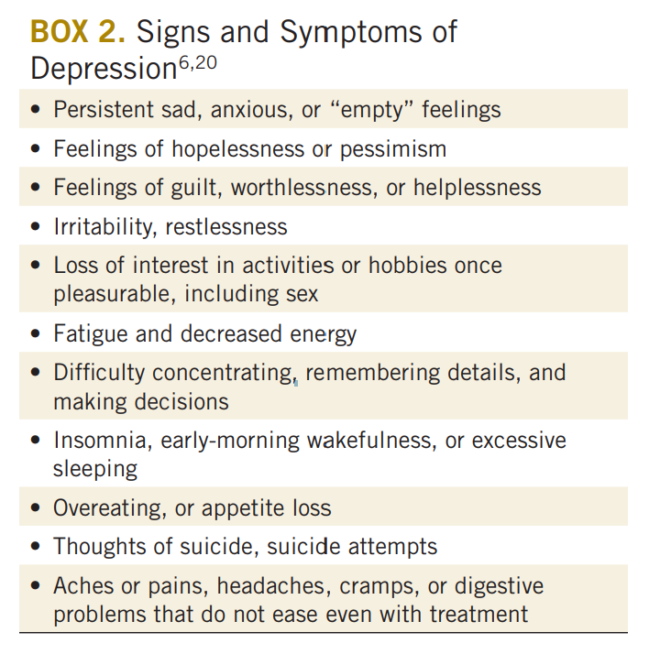
Clinical presentation
Notes:
Delayed thinking and problem solving
Indecisiveness
Confusion or agitation
Perceived lack of competence and control
Low self-esteem
Apathy
Irritability
Sleeping pattern changes
Appetite or weight changes

Slide 5
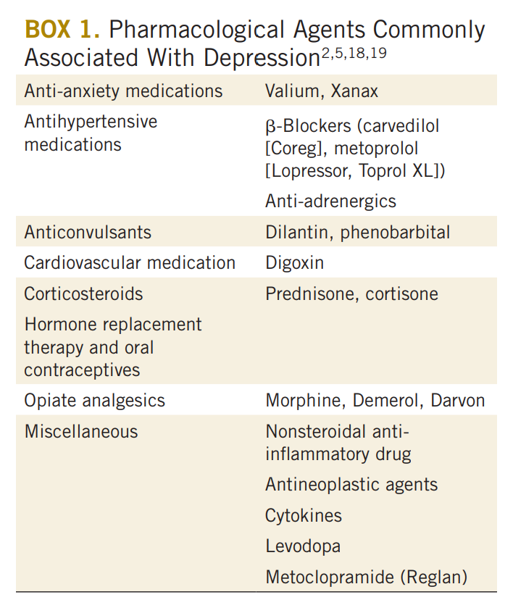
Risk factors
Combination of biology + environment
First-degree relative with depression
A recent diagnosis or change in health status
Female
Lower income
Lower education level
Medication effect and polypharmacy
Cardiovascular disease and cancer are the most prevalent medical illnesses associated with depression among hospitalized elderly.
However, depression can occur in those without a family history and with or without a situational trigger
Notes:
Individuals who have a first-degree relative with depression have a higher incidence of developing depression.
Women are diagnosed 70% more frequently than men.
Environmental or situational factors may be related to medical illness and associated signs and symptoms, stress, death, financial problems, trauma, or other
Porth and Matfin report that the incidence of depression is higher in those living in or near poverty.
Alamri SH, Bari AI, Ali AT. Depression and associated factors in hospitalized elderly: a cross-sectional study in a Saudi teaching hospital. Ann Saudi Med. 2017;37(2):122-129. doi:10.5144/0256-4947.2017.122
Billek-Sawhney B, Wagner A, Braun J. Depression. J Acute Care Phys Ther. 2014;5(2):77-88. doi:10.1097/01.JAT.0000453142.16547.86

Slide 6
Depression and Therapy
High incidence requires acute therapists to understand depression
Lack of motivation leads to more refusals and less participation
Poor self-efficacy leads to poor motor learning
Lack of adherence to HEP / mobility program
Increased falls risk
Pseudodementia
Depression can mimic dementia
Recognize that signs of early dementia can superimpose depression
Longer length of stay
Higher readmission rate
Higher risk of hospitalization
Notes:
Prina AM, Cosco TD, Dening T, Beekman A, Brayne C, Huisman M. The association between depressive symptoms in the community, non-psychiatric hospital admission and hospital outcomes: a systematic review. J Psychosom Res. 2015;78(1):25-33. doi:10.1016/j.jpsychores.2014.11.002

Slide 7
Screening for Depression
Notes:
Specificity – 89%
Sensitivity – 97%

Slide 8
Interventions for Depression
Similarly, to the Shum-way-Cook and Wollacott’s conceptualization of motor control model we must consider three variables when treating psychological concerns:
1- the activities / interventions employed
2- the therapeutic setting / environment
3 – one’s own behavior / interaction with the patient
Consider and potentially modify variables to be more effective with your patients
Notes:
We can use the motor control model to also consider what variables we should modify when working with individuals with psychological concerns.

Slide 9
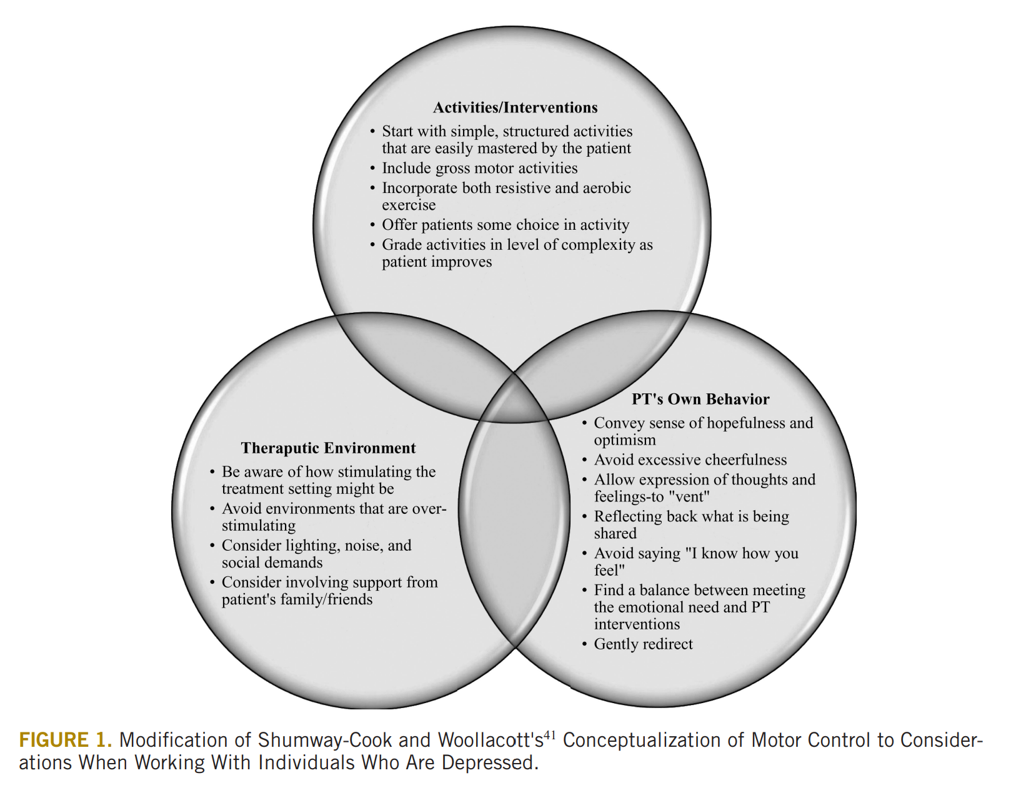
Notes:
Simple activities promote self-efficacy and a greater sense of personal control. “Self-efficacy has long been shown to provide a buffering effect on depression. The promotion of self-efficacy takes on greater significance in light of research indicating that recovery from illness and injury is enhanced in individuals with a strong belief in their physical efficacy.”
Grade level of complexity as the patient’s confidence and capabilities improve
Including gross motor activities in patients’ interventions can relieve depressive symptoms by releasing stress and increasing oxygen intake and blood flow to the brain
Resistive and aerobic better than aerobic alone
Some but limited choice increases self control and empowerment
Stimulating environments may cause feelings of helplessness and/or powerlessness to be exacerbated – resulting in feeling overwhelmed and withdrawing
Allow for venting, gently redirect to be kept on task at hand

Slide 10
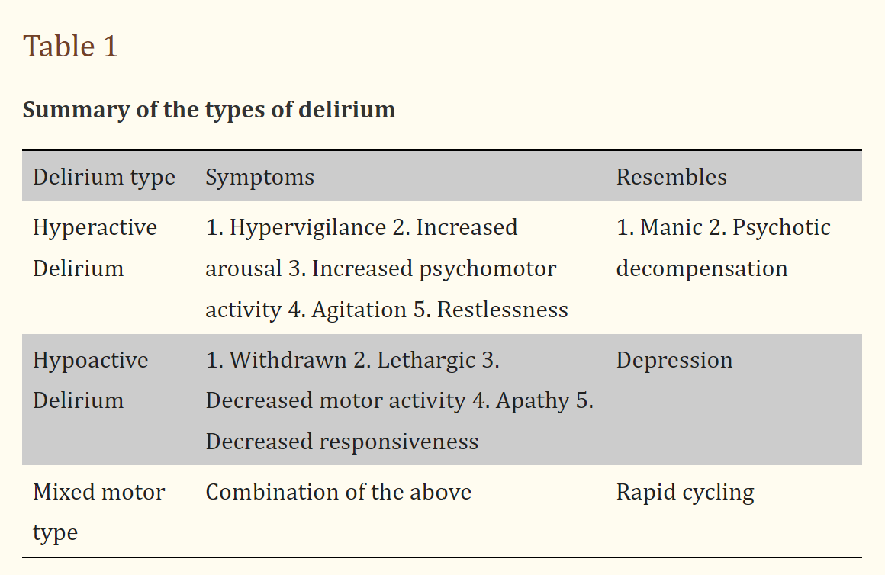
What is Delirium?
An acute disturbance of consciousness with changes in cognitive functioning, inattention, perceptual disturbances and fluctuating symptoms during the course of the day.
Two types: hyperactive and hypoactive
Associated with prolonged hospital stay, cognitive and functional decline, increased mortality and increased risk of institutionalization
Underestimated in elderly hospitalized patients
Delirium symptoms can persist for up to 6 months after discharge from a hospital
Pagad S, Somagutta MR, May V, et al. Delirium in Cardiac Intensive Care Unit.
Notes:
Miu, D. K. Y., Chan, C. W., and Kok, C. (2016) Delirium among elderly patients admitted to a post-acute care facility and 3-months outcome. Geriatrics & Gerontology International, 16: 586– 592. doi: 10.1111/ggi.12521.
Pagad S, Somagutta MR, May V, et al. Delirium in Cardiac Intensive Care Unit. Cureus. 2020;12(8):e10096. Published 2020 Aug 28. doi:10.7759/cureus.10096
“The hypoactive being the most common form of delirium as high as 92% in one study, is also associated with increased mortality as it is challenging to diagnose in earlier stages.”

Slide 11
Risk factors for delirium
Pre-existing cognitive impairment
Illness/ acute infection
Sepsis
Metabolic disturbance – glucose, electrolytes
Dehydration
Surgery
Hospitalization / immobilization
Polypharmacy and the use of psychoactive drugs
Narcotics, opioids, benzodiazepines
Older age
Chronic comorbidities
Sleep deprivation
Depression / Emotional distress
MCI / Dementia
Mechanical ventilation
Sensory impairment
Pain
Alcohol misuse

Slide 12
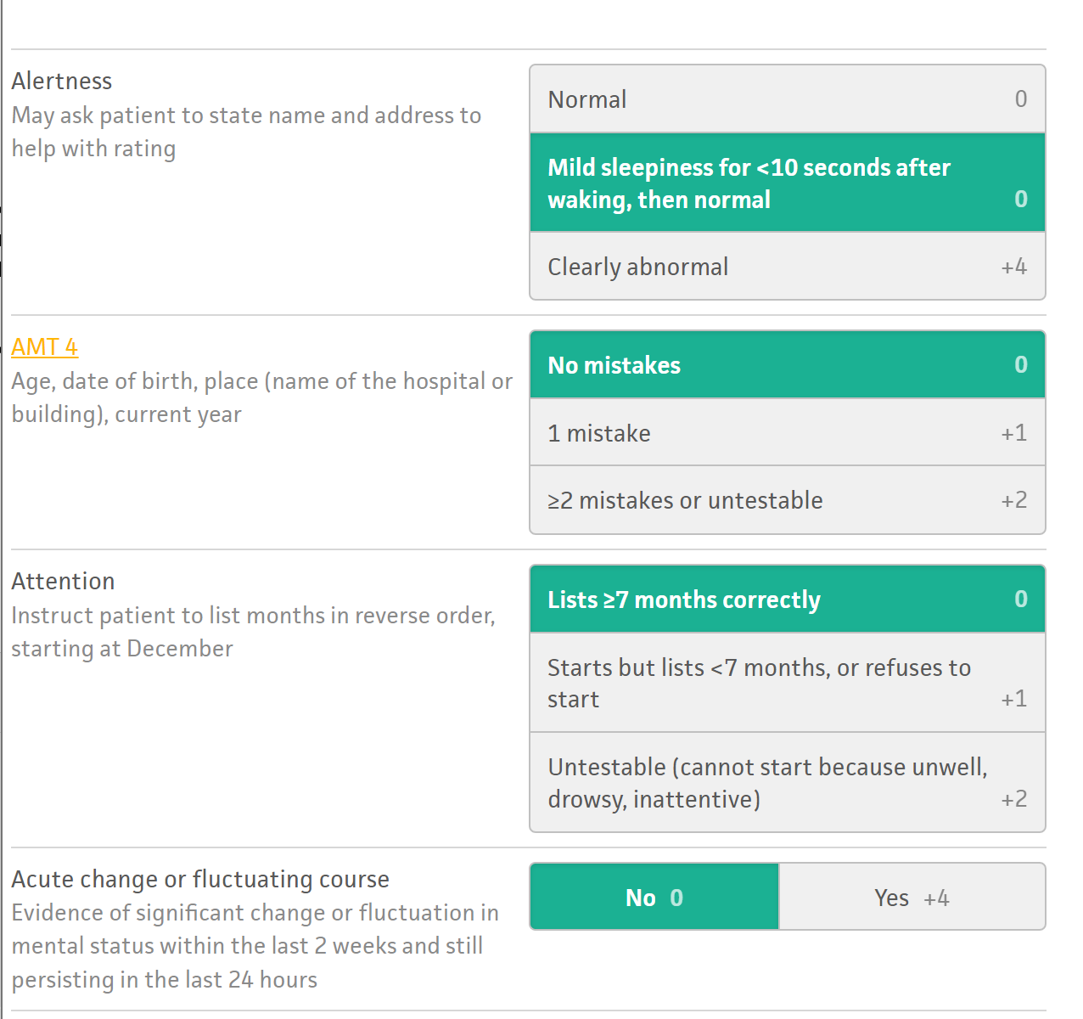
Screening for Delirium
Screen for delirium in older patients who are at high risk based on information provided in the medical chart and patient/caregiver interview
4 A’s Test for Delirium
4 points = possible delirium
https://www.mdcalc.com/calc/3982/4-test-delirium-assessment
Notes:
There are two different screening tools for delirium that I will introduce today. The first is the 4 A’s test for delirium. I found this online calculator that provides you with a score after inputting the information you gathered from your interaction with your patient. This tool is simple, effective, and may be a way to produce objective results from subjective information that you are already gathering from most if not all your patients.

Slide 13
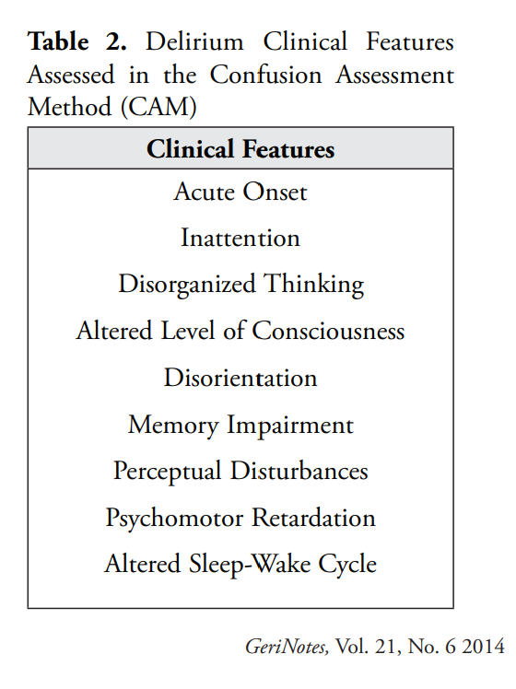
Screening for Delirium Cont.
Confusion Assessment Method (CAM)
Developed for use by trained non-psychiatric clinicians
Can help differentiate delirium from depression and dementia
Does NOT measure delirium severity
Can be completed in 5 minutes, 9 clinical features with YES/NO options
Notes:
This is the CAM. This is a common screening tool for delirium used in the acute setting.

Slide 14
Interventions for Delirium
Reduce risk factors
Hydration, polypharmacy, educate caregivers
Early identification
Early mobility and exercise
Orientation
Encourage proper sleep-wake cycle
Address vision and hearing
Discharge - Return to a familiar environment
Referral – screen and tell the provider

Slide 15
What is Dementia?
Not a normal process of aging
Pathological changes in the brain
Increased amyloid plaques and neurofibrillary tangles
Multiple cognitive deficits including memory and at least one of the following:
Aphasia- loss of ability to understand or express speech
Apraxia - the loss of ability to execute or carry out skilled movement and gestures, despite having the physical ability and desire to perform them
Agnosia - Loss of the ability to identify objects or people.
Disturbance of executive function – impairments in problem solving, decision making, following commands, comprehension
Multiple types: Cortical, Subcortical, Combined, Other
Most common type is Alzheimer's- 60-80% of people with dementia have Alzheimer’s
½ of people over 85 have Alzheimer’s
Notes:
Changes related to the onset of Alzheimer’s disease are noted over a 6-month to 12-month period and can last 8 to 12 years. Most are often not diagnosed with dementia until the later stages as the initial small changes are often missed by physicians and families . Early symptoms may also be mistaken for normal parts of the aging process or symptoms of depression or delirium.
Alzheimer’s is diagnosed through CT scan, MRI, and observation of symptoms.

Slide 16
Screening for Dementia
6-Item Cognitive Impairment Test (6CIT)
Mini Mental State Examination (MMSE)
Most frequently used
Montreal Cognitive Assessment (MoCA)
St. Louis University Mental Status (SLUMS)
Takes into account education level
More sensitive than the MMSE
MMSE, MoCA, and SLUMS all help differentiate between the different cognitive domains
Attention and concentration, executive functions, memory, language, visuo-constructional skills, conceptual thinking, calculations, and orientation.
Notes:
Most take less than 10 minutes to administer.
Can infer a lot about the patient’s ability to learn new skills or information.

Slide 17
PT Interventions & Dementia
Calm environment, eliminate distractions
Consistency with treatment sessions is best
High repetition
Remove obstacles to ensure safety – mark steps or changes in surface with colored tape
Demonstrate tasks while providing tactile cues
Show – tell – touch
Break the task down into parts
Exercise
Moderate to high intensity aerobic training
Resistance training
Gait and balance training
Assistive devices – Is this a new device? Can this patient learn to use a new device? Is this the least restrictive device?
Cognitive tasks
Dual tasking – use something meaningful to the patient
Higher cognitive reserve linked to decreased progression of disease

Slide 18
Communication is key
Approach from the front. Make eye contact. Speak slowly and smile.
Allow for a processing time before speaking again
Provide praise and encouragement often
Always agree, never argue
Especially about orientation
Use simple, one step commands
Offer only two choices

Slide 19
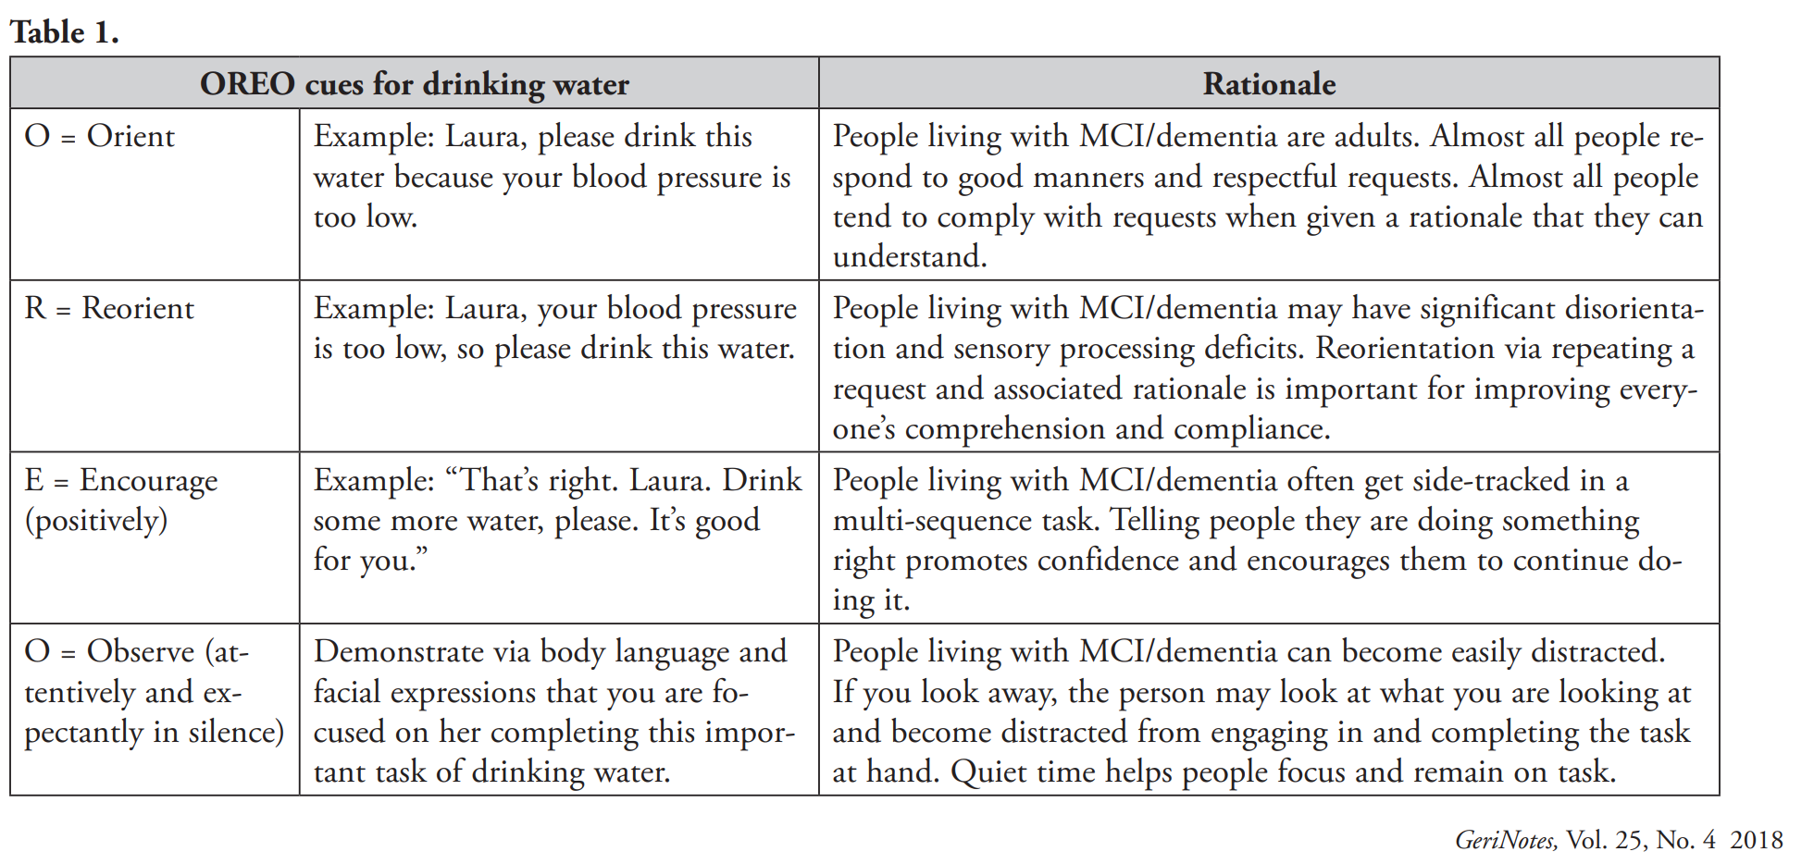
OREO Cues
OREO cues- can be effective cues that are structured to help people living with mild cognitive impairment (MCI)/dementia digest and respond to verbal requests (eg, drink water, stand up, perform an exercise).
ORIENT
REORIENT
ENCOURAGE
OBSERVE

Slide 20
Notes:
I thought that this was a simple graphic to remind us that our verbal and nonverbal communication are both equally important when interacting and building a rapport with patients living with dementia. Often the best communication is less words and more action.

Slide 21
Summary
Notes:
Depression can impact physical therapy treatments and the inpatient population is more susceptible to this syndrome. Delirium is an acute and reversible consequence of another health issue while dementia is irreversible and progressive. Dementia comes in many forms with earlier onset mimicking depression. All three syndromes and their symptoms can co-exist and predispose patients to the others, like having dementia can predispose you to having delirium. It is important as therapists to understand these syndromes we can best tailor our interventions to meet the specific needs of these patients.

Slide 22
Trivia TIME!!!!!!
Prizes included ☺

Slide 23
Fill in the Blank
When an individual experiences the ﬁrst bout of
depression after age 65 years, it may be a precursor to __________.
dementia

Slide 24
With which delirium subtype are older adults more likely to present than younger adults?
A. Hyperactive
B. Hypoactive
C. Mixed
D. There is typically no difference in clinical presentation between younger and older adults

Slide 25
What is the latest stage of Dementia on the Global deterioration scale (GDS) in which patients can still demonstrate carryover of new information?
A. Stage 2 because they are frustrated and mask everything
B. Stage 3 because they get lost frequently
C. Stage 4 because their brain cells have significantly deteriorated
D. Stage 6 because they wander away and have outbursts of frustration
Notes:
Using the Global Deterioration Scale (GDS)

Slide 26
Which of the following clinical features assessed on the Confusion Assessment Method (CAM) would be most helpful in differentiating delirium from dementia?
A. Disorientation
B. Memory impairment
C. Perceptual disturbance
D. Acute onset

Slide 27
The severity of symptoms displayed by patients with dementia depends on which part of the brain is affected. Which part of the brain shows the least effects?
A. Frontal
B. Hippocampus
C. Parietal
D. Temporal

Slide 28
Resources

Slide 31
Resources Cont.
NIMH » Depression. Accessed April 18, 2023. https://www.nimh.nih.gov/health/topics/depression
Recognizing and treating depression in hospital patients. Accessed April 18, 2023. https://www.medstarhealth.org/blog/recognizing-and-treating-depression-in-hospital-patients
Alamri SH, Bari AI, Ali AT. Depression and associated factors in hospitalized elderly: a cross-sectional study in a Saudi teaching hospital. Ann Saudi Med. 2017;37(2):122-129. doi:10.5144/0256-4947.2017.122
Billek-Sawhney B, Wagner A, Braun J. Depression: Implications for the Acute Care Therapist. J Acute Care Phys Ther. 2014;5(2):77-88. doi:10.1097/01.JAT.0000453142.16547.86
Wetzel, PT, DPT, OCS, GCS, Cert. MDT, N. Depression, Dementia, and Delirium. Lecture presented at the University of North Carolina at Chapel Hill, NC. January 14, 2023.
Prina AM, Cosco TD, Dening T, Beekman A, Brayne C, Huisman M. The association between depressive symptoms in the community, non-psychiatric hospital admission and hospital outcomes: a systematic review. J Psychosom Res. 2015;78(1):25-33. doi:10.1016/j.jpsychores.2014.11.002
Thase ME. The multifactorial presentation of depression in acute care. J Clin Psychiatry. 2013;74 Suppl 2:3-8. doi:10.4088/JCP.12084su1c.01
Miu, D. K. Y., Chan, C. W., and Kok, C. (2016) Delirium among elderly patients admitted to a post-acute care facility and 3-months outcome. Geriatrics & Gerontology International, 16: 586– 592. doi: 10.1111/ggi.12521.
Pagad S, Somagutta MR, May V, et al. Delirium in Cardiac Intensive Care Unit. Cureus. 2020;12(8):e10096. Published 2020 Aug 28. doi:10.7759/cureus.10096
White L. Screening for delirium in older adults. Gerinotes. 2014;21(6):9-11.
Stuhler N. Slow and low; my patient has dementia. Gerinotes. 2014;21(6):12-17.
Staples W. Depression and anxiety. Gerinotes. 2018;25(5):22-24.
Fischer MG, Harb J, Josef KL. Delirium prevention, assessment, and treatment by physical therapists. Gerinotes. 2016;23(6):28-33.
Stages of Alzheimer’s. Alzheimer’s Association. https://www.alz.org/alzheimers-dementia/stages. Accessed on May 23, 2019.
Cognitive and Mental Health Special Interest Group Toolkit. APTA Geriatrics. https://aptageriatrics.org/wp-content/uploads/2022/12/CMHSIG-Toolkit-Final-version.pdf. Accessed January 14, 2023.

Slide 32
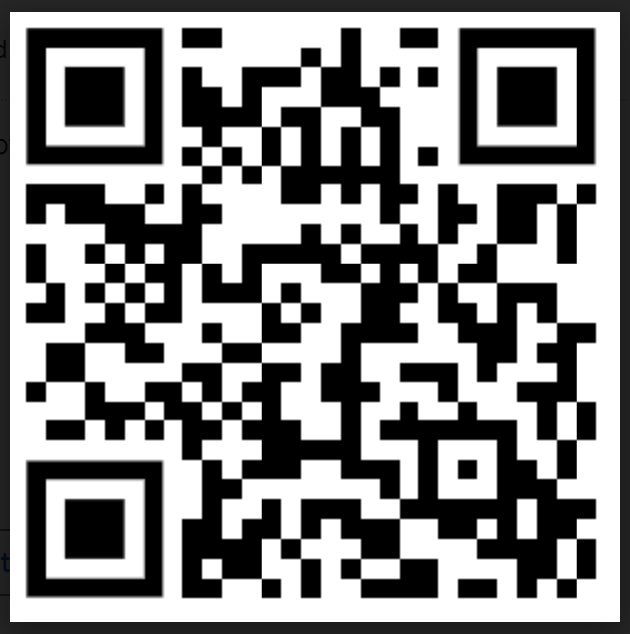
Please provide your feedback:
QR CODE:
Link: https://forms.gle/hSTB38AmTnLLimRo6

