Slide 1
Communication Disorders and Outcome Measurement
PHYT 724
Karolyne Hill

Slide 2
Objectives:
Understand how communication issues can impact patient care and hinder outcome measurement utilization and validity
Consider various factors of communication and how they relate to outcome measure administration
Learn practical strategies to improve verbal and written communication with patients
Practice applying strategies to facilitate effective communication and outcome measurement in clinical situations

Slide 3
Ice Breaker Activity
Grab a partner
Describe to them what you did last night without using the words “the” and “a”
Notes:
“We are going to begin with a brief ice breaker activity. I want you grab a partner and describe to them what you did last night without using the words “the” and “a”.”
Give about 2-3 minutes for students to participate in the actvity.
“That activity was meant to be challenging and introduce you to the experience of individuals with communication disorders. This activity required you to monitor what you were saying while inhibiting using common words. By doing so you were able to experience the mental effort and fatigue that some of our patients experience during simple conversation. Remembering this experience and how taxing communication felt can help you be more patient and understanding when working with patients who have communication disorders.”

Slide 4
Communication Disorders¹
TBI
Stroke
Delirium and Dementia
Neurodevelopmental disorders
Hearing or visually impaired individuals
Neurodegenerative diseases
Notes:
“First I want to reintroduce you to some common commincation disorders that you may encounter in the clinical setting. When thinking about communication disorders it is important to consider impairments of speech, language, cognition, or hearing, as all may contribute to a communication disorder. Communication disorders may be present in individuals with TBI, stroke, delirium and dementia, neurodevelopmental disorder, the hearing or visually impaired, and neurodegenerative diseases. Stroke is a common cuase of speech impairments, like aphasia, dysarthria, and apraxia. Neurodevelopmental disorders like Down Syndome or Autism may also present with a communication impairment. Neurodegeneative diseases, like ALS or Parkinson’s Disease, may impair communication due to motor or cognitive deficits.”

Slide 5
Why is effective communication important?¹⁻⁴
Prompt and correct diagnosis and treatment
Preventing adverse events
Patient autonomy
Rule out cognitive impairment
Patient satisfaction
Notes:
“Any comminucation disorder results in a difficulty of patients being able to relay important information to the healthcare provider and in them being able to understand what the provider is presenting to them. This can lead to pertinent information about the patient’s symptoms and lifestyle not being shared or misunderstood, which can result in delayed or incorrect diagnosis and treatment by the provider.
Therefore, communication disorders can be the cause of preventable adverse events in healthcare. In fact, patients who have communication disorders are almost 2x more likely to experience preventable adverse events than those without a communication problem. Adverse events can range frm paient injury to complication, inappropriate discharge home or inadequate discharge plan, or even cardiac arrest, respiratory failure, and death.
Effective communication is also important for patient autonomy. Communication barriers can prevent these patients from being active participants in their care. By ensuring effective communication between you, the provider, and the patient, you are devilering patient-centered care. This includes not excluding them from consultation and decision making and not relying on others to communicate for them.
Communication disorders often times result in the healthcare provider assuming that there is also cognitive impairment, which is not always the case. This is why the utilization of standardized outcome measures is important in this patient population, as it can help you rule out cognitive impairment and prevent inappropriate treatment of patients.
Lastly, all of these factors can result in a breakdown in the quality of care that patients with communication disorders experience which in turn results in patients being less satisfied with their care.”

Slide 6
Barriers to Outcome Measure Utilization⁵
Outcome measures are widely underused
Clinicians’ concerns about their patients’ ability to complete outcome measures significantly impacted use of an outcome measure
This includes communication disorders
Notes:
“Within the context of this class it is also important to consider how communication disorders may impact the ability to use a standardized outcome measure. Outcome measures are usually created and studied within populations where communication is intact. Therefore, when we try to use them in the clinical setting with patients who have comminucation disorders we may run into barriers with administration or scoring. Therefore, communication disorders contribute to the list of many barriers to utilization of standardized tests and outcome measures.”

Slide 7
Addressing the Issue^{1,4,6,7}
Training medical students and allied health providers in communication disorders
Provide supportive strategies and accommodations so that students are better prepared
These programs have been shown to:
Increase providers’ knowledge about communication disorders
Improve provider attitudes and confidence
Increase communication skills in practice
Notes:
“One method for improving communication access is to better prepare physicians and allied health providers with relevant communication skills. Healthcare curriculums are generally lacking in this type of training so many providers feel unprepared and less confident when working with these patients. Training programs that aim to teach medical students about communication disorders and increase communication skills have been shown to be effective in terms of increasing knowledge, improving provider attitudes and confidence, and increasing the use of supportive communication strategies in practice.”

Slide 8
Factors to consider⁸
Language demands
Attention
Hearing loss
Visual impairment
Medications
Fatigue
Notes:
“When considering communication disorders, it is important to understand the many factors that can contribute to communication deficits. Understanding how these factors might impact communication can help you better address the specific communication needs of these patients. We are going to go through each one and discuss how they influence communication in the healthcare setting.”

Slide 9
Language demands^{8,9}
Words, language, sentence structure ​
Are there unfamiliar words?
Are you using abbreviations or medical terms?
Is the sentence structure complex? ​
Notes:
“First, lets look at how language can influence patient-provider communication, especially oral communication. Language includes the words we use and how we use them. This is especially important in healthcare as health literacy can widely vary from patient to patient. Consider how many unfamiliar words you might be using when explaining a diagnosis or treatment to a patient? Is there abbreviations or medical terms in patient handouts? Lastly, is your sentence structure complex in that it could be misinterpreted? Using clear, concise, and simple language is most appropriate when working with patients who have communication disorders.”

Slide 10
Attention^{8,10,11}
Patients with communication issues may also have impaired attention
How long does the test take?
Are your instructions brief or lengthy?
Are there distractions in the room/clinic?
Notes:
“Next is attention. There are various types of attention, including selective, sustained, divided, and others. When communicating we require sufficient attention in order to attend to the person we are speaking with, interpret what they are saying, and then formulate an appropriate response. Patients with communication disorders may have deficits in attention that impede effective communication. For example, patients with stroke may have deficits in selective and sustained attention which influence their ability to not only communicate but to participate in treatment. When attentional deficits are suspected, it is important to consider the length of your tests and measures and any instructions you give. Also, recognizing when there are distractions in the treatment area and minimizing them to decrease attentional demands can be helpful.”

Slide 11
Hearing loss or visual impairment⁸
Ensure hearing and visual aids are in place prior to initiating assessment or performing an outcome measure
Is there a need for referral?
Notes:
“Next is hearing or visual impairment. Make sure that you are knowledgeable about a patient’s hearing and visual abilities. Check the chart for any indication that there may be hearing loss or visual impairment. If present, make sure you have appropriate hearing or visual aids in place prior to initating communication or beginning assessment. If a hearing or visual impairment is suspected and has not been addressed than it is important that your initiate the appropriate referral so that this can be addressed.This may be especially revelnat when working with individuals who have a brain injury or when working with older adults.”

Slide 12
Medications⁸
Review the patient’s medication list
Notes:
“Make sure you review the patient’s medication list. Consider what medications your patient is taking and how they may have an impact on alertness, attention, fatigue, and ultimately, communication.”

Slide 13
Fatigue⁸
Consider when you are performing the measure
Morning vs. afternoon
How many other providers have performed measures with the patient prior to your session? ​
Can you perform the measure at the start of your session instead of the end?
Notes:
“Lastly, you have to consider fatigue. Fatigue can exacerbate cognitive-communication deficits so consider performing the measure when the patient is rested (if able). This may be especially important when working in a acute setting where a patient’s sleep may be irregular and disturbed. Also, in these settings patients are often receiving multiple therapies so consider how fatigue may be impacting communication and your patient’s participation in treatment.”

Slide 14
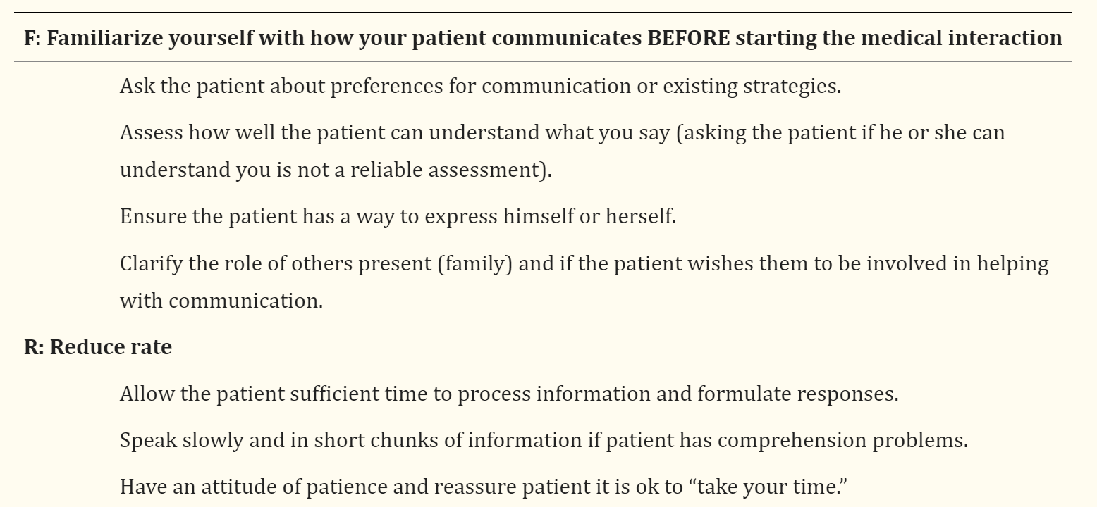
The FRAME mnemonic^{1,4}
Table from Baylor, 2019, Table Adapted from Burns 2012
Notes:
“The FRAME mnemonic is apart of the FRAME training program which was developed to educate medical students on communication disorders and provide recommendations for accommodating communication to fit the needs of these patients. The FRAME program focuses on five key areas of communication accommodations. These include Familiarize, Reduce Rate, Assist patient with communication, Mix communication methods, and Engage patients to respect autonomy. These strategies provide a general framework for effectively communicating with patients who have communication disorders of any type.”
Table from Baylor, 2019, Table Adapted from Burns 2012^{1,4}

Slide 15
The FRAME mnemonic cont. ^{1,4}
Table from Baylor, 2019, Table Adapted from Burns 2012

Slide 16
The FRAME mnemonic cont. ^{1,4}
Table from Baylor, 2019, Table Adapted from Burns 2012

Slide 17
Applying Strategies to Outcome Measurement^{1,4,12}
Allow for increased processing time between command and action
Can do a practice session
Give access to instructions
Print out instructions so patient can read as you speak
Reduce distractions
Ask family members to step out, turn off the TV, etc.
Notes:
“The FRAME strategies can also be applied to performing outcome measures with patients who may have communication difficulties. First, when giving instructions for the test make sure to slow rate and allow for increased processing time between giving a command and allowing the patient to act. Allowing for a practice session can help check comprehension of the instructions and allow for correction of any misunderstandings. Next, providing patients with a written copy of the instructions may assist with comprehension. This may be especially useful for patients with aphasia as they benefit from having a written support. Lastly, reducing distractions can improve the patient’s ability to focus on the task at hand and prevent the patient from becoming overwhelmed.”

Slide 18
Example: 5 Times Sit-to-Stand¹⁵
Instruct the patient:
“I want you to stand up and sit down five times in a row, as quickly as you can, when I say ‘Go’. Be sure to stand up fully and try not to let your back touch the chair back between each repetition. Do not use the back of your legs against the chair.”
Notes:
“So let’s now do an example together applying the strategies we just discussed to the 5x STS. These are the instructions for the 5x STS. Is there anything that you notice about these instructions that you think might be difficult for a patient with communication issues to understand?”
Examples: Complex sentences, lengthy instructions, multi-step instructions, etc.

Slide 19
So what can we do to help?
Verbal instructions:
Shorter pieces
Pausing in between sentences or commands
5 Times Sit-to-Stand Instructions:
Instruct the patient: “I want you to stand up and sit down five times in a row, as quickly as you can, when I say ‘Go’. Be sure to stand up fully and try not to let your back touch the chair back between each repetition. Do not use the back of your legs against the chair.”
Notes:
“So, what can we as the clinician do to make this outcome measure more accommodating to patients with communication disorders? Well first we can break down the instructions to shorter pieces. Using shorter commands with pauses in between for processing can help with comprehension. So, this could look like “I want you to stand up and sit down 5 times in a row”, pause, then continue with shorter pieces until you reach the end of the instructions.”

Slide 20
So what can we do to help?
Simplifying language
“I want you to stand up and sit down five times in a row, as quickly as you can, when I say ‘Go’.
“When I say “Go”, Stand up and sit down five times.”
Notes:
“Simplifying language may also be appropriate for patients with certain communication disorders. The instructions are complex in that they contain lots of details. It may be of benefit to simplify the language used to ensure adequate comprehension of the instructions.”
“Other suggestions may be to provide a written copy of the instructions to the patient, use a demonstration or gestures to supplement the spoken instructions, or allow a practice session.”

Slide 21
Simplifying Instructions Activity
In groups discuss how to conduct the test, and strategies you might use with someone who might have a communication issue.
How would you simplify the instructions?
How could you implement the tips provided?​
Notes:
“Now you all are going to break into groups and practice applying the strategies we discussed to a different outcome measure, the Timed Up and Go. Think about different patients that you have encountered with communication disorders and how you might instruct them to perform the measure. Make sure to practice instructing one of your group members through the measure utilizing the strategies you chose.”

Slide 22
Patient-reported Outcome Measures (PROMs)¹³
Patient-reported measures can be designed to reduce barriers with communication and cognitive impairments
Consider cognitive and communication accessibility
Notes:
“Now we will discuss patient-reported outcome measures, which can be written or administered orally. Cognitive dysfunction is huge barrier to PROM use as cognitive impairments make is difficult to meet the cognitive demands to self-report. Cognition and communication are closely related so therefore, cognitive functioning is important to consider.”

Slide 23
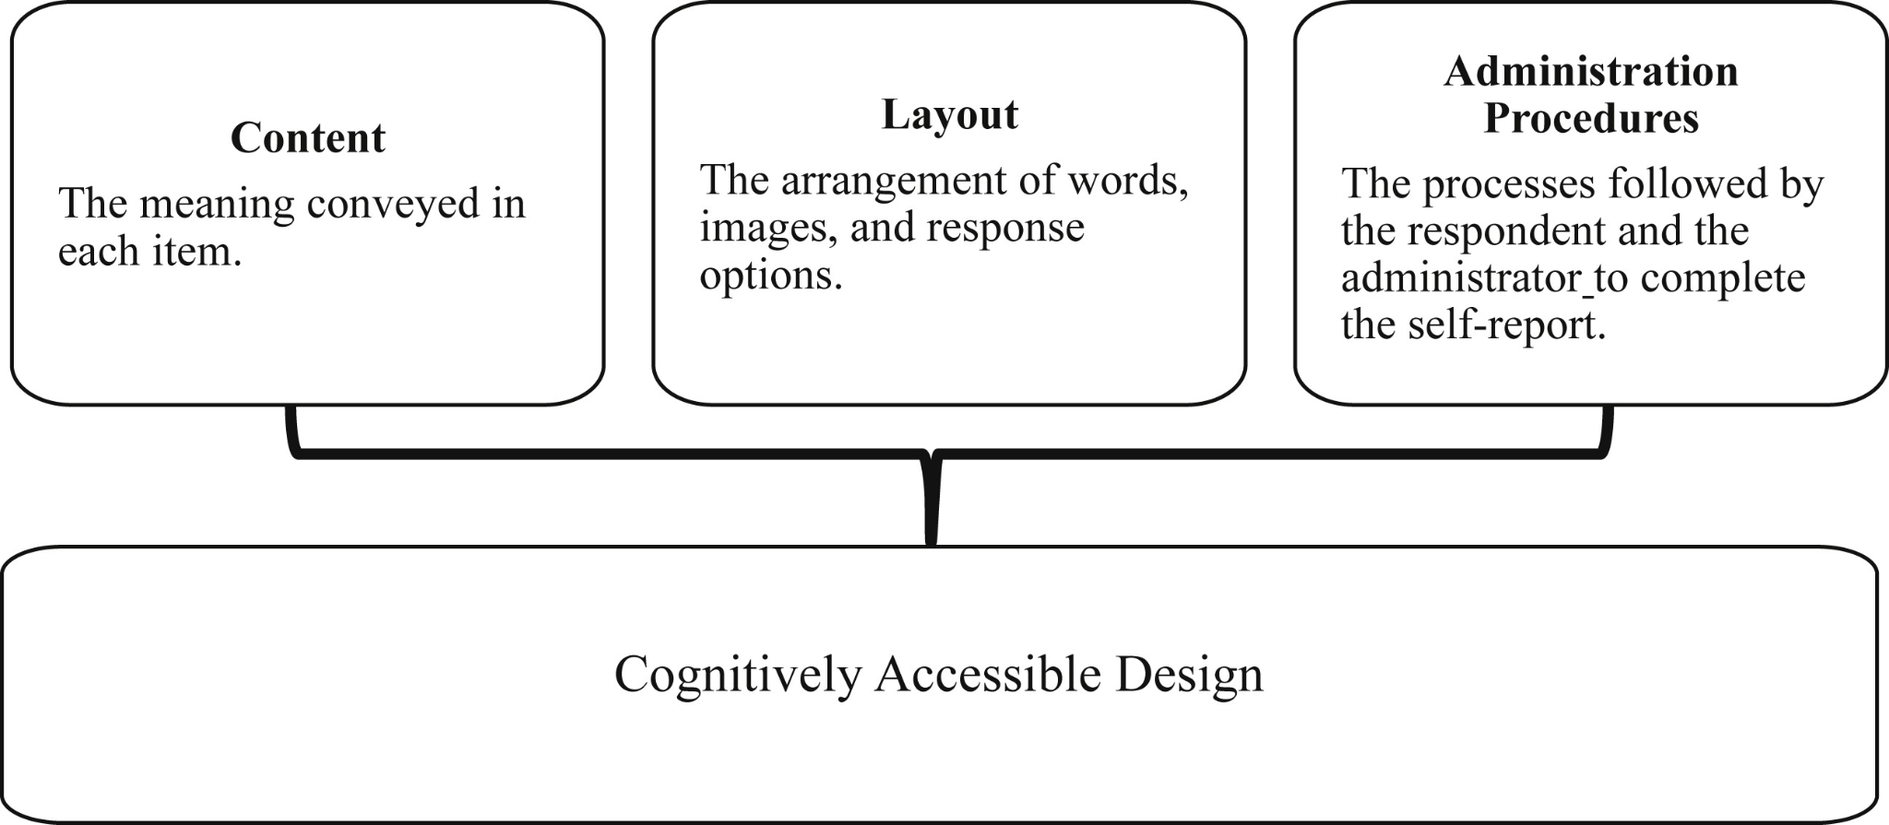
Cognitively Accessible Design¹³
Notes:
“There are three factors that go into making sure a material is cognitively accessible, there are content, layout, and administration technqiue. Content includes making sure the context is specific, currency is defined, sentence structure and wording is simple and unfamiliar words are defined.
The layout includes:
Color, size of the font, legibility, length of the text, punctuation, white space, use of images, etc.
Administration procedures:
How the measure is read- electronic read-aloud, administrator read, braille
How the items are responded to - dictate, write, technology
Time restrictions and pacing
Teaching and paraphrasing or extended definitions
Encouragement and validation
We as therapists cannot control content of the measures we choose. However, we may be able to control layout or how we administer outcome measures.”

Slide 24
Layout Recommendations¹²⁻¹⁴
Legible font - Arial or Calibri
Large font size - 14pt or larger
Simple sentences and punctuation
Left text justification
Decrease length of text
Order is logical
Increased white space
Selection of appropriate images
Notes:
“When providing a written PROM or any patient education material these are some layout recommendations that should be used when your patient has a communication or cognitive disorder.”

Slide 25
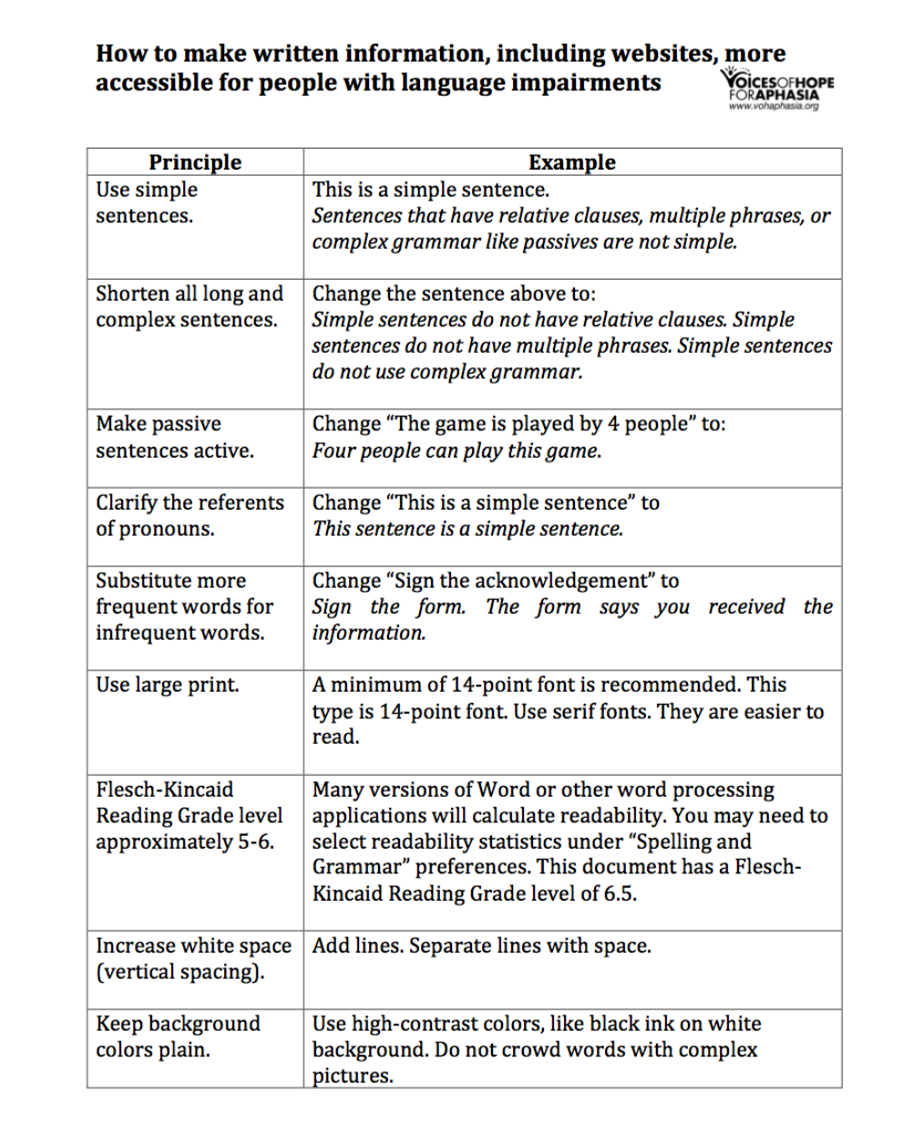
Aphasia friendly documents¹⁴
Notes:
“These are some specific recommendations for making written information more accessible to people with aphasia. This document also gives examples which can be hlepful to reference when trying to modify an outcome measure.”
Accessed from: https://www.vohaphasia.org/make-written-material-aphasia-friendly-guide/

Slide 26
Other resources:
https://www.med.unc.edu/healthsciences/sphs/card/resources/aphasia-friendly-printed-material/
Aphasia-friendly documents created by UNC graduate students in the Division of Speech and Hearing Science
https://acrm.org/resources/professional/aphasia-and-related-disorders/aphasia-friendly-clinical-resources/
Accessible guidelines for people with aphasia by the American Congress of Rehabilitation Medicine
Notes:
“These are some other resources on making aphasia-friendly documents for patient use.”

Slide 27
Administration^{12,13}
Be flexible!
Read the items aloud and provide written questions simultaneously
Provide practice items to ensure comprehension
Repeat or explain items
Include multiple methods of responding
Handwritten, computer-based, verbal, signs
Encourage and validate
Self-paced
Explain how responses will be used
Notes:
“When it comes to administering patient-reported outcome meaures, the needs of each patient are so unique so administration of the measure may vary from patient to patient. Make sure to account for the needs and preferences of your patient and try to reduce the cognitive and communication demands on the patient. This can look like reading items aloud, repeating items, including multiple methods of responding, and allowing more time for the patient to complete the measure.”
Kramer JM, Schwartz A. Reducing Barriers to Patient-Reported Outcome Measures for People With Cognitive Impairments. Arch Phys Med Rehabil. 2017;98(8):1705-1715. doi:10.1016/j.apmr.2017.03.011
Tucker FM, Edwards DF, Mathews LK, Baum CM, Connor LT. Modifying health outcome measures for people with aphasia. Am J Occup Ther. 2012;66(1):42-50. doi:10.5014/ajot.2012.001255

Slide 28
Think-Pair-Share
Grab a copy of the Stroke Impact Scale
Use any of the layout recommendations mentioned above to make the document more “aphasia friendly”
Then pair up with a partner and share your ideas!

Slide 29
Final Word
Understand that outcome measures are tools used to provide objective information about the patient
What does this tell you about their current needs and how can your tailor your interventions to meet these needs?
You may have to utilize an outside party to gather information for an outcome measure
Caregiver, spouse, family member, other healthcare professional
Notes:
“Overall, don’t forget the main purpose for administering an outcome measure is to gather information. If modifications are needed for the patient (such as repetition of instructions, or increased time for processing), then this is additional objective information that you can use in your assessment and subsequent intervention. What does this tell you about their current needs and how can your tailor your interventions to meet these needs? Just make sure you document any modifications you made as this ensures preservation of both intra-rater and inter-rater reliability and the validity of the measure.”

Slide 30
References:
Baylor C, Burns M, McDonough K, Mach H, Yorkston K. Teaching Medical Students Skills for Effective Communication With Patients Who Have Communication Disorders. Am J Speech Lang Pathol. 2019;28(1):155-164. doi:10.1044/2018_AJSLP-18-0130
Bartlett G, Blais R, Tamblyn R, Clermont RJ, MacGibbon B. Impact of patient communication problems on the risk of preventable adverse events in acute care settings. CMAJ. 2008;178(12):1555-1562. doi:10.1503/cmaj.070690
Hoffman J., Yorkston K. M., Shumway-Cook A., Ciol M. A., Dudgeon B. J., & Chan L. (2005). Effect of communication disability on satisfaction with health care: A survey of medicare beneficiaries. American Journal of Speech-Language Pathology, 14, 221–228.
Burns M., Baylor C., Dudgeon B. J., Starks H., & Yorkston K. (2015). Asking the stakeholders: Perspectives of individuals with aphasia, their family caregivers, and physicians regarding communication during medical interactions. American Journal of Speech-Language Pathology, 24, 341–357.
McDonnell B, Stillwell S, Hart S, Davis RB. Breaking Down Barriers to the Utilization of Standardized Tests and Outcome Measures in Acute Care Physical Therapist Practice: An Observational Longitudinal Study. Phys Ther. 2018;98(6):528-538. doi:10.1093/ptj/pzy032
Burns M., Baylor C., Morris M., McNalley T., & Yorkston K. M. (2012). Training healthcare providers in patient–provider communication: What medical education and speech-language pathology can learn from one another. Aphasiology, 26(5), 673–688.
Forsgren E, Hartelius L, Saldert C. Improving medical students' knowledge and skill in communicating with people with acquired communication disorders. Int J Speech Lang Pathol. 2017;19(6):541-550. doi:10.1080/17549507.2016.1216602
Byom L. Cognitive Communication Disorders. Published online October 26, 2023.

Slide 31
References cont.
Nouri SS, Rudd RE. Health literacy in the "oral exchange": an important element of patient-provider communication. Patient Educ Couns. 2015;98(5):565-571. doi:10.1016/j.pec.2014.12.002
Spaccavento S, Marinelli CV, Nardulli R, et al. Attention Deficits in Stroke Patients: The Role of Lesion Characteristics, Time from Stroke, and Concomitant Neuropsychological Deficits. Behav Neurol. 2019;2019:7835710. Published 2019 May 23. doi:10.1155/2019/7835710​
Varkanitsa M, Godecke E, Kiran S. How Much Attention Do We Pay to Attention Deficits in Poststroke Aphasia?. Stroke. 2023;54(1):55-66. doi:10.1161/STROKEAHA.122.037936
Tucker FM, Edwards DF, Mathews LK, Baum CM, Connor LT. Modifying health outcome measures for people with aphasia. Am J Occup Ther. 2012;66(1):42-50. doi:10.5014/ajot.2012.001255
Kramer JM, Schwartz A. Reducing Barriers to Patient-Reported Outcome Measures for People With Cognitive Impairments. Arch Phys Med Rehabil. 2017;98(8):1705-1715. doi:10.1016/j.apmr.2017.03.011
Yones D. How to make written material aphasia-friendly: A guide. Voices of Hope for Aphasia. Published August 27, 2017. Accessed November 16, 2023. https://www.vohaphasia.org/make-written-material-aphasia-friendly-guide/
Shirley Ryan AbilityLab. Five Times Sit to Stand Test. Shirley Ryan AbilityLab - Formerly RIC. Published June 20, 2013. https://www.sralab.org/rehabilitation-measures/five-times-sit-stand-test

