Slide 1
Evaluation/Intervention for Common Conditions of the Foot and Ankle
By: Conner heermann

Slide 2
Objectives
Review pertinent anatomy and biomechanics of the foot/ankle.
Consider implications of foot/ankle anatomy on structures up the kinetic chain.
Review biomechanics of the foot/ankle during gait.
Define and discuss “drivers” of musculoskeletal pathology at the foot/ankle.
Consider evaluation strategies of the foot and ankle.
Review important components of the lower quarter screen.
Develop a framework for understanding the “optimal foot” and the role of footwear and orthoses in achieving it.
Discuss anatomical/biomechanical features, clinical presentation, potential drivers, and PT intervention for 5 common pathologies of the foot/ankle: plantar fasciitis, midfoot OA, hallux rigidus, ankle mortise OA, and insertional/mid-substance Achilles tendinopathy.

Slide 3
Introduction

Slide 4
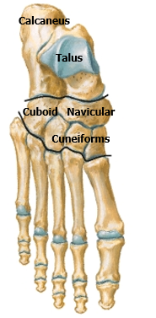
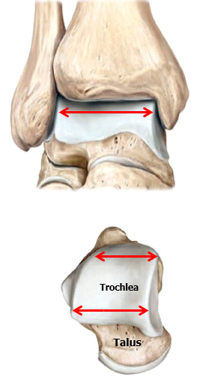
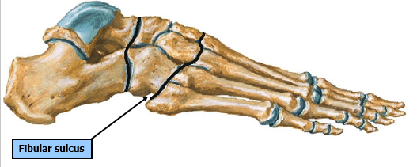
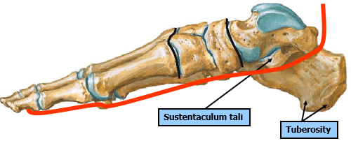
Anatomy of the Foot and Ankle
Notes:
- Talocrural joint is the most congruent join in the body

Slide 5
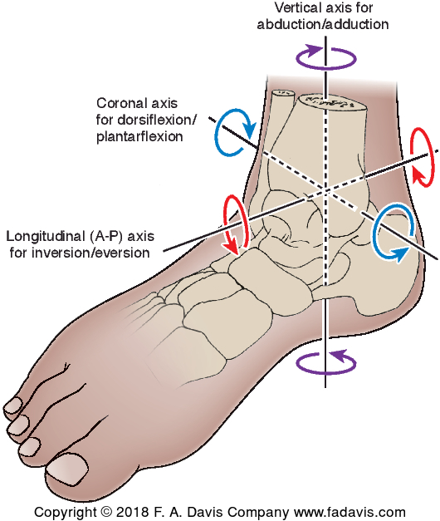
Foot/Ankle Biomechanics
Triplanar Motion: pronation and supination have an oblique axis that incorporates movement elements in multiple planes from multiple joints
Pronation – eversion, abduction, dorsiflexion
Supination – inversion, adduction, plantar flexion
Each joint in the foot and ankle is designed to do business in one or more of these 3 planes. When they all work together properly, the foot and ankle unit is a structural miracle for stability with propulsion, shock absorption, and mobile adaptation to environmental challenges. When one or more joints aren’t pulling their weight and compensatory measures are either exhausted or unavailable, problems arise.
Talocrural – PF/DF
Subtalar – 1) INV/EV, 2) ABD/ADD, 3) PF/DF
Transverse Tarsal – 1) INV/EV, 2) ABD/ADD, 3) PF/DF
Midfoot – should not move; keystone wedging with truss support to achieve rigid foot
Dr. Mike Lewek, Biomechanics, Foot and Ankle, Dr. Mike Gross, MSK II, Foot and Ankle

Slide 6
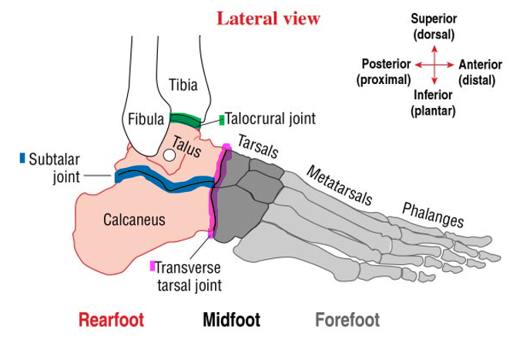
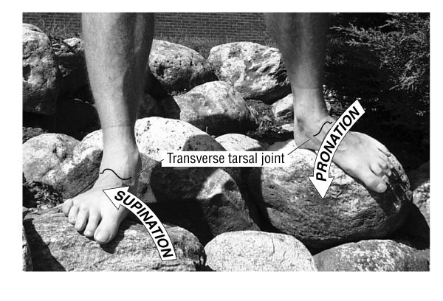
Dr. Mike Lewek, Biomechanics, Foot and Ankle
Notes:
Transverse tarsal joint allows for adaption to uneven surfaces

Slide 7
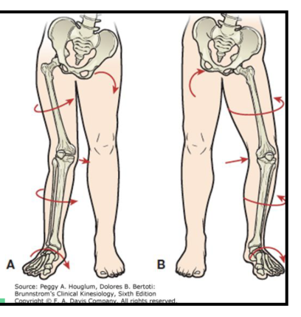
Considerations Up the Chain…
Just as anatomical deviations in pelvic, hip, knee, or long bone structure can drive foot/ankle structure and pathology, foot/ankle anatomy and biomechanics can drive structural anatomy and pathology up the kinetic chain – Sub-Talar joint neutral considered “optimal”
Pronated foot in the closed chain MAY drive one or more of the following:
  Calcaneal eversion
  Adduction and PF of the talus
  Medial rotation of the talus
  Medial rotation of the tibia/fibula
  Valgus at the knee
  Medial rotation of the femur
  Anterior tilting of the pelvis
Supinated foot in the closed chain MAY drive one or more of the following:
  Calcaneal inversion
  Abduction and dorsiflexion of the talus
  Lateral rotation of the talus
  Lateral rotation of the tibia and fibula
  Varus at the knee
  Lateral rotation of the femur
  Posterior tilting of the pelvis
Brainstorm: what are implications for pathology with alteration of position of bony anatomy?

Slide 8
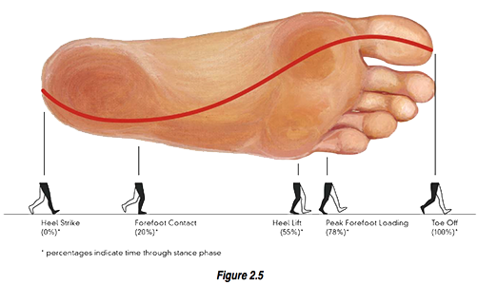
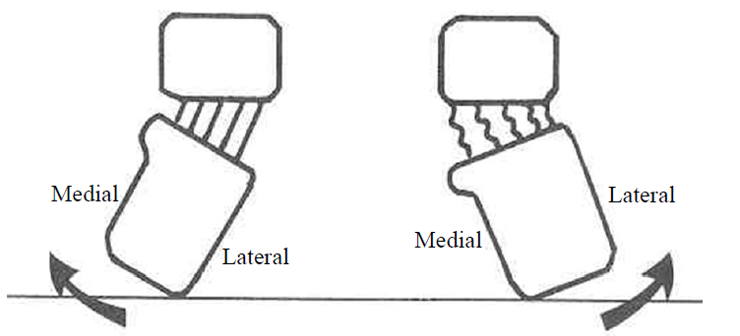
Foot/Ankle Biomechanics During “Normal” Gait
Landing
The subtalar joint should be in slight inversion (“locked”) as it makes contact with the ground
Subsequent pronation “unlocks” mobility around the midfoot for shock absorption
Contributors to shock absorption during landing which increase ΔT for attenuation of GRF:
  Hip/knee flexion, ankle plantar flexion, subtalar joint pronation, calcaneal fat pad deformation, deformation of other soft tissues, footwear
Push-Off
From midstance to push-off, subtalar joint supination “re-locks” mobility around midfoot to create a rigid lever for push-off - GRF typically shifts from lateral rearfoot to medial forefoot through stance phase
STJ Supination
Talus
Talus
STJ Pronation
Interosseus
Ligaments
Calcaneus
Calcaneus
Notes:
Problems occur when:
Not enough pronation
Too much pronation
Pronation occurs too early
Pronation occurs too late
Pronation occurs too long

Slide 9


Personal Related Drivers
Equipment Related Drivers
Anatomical Drivers
Biomechanical Drivers
Activity/Training Related Drivers
Drivers of Musculoskeletal Pathology
Environmental Drivers

Slide 10
Anatomical Drivers
Static positions of joints at rest which MAY predispose tissues to excess stress/strain
Bony Anatomy – leg length discrepancy, tibial varum, femoral torsion
Hip Structure – anteversion/retroversion, coxa varum/coxa valgum, leg length discrepancy
Knee Structure – genu valgus, genu varus, genu recurvatum,
Ankle/Foot Structure – pes planus, pes cavus, rearfoot varus/valgus, forefoot varus/valgus, foot equinus, hallux valgus, hallux rigidus, hammer toes, turf toe
So, if I find one or more of these on an exam, it’s a problem right?
It depends…
“Normal” or “optimal” foot anatomy is a spectrum
If it ain’t broke, don’t fix it; the optimal foot is the foot that does what you want it to without excessive or endurant pain
Normally only a problem if compensations are exhausted or unavailable
After skeletal maturity, we can’t change bone structure, but we can attenuate and alter forces around joints to relieve excess stress/strain in ornery musculoskeletal tissues

Slide 11
Biomechanical Drivers
Mechanical constraints or mechanical behavior of musculoskeletal tissues under dynamic or loaded circumstances
ROM constraints – inadequate ROM to manage internal and external forces, constraints, and conditions
Muscular strength – inadequate muscle shielding of passive joint structures
Ligamentous laxity – excess joint play or overly rigid joint/joint capsule
Neurological Input – speed of neurological input to muscle providing shielding
Mechanics – movement patterns, body mechanics, gait patterns, running mechanics, jumping/landing mechanics, etc.

Slide 12
Activity/Training Related Drivers
The intensity, frequency, duration, and/or mode of performed activities that may or may not place soft tissues at a disadvantage to manage forces imposed
Training Errors:
Intensity – too heavy or too intense too soon?
Frequency – too often too soon?
Duration – too long too soon?
Mode – what are the anatomical/biomechanical demands of a potentially offensive activity?
Thoughts:
A) Are the bodies tissues fit to handle the demands of a regular or desired activity?
B) If not, consider rest (4 wks), manage drivers of pathology, and gradually progress training to return to activity
C) Alter activity/training parameters to find “Goldilocks Zone”
Notes:
Type – what is the position of the body during the activity (static or dynamic), what types of movements are involved? Bending, lifting, twisting, pivoting? How do these movements affect bony anatomy and biomechanical factors
Goldilocks zone – enough of a stimulus to drive tissue adaptation without causing tissue damage – just the right amount

Slide 13
Environmental Drivers
Environmental conditions which alter active/passive force attenuation
With foot and ankle, we are thinking primarily of activity/training surfaces…
Surface type – hard, soft, springy
Surface grade – hilly terrain, road pitch, flat grade
Surface variability – even or uneven; track running vs trail running
Consider how each of these conditions:
a) Might “ask” more of anatomical/biomechanical structures
b) Might challenge or aid shock absorption (attenuation of GRF)

Slide 14
Personal Related Drivers
Characteristics relating to a persons physical/mental health and accompanying comorbidities or medical history
Physical health – BMI/weight status, hydration, nutrition
Mental health – anxiety/depression
Comorbidities – diabetes, neurological impairment, etc.
Medical history – Hx of illness, injury, traumatic injury, surgical history, etc.
Consider how personal factors relating to physical health, mental health, and medical Hx affect soft tissue structures…

Slide 15
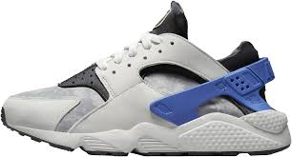
Equipment Related Drivers
Any external device fixed to the body affecting joint position and/or attenuation of static/dynamic forces imposed on musculoskeletal structures
At the foot/ankle, we’re thinking primarily of…
Footwear – does the shoe alleviate, aggravate, or do nothing to deal with identified drivers?
Orthoses – inserts, AFO, etc.
Bracing – ankle brace
Equipment is typically used for protection, stability, and/or function…

Slide 16
Evaluation of the Foot and Ankle

Slide 17
Strategy for Evaluation
1) Gather a subjective historical timeline of the patients CC
2) Pinpoint the EXACT location of pathology – establish differential
3) Investigate subjective behavior of the pathology
  24 hr cycle, intensity, irritability, pain descriptor, aggs, eases, medical management?, etc.
4) Investigate “drivers”
  Anatomical, biomechanical, activity/training related, environmental, equipment related, personal related
5) Use objective exam components to gather more information related to drivers
6) Synthesize findings to establish a working hypothesis – communicate this to the patient
7) Address drivers with initial interventions
  Education (activity modification), manual, modalities, orthotics, footwear recommendations, therapeutic exercise, referral, etc.

Slide 18
Evaluation Template for Foot/Ankle
Subjective Interview – doesn’t end when the objective exam starts!
Palpation
Investigate Shoe Wear – wear patterns, subjective comfort/pain, shoe characteristics
Observation – appearance, alignment, posture
Lower Quarter Screen
Gait Analysis
ROM/Muscle Testing
Additional Objective/Special Tests
Synthesis – use subjective/objective information to assemble a “story” that the patient will understand – use models and/or images to facilitate learning
  What is the problem?
  What is driving the problem?
  How can PT manage drivers contributing to the problem?

Slide 19
Subjective Interview
Important Topics to Cover:
Gather a thorough history of the problem – when did it start, what has/hasn’t worked?
Investigate daily activity – work, leisure, sport, sleep, etc.
  If you don’t know, ask!
Ask about changes in activity or training parameters: frequency, intensity, and volume
Ask about footwear – which feel good, which don’t, which do they wear at work, do they ever walk barefoot, any problems with barefoot walking?
When applicable ask about home and/or training environment – ex: running on asphalt or trails? Stairs in home?
Always assess goals – this will guide and prioritize interventions and can help narrow the scope of PT POC in patients with lots of issues/comorbidities; what is most important to the patient?
Be a Dynamic Interviewer!
Notes:
**in addition to normal subjective components of the exam

Slide 20
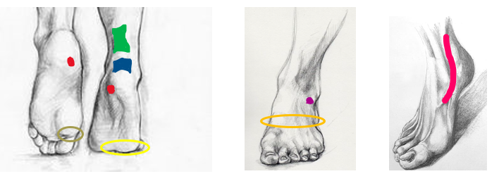
Palpation – What “lives” there?
Match the condition to the color: A) Plantar fasciitis, B) mid-substance/insertional Achilles tendinopathy, C) lateral metatarsalgia, D) midfoot OA, E) hallux rigidus, F) anterolateral ankle mortise OA, G) tibialis posterior tendinopathy
Notes:
**check for TTP; sometimes need to place the tissue in question in stretched position then palpate to elicit CC
Red – plantar fasciitis
Blue – Insertional Achilles Tendinopathy
Green – Mid-Substance Achilles Tendinopathy
Yellow – Lateral Metatarsalgia
Orange – Midfoot OA
Purple – Ankle Mortise OA
Sage – Hallux Rigidus
Pink – Tibialis Posterior Tendinopathy

Slide 21
Lower Quarter Screen
Seated
Equinus foot
Patellofemoral position (patella alta/baja)
Prone
Forefoot-rearfoot alignment (varus/valgus)
Triceps surae extensibility
Rearfoot motion (inversion/eversion)
Craig’s Test (anteversion/retroversion)
Supine/Side-Lying
Thomas Test (quadriceps flexibility)
Obers Test (ITB extensibility)
Patellar mobility (glides)
Standing
Navicular drop
Medial talonavicular bulge
Arch height in WB
Sagittal alignment of the legs (genu recurvatum)
Frontal alignment of the legs (genu varus/valgus)
Frontal orientation of the patellae
Limb length inequality
Gait (foot/ankle, knee, hip)
Dr. Mike Gross, MSK II, Lower Quarter Screen
Notes:
**not an all inclusive list but a core set

Slide 22
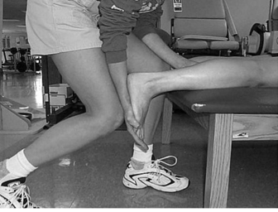
ROM Considerations
Assessment:
Triceps surae extensibility
Soleus extensibility (bent knee)
PROM/AROM/Resisted Motion – end feel, pain with active/resisted motion, pain with passive stretch/overpressure
Considerations:
Muscular or capsular limitation or both? – assess joint play at the talocrural joint
10 degrees dorsiflexion required for terminal stance with extended knee during gait just prior to heel off
Dorsiflexion ROM “debt” at the talocrural joint is “paid” by excess motion in other joints of the foot (midfoot) or by compensatory patterns up the kinetic chain
  Gait deviations (ex: reduced step length)
  Mobility: stairs, squat, sit to stand, lunge, etc. (ex: forward trunk lean)
Dr. Mike Gross, MSK II, Lower Quarter Screen

Slide 23
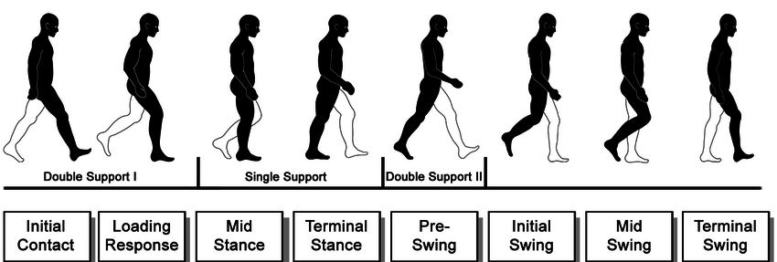
Gait Analysis
Use stages of gait to help identify pathology and plan interventions… does stage of gait elicit the patients CC?
Break it down for the patient before they walk… “You have 4 options; at what point do you feel your pain while walking, when…” (demonstrate)
The heel hits the ground (Initial Contact)
You stand directly over your foot (Mid-Stance)
Right before the heel comes off the ground (Terminal Stance)
As you push off your toes to step forward (Pre-Swing)
If possible, assess gait with shoes on AND shoes off…
Notes:
**what does each phase “ask” of a particular area of the foot – what forces is that area experiencing in each phase? Compressive, tensile, concentric/eccentric loading?

Slide 24

Be a Shoe Detective
If you are seeing someone for a foot/ankle issue, ask them to bring the 4 pairs of shoes they wear most often…
Determine:
Which shoes feel good, if any? Which do not? Did they change shoes recently? Did the change coincide with onset of CC?
Look for wear patterns (insole, outsole, heel counter) – offers clues for behavior of foot in shoe
Look for areas of deformation of the shoe – bulging heel counter, abrsions
Remove and assess inserts – based on drivers for pathology, are they helping, hurting, or neither?
Look at shoe characteristics – heel lift, heel counter, toe break, sole width, toe box etc.
  Are these characteristic right for THIS foot?
  Know how each of these shoe characteristics affect biomechanics of the foot and ankle
  What are the characteristics of the pair of shoes that feel the best to the patient? The worst?

Slide 25
Common Exam Findings and Management of Common Foot/Ankle Pathology

Slide 26
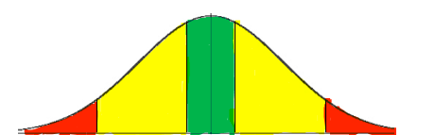
The “Optimal” Foot
Subtalar joint neutral, right? It depends…
Idealist Perspective – yes; a neutral rearfoot with a perfectly aligned/balanced foot structure in absence of any kind of motion restrictions, strength limitations, or instabilities creates optimal bony contact for handling internal/external loads
Realist Perspective – it doesn’t have to be; the optimal foot is the foot that allows you do what you want it to, when you want it to, for as long as you want it to without excessive pain or injury
Optimal feet are somewhere between two extremes:
Overly “flimsy” foot (pes planus) = too much pronation/deformation of soft tissues → structural collapse of bony anatomy → injury to soft tissue structures in the foot + arthritic changes in foot or up the chain due to malignment/structural collapse
Overly “rigid” foot (pes cavus) = not enough pronation to give for shock absorption → decreased potential for shock absorption in foot/ankle → increased stress fractures + arthritic changes + compartment syndromes up the chain due to reduced potential to attenuate forces in the foot/ankle
**Both extremes can be moved towards the green by managing drivers through activity modification, external support, and/or tissue adaptation – after 11-12 yo, you aren’t going to modify bony anatomy with your interventions, so how can you work with what the patient has to move them toward the green?
Notes:
you’ll notice that either end of the spectrum (too rigid or too floppy) can cause drive similar pathology; too simplistic to compartmentalize pathologies to rigid foot vs floppy foot but some variation in presentation and risk dependending on drivers
Someone in the Red is going to need all the help they can get; someone in the yellow

Slide 27
A word on foot orthoses…
“In all instances, orthotics can be thought of as either potentially load sharing, corrective, or accommodative.”
Orthotic: adjective describing a device used to correct an orthopedic problem (orthotic device)
Orthosis: noun describing a single externally applied device used to influence characteristics of orthopedic structures
Orthoses: plural form of the noun orthosis
“But orthoses are a crutch, right?”
Yes; but consider the alternative… what is the patients goal?
“Yes, but if I give them a crutch, won’t they always have to rely on that?”
It depends; orthoses offer support that relieves drivers of tissue stress – time frame for use of orthoses depends on the patient in front of you…
Notes:
Consideration for orthotic intervention: condition, severity, patients' goals, other drivers or pathology
May affect intrinsic strength, but how much does this effect function?
Use in conjuncture with other treatments

Slide 28
Orthoses continued…
How to use orthoses:
Should always be custom to the anatomical/biomechanical characteristics of the patient – there is no one-size-fits all approach
Complete lower quarter exam to determine what kind of support may help to relieve tissue stress
Trial orthoses in clinic in best pair of shoes for that patient – expect to make modifications
Orthoses DO NOT “wear-in” – if they don’t feel right to the patient in clinic, this will not improve; strive for complete relief
Allow tissues time to heal with orthotic use; use other interventions to address drivers
Follow up with the patient (2 wks)

Slide 29
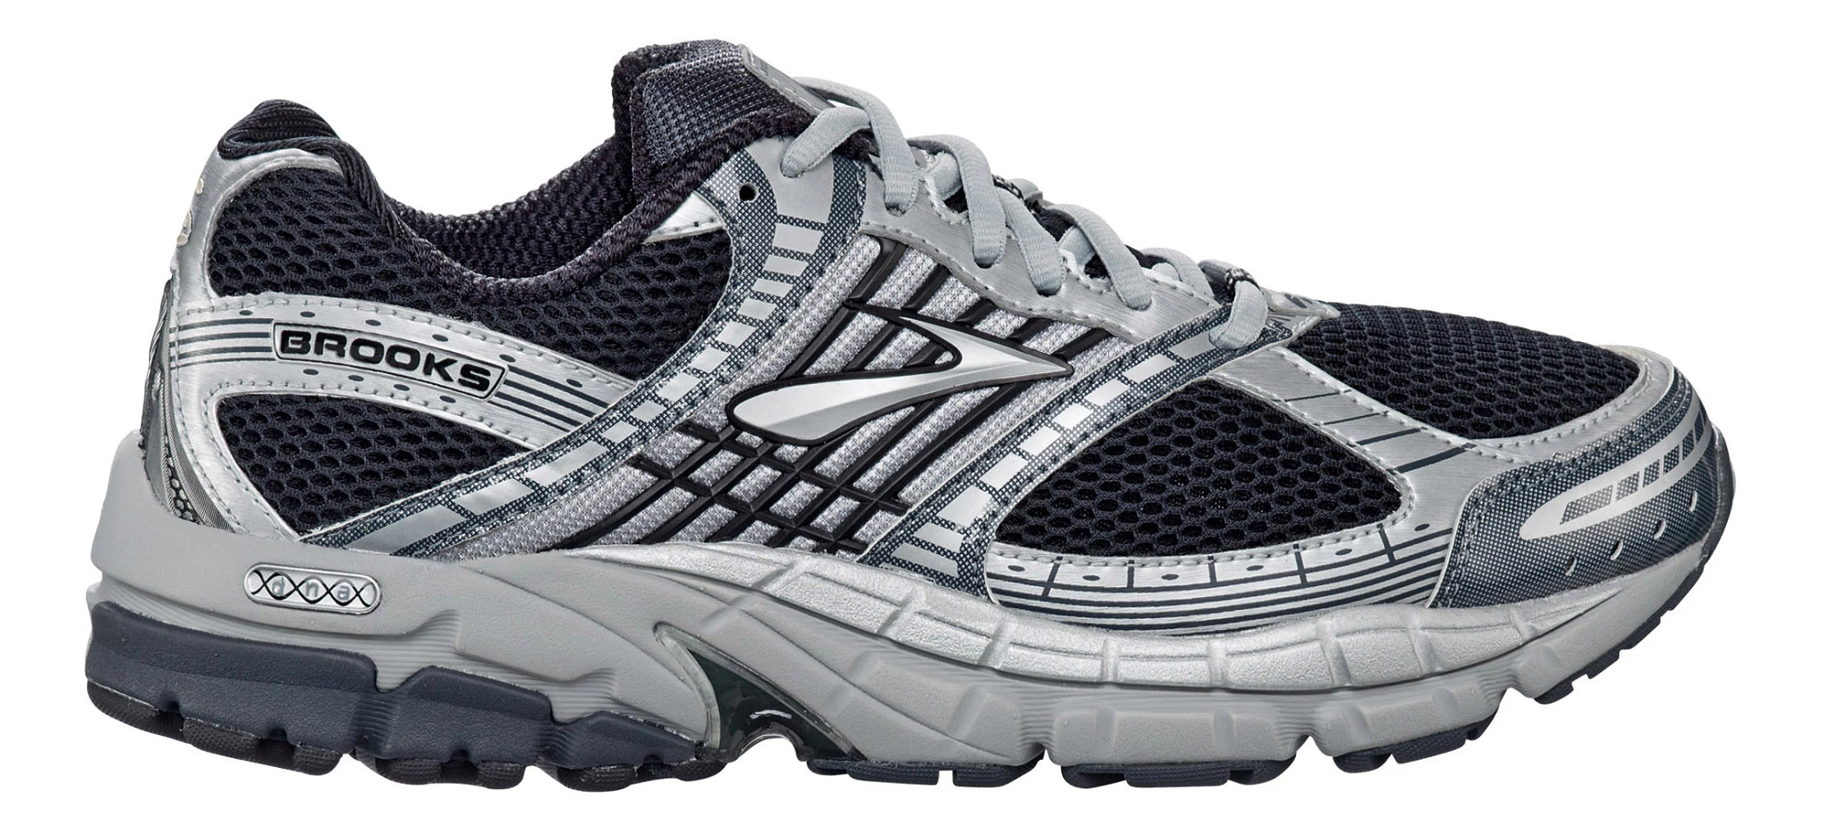
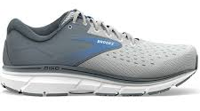
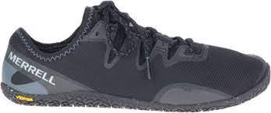
A word on footwear…
Think of footwear on a continuum from “concrete” to neutral to “marshmallow”
Most people best off somewhere between the two extremes
Too simplistic to say that “concrete” shoe is best for everyone with flat feet that pronates – how do the characteristics of the shoe “get along” with anatomical/biomechanical characteristics of the patient?
Ask yourself what does this patient need in terms of protection/support from a shoe to accomplish the desired activity?
Best shoe is often the one that feels best to the patient
Do not disregard footwear; not always the culprit but can very often present as a contributing driver for foot/ankle pathology
Notes:
- too simplistic to say a very supportive shoe is good for everyone with flat feet or pronated
- what shoe feels good to the patient
- how does shoe get along with all the other players in the room?

Slide 30
Plantar Fasciitis (PF)

Slide 31
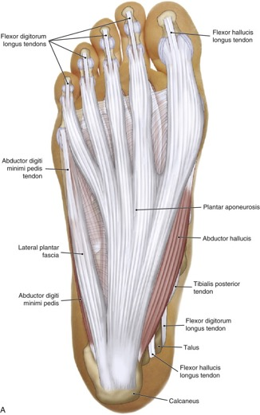
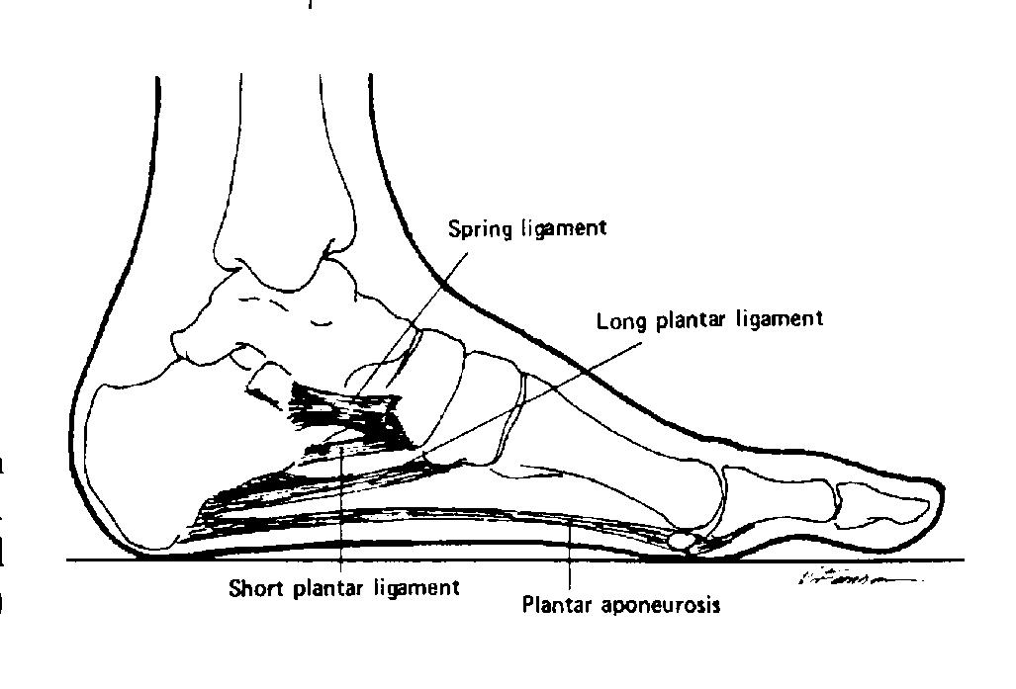
Anatomy and Biomechanics
Medial Longitudinal Arch Support:
Plantar aponeurosis
Posterior tibialis tendon
Spring ligament
Short and long plantar ligament
Some support from flexor intrinsics
Characteristics:
Originates on calcaneus and inserts onto proximal phalanges
Medial bands of aponeurosis are thickest and under most stress d/t concentration of forces from medial forefoot during concentric propulsion and eccentric shock absorption; also highest part of the arch
Composed of Type 1 Collagen Fiber
Babu et al and Dr. Mike Lewek, Biomechanics, Foot and Ankle
Notes:
Windlass mechanism of plantar aponeurosis
Posterior tib inserts on the inferolateral surface of the navicular tuberosity – weakness drives pronation

Slide 32
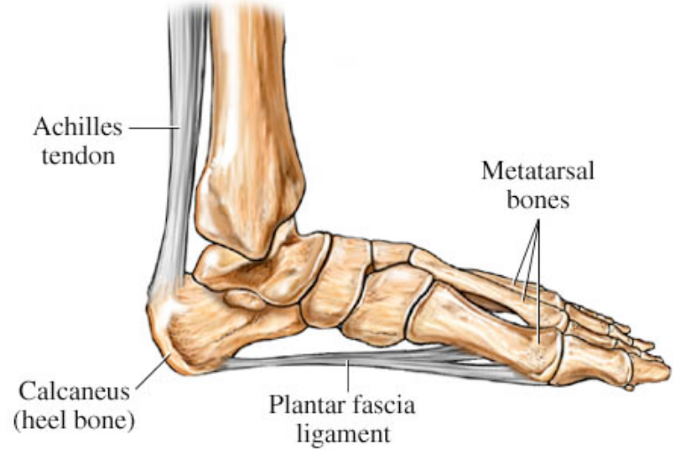
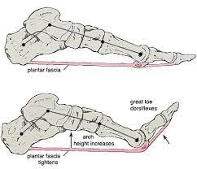
Biomechanical Function of the Plantar Fascia:
Elevates medial longitudinal arch, stabilizing the midfoot and increasing overall rigidity of the foot
Regulates ankle movement
Distributes forces evenly across the foot in response to loading
Stores mechanical energy during shock absorption for increased force output during propulsion
Influence of Triceps Surae:
Triceps surae pull superiorly on the calcaneus, increasing tensile load on the plantar fascia – when tight, exerting this load all day long
Windlass Mechanism:
Elevation of the medial longitudinal arch occurring with increased tension in the plantar aponeurosis from dorsiflexion that occurs around the metatarsal heads during the propulsion stage of gait
Increases rigidity of the foot for propulsion of the body during gait, running, jumping, etc.
Dr. Mike Gross, MSK II, Foot and Ankle and Dr. Mike Lewek, Biomechanics, Foot and Ankle

Slide 33
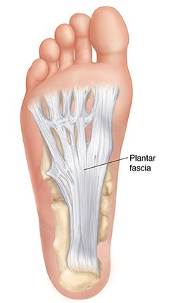
Tissues Affected…
The plantar fascia is essentially a large ligament composed primarily of water and Type 1 collagen fiber with some elastin to allow for some deformation
Primary functions of ligaments:
Joint stability with tension
Protection of other joint structures
Force attenuation with deformation
Protective reflexes and position sense
Problems arise when the plantar fascia is exposed to excess stress/strain causing microtears to vulnerable areas of the tissue
The plantar aponeurosis originates on the medial calcaneal tubercle then fans out and attaches to met-heads and proximal phalanges of all 5 rays; concentration of forces just distal to the medial calcaneal tubercle - consequently, this is the most common site of pain
Mike Gross, Advanced Ortho, Ligaments
Notes:
Clinical Pearl: this site will typically be TTP, though is less severe case, may only be TTP with dorsiflexion of the ankle and great toe, try palpating here with the patient in prone; also appreciate tightness of medial bands of PF in this position

Slide 34
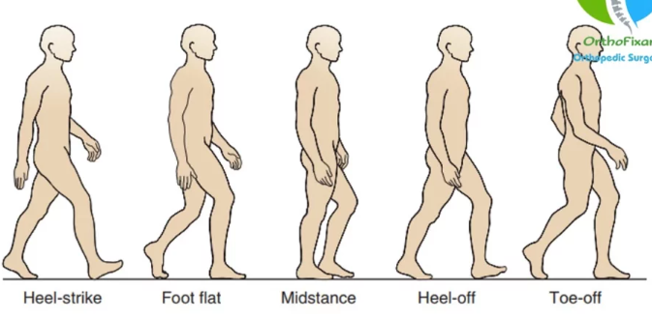
Plantar Fasciitis and Gait
2 Instances during gait in which tension in the plantar fascia is highest:
1) During max ankle pronation occurring during weight acceptance between heel strike and midstance
  Tensile stress due to flattening of longitudinal arch with pronation + acceptance of body weight + absorption of GRF (dealing with forces in lengthened state)
2) During max ankle supination occurring during propulsion between midstance and toe-off
  Tensile stress due to elevation of longitudinal arch with supination + Windlass mechanism + influence of tension in triceps surae is position of max ankle DF (dealing with forces in shortened state)
Dubin et al
Notes:
Activity/Pathology Risk Curve

Slide 35
Clinical Presentation
From 2014 CPG for Plantar Fasciitis:
Plantar medial heel pain: most noticeable with initial steps after a period of inactivity but also worse following prolonged weight bearing
Heel pain precipitated by a recent increase in weight bearing activity
Pain with palpation of the proximal insertion of the plantar fascia
Positive Windlass test
Negative Tarsal Tunnel tests
Limited active and passive talocrural joint dorsiflexion range of motion
Abnormal Foot Posture Index score
High BMI in non-athletic individuals
Martin et al

Slide 36
Potential Pathological Drivers
Anatomical
Pes cavus, pes planus, foot Equinus, rearfoot valgus, forefoot varus, tibial varum, knee valgus, leg length discrepancy, etc.
Biomechanical
Tight triceps surae, reduced ankle ROM (DF, eversion), reduced strength in muscles supporting the arch, pronation too early/late/long
Activity/Training
Occupational demands (standing/carrying weight/squatting), excessive walking or running (too much too soon or too much period)
Environmental
Running/walking uphill, uneven terrain, running/walking on grade (lateral aspect of shoe on high side – driving pronation without pronation to give)
Equipment
Shoes with no heel lift in the presence of reduced DF ROM, shoes with inadequate arch support in deficient foot, shoes with inadequate cushion under heel, no shoes - “Covid foot”
Personal
Sedentary lifestyle, high BMI (>27 kg per m²), diabetes
Tojian et al and clinical commentary
Notes:
Too little pronation (pes cavus)
Too much pronation (pes planus)
Squatting on toes

Slide 37
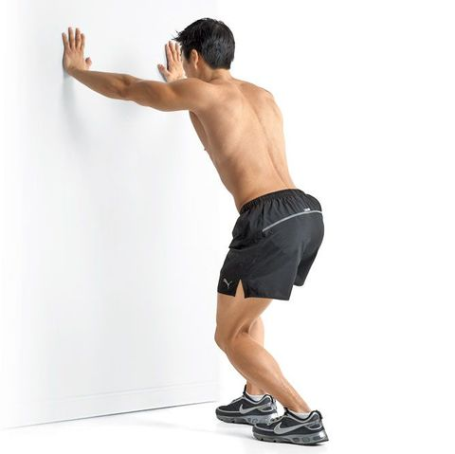
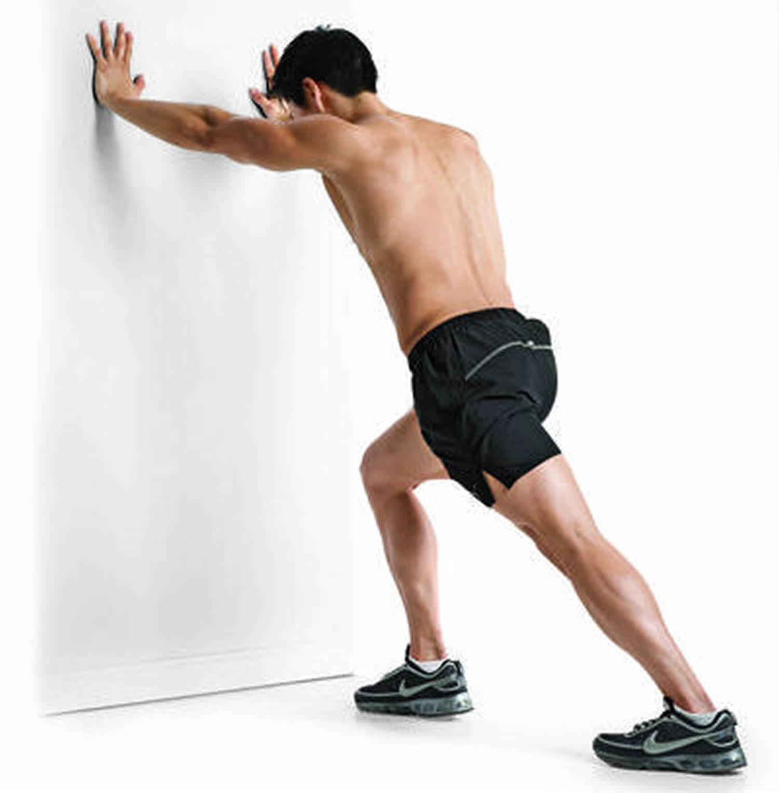
Intervention
Activity Modification: – “put out the fire before you rebuild the house”
Rest – manage activity/training loads to break up long period of static/dynamic loads; education addressing rapid changes or excessive training loads in athletic populations – considering cycling or swimming to maintain CV capacity
Vigorously stretch calves before stepping out of bed
AVOID barefoot walking while tissue heals (Oofos shower sandals with heel lift)
If runner, avoid hills/uneven terrain while recovering (sagittal/frontal plane challenges), graded reintroduction later in rehab
Night splints – 1-3 months for patients with reduced DF and irritable pain first thing in morning
Martin et al , Morrissey et al and clinical commentary
Notes:
Rationale for night splints
Parameters for return to running…
Foot position for cycling

Slide 38
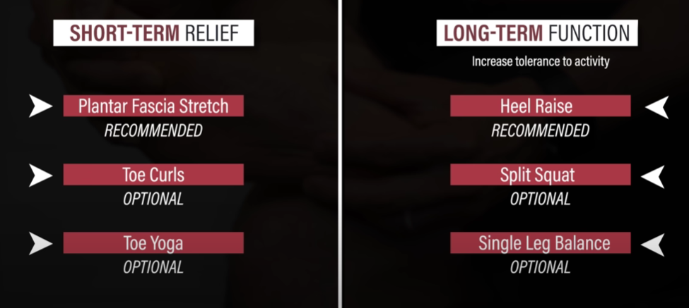
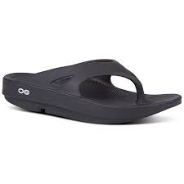
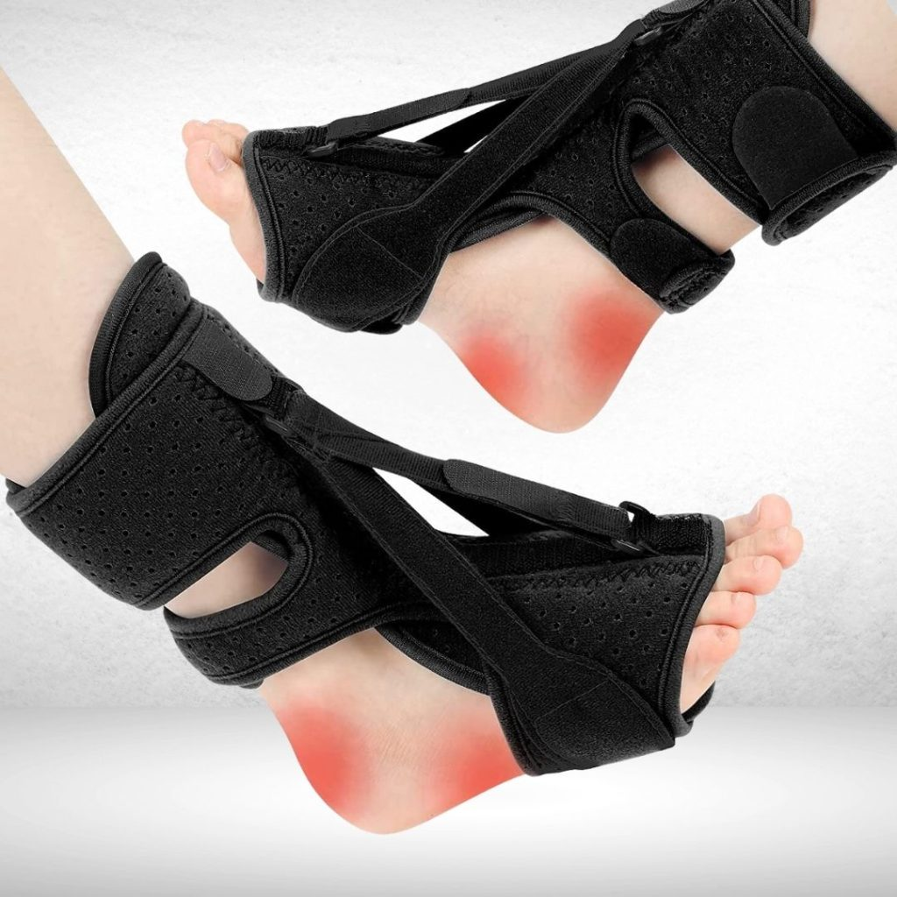
Interventions: – manage “drivers”
Manual therapy – STM to reduce pain or improve calf flexibility, mobilizations to increase DF ROM (talocrural glides)
Stretching – standing calf stretch (straight knee/bent knee), PF stretch with towel roll – 3x 1 min each at least 2x/day
Taping – immediate pain reduction and improved function with taping to “support” the longitudinal arch
Footwear – temporarily avoid shoes with no rearfoot to forefoot drop (Hokas); shoe wear should help manage anatomical drivers of stress to plantar fascia (ex: heel lift, medial arch support, firm heel counter, etc.)
  Rocker bottom could be useful to limit great toe DF…
Exercise – (expert opinion*) strengthening/movement training for muscles controlling pronation; progressive loading/return to activity, monitor symptoms
  Also consider strengthening/stabilization up the chain – make each joint “pull its weight” (hips, quads, hamstrings)
Orthoses – custom foot orthoses are best, but prefabricated can work for some
  Heel lift to allow more “relative” DF ROM
  Medial forefoot post to manage pronation driver from forefoot varus
  Medial rearfoot wedge to manage pronation driver from genu valgus
Corticosteroid Injections – can be helpful but only for short term with potential for long term consequences; conservative management first…
Martin et al and clinical commentary
Notes:
*expert opinion – less evidence for exercise alone as intervention for PF but recommended clinically
For intervention – what does the patient want? What is their goal? Full resolution of pain immediately? Get back to barefoot running on the beach? How irritable is their pain? Do they need maximum intervention and support or moderate? Consider activity/training demands
E3 Rehab Video Link: (1) Plantar Fasciitis (Education | Myths | Stretching & Strengthening Exercises) - YouTube

Slide 39
Midfoot OA

Slide 40
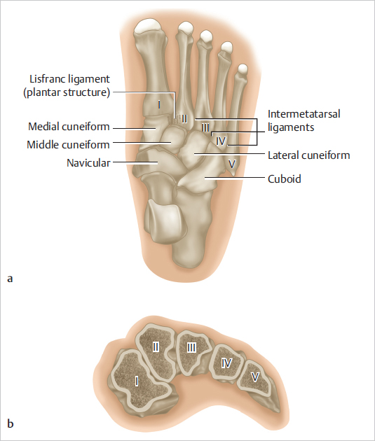
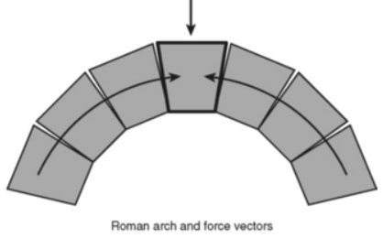


Anatomy/Biomechanics:
Wedged shaped cuneiforms wider superiorly – Roman Arch
  Arch is supported by soft tissue truss in the human foot
  Incredible stability with normal contact area
  Receives support from peroneus longus tendon
The midfoot acts as a stable beam connecting FF to HF – rigid lever for push off
Less mobile than other joints – should not move – job is to transfer forces from FF to HF
Elevated tensile stress in soft tissue “truss” structures drive midfoot collapse
  Decreased contact pressure
  Increased contact force
  Double Whammy!
Kurup et al and clinical commentary

Slide 41
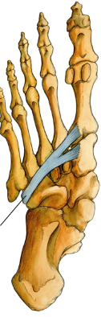


Peroneus Longus Tendon
Dr. Mike Gross, MSK II, Foot and Ankle

Slide 42
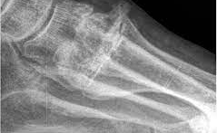
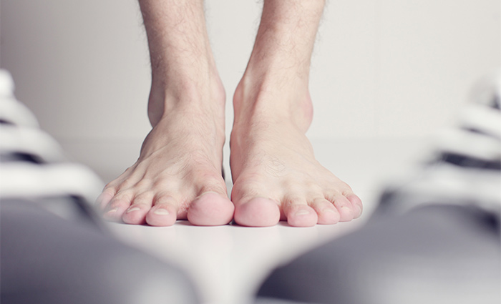
Tissues Affected…
Etiology:
Degenerative
Post-Traumatic
Inflammatory (ex: RA)
Neuropathic (ex: diabetes)
Post Hindfoot fusion
Location:
Loss of articular cartilage at dorsal surface of midfoot with calcium deposition forming osteophytes
2nd and 3rd TMT joints most common joints for development of midfoot OA
Kurup et al

Slide 43
Clinical Presentation
From Kurup et al and clinical commentary:
May have Hx of trauma or foot/ankle Sx
  Lisfranc injuries, fracture, etc.
  Ankle/hindfoot fusion – loss of ROM
Hx of RA or diabetes (neuropathic Charcot foot)
Pain over area of the midfoot
Pain with walking, typically worst at terminal stance to toe-off; also aggravated by stairs or uneven terrain
May have palpable osteophyte formation over area of the midfoot; may display osteophyte formation on radiographs
May present with swelling in the area
May demonstrate arch collapse in stance during barefoot gait trial
Anatomical/biomechanical drivers limiting sagittal/frontal plane motion
**If the talocrural joint can’t produce enough DF, it will look for it at the subtalar and transverse tarsal joints; if it can’t find it there or motion at these joints is insufficient to manage activity/environmental demands, it will look for motion at the midfoot which is not designed to move…
Kurup et al

Slide 44
Potential Pathological Drivers
Anatomical
Pes cavus, pes planus, foot Equinus, rearfoot valgus, forefoot varus, tibial varum, knee valgus, leg length discrepancy, etc.
Biomechanical
Tight triceps surae, reduced ankle ROM (DF, eversion, pronation), reduced strength in muscles supporting the arch (peroneus longus tendon), pronation too early/late/long
Activity/Training
Occupational demands (standing/carrying weight/squatting), chronic excessive walking/running
Environmental
Running/walking uphill, uneven terrain, running/walking on grade (lateral aspect of shoe on high side – driving pronation without pronation to give)
Equipment
Shoes with no heel lift in the presence of reduced DF ROM, shoes with inadequate arch support in deficient foot to prevent collapse
Personal
Sedentary lifestyle, obesity, diabetes, Sx history
Clinical commentary

Slide 45
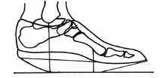
Intervention
Activity Modification
If highly irritable/edematous, rest from offending activities x4 weeks, manage drivers
Education to remain active outside of aggravating activities (low impact – swimming, biking); adjust activity/training parameters
Graded return to activity; monitor response
Environmental Modification
Similar to plantar fasciitis, avoid running on hills/uneven terrain until managed; challenges in the sagittal/frontal plane can aggravate symptoms without management of drivers
Manual Therapy
Mobilizations to improve DF ROM
Stretching
Stretch triceps surae (wall stretches) to increase DF ROM
Footwear
Heel to toe rocker sole shoe allows for natural rolling of the foot without bending through the middle of the arch
Shoes with arch support, heel lift and firm heel counter to prevent arch collapse with sagittal plane challenges
Tie shoelaces to avoid pressure over the site of osteophytes (skip eyelets)
Orthoses
Heel lift to allow more “relative” DF ROM
Medial forefoot post to manage pronation driver from forefoot varus
Medial rearfoot wedge to manage pronation driver from genu valgus
Clinical commentary

Slide 46
Hallux Rigidus

Slide 47
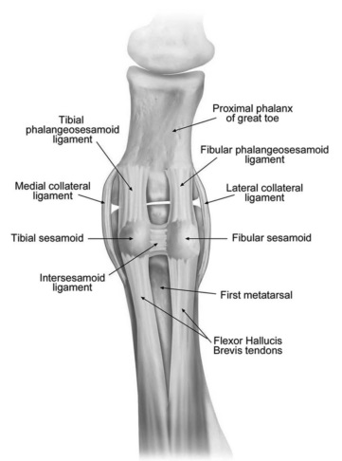
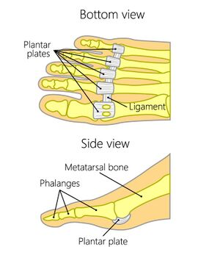
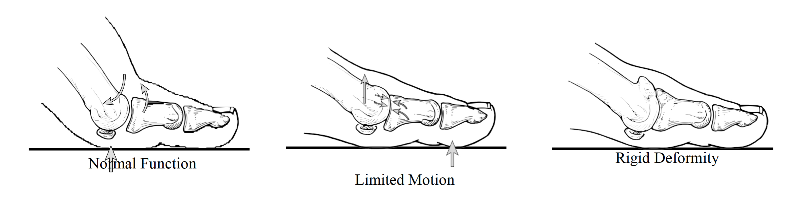
Anatomy/Biomechanics:
Occurs at the first metatarsophalangeal (MTP) joint
2 sesamoid bones on plantar plate as part of a capsuloligamentous complex
  Functions to protect AC and allow gliding of met head along the joint capsule
Resting position relative to axis of 1st metatarsal = 16˚ DF
Need about 70˚ to clear heel for normal gait w/o compensation
Critical Functions of 1st MTP Joint:
  Load bearing (twice the load of other toes) – as much as 8x BW during athletic activities
  Site of Windlass mechanism for arch stiffening (prevents collapse, aids in stiffness)
  Static/dynamic balance
Hallinan et al
Hallux Limitus
Hallux Rigidus

Slide 48
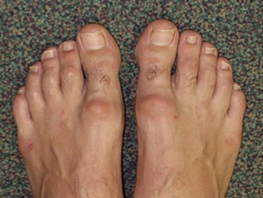
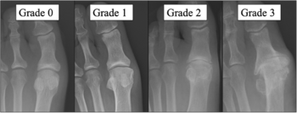
Tissues Affected…
Degenerative arthritis of articular cartilage of first MTP joint
Arthritis changes typically begin at dorsal surface then progress to involve the whole joint
Painful osteophyte formation at dorsal surface as pathology develops
Patel et al

Slide 49
Clinical Presentation
From Patel et al:
C/o pain at 1st MTP joint with walking; gait may be altered (walking on lateral foot to avoid 1st MTP extension)
May observe increased bulk of 1st MTP joint with c/o difficulty with shoe wear
May present with numbness/tingling along medial border of great toe d/t compression of dorsal medial cutaneous nerve
1st MTP swollen and/or TTP
Increased bulk of 1st MTP or palpable dorsal osteophyte formation
Decreased ROM in 1st MTP: DF limitation > PF limitation; pain at terminal ROM, progressing to mid-range with more severe arthritic changes
Pain reproduction with forced DF, (+) grind test
** Hallux Limitus = functional pain d/t soft tissue tightness or elevated/long 1st metatarsal; Hallux Rigidus = pain d/t an arthritic joint
Patel et al, Lam et al

Slide 50
Pathological Drivers
Anatomical
Hallux valgus, long 1st metatarsal, elevated 1st metatarsal
Biomechanical
Tight triceps surae, reduced ankle ROM, prolonged or excessive foot pronation with gait
Activity/Training
Repetitive stress, training errors, sport/activity specific (ballet dancers)
Environmental
Running/walking uphill, or on hard terrain
Equipment
Shoes with tight toe box, inadequate arch support in deficient foot
Personal
Female gender, Hx of trauma to the area, Hx of OA, iatrogenic (Sx), inflammatory conditions (gout, RA, metabolic conditions, osteochondritis dissecans)
Patel et al, Lam et al, Senga et al, clinical commentary

Slide 51
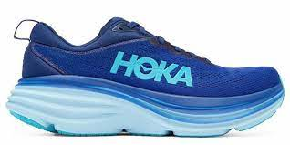
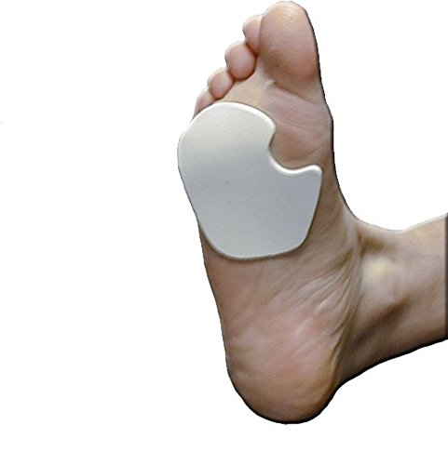
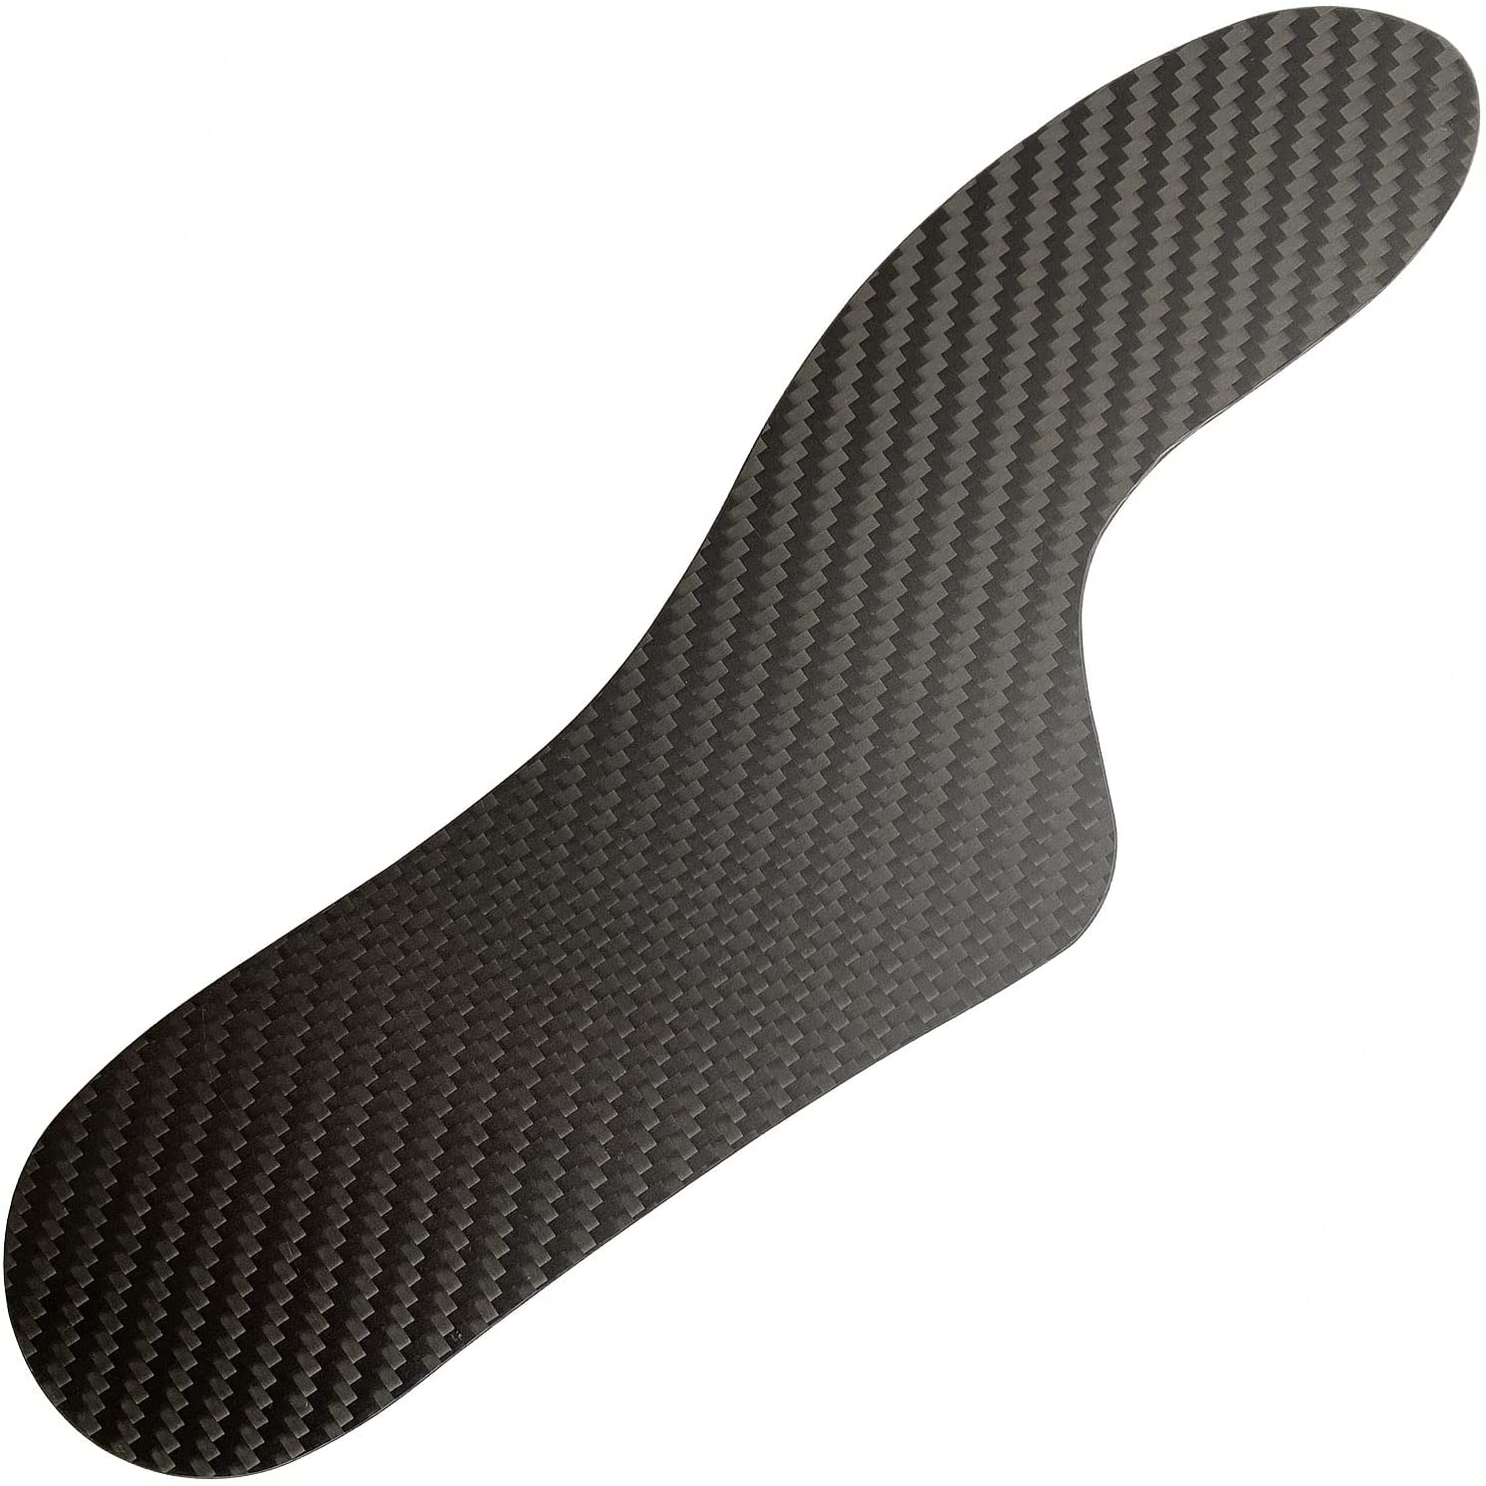
Intervention
Activity Modification
If highly irritable/edematous, rest from offending activities x4 weeks, manage drivers
Avoid wearing high heels
Education to remain active outside of aggravating activities (cycling/aquatic therapy); adjust activity/training parameters
Graded return to activity; monitor response
Environmental Modification
Walking/running on grass or dirt instead of concrete
Manual Therapy
Distraction of 1st MTP with dorsal/plantar glides, Grade III mobilization to medial/lateral sesamoids (probably only effective in those with hallux Limitus vs rigidus), talocrural glides to maintain or improve ROM at the ankle joint
Stretching/Exercise
Stretching of triceps surae to maintain or improve ROM at ankle joint
Isometric/isotonic strengthening of flexor hallucis longus and plantar intrinsics to improve 1st MTP stability
Progression to single leg exercises to improve functional stability (single leg balance, rocker board, BOSU, star excursion)
Footwear
Shoes with rocker bottom and stiff toe break to avoid painful DF of first MTP
Shoes with a high/wide toe box to avoid contact pressure over osteophytes
Orthoses
1st Metatarsal pad or arch just proximal to head to place joint in more PF position (less compression dorsally)
Carbon fiber shank as splint to limit dorsiflexion of 1st MTP and decreased forces acting on the forefoot
Make sure that inserts don’t limit space in the toe box too much
Patel et al, Shamus et al, Finch et al, Colo et al

Slide 52
Ankle Mortise OA

Slide 53
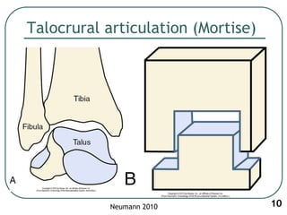
Anatomy and Biomechanics
Talocrural Joint:
Distal tibia/fibula form ankle “mortise” in which the trochlea of the talus articulates
Greatest congruency in max dorsiflexion in WB; closed packed position
Majority of load transferred through the talar dome (tibia)
Talus is wider anteriorly – with dorsiflexion, increase in load distribution to medial and lateral surfaces of the mortise
Mortise extends further laterally
Large contact area in joint makes this a rarer site for arthritis than other major LE joints - alignment issues inc. risk
Congruency within the mortise is greatest in subtalar joint neutral
Brockett et al, Dr. Mike Lewek, Biomechanics, Foot and Ankle

Slide 54
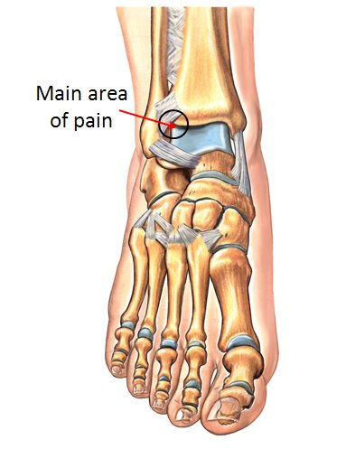
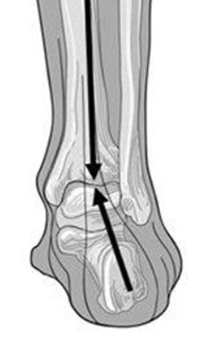
Ankle Impingement:
Anterior, anterolateral, anteromedial, posterior, posteromedial
Anterolateral most common
Subtalar joint pronation results in increased contact forces to anterolateral aspect of the mortise, especially as the ankle goes into dorsiflexion and the wide part of the talus is driven up into the mortise
Anatomical deviations that increase eversion/pronation at the ankle joint increase risk for anterolateral ankle mortise impingement and OA
Degradation of AC may cause osteophyte formation in this area, increasing pain and reducing ROM of the ankle joint, especially into dorsiflexion
May be primary or secondary OA
Posterior View of Right Foot
Zbojniewicz et al

Slide 55
Typical Presentation
From Khlopas et al:
Typically > 60 yo
Insidious onset joint pain; relieved by rest in early stages
  Night pain as disease progresses
May c/o short term stiffness that improves with activity; morning stiffness described as deep pain with crunching or clicking noises
Pain is activity related; aggravated with WB, especially stairs (end range DF) and overactivity
May have swelling over area

Slide 56
Pathological Drivers
Anatomical
Genu varus/valgus, tibial varum, pes planus, hindfoot malignment; drivers of pronation
Biomechanical
Tight triceps surae, reduced ankle ROM, prolonged or excessive foot pronation with gait
Activity/Training
Repetitive stress, training errors, sport/activity specific (ballet dancers)
Environmental
Running/walking uphill, or on hard terrain
Equipment
Shoes with inadequate support in deficient foot
Personal
Hx of ankle trauma, inflammatory conditions (RA), metabolic disease, obesity
Khlopas et al

Slide 57
Intervention
Physical Therapy most successful as intervention in early stages of the disease…
Education and Activity/Training Modification
Weight loss if pertinent (each pound lost = 4-fold reduction in load!)
Education to manage aggravating activities
Orthoses
Custom inserts to improve biomechanical loading/alignment of the talus in the mortise and to reduce demand for end range DF; address drivers of pronation/rearfoot valgus
Footwear
Stiff heel counter – limits rearfoot motion
Arch support – limits arch collapse/pronation
Forefoot/rearfoot wedging – manages anatomical malignments by realigning forces

Slide 58
Achilles Tendinopathy (Mid-substance and Insertional)

Slide 59
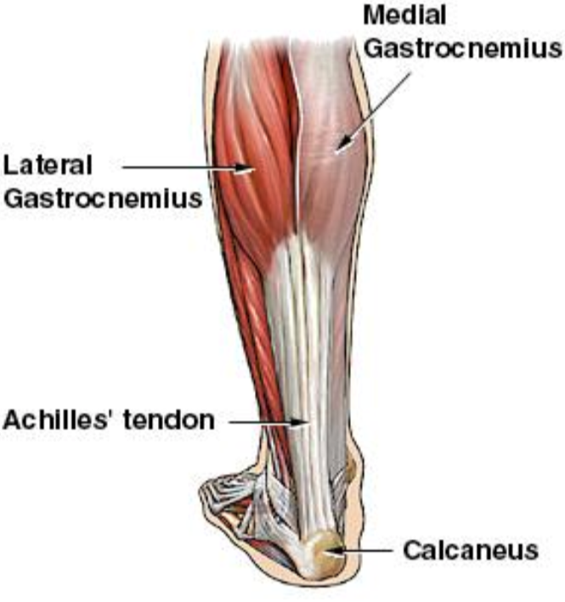
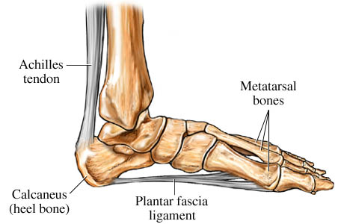
Anatomy and Biomechanics
Largest and strongest tendon in the body; distal joining of the triceps surae on the calcaneus
Composed mostly of strong Type I collagen fibers
Mid-substance is most avascular portion of the tendon
Silbernagel et al

Slide 60
Terminology
Tendinopathy: broad term meaning degeneration or failed healing of tendon as a result of continuous overload with inadequate recovery
Tendonitis: acute inflammatory response of tendinous tissue due to microtrauma
Tendinosis: localized or diffuse increased thickness and/or alteration of normal architecture of the tendon due to chronic tissue degradation
**Commonly held supposition that tendonitis precedes tendinosis; however, it is likely the other way around..
  Healthy tendon is twice as strong as muscle; unlikely microtearing would be occurring in healthy tendon
  Incorrect to assume microtears and inflammation are a precursor to collagen degeneration
  Collagen degeneration more likely due to excessive and/or repetitive tensile forces which instigates degrative changes which THEN predispose tendon to micro-tearing (tendonitis)
Bass et al, Silbernagel et al

Slide 61
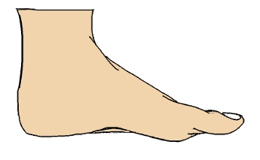
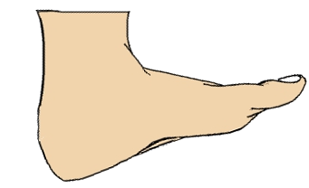


Mid-Substance vs. Insertional Tendinopathy
Mid-substance
Insertional
55-66% of cases
Tensile loads are primary culprit
Most avascular portion of tendon
20-25% of cases
Compressive loads are primary culprit
  End range DF; hard/tight shoes
Martin et al, Silbernagel et al
Notes:
Can present simultaneously

Slide 62
Pathophysiology and Diagnosis
Pathophysiology:
Multifactorial; intrinsic/extrinsic drivers that decrease load tolerance of the tendon or movement/activity patterns that overload the tendon
Degenerative changes (-osis) and/or microtrauma (-itis) to the tendon without adequate recovery weakens tendon over time
Compression from high frequency/duration of end-range DF activity or from footwear increases risk of insertional Achilles tendinopathy
Diagnostic Cluster From Martin et al (mid-substance):
Pain 2-6 cm proximal to the Achilles tendon insertion
gradual onset
TTP at midportion of tendon
(+) arc sign
Royal London Hospital Test
Martin et al, Silbernagel et al
Notes:
- Explain tests

Slide 63
Typical Presentation
From Silbernagel et al and Aicale et al:
Gradual onset of symptoms
Stiffness in the morning or after long periods of sitting
Pain with activity (running/jumping/stairs); usually worst at the beginning and shortly after the end of an exercise session; pain during whole activity in progressed stages
Silbernagel et al, Aicale et al

Slide 64
Pathological Drivers
Anatomical
Any anatomical deviations leading to excessive foot pronation (increased tensile stress on Achilles with arch collapse)
Biomechanical
Tight and weak triceps surae, reduced ankle ROM, prolonged or excessive foot pronation with gait, reduced hip/knee neuromuscular control
Activity/Training
Repetitive stress/strain with inadequate recovery for tissue remodeling, active populations, running/jumping sports, “too much too soon,” poor technique
Environmental
Running/walking uphill, or on hard/uneven terrain
Equipment
Shoes that are too tight, inadequate heel lift in presence of ankle ROM deficit, shoes that are too hard or compress Achilles tendon, switch from shoe with heel lift to zero drop w/o adequate progression
Personal
Increased body weight, family Hx, inflammatory conditions, diabetes, corticosteroid use
Silbernagel et al

Slide 65

Intervention
Use this for pain monitoring/progression with tendinopathies!
Education/Activity Modification
Education on purpose of exercises, pain monitoring (teach NPRS), and expected prognosis
Discussion of load management – complete rest is not indicated (continue activity within “acceptable” pain tolerance)
  Temporarily avoid running on hard, uneven, or slanted surfaces
Modalities
Iontophoresis – effective in reducing acute pain
Taping – no significant effect on pain but may reduce strain on Achilles with rigid taping techniques
Manual – if restrictions present, consider using joint mobes and STM to increase ROM
Extracorporeal shockwave therapy – effective for acute pain relief and tissue healing; best combined with exercise
Orthoses
Generic or custom inserts may reduce strain on Achilles but not supported in the literature for pain reduction (ex: heel lift/arch support); clinical commentary – success alleviating pain with custom inserts to manage drivers of pronation if present
Martin et al, Silbernagel et al, clinical commentary

Slide 66
Footwear
Properly fitting footwear to avoid irritation of the Achilles tendon (padded heel?)
Neutral shoe with arch support to prevent arch collapse with pronation, driving increased tensile loads
Use heel lift, especially in insertional to prevent high compressive loads b/t Achilles tendon and calcaneus in end range DF during gait
Exercise
Cornerstone of treatment for Achilles tendinopathy
4 Phases as Described in Silbernagel et al:
  Symptom Management and Load Reduction
    Halt negative cycle of overloading and injury progression (manage drivers)
    Consider cycling/swimming to maintain cardiovascular fitness
    Begin loading using NPRS as guide; consider initiating hip/knee strengthening/stability exercises in this phase
      Isometrics, 2 up 1 down eccentrics, Concentrics in modified plantigrade
  Recovery
    Regain strength in calves and improve Achilles tolerance to loads (frequency/duration/velocity); exercise daily
  Rebuilding
    Heavier strength training of calf muscles; initiate running/jumping activities (3x15)
    Progress jumping bilateral to unilateral
  Return to Sport
    Resolution of symptoms with sport or goal specific training
Martin et al, Silbernagel et al

Slide 67


Silbernagel et al

Slide 68
Conclusion
Ask yourself these 3 questions:
What is the desired activity (goal) “asking” of the foot and ankle?
What is the foot and ankle able to give based on anatomical/biomechanical “resources?”
Is the “ask” too big, are the “resources” inadequate, or both?
Intervention: Decrease the “ask” and increase the “resources” to achieve the goal. The “ask” can increase once the “resources” have. “Resources” can be increased with tissue adaptation through rest/training and/or external support.
Both the great challenge and the great joy of our line of work lie in the complexity of the people to whom we provide our services. Growing as a therapist means embracing that challenge. Use the subjective/objective exam to paint a clinical picture. This should reveal the origin site and tissue causing the problem and the internal/external conditions “driving it.” Manage the condition by addressing the drivers. CPGs should inform practice, but foundational knowledge and investigative skills should guide it.

Slide 69
Special Thanks
Dr. Mike Gross
Dr. Jeff O’Laughlin

Slide 70
References
Slides adapted from Dr. Mike Gross, MSK II, Foot and Ankle Biomechanics
Slides adapted from Dr. Mike Lewek, Biomechanics, Foot and Ankle and Lower Quarter Screen
Babu D, Bordoni B. Anatomy, Bony Pelvis and Lower Limb: Medial Longitudinal Arch of the Foot. In: StatPearls. Treasure Island (FL): StatPearls Publishing; November 11, 2022.
Dubin A. Gait: the role of the ankle and foot in walking. Med Clin North Am. 2014;98(2):205-211. doi:10.1016/j.mcna.2013.10.002
Trojian T, Tucker AK. Plantar Fasciitis. Am Fam Physician. 2019;99(12):744-750.
Martin RL, Davenport TE, Reischl SF, et al. Heel pain-plantar fasciitis: revision 2014. J Orthop Sports Phys Ther. 2014;44(11):A1-A33. doi:10.2519/jospt.2014.0303
Morrissey D, Cotchett M, Said J'Bari A, et al. Management of plantar heel pain: a best practice guide informed by a systematic review, expert clinical reasoning and patient values. Br J Sports Med. 2021;55(19):1106-1118. doi:10.1136/bjsports-2019-101970
Kurup H, Vasukutty N. Midfoot arthritis- current concepts review. J Clin Orthop Trauma. 2020;11(3):399-405. doi:10.1016/j.jcot.2020.03.002
Hallinan JTPD, Statum SM, Huang BK, et al. High-Resolution MRI of the First Metatarsophalangeal Joint: Gross Anatomy and Injury Characterization. RadioGraphics. 2020;40(4):1107-1124. doi:https://doi.org/10.1148/rg.2020190145
Senga Y, Nishimura A, Ito N, Kitaura Y, Sudo A. Prevalence of and risk factors for hallux rigidus: a cross-sectional study in Japan. BMC Musculoskelet Disord. 2021;22(1):786. Published 2021 Sep 13. doi:10.1186/s12891-021-04666-y

Slide 71
References
Shamus J, Shamus E, Gugel RN, Brucker BS, Skaruppa C. The effect of sesamoid mobilization, flexor hallucis strengthening, and gait training on reducing pain and restoring function in individuals with hallux limitus: a clinical trial. J Orthop Sports Phys Ther. 2004;34(7):368-376. doi:10.2519/jospt.2004.34.7.368
Finch R. Hallux Rigidus. Plus Course 2023 via Physiopedia
Colò G, Fusini F, Samaila EM, et al. The efficacy of shoe modifications and foot orthoses in treating patients with hallux rigidus: a comprehensive review of literature. Acta Biomed. 2020;91(14-S):e2020016. Published 2020 Dec 30. doi:10.23750/abm.v91i14-S.10969
Zbojniewicz AM. Impingement syndromes of the ankle and hindfoot. Pediatr Radiol. 2019;49(12):1691-1701. doi:10.1007/s00247-019-04459-5
Brockett CL, Chapman GJ. Biomechanics of the ankle. Orthop Trauma. 2016;30(3):232-238. doi:10.1016/j.mporth.2016.04.015
Khlopas H, Khlopas A, Samuel LT, et al. Current Concepts in Osteoarthritis of the Ankle: Review. Surg Technol Int. 2019;35:280-294.
Silbernagel KG, Hanlon S, Sprague A. Current Clinical Concepts: Conservative Management of Achilles Tendinopathy. J Athl Train. 2020;55(5):438-447. doi:10.4085/1062-6050-356-19
Martin RL, Chimenti R, Cuddeford T, et al. Achilles Pain, Stiffness, and Muscle Power Deficits: Midportion Achilles Tendinopathy Revision 2018. J Orthop Sports Phys Ther. 2018;48(5):A1-A38. doi:10.2519/jospt.2018.0302
Aicale R, Oliviero A, Maffulli N. Management of Achilles and patellar tendinopathy: what we know, what we can do. J Foot Ankle Res. 2020;13(1):59. Published 2020 Sep 29. doi:10.1186/s13047-020-00418-8
Bass E. Tendinopathy: why the difference between tendinitis and tendinosis matters. Int J Ther Massage Bodywork. 2012;5(1):14-17. doi:10.3822/ijtmb.v5i1.153

