Slide 1
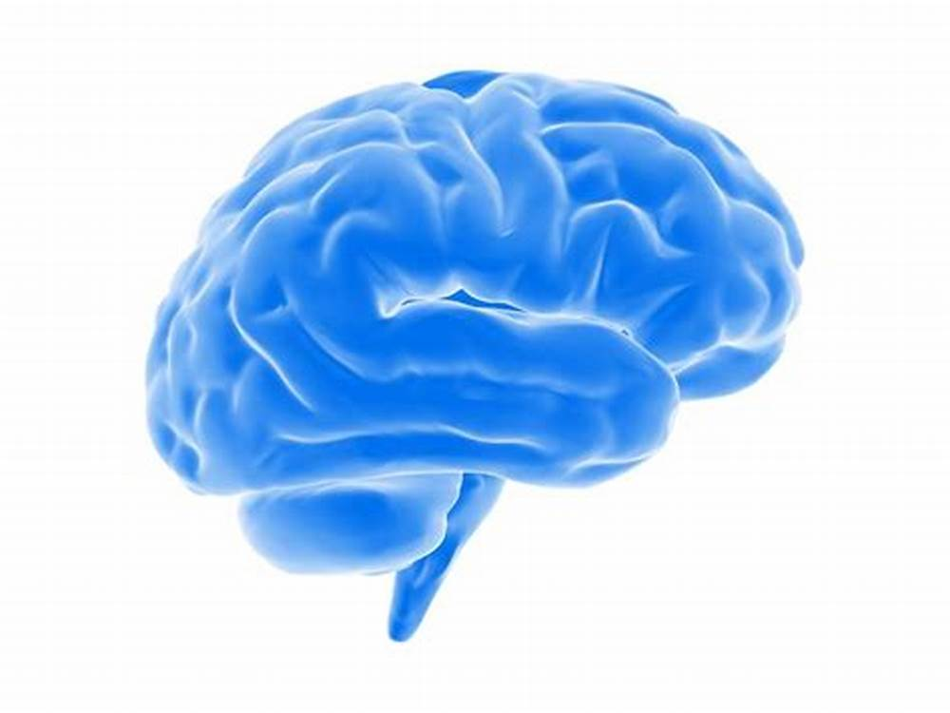
Atypical Parkinsonian Disorders (APDs): Pathophysiology, Differentiating Factors, and PT Intervention
Presented By: Conner Heermann, SPT

Slide 2
Learning Objectives
Recall pathophysiology, clinical features, and medical/PT intervention strategies for traditional idiopathic Parkinson’s disease.
Understand the general pathophysiology of Atypical Parkinsonian Disorders.
Differentiate Atypical Parkinsonian Disorders from traditional idiopathic Parkinson’s Disease, and from one another, depending on how they present in patients.
Understand current medical/PT strategies in management of Atypical Parkinsonian Disorders.

Slide 3
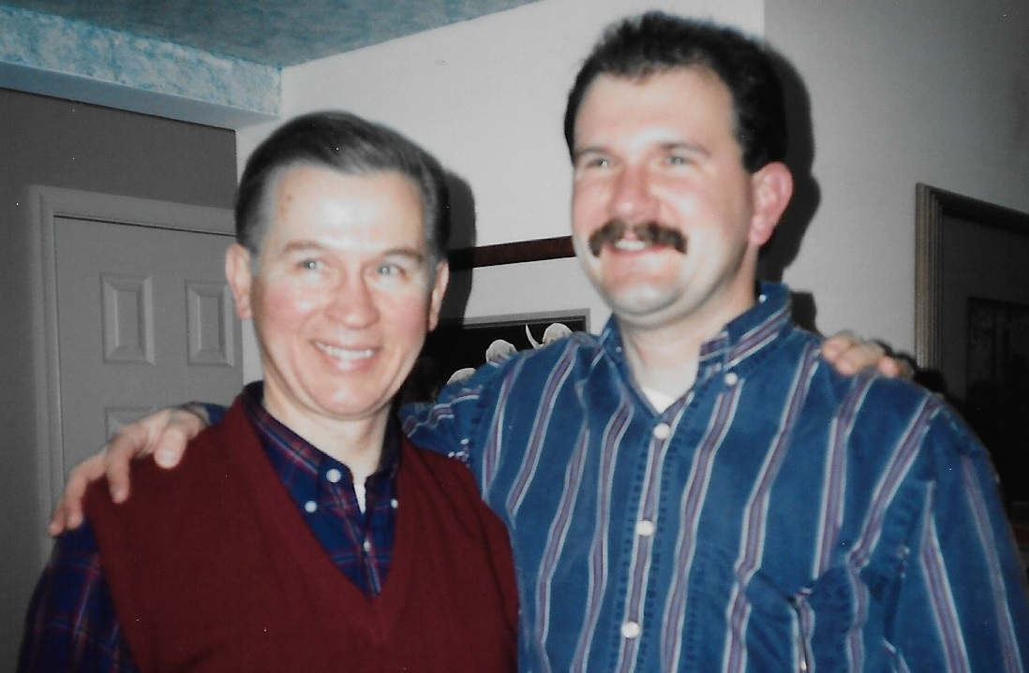
Dedication
The “Badass from Brooklyn”
Henry William Heermann (Jan. 29, 1934 – July 6, 2017)

Slide 4
Definition of Terms
Parkinsonism – clinical syndrome characterized by bradykinesia, rigidity, resting tremor, and postural instability
Parkinson’s Disease (PD) – the leading cause of the clinical syndrome of Parkinsonism
Atypical Parkinsonian Disorders (APDs) – together comprise the second leading cause of the clinical syndrome of Parkinsonism; clinical features consistent with Parkinsonism, but with different underlying mechanisms driving the disease process and additional clinical features beyond those observed in idiopathic Parkinson’s Disease
Parkinson’s Plus Syndromes – used interchangeably with Atypical Parkinsonian Disorder (APDs)
Usually in reference to Coritcobasal Degeneration (CBD), Lewy Body Dementia (LBD), Multiple Systems Atrophy (MSA), and Progressive Supranuclear Palsy (PSP)
Additional clinical features may include: gait ataxia, dystonia, orthostatic hypotension, abnormal reflexes, oculomotor dysfunction, etc.
Notes:
Atypical Parkinsonian Disorders (APDs) seems to be the preferred term in the literature to describe the 4 most common “Parkinson’s Plus Syndromes”

Slide 5
Causes of the Clinical Syndrome of Parkinsonism
Neurodegenerative:
Idiopathic Parkinson’s Disease (PD)
Atypical Parkinsonian Disorders (APDs)
Coritcobasal Degeneration (CBD)
Lewy Body Dementia (LBD)
Multiple Systems Atrophy (MSA)
Progressive Supranuclear Palsy (PSP)
Many other rare syndromes*
Secondary Parkinsonism:
Head Trauma
TBI
Concussion
Drug Induced
Antipsychotics (Dopamine antagonists)
Haldol, Thorazine
Antihypertensives
Aldomet, Harmonyl
Antiemetics (anti-nausea)
Compazine, Reglan
Notes:
*Frontotemporal Dementia with Chromosome 17 (FTDP-17), Pick’s Disease, Pallidonigral Degeneration, Wilson’s Disease, and Parkinsonian-Dementia Complex of Guam

Slide 6
Parkinson’s Disease: A Quick Review
Pathophysiology: driven by the degeneration of dopaminergic neurons located in the substantia nigra pars compacta of the midbrain via aggregation of alpha-synuclein proteins, resulting in dopamine shortage
Mostly idiopathic (78%); though studies suggest combination of genetic and environmental factors; ~30% genetics and ~70% environmental factors (chemical exposure, head injury, etc.)
Typical age of onset 50-65 yo
Notes:
Environmental
Exposure to chemicals – pesticides, chlorinated solvents (lubricant, coolants), manganese in welding fumes
Head Injuries – concussions etc.

Slide 7
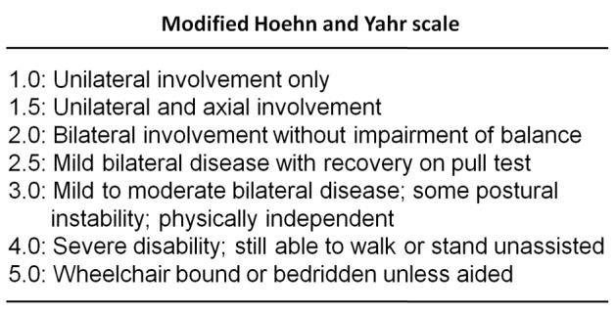
Typical Course of Clinical Features for PD
Early Stage
Resting tremor or micrographia as initial symptom
Rigidity and bradykinesia (typically unilateral)
Balance difficulties
Later Stage
Festination, dyskinesia, akinesia, hypokinesia
“Freezing” episodes
Postural instability – higher fall risk
Weakness, contracture, decreased aerobic capacity
Final Stage
Unable to ambulate
ADL dependent
Cognitive impairments probable

Slide 8
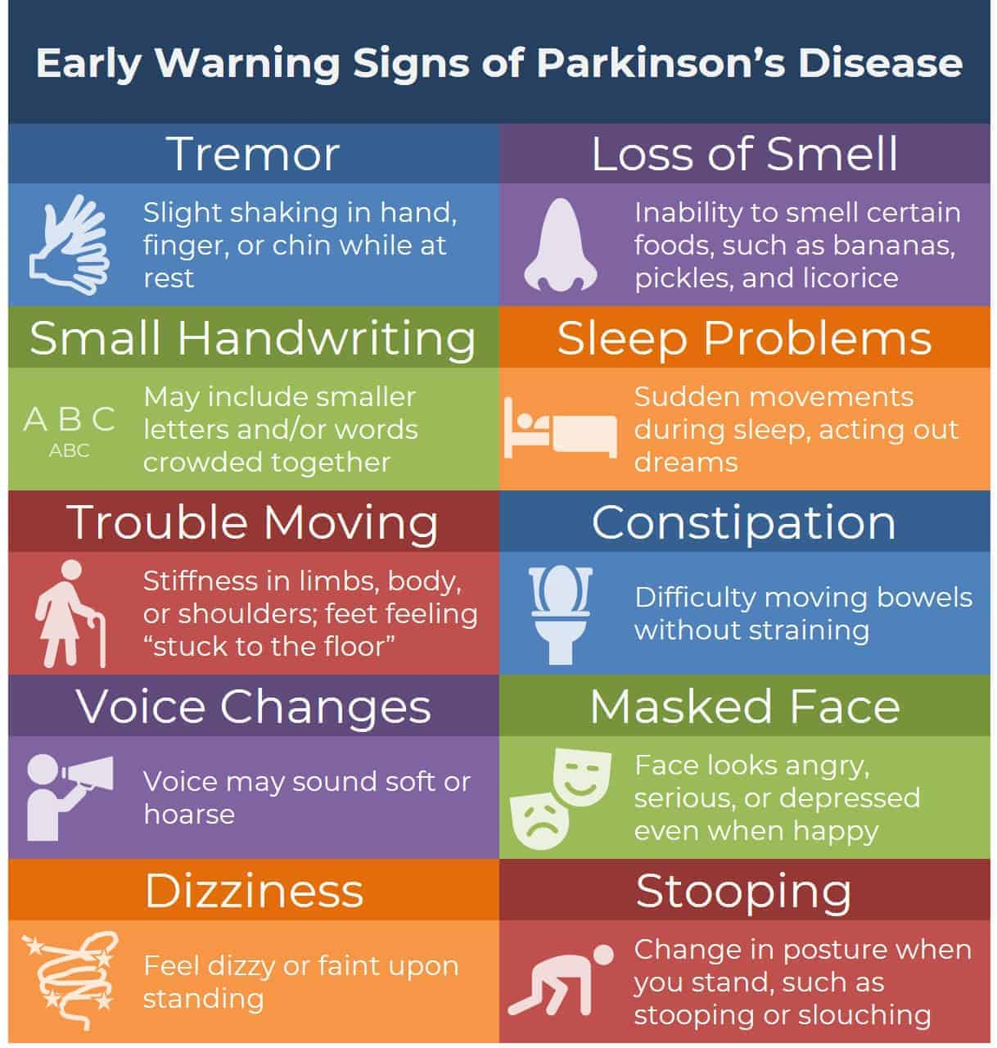
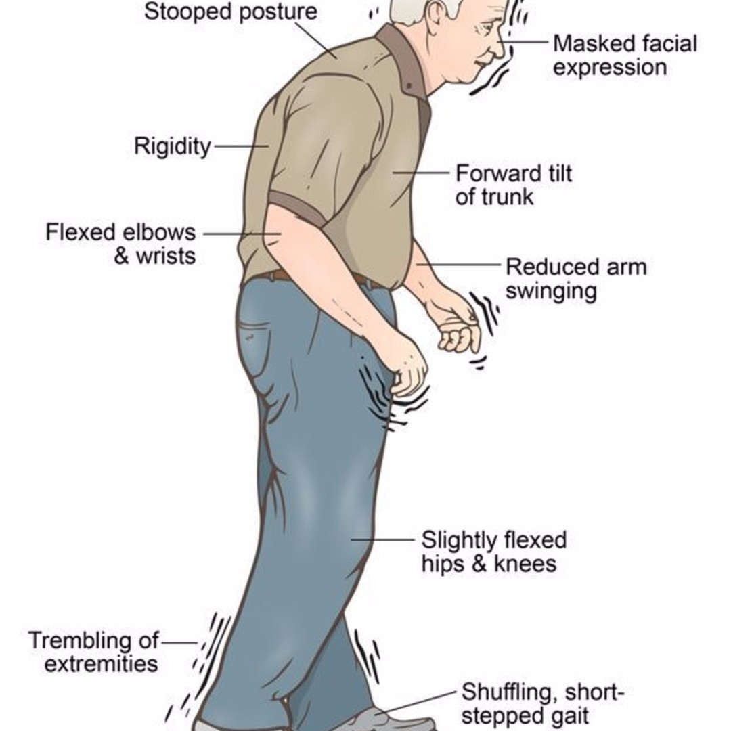
Parkinson's Disease Early Warning Signs - Bing images
parkinson's disease - Bing images

Slide 9
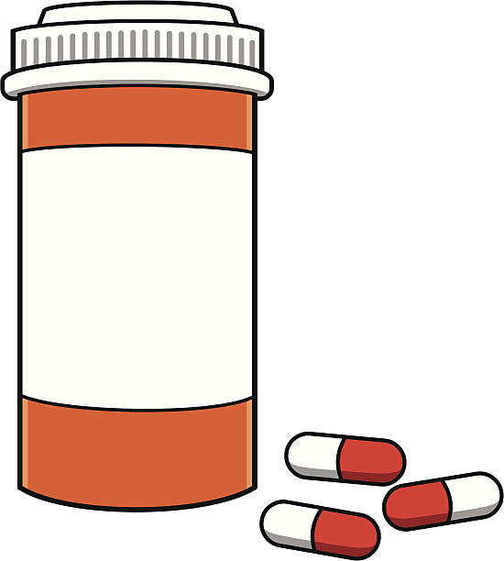
Typical Medical Management
Levadopa Therapy
Dopamine precursor improving rigidity, bradykinesia, and tremor (not helpful for postural instability)
~50% patients will experience dyskinesias/dystonias as side effect within 6 years of treatment initiation
“On-Off” phenomenon – L-dopa effective for about 4 hours at a time with peak effectiveness 3 hrs after taking medication
Carbidopa commonly used alongside Levadopa to block peripheral metabolism of Levadopa and reduce side effects of medication
Other Medications:
Sinemet – combo of Levadopa and Carbidopa
Dopamine agonists – more effective for bradykinesia than anything else
Mirapex, Apokyn, Requip
Symmetrel – (amantadine) increases release of dopamine, blocks reuptake, and stimulates dopamine receptors; more effective for akinesia and rigidity than tremor
Notes:
Levadopa side effects: severe drowsiness, uncontrolled muscle movements, worsening tremor, severe N/V, confusion and/or hallucination, depression, seizure, severe NS reaction (flu like symptoms)

Slide 10
rTMS Repetitive Transcranial Magnetic Stimulation
Non-invasive; use of magnetic coil targeting scalp to stimulate neurons
Effects vary depending on target of stimulation, protocol used, and frequency/duration/intensity of the stimulation
High frequency = Excitatory - Long Term Potentiation of Neurons (+) Neuroplasticity
Low Frequency = Inhibitory - Long Term Depression of Neurons (-) Neuroplasticity
In general, stimulation modulates neuroplasticity of the cortex, increasing or decreasing the excitability of deep brain regions depending on stimulation protocol and desired results
Extensively studied in PD; improvement in motor and non-motor symptoms and therapy complications; typically used in later stages once other strategies have been exhausted
Notes:
Petsani C, Aloizou AM, Siokas V, et al. Therapeutic Application of rTMS in Atypical Parkinsonian Disorders. Behav Neurol. 2021;2021:3419907. Published 2021 Dec 23. doi:10.1155/2021/3419907
Proposed use for other neurodegenerative diseases such as Alzheimer's and for depression

Slide 11
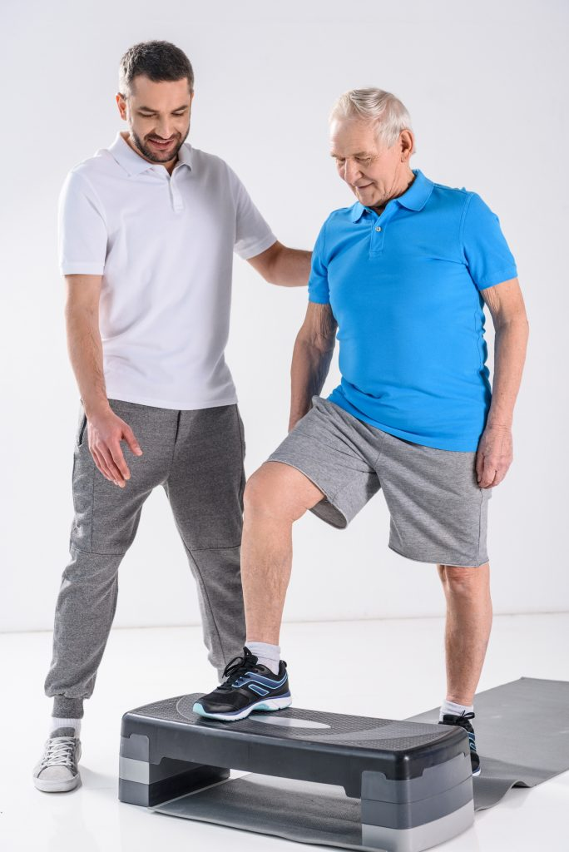
PT Assessment
Measures:
UPDRS – Gold Standard; lengthy to administer
Berg Balance Scale
TUG Cognitive – may be better indicator for falls than standard TUG
PDQ-39 – questionnaire for health status and health related QOL
Notes:
Vance RC, Healy DG, Galvin R, French HP. Dual tasking with the timed "up & go" test improves detection of risk of falls in people with Parkinson disease. Phys Ther. 2015;95(1):95-102. doi:10.2522/ptj.20130386

Slide 12
PT Intervention
PT Intervention:
Prevent deconditioning (strength, aerobic capacity, skeletal deformity)
Smaller declines in PDQ-39 and TUG for self reported exercisers (greater than 2.5 hrs/wk) over 2 year period
LSVT-BIG – better results, though not limited to, earlier stages
Make training environments specific to where problems arise
Strategies may change with disease progression
Early Stage: motor learning – high intensity, variable practice, dual task
Later Stage: compensation – repetition, drill practice, break down task into components, avoid multitasking
Compensatory strategies to:
Rely on cortical control mechanisms
Focus attention
Rely on external cues (visual, auditory, proprioceptive)
Notes:
Rafferty MR, Schmidt PN, Luo ST, et al. Regular exercise, quality of life, and mobility in parkinson’s disease: a longitudinal analysis of national parkinson foundation quality improvement initiative data. J Parkinsons Dis. 2017;7(1):193-202. doi:10.3233/JPD-160912
Morris ME, Martin CL, Schenkman ML. Striding out with Parkinson disease: evidence-based physical therapy for gait disorders. Phys Ther. 2010;90(2):280-288. doi:10.2522/ptj.20090091

Slide 13
Notes:
Sparrow D, DeAngelis TR, Hendron K, Thomas CA, Saint-Hilaire M, Ellis T. Highly Challenging Balance Program Reduces Fall Rate in Parkinson Disease. J Neurol Phys Ther. 2016;40(1):24-30. doi:10.1097/NPT.0000000000000111

Slide 14
Atypical Parkinsonism Disorders (APDs)
Commonalities:
Symmetric distribution of symptoms
Rapid deterioration
Poor response to medications (Levadopa or other dopaminergic agonists)
Classic PDs therapies appear to be only partially beneficial
Subdivisions of APDs*
Tauopathies
PSP
CBD
Synucleinopathies
PD
MSA
LBD
Notes:
*APDs are subdivided into Tauopathies and Synucleinopathies based on the type of abnormally accumulated protein that contributes to neurodegenerative damage
Petsani C, Aloizou AM, Siokas V, et al. Therapeutic Application of rTMS in Atypical Parkinsonian Disorders. Behav Neurol. 2021;2021:3419907. Published 2021 Dec 23. doi:10.1155/2021/3419907

Slide 15
Differential Diagnosis: PD or APD?
Parkinson’s Disease
Mostly unilateral onset becoming asymmetric bilateral
Slow progression of disease course
If “pill rolling,” resting tremor is primary symptom, APD is unlikely
Generally responsive to Levadopa or other dopaminergic agonists
Hyperkinesia/dyskinesias observed in later stages of PD, though not in APD
Presence thought to be more heavily influenced by environmental factors than genetic factors
Atypical Parkinsonian Disorders
Mostly symmetric bilateral distribution of symptoms
Lack of or irregular resting tremor
Rapid progression of disease course
Limited or absent response to Levadopa
Genetic factors thought to play a larger role than in PD
Wide set feet while walking
May demonstrate abnormal eye movements
Severe disability within 5 years of symptom onset
Notes:
Deutschländer AB, Ross OA, Dickson DW, Wszolek ZK. Atypical parkinsonian syndromes: a general neurologist's perspective. Eur J Neurol. 2018;25(1):41-58. doi:10.1111/ene.13412

Slide 16
Coritcobasal Degeneration (CBD)
Pathophysiology: perpetuated by the abnormal accumulation of tau proteins in neurons and glial cells primarily in the forebrain
Clinical Features:
Motor
Parkinsonism
Tremor is rare; if present, more action/postural tremor than resting (jerkier)
Impaired postural reflexes
Dystonia (often single limb); may lead to contractures/pain in limb
Stimulus sensitive myoclonus
Alien limb phenomenon common feature (Arm > Leg)
Non-motor
Cognitive impairment
Visuospatial deficits
Speech apraxia, executive dysfunction, non-fluent aphasia
Notes:
Litvan I, Agid Y, Goetz C, et al. Accuracy of the clinical diagnosis of corticobasal degeneration: a clinicopathologic study. Neurology. 1997;48(1):119-125. doi:10.1212/wnl.48.1.119
Deutschländer AB, Ross OA, Dickson DW, Wszolek ZK. Atypical parkinsonian syndromes: a general neurologist's perspective. Eur J Neurol. 2018;25(1):41-58. doi:10.1111/ene.13412

Slide 17
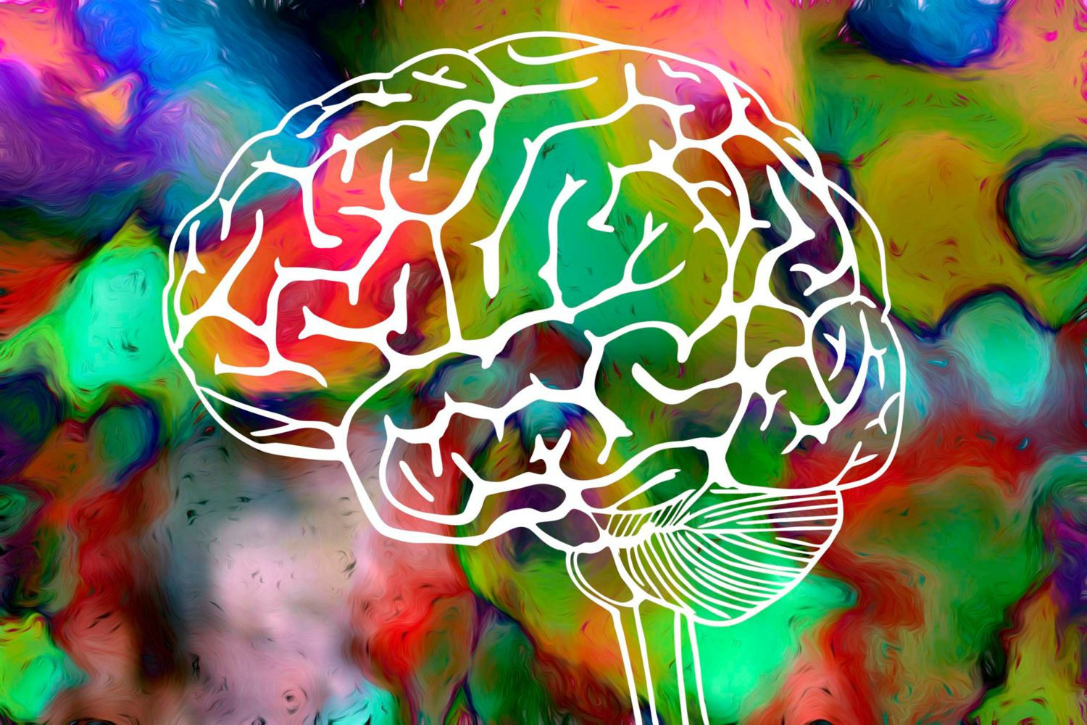
Lewy Body Dementia (LBD)
Pathophysiology: perpetuated by abnormal aggregation of alpha-synuclein proteins or “Lewy Bodies”
Both Dementia with Lewy Bodies (DLB) and Parkinson’s Disease Dementia (PDD) are subcategories of “Lewy Body Dementias”
PDD is simply the dementia that typically occurs in later stages of PD
DLB differs from PDD in the sequence of onset of motor vs. cognitive symptoms
DLB = cognitive symptoms usually occur BEFORE Parkinsonism (early hallucinations)
PDD = cognitive symptoms usually occur AFTER well established Parkinsonism
Clinical Features:
Motor
Parkinsonism
Non-motor
2nd leading cause of neurodegenerative dementia behind AD
Cognitive impairment
Serious behavioral disorders
Vivid and recurrent hallucinations
Sensitivity to antipsychotics
Notes:
Petsani C, Aloizou AM, Siokas V, et al. Therapeutic Application of rTMS in Atypical Parkinsonian Disorders. Behav Neurol. 2021;2021:3419907. Published 2021 Dec 23. doi:10.1155/2021/3419907
Liang X., Liu K., Guo L. Repetitive transcranial magnetic stimulation (rTMS): a possible novel therapeutic approach to dementia with Lewy bodies. Medical Hypotheses . 2010;74(5):877–879. doi: 10.1016/j.mehy.2009.11.020.
Gomperts SN. Lewy Body Dementias: Dementia With Lewy Bodies and Parkinson Disease Dementia. Continuum (Minneap Minn). 2016;22(2 Dementia):435-463. doi:10.1212/CON.0000000000000309

Slide 18
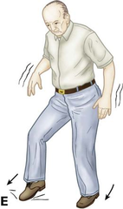
Multiple Systems Atrophy (MSA)
Pathophysiology: perpetuated by irregular aggregation of alpha-synuclein proteins in striato-nigral and olivo-ponto-cerebellar regions
Clinical Features:
Motor
Parkinsonism (MSA-P) – rigidity > tremor
Cerebellar ataxia (MSA-C) – gait ataxia, dysarthria, limb ataxia
Non-motor (may precede motor symptoms by years)
Autonomic dysfunction or failure: orthostatic hypotension, urinary incontinence, ED
REM sleep behavior disorders, sleep apnea
Pyramidal Signs – positive Babinski, hyperreflexia > spasticity
Respiratory dysfunction
Depression/anxiety
Dysphagia
Dystonia – antecollis
Notes:
Petsani C, Aloizou AM, Siokas V, et al. Therapeutic Application of rTMS in Atypical Parkinsonian Disorders. Behav Neurol. 2021;2021:3419907. Published 2021 Dec 23. doi:10.1155/2021/3419907
Deutschländer AB, Ross OA, Dickson DW, Wszolek ZK. Atypical parkinsonian syndromes: a general neurologist's perspective. Eur J Neurol. 2018;25(1):41-58. doi:10.1111/ene.13412

Slide 19
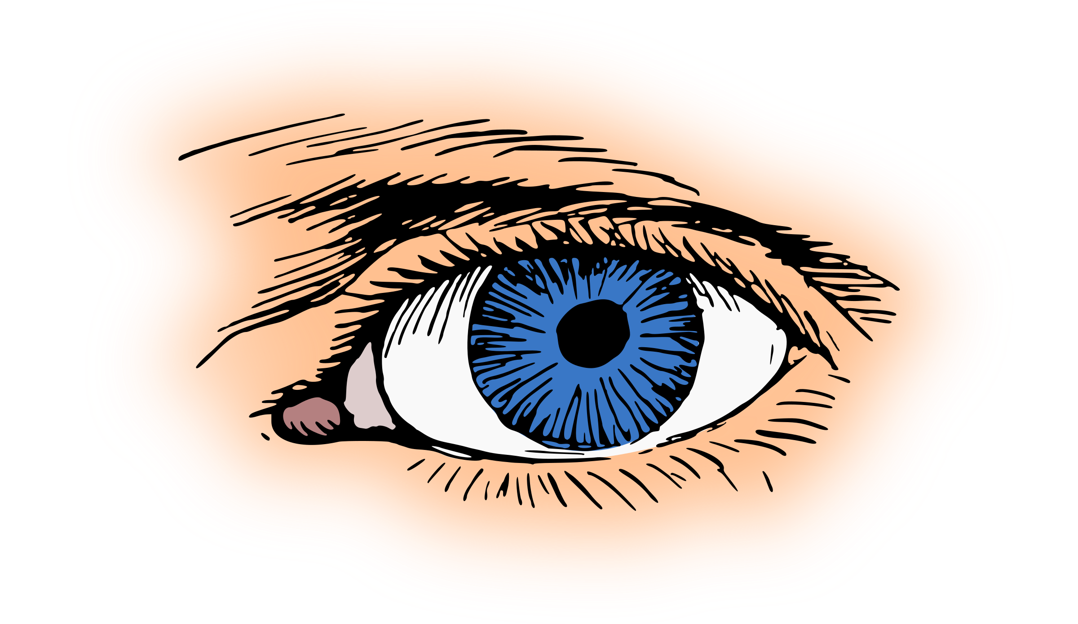
Progressive Supranuclear Palsy (PSP)
Pathophysiology: perpetuated by abnormal aggregation of tau proteins in regions of the basal ganglia and brainstem, usually superior to nuclei in charge of oculomotor function (hence “supranuclear”)
Clinical Features:
Motor
Difficult to distinguish from PD
Many phenotypes (10) with varying presentations depending on localization of tau protein accumulation
Postural instability + falls early (typically backwards), akinetic rigidity, ocular dysfunction (vertical gaze stability – especially downward limitation of eye movement)
Non-Motor
Early dementia – impaired memory
Behavioral changes, impaired inhibition, apathy, slowed thinking
Notes:
Progressive Supranuclear Palsy – EyeWiki
Petsani C, Aloizou AM, Siokas V, et al. Therapeutic Application of rTMS in Atypical Parkinsonian Disorders. Behav Neurol. 2021;2021:3419907. Published 2021 Dec 23. doi:10.1155/2021/3419907
Deutschländer AB, Ross OA, Dickson DW, Wszolek ZK. Atypical parkinsonian syndromes: a general neurologist's perspective. Eur J Neurol. 2018;25(1):41-58. doi:10.1111/ene.13412

Slide 20
Medical/PT Interventions for APDs
Not currently any DMDs successfully targeting tau/alpha-synuclein phosphorylation and overaccumulation
No large scale clinical trials have been completed to date on specific PT interventions – anecdotal success from clinical experience (LSVT-BIG)
Limited to symptomatic therapies
Early trial with levodopa is common in differentiation stage
Gradual increase to 900-1000 mg for 2-3 months for trial; continue if well tolerated
If APD, levodopa is generally ineffective, or only transiently effective
Botox injections for focal dystonia if present
Neuroleptics for psychotic symptoms (delusions, hallucinations, aggressiveness)
REM sleep disorders seen in MSA treated with clonazepam and melatonin
Notes:
Deutschländer AB, Ross OA, Dickson DW, Wszolek ZK. Atypical parkinsonian syndromes: a general neurologist's perspective. Eur J Neurol. 2018;25(1):41-58. doi:10.1111/ene.13412
Petsani C, Aloizou AM, Siokas V, et al. Therapeutic Application of rTMS in Atypical Parkinsonian Disorders. Behav Neurol. 2021;2021:3419907. Published 2021 Dec 23. doi:10.1155/2021/3419907

Slide 21
PT Role/Recommendations
Treat the person; discover what is important to them
Capitalize on potential neuroplastic changes with early intervention
May benefit from high intensity training such as LSVT-BIG
Tailor treatment strategies to stage of illness – motor learning vs. compensatory strategies
Drill importance of tailored daily exercise regimen as important management strategy to delay progression of neurodegenerative changes

Slide 22
A Cause To Hope
What’s the hold up?
Early and accurate APD diagnosis is prerequisite for large scale randomized clinical trials – considerable overlap in presentation of APD has made this difficult
MRI, radioligand imaging techniques (SPECT, PET) in development/undergoing trials
Genetics: new sequencing techniques and bioinformatics to identify disease causing genes and risk genes
Some early success in small scale pre-clinical trials with therapeutic application of repetitive Transcranial Magnetic Stimulation (rTMS) or deep brain stimulation with PSP (cerebellar rTMS), CBD, and LBD
Notes:
Petsani C, Aloizou AM, Siokas V, et al. Therapeutic Application of rTMS in Atypical Parkinsonian Disorders. Behav Neurol. 2021;2021:3419907. Published 2021 Dec 23. doi:10.1155/2021/3419907

Slide 23
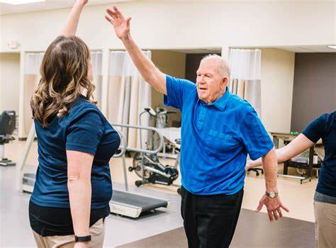
Questions?

Slide 24
References
1. Deutschländer AB, Ross OA, Dickson DW, Wszolek ZK. Atypical parkinsonian syndromes: a general neurologist’s perspective. Eur J Neurol. 2018;25(1):41-58. doi:10.1111/ene.13412
2. Petsani C, Aloizou A-M, Siokas V, et al. Therapeutic Application of rTMS in Atypical Parkinsonian Disorders. Behav Neurol. 2021;2021:3419907. doi:10.1155/2021/3419907
3. Sparrow D, DeAngelis TR, Hendron K, Thomas CA, Saint-Hilaire M, Ellis T. Highly challenging balance program reduces fall rate in parkinson disease. J Neurol Phys Ther. 2016;40(1):24-30. doi:10.1097/NPT.0000000000000111
4. Rafferty MR, Schmidt PN, Luo ST, et al. Regular exercise, quality of life, and mobility in parkinson’s disease: a longitudinal analysis of national parkinson foundation quality improvement initiative data. J Parkinsons Dis. 2017;7(1):193-202. doi:10.3233/JPD-160912
5. Morris ME, Martin CL, Schenkman ML. Striding out with Parkinson disease: evidence-based physical therapy for gait disorders. Phys Ther. 2010;90(2):280-288. doi:10.2522/ptj.20090091
6. Brusse KJ, Zimdars S, Zalewski KR, Steffen TM. Testing functional performance in people with Parkinson disease. Phys Ther. 2005;85(2):134-141. doi:10.1093/ptj/85.2.134
7. Vance RC, Healy DG, Galvin R, French HP. Dual tasking with the timed “up & go” test improves detection of risk of falls in people with Parkinson disease. Phys Ther. 2015;95(1):95-102. doi:10.2522/ptj.20130386
8. Gomperts SN. Lewy body dementias: dementia with lewy bodies and parkinson disease dementia. Continuum (Minneap Minn). 2016;22(2 Dementia):435-463. doi:10.1212/CON.0000000000000309
9. Progressive Supranuclear Palsy - EyeWiki. Accessed June 7, 2022. https://eyewiki.org/Progressive_Supranuclear_Palsy
10. Litvan I, Agid Y, Goetz C, et al. Accuracy of the clinical diagnosis of corticobasal degeneration: a clinicopathologic study. Neurology. 1997;48(1):119-125. doi:10.1212/wnl.48.1.119
11. Keener AM, Bordelon YM. Parkinsonism. Semin Neurol. 2016;36(4):330-334. doi:10.1055/s-0036-1585097
12. Differences of Parkinsonism vs. Parkinson Plus vs. Parkinson’s Disease. Accessed June 5, 2022. https://www.apdaparkinson.org/article/atypical-parkinsonism-parkinson-plus-syndromes/
13. Simon DK, Tanner CM, Brundin P. Parkinson disease epidemiology, pathology, genetics, and pathophysiology. Clin Geriatr Med. 2020;36(1):1-12. doi:10.1016/j.cger.2019.08.002

