Slide 1
ALS
Case Study
Hasmik Telfeyan, SPT
2nd Year Neuro STEP UP Scholar
DPT Class of 2023

Slide 2
Objectives
To understand common signs and symptoms of ALS
Develop an understanding of a usual course of PT care for an individual with ALS
To learn common outcome measures used for patients with ALS
Identify and apply evidence-based interventions for individuals with ALS

Slide 3
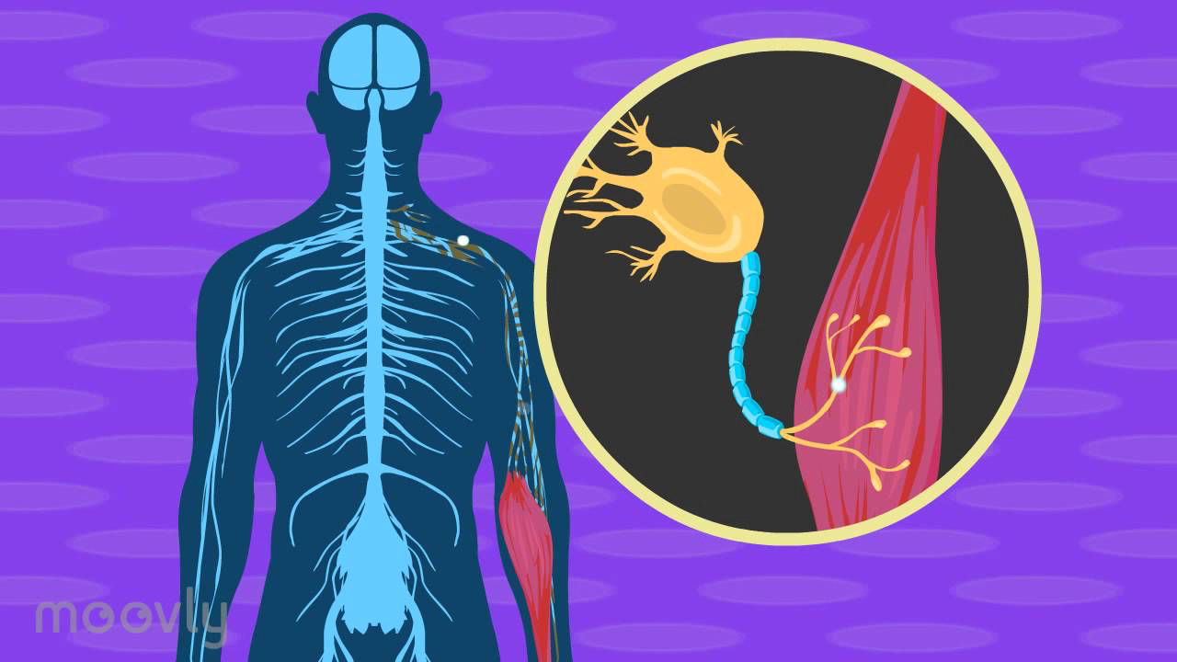
What is Amyotrophic Lateral Sclerosis?
Progressive neurodegenerative disease; loss of motor neurons which control voluntary muscles
90% of cases there is no known family history of the disease or presence of genetic mutation linked to ALS
5-10% of cases there is a known family history of disease
Diagnosis Criteria
Notes:
Diagnosis criteria
Signs of lower motor neuron degeneration by clinical, electrophysiological or neuropathologic examination
Signs of upper motor neuron degeneration by clinical examination
Progressive spread of signs within a region or to other regions with the absence of:
Electrophysiological evidence of other disease processes that might explain the signs of LMN/UMN degenerations
Neuroimaging evidence of other disease processes that might explain the observed clinical and electrophysiological signs

Slide 4
Common signs/symptoms
Lower Motor Neuron
Twitching - fasciculations
Cramping
Weakness with atrophy
Rapidly progressive disease
Eventually respiration is affected
Relatively preserved sensation, cognition, extraocular control, bowel/bladder function
Patterns of Progression
Focal weakness - arm, leg or bulbar
Often asymmetrical, progresses from distal to proximal
Upper Motor Neuron
Muscular stiffness
Hyperreflexia
Babinski reflex
Bulbar
Dysphagia
Dysarthria

Slide 5
Meet “Judy”: Chart Review
52 year old female diagnosed with ALS in August 2020
Had back spasms for 5 years prior to diagnosis
Initially noticed onset of R LE weakness, and R foot drop
Currently taking baclofen and gabapentin for spasticity and nerve pain
Hoffmans: present; Babinski: absent
Last visit to ALS multidisciplinary clinic December 2023
3 months ago reported she is having more difficulty walking
No other significant PMH or surgeries

Slide 6
Subjective
Changes and symptom progression?
Patient notices her R LE is weaker and her knees tend to buckle more
She is having difficulty sleeping at night due to muscle spasms and pain
She can transfer independently from her bed to her wheelchair, but requires assistance if she has been sitting for long periods of time
No falls
Home set up?
Single level house with ramp to enter
Bathroom is accessible with power chair, able to shower independently in shower WC
Activities? / ADL’s?
Retired school teacher
No longer driving
Able to do laundry, dishes, and chores around the house independently in her power chair
Exercise/stretching routine?
Patient says she is more “unmotivated” to perform exercises and stretches, and she is experiencing a lot of fatigue
She has a massage therapist come to her house once a week
Assistive device use?
Power chair for most mobility
Rollator for household ambulation
Off-the-shelf posterior AFO’s
In the process of getting custom solid AFO’s
Can’t use slide board for transfers due to softness of Roho cushion
Goals?
To stand at her daughter's wedding
To maintain independence with transfers
To have regular PT visits at home

Slide 7
Primary vs. Secondary Fatigue
Primary => caused by etiology
Remaining neurons or sprouted neurons overburdened, weak muscles work at higher percentage of max strength which quickens muscle fatigue
Secondary => Secondary to main symptoms and the toll the symptoms take on the body
Sleep disturbances, respiratory impairments, hypoxia, depression, immobility

Slide 8
Objective Information
ROM: R LE limited, especially hip flexion and DF
Spasticity: 1/4 MAS in B knee extensors; pt reports severe LE extensor tone especially at night and after resting for long periods of time
Sit ⇔ Stand: Requires use of BUE, locks out knees in standing with rolling walker
Standing Balance: Requires BUE use on walker to maintain standing; pt denied ambulation due to feeling of unsteadiness
Endurance: Pt able to stand for 2 minutes before needing to sit
Pain:
Patient reports she always has pain, describes as burning and achy
Worst: 8/10
Current: 2/10, mainly located in right hip and LE
MMT:
UE: Grossly 5/5
LE:
Hip Flexion: R: 2+/5; L:3-/5
Knee Extension: R: 3-/5; L: 4/5
Ankle Dorsiflexion: R: 1+/5; L: 3-/5

Slide 9
Outcome Measures
ALS-Functional Rating Scale
Function In Sitting Test
Gait Speed

Slide 10
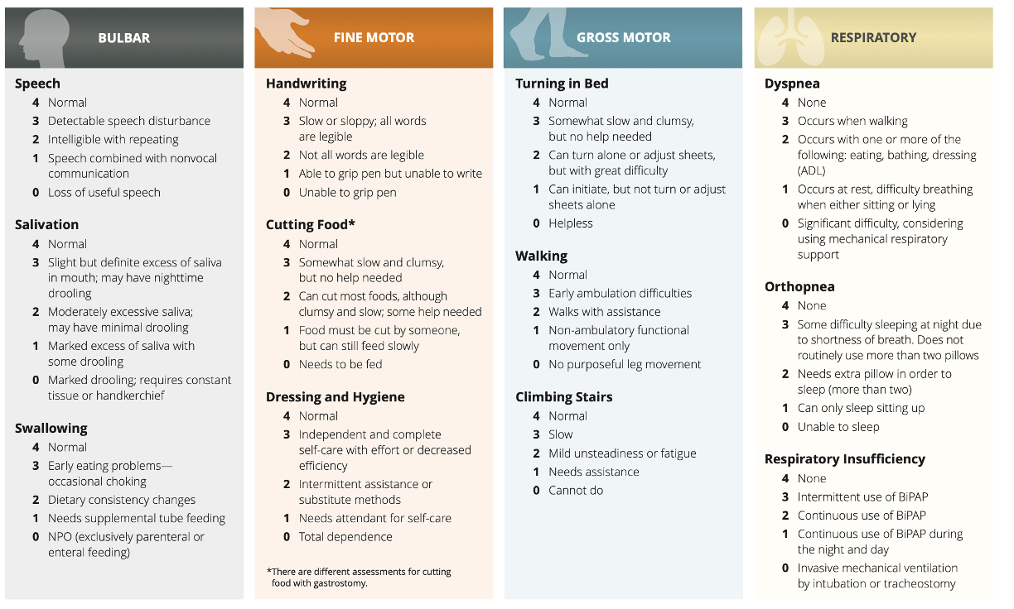
ALS-Functional Rating Scale Revised (ALSFRS-R)
Notes:
Max score 40, min score 0 - higher score, more function
0 indicates unable, 4 indicates normal ability

Slide 11
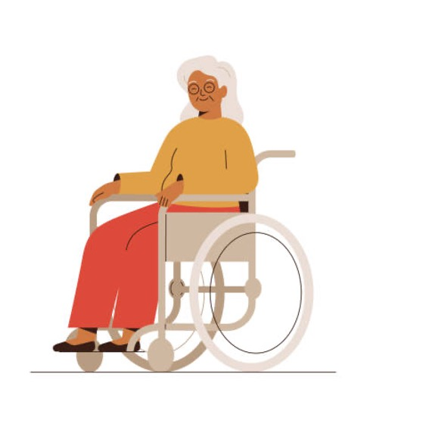
Function in Sitting Test
https://www.sralab.org/sites/default/files/2017-07/fist_score_sheet.pdf
Notes:
●Static sitting: 30 seconds
●Sitting, shake ‘no’: left and right
●Sitting, eyes closed: 30 seconds
●Sitting, lift foot: dominant side, lift foot 1 inch twice
●Pick up object from behind: object at midline, hands breadth posterior
●Forward reach: use dominant arm, must complete full motion
●Lateral reach: use dominant arm, clear opposite ischial tuberositiy
●Pick up object from floor
●Posterior scooting
●Anterior scooting
●Lateral scooting
●
●4 = Independent (completes task independently & successfully)
3 = Verbal cues/increased time (completes task independently & successfully and only needs more time/cues) 2 = Upper extremity support (must use UE for support or assistance to complete successfully)
1 = Needs assistance (unable to complete w/o physical assist; document level: min, mod, max)
0 = Dependent (requires complete physical assist; unable to complete successfully even w/physical assist)

Slide 12
Stages of ALS: Exercise Considerations
Early:
Safe enough to participate in most strengthening
moderate intensity exercise
pronounced fatigue and shortness of breath (SOB) with activity
Middle:
Adaptations for exercise
Monitor for SOB
Preferable to use stationary bike for aerobic over walking
Closely monitor if over-extended/over-fatigued
Late:
ROM
Pain management
PROM with caregivers
Breathing

Slide 13
Interventions
Evidence suggests exercise can slow the decline of function and benefit an individual’s quality of life
Therapeutic Exercise
Gait training
Postural exercises/education
Assistive device recommendations
Patient/family education
HEP

Slide 14
Multidisciplinary Clinic Recommendations
TherEx
Gait Training
Education
Stretching: Passive range of motion especially into dorsiflexion
Aerobic Exercise: 10 minutes of recumbent cycling at 40-60% of HR reserve; recommended foot bike
Resistance Exercise: pt must have at least 3/5 in mm group; 3 sets of 5 reps targeting UE
Ambulation with AFO’s and rollator
Gait speed
Ambulating on flat surfaces: recreate pt home environment to practice functional tasks
Exercise parameters: feelings of fatigue/weakness should not last more than 20-30min after exercise
Disease progression and what to expect
Educate caregiver on how to assist with exercises
Education on positioning

Slide 15
Forum Questions
Judy is starting home health therapy and you are her therapist. Write out a plan of care including what you would evaluate on the first visit, interventions you would implement, and 4-5 goals. Be sure to include frequency and duration of PT.
What other assistive devices/assistive technologies would you expect Judy would need as her disease progresses? What resources would you provide to help her and her family? Use resources to support your response.
As Judy continues to lose function, how would you change your interventions? Use evidence to support your response.
Judy and her family are worried about her prognosis and how rapidly ALS can progress. Write out your response to them, and make sure to use resources to support your response.

Slide 16
References
McCulloch, Karen. Amyotrophic Lateral Sclerosis. University of North Carolina at Chapel Hill. 2022
Causes of fatigue | MS Society. Accessed April 24, 2023. https://www.mssociety.org.uk/about-ms/signs-and-symptoms/fatigue/causes-of-fatigue
Gordon PH, Miller RG, Moore DH. ALSFRS-R. Amyotroph Lateral Scler Other Motor Neuron Disord. 2004;5 Suppl 1:90-93. doi:10.1080/17434470410019906
Function in Sitting Test | RehabMeasures Database. Accessed April 24, 2023. https://www.sralab.org/rehabilitation-measures/function-sitting-test
Kalron A, Mahameed I, Weiss I, et al. Effects of a 12-week combined aerobic and strength training program in ambulatory patients with amyotrophic lateral sclerosis: a randomized controlled trial. J Neurol. 2021;268(5):1857-1866. doi:10.1007/s00415-020-10354-z
Bello-Haas VD, Florence JM, Kloos AD, et al. A randomized controlled trial of resistance exercise in individuals with ALS. Neurology. 2007;68(23):2003-2007. doi:10.1212/01.wnl.0000264418.92308.a4

