Slide 1
Billing in Acute Care With a focus on ethical and legal obligations as practicing clinicians
An Inservice by Mac Garrett, SPT
Notes:
Information in italics is what I plan to speak to the audience on each slide, aside from what is already on the slide.
Good afternoon everyone. My name is Mac Garrett, the topic of the Inservice today is Billing in Acute Care, with a focus on ethical and legal obligations as practicing clinicians. If everyone will hold questions and comments till the end, we will have a few minutes that are dedicated to a brief open discussion.

Slide 2
**Disclaimer**
This Inservice is not intended to be targeted at any specific corporation, healthcare facility, or individual clinician. This is meant to be an open discussion for PT’s and PTA’s regarding productivity and billing through a broad scope of Physical Therapy as practicing clinicians.
Notes:
I felt as though it was appropriate to include a disclaimer due to the nature of the topics of ethics and productivity.

Slide 3
Learning Objectives
With completion of this Inservice, participants will be able to accurately define the differences between CPT codes and how to appropriately bill for them.
With completion of this Inservice, participants will be able to understand how untimed evaluation charges and timed charges are billed in the same session while maintaining ethical and legal standards.
Notes:
Here are the learning objectives for this presentation, I will give everyone some time to read through these.

Slide 4
Timed vs. Untimed Codes¹
Timed Codes
Provider furnishing the service must remain in constant attendance with the patient receiving the services.
Therapeutic Exercise
Therapeutic Activities
Manual Therapy
Neuro Re-Ed
Gait Training
Untimed Codes
Typically billed as a “one time” charge per patient per date of service
PT Evaluations
PT re-evaluations
Notes:
You can get the new 2023 coding and payment billing guide from the APTA for $150.
In the acute setting, fee for service is not the system for reimbursement, we will explore this later on.
https://www.webpt.com/blog/timed-and-untimed-a-tale-of-two-physical-therapy-billing-codes/

Slide 5
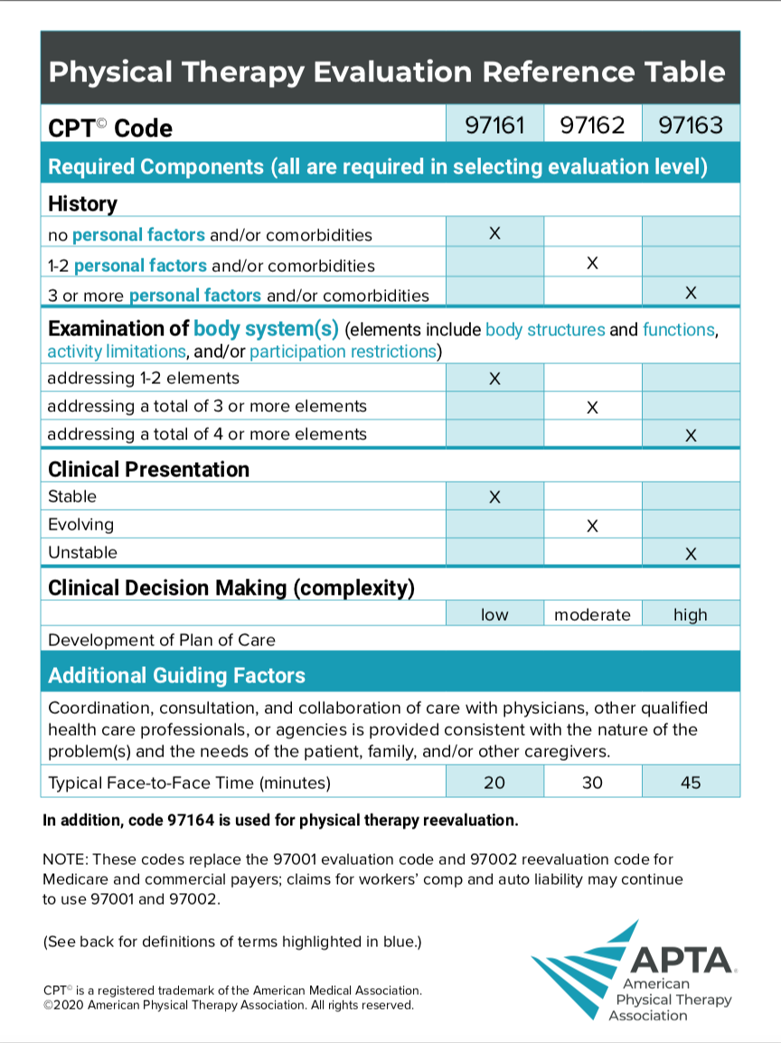
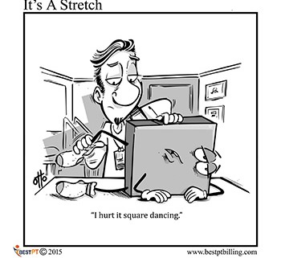
Notes:
This is a screenshot of the APTA’s quick guide for evaluations. It is a great resource for determining evaluation complexity.

Slide 6
CPT Codes Defined*
CPT code definitions, some examples
Therapeutic Exercises: pt performs exercises to one or more areas to increase strength, ROM, endurance, and flexibility
Therapeutic Activities: pt performs activities designed to achieve improved functional performance
Neuro Re-Ed: pt performs activities that facilitate reeducation of movement, balance, coordination, posture, and proprioception
Gait Training: Provider trains pt in activities to facilitate ambulation and stair climbing, with or without AD. Instruction includes proper gait sequencing, instruction in weight bearing, and safety.
*Per handout from PHYT 705 Class, Ellen Roeber, PT, DPT. Taken from: Ingenix "Coding and Payment Guide for the physical therapist"
Notes:
Before: Here we have some CPT codes that are defined through a handout I received in school. This is for your reference.
After: I find it helpful that Therapeutic Activity is the broadest definition of these examples, this gives us more flexibility when working with patients and documenting our sessions.

Slide 7
Where does one end and the other begin?
Example Scenario:
You perform an evaluation on a patient and are questioning if there was additional time spent with therapeutic activity or therapeutic exercise, what do you do when documenting your total time vs treatment time?
Documentation needs to support that there was clearly time spent solely on a timed service such as therapeutic exercise, gait training, etc. that is separate from evaluation time
“PT Eval and Treat”
Notes:
Before: This is a scenario that I personally have encountered throughout my clinical experiences.
After: If you are given orders of “PT Eval and Treat,” this gives the therapist the “go-ahead” to perform an evaluation and treatment within the same day and session of the service.

Slide 8
If you are audited, how do you stay covered?*
Audits are used to determine if existing standards of care are being met
This may include focusing on billing accuracy compared to the medical record or it may focus on the medical necessity
Make sure the claims you are making are accurate and supported by your documentation
Documentation review sample checklists are available online
*Today’s Physical Therapist: A Comprehensive Review of a 21st-Century Health Care Profession, Prepared by the American Physical Therapy Association January 2011
Notes:
Before: There are systems in place to ensure quality and accuracy of documentation is maintained. This is through audits.
After: ”Today’s Physical Therapist” is a great resource I found from the APTA that gives you a nice comprehensive overview of everything you need to know with practicing as a PT in today’s world.

Slide 9
Payment for PT Service Under Medicare²
Medicare Part A
Medicare policies are determined based*
Setting of service
Acute conditions
Manifestations of chronic conditions
Inpatient hospital PPS (prospective payment system) pays pre-determined per-discharge rates that are based primarily on patient’s condition and related treatment strategy.*
PT service does not directly generate money for the hospital, our value comes from decreasing chance of readmission, proper discharge, and increased patient satisfaction.²
If a patient gets a condition while staying in the Hospital, this is not reimbursed by insurance and the hospital will have to cover cost²
Pressure Ulcers
Information also taken from:
Today’s Physical Therapist: A Comprehensive Review of a 21st-Century Health Care Profession, Prepared by the American Physical Therapy Association January 2
Notes:
Between 3rd and 4th bullet point: In acute care, when a PT/ PTA issues “charges,” it is more for recording services provided rather than collecting directly on the charges issued for a session, so not technically billing for time and services.
Today’s Physical Therapist:
A Comprehensive Review of a
21st-Century Health Care Profession
Prepared by the American Physical Therapy Association January 2011
https://billingdynamix.com/medicare%E2%80%8C-%E2%80%8Cregulation%E2%80%8C-%E2%80%8Cdocumentation%E2%80%8C-%E2%80%8Cand%E2%80%8C-%E2%80%8Cfinance/

Slide 10
Notes:
Here is the resource I mentioned previously.

Slide 11
Productivity standards, the good.
The Good:
With healthcare costs on the rise, it is a way to quantify that our service is medically necessary³
Opens the door for incentives with employees
Intended to reduce administrative burden
Large amounts of research shows the neurological connection between happiness and productivity⁴
Notes:
Before: Now let’s move on to talk about productivity, I would like to briefly touch on some of the ”good and bad” of productivity that I was able to find through my research.
https://www.healthaffairs.org/do/10.1377/forefront.20190321.822588/full/ 3
https://www.mwtherapy.com/blog/3-ways-to-measure-physical-therapist-productivity/ 4

Slide 12
Productivity standards, the bad
The Bad:
Study of PT’s and PTA’s surveyed for ethical behavior in Texas.⁵
Positive correlation found between expected productivity rate and rate of unethical behavior observed
Organizations that emphasized ethical practice and evidence-based practice were negatively correlated with total observed unethical behavior.
Healthcare is a difficult field to be “productive” in
Patients are typically not stable
No two patients are exactly alike
Notes:
Middle: This research is from schools that surveyed Texas PT settings in 2019 found that 89% of total responses to the survey found some form of unethical behavior but almost 70% of them said it rarely happened.
The last bullet points are some personal thoughts I came up with throughout reflecting on my clinical experiences.
https://www.sciencedirect.com/science/article/pii/S2590109519300011

Slide 13
Percent of clinicians observing unethical behavior⁵
Patients on caseload not meeting skilled criteria
Acute Care: 81%
SNF: 86%
Private OP: 63%
Subacute IPR: 81%
Counting treatment time not permitted by payer sources
Acute Care: 54%
SNF: 76%
Private OP: 39%
Subacute IPR: 61%
Notes:
Here are some of the responses to the survey by the numbers.

Slide 14
Some examples in North Carolina
Current Disciplinary Actions in NC⁶
Of 6 PTA’s on the list, 3 of them are due to misleading or falsifying documentation.
Notes:
Disciplinary actions based around billing or fraudulent charging tends to be oriented towards PTA’s more so than PTs
https://ncptboard.org/app/ConsumerProtection/DisciplinaryActions.php

Slide 15
NC Laws
NC PT Board Rules
21 NCAC 48G .0601 PROHIBITED ACTIONS:
(19) billing or charging for services or treatment not performed
(20) making treatment recommendations or basing a patient's continued treatment on the extent of third party benefits instead of the patient's condition;
PT’s/PTA’s suspected or found to be performing prohibited actions are at risk of disciplinary action by the board
Probation
Warning
Here is a great resource for frequently asked questions regarding scope of practice:
https://www.ncptboard.org/app/LandingPages/ScopeOfPracticeHome.php
Notes:
These are behaviors prohibited and can result in disciplinary action by the board.
21 NCAC 48G .0601 PROHIBITED ACTIONS:

Slide 16
Ethical Standards
APTA Code of Ethics Stance with regards to Documentation⁷
3A. Physical therapists shall demonstrate independent and objective professional judgment in the patient’s or client’s best interest in all practice settings.
4A. Physical therapists shall provide truthful, accurate, and relevant information and shall not make misleading representations.
7E. Physical therapists shall be aware of charges and shall ensure that documentation and coding for physical therapist services accurately reflect the nature and extent of the services provided.
7F. Physical therapists shall refrain from employment arrangements, or other arrangements, that prevent physical therapists from fulfilling professional obligations to patients and clients.
Notes:
These are the specific APTA Code of Ethics standards I could find that should be considered when we are conducting sessions with patients and documenting.
https://www.apta.org/siteassets/pdfs/policies/codeofethicshods06-20-28-25.pdf

Slide 17
Combined Forces!
“A consensus statement by AOTA, the American Physical Therapy Association (APTA), and the American Speech-Language-Hearing Association (ASHA) strongly emphasized that clinical judgment is central to making informed decisions about patient care. Treatment should always be designed in the client’s best interest and be medically necessary.”⁸
Notes:
Before: Here is a statement made by AOTA addressing productivity, I thought it was great that OT’s, Speech Therapists, and PT’s were able to come together on this, considering we work so closely within the practice setting.
https://scholarworks.wmich.edu/cgi/viewcontent.cgi?article=1598&context=ojot

Slide 18
Shortcomings of the research
Most of the productivity research is based on self-reporting from surveys of therapists
Other information on productivity is from news/ journal articles created by an individual
This gives potential for response bias, more likely opinion based
Notes:
Before: Here are some of the shortcomings I found along the way with the research I found for this Inservice.
After: People who are passionate about the subject may be more inclined to provide a response.

Slide 19
Opening the floor up…
Have we self inflicted these wounds?
The more research on necessity for PT, the more patients are “appropriate,” the more employment required, the more productivity standards increase to justify service
One article reports that 20 years ago, Johns Hopkins Hospital had 3,000 people employed to take care of 1,000 beds. That number of employed is now 12,000 with the same number of beds and discharges.²
We are constantly “evaluating” a patient’s performance during evaluations and treatment sessions, are you allowed to evaluate a patient while you have them perform therapeutic exercises?
Notes:
Before: Now, I would like to open the floor up to any questions/ comments for a brief discussion. Here are some reflection questions I tried to jot down as I conducted research and created this PowerPoint.
The third bullet is an interesting fact I found online when Johns Hopkins was assessing productivity in a hospital setting.
https://www.healthaffairs.org/do/10.1377/forefront.20190321.822588/full/

Slide 20
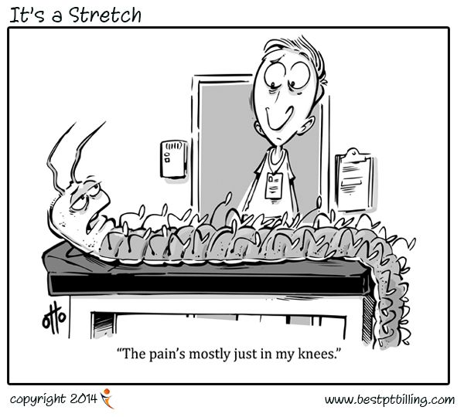
The purpose of this Inservice
Confidently bill for your time!
Know your ethical and legal obligations!
Notes:
Thank you everyone, for taking the time out of your busy schedules to listen to this Inservice. At the end of the day, be confident with your billing and abide by your ethical and legal obligations!

Slide 21
Sources Cited
Hughes M, Clifford M. Timed and untimed: A tale of two physical therapy billing codes. WebPT. https://www.webpt.com/blog/timed-and-untimed-a-tale-of-two-physical-therapy-billing-codes/. Published May 24, 2021. Accessed June 12, 2022
Blonksi N. Medicare regulation, documentation, and Finance. Billing Dynamix. https://billingdynamix.com/medicare%E2%80%8C-%E2%80%8Cregulation%E2%80%8C-%E2%80%8Cdocumentation%E2%80%8C-%E2%80%8Cand%E2%80%8C-%E2%80%8Cfinance/. Published November 9, 2020. Accessed June 12, 2022.
Pronovost PJ, Sapirstein A, Ravitz A. Improving hospital productivity as a means to reducing costs: Health Affairs Forefront. Health Affairs. https://www.healthaffairs.org/do/10.1377/forefront.20190321.822588/full/. Published March 26, 2019. Accessed June 12, 2022.
3 ways to measure physical therapist productivity. MWTherapy. https://www.mwtherapy.com/blog/3-ways-to-measure-physical-therapist-productivity/. Published May 26, 2020. Accessed June 12, 2022.
Tammany JE, O’Connell JK, Allen BS, Brismée J-M. Are productivity goals in rehabilitation practice associated with unethical behaviors? American Congress of Rehabilitation Medicine. 2019;1(1-2):100002. doi:10.1016/j.arrct.2019.100002
Disciplinary Actions. Disciplinary actions. https://ncptboard.org/app/ConsumerProtection/DisciplinaryActions.php. Published December 26, 1970. Accessed June 12, 2022.
Code of Ethics for the Physical Therapist. https://www.apta.org/siteassets/pdfs/policies/codeofethicshods06-20-28-25.pdf. Published December 8, 2020. Accessed June 12, 2022.
Bennett LE, Jewell VD, Scheirton L, McCarthy M, Muir BC. Productivity standards and the impact on quality of care: A national survey of inpatient rehabilitation professionals. The Open Journal of Occupational Therapy. 2019;7(4):1-11. doi:10.15453/2168-6408.1598

