Slide 1
Improving Efficiency in Utilization of Acute Care Physical Therapy
Justin Dreessen, SPT
University of North Carolina – Chapel Hill
Notes:
Improving Efficiency in Utilization of Acute Care Physical Therapy

Slide 2
Objectives
Define unskilled consult
Recognize the opportunity to improve efficiency in acute care PT
Understand the importance of interdisciplinary education and collaboration
Take away tangible action steps to implement in practice to improve patient care

Slide 3
Improvement of Physical and Occupational Therapy Referral Process to Reduce Unskilled Consults¹
Northwestern Memorial Hospital houses 894 beds w/ 34 PT/PTAs and 26 OTs
Baseline data collected for 9 months showed PT and OT services consulted 14.5% of the time for unskilled therapy needs
Multidisciplinary education intervention to reduce unskilled consults
“Unskilled consults” defined and categorized as:
Patient not medically appropriate to participate
Patient not cognitively intact to actively participate in a therapeutic manner
Patient demonstrating baseline level of functional mobility with nursing/medical team
Patient requiring next level of care to address musculoskeletal issue in the outpatient setting

Slide 4
Methods¹
Team of PTs and OTs covering 4 adult inpatient general medicine units
Trained through one-time meeting on how to define each category, how to select these categories in the EMR, and how the data would be collected
One follow-up education session and one recurring monthly meeting, which included 3 case scenarios

Slide 5
Methods¹
Established interdisciplinary focus group, including 2 PTs, 1 OT, 2 MDs, 2 RNs, 2 attending (discharge) RNs, and a SW
Feedback from providers regarding culture of mobility, role of PT/OT, skilled versus unskilled PT/OT consults, and strategies to reduce unskilled consults
Incorporate mobility and ADL discussion for each patient in IDR
What is the expectation of mobility/ADL performance, and by whom/how should this be communicated?
4 likely root causes to unskilled consults:
Orders placed preemptively by hospitalists
Hospitalists unsure of mobility level before consulting PT/OT
Mobility/ADL expectation as a priority in IDR is not high
RN unsure of mobility or ADL level

Slide 6
Methods¹
PT/OT attended IDR 3 days per week and led discussion around mobility and ADL performance and discharge recommendations
Unit clinic coordinator and hospitalists led IDR meetings and were tasked to educate their department to consistently promote discussion of mobility and ADL performance during IDR
Unit clinic coordinator provided with and educated on using handout to stimulate mobility/ADL discussion

Slide 8
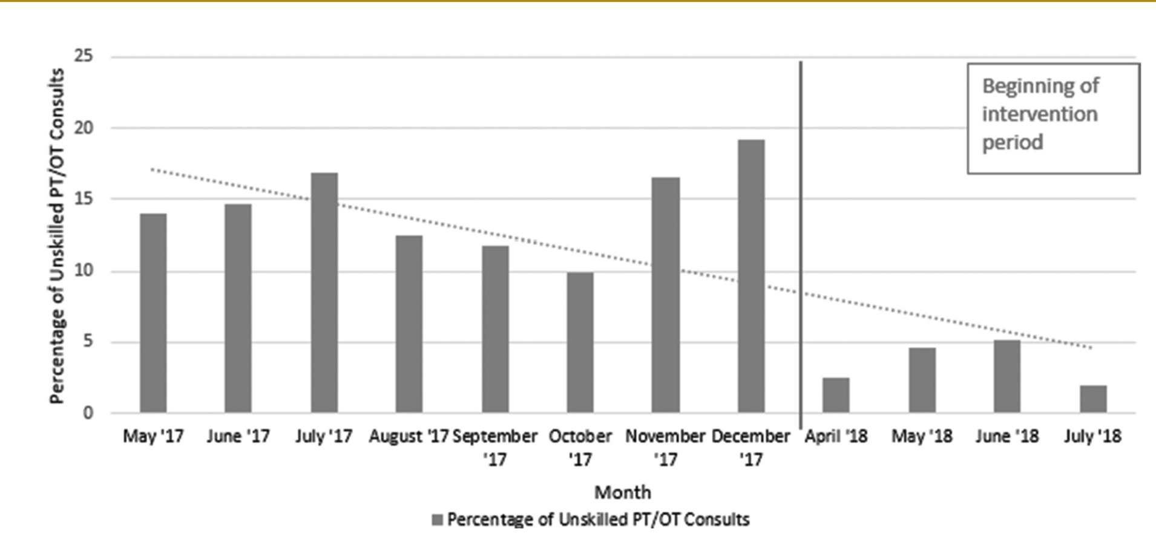
Results¹
PT and OT collectively consulted for unskilled therapy needs 14.5% of the time down to 3.05%
“Patient at baseline level of function” was most likely type of unskilled consult preintervention
Interdisciplinary approach using IDR can reduce unskilled consults
Total PT/OT consults during intervention period = 734
% reduction in unskilled consults = 10.55%
734 x 10.55% = 78 less PT/OT consults over 8 weeks across 3 therapists

Slide 9
Efficiency Breakdown¹
Total PT/OT consults during intervention period (734) × % reduction in unskilled consults (10.55%) = number of skilled PT/OT consults culled by reducing unskilled consults (78)
Divided among 3 PTs, the consult volume/week during intervention period = 30.5 consults/week (734/8 weeks = 91.75/3 therapists = 30.5)
Using the % reduction in unskilled consults (10.55%), after the intervention period = 27.3 consults/week (734 − 78 = 656/8 weeks = 82/3 therapists = 27.3)
The consult volume reduction from 30.5 to 27.3 (3.2), creates 19.2 weeks of PT time/year, or 0.37 FTE (19.2/52) to respond to skilled consults.
Notes:
FTE (full-time equivalent) = scheduled hours/employer’s hours for a full-time work week

Slide 10
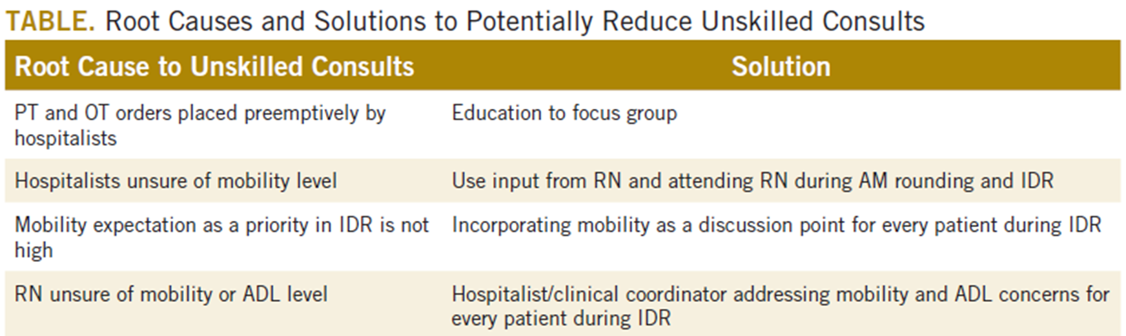
Discussion¹
Flexibility to respond to same-day orders for other patients with skilled therapy need for evaluation/treatment
Improved communication within interdisciplinary team opening discussion for each discipline’s role in patient mobility while hospitalized
PT/OT role in education was objectifying what constituted as a skilled versus unskilled consult
Mobility and ADL discussions were more productive when hospitalists set expectation for daily mobility with nursing staff
Developed culture of mobility and assisted in determining the right provider to perform tasks like walking and toileting

Slide 11
Defining Potential Overutilization of Physical Therapy Consults on Hospital Medicine Services²
During hospitalization, patients spend 87% to 100% of their time in bed, which is a key contributor to hospital-associated disability (HAD)
Early mobilization and throughout hospitalization to prevent HAD typically falls on shoulders of PT
PTs are a constrained resource in most inpatient settings
Aimed to assess potential overutilization of PT consults on direct care hospital medicine services using validated AM-PAC cutoffs

Slide 12
Methods²
Retrospective cohort of admissions throughout one year on all direct care hospital medicine services at the University of Chicago Medical Center (UC)
General medicine, oncology, transplant (renal, lung, and liver), cardiology, and cirrhotic populations at the medical-surgical and telemetry level of care
Patients hospitalized for longer than 48 hours
Exclusion: patients who left AMA; died; d/c to hospice, another hospital, or an inpatient psychiatric facility; or received no PT referral during admission
Age, sex, admission and d/c dates, admission and d/c AM-PAC scores, and discharge disposition obtained
At UC, nursing staff assess and documents AM-PAC mobility scores for each patient at the time of admission and every nursing shift thereafter

Slide 13
Methods²
Primary outcome: potential overutilization
Secondary outcome: d/c disposition and change in mobility
Predictors: AM-PAC score, age, and sex
AM-PAC score of 42.9 (raw score, 17) = cutoff for predicting d/c to home
Physical therapy consults “potentially inappropriate”: patients with admission AM-PAC scores >43.63 (raw score, 18) who were d/c home
At UC, nursing staff independently mobilize patients with AM-PAC scores >18
D/c home: going home with no additional needs or services, going home with outpatient PT, or going home with home health PT
None of these require inpatient PT assessment for order to be placed
D/c to post-acute care: long-term acute care, SNF, subacute rehab facility, or acute rehab facility
Loss of mobility calculate as: d/c AM-PAC – admission AM-PAC

Slide 14
Results²
3592 admissions with PT consults (58% of all admissions)
Mean age: 66.3 years
48% female
Mean admission AM-PAC score: 43.9 (SD, 11.1)
Mean admission d/c AM-PAC: 46.8 (SD, 10.8)
38% of PT consults for patients with AM-PAC score >43.63 who were d/c to home and deemed “potential overutilization”
89% of patients with AM-PAC >43.63 d/c home compared to 55% ≤43.63
Most of the 11% with high mobility not d/c home due to personal/social or medical needs
Only 16% of the 11% (n = 23) experienced deconditioning necessitating PT consult during hospitalization
79% of patients younger than 65 d/c home compared to 63% older than 65
Mean delta AM-PAC: AM-PAC > 43.63 on admission = -0.41, AM-PAC on admission ≤ 43.63 = +5.69
AM-APC > 43.63 and age younger than 65 associated with increased odds to d/c to home

Slide 15
Discussion²
Limitations:
Did not consider whether PT contributed to patients’ ability to return home after d/c
Did not consider d/c diagnosis
PTs may be unnecessarily consulted on direct care hospitalist services as much as 38% of the time based on AM-PAC score
Patients admitted with high mobility by AM-PAC score are more than 5 times as likely to d/c to home
When admitted with high AM-PAC scores, patients had very little change in mobility during hospitalization, whereas patients with low AM-PAC scores gained mobility during hospitalization
Significant benefit of PT in low AM-PAC patients
Appropriate allocation of PT has the potential to improve outcomes from the patient to the payor level
Identifying patients who will benefit from skilled physical therapy at time of admission can help prevent disability and institutionalization and shorten length of stay
PT consult may be necessary later in hospitalization for reasons other than mobility
Decreasing PT referrals for low-risk patients can increase amount of time spent rehabilitating at-risk patients
Notes:
Resilience

Slide 16
Development of a Unique Triage System for Acute Care Physical Therapy and Occupational Therapy Services³
Purpose: develop a triage tool to improve patient access to medically necessary therapy services
Reduce the following: inefficient use of resources, potential liability risks for patients not seen, and staff dissatisfaction from burnout
Triage tool and decision tree developed to determine which patients referred to therapists for acute care therapy required skilled services
Triage tool examined therapy referrals for patients from 2 large academic hospitals (1,157 beds with 38 PTs/8 PTAs/33 OTs/9 COTAs/295-430 caseload, 794 beds with 10 PTs/3 PTAs/3 OTs/70-90 caseload)
6 criteria used to determine which evaluations should be cancelled
Notes:
Burnout from determining which patients take precedence when the demands for care exceed what can be provided – limiting the provision of healthcare
High demand of PT services can lead to inadequate therapy interventions

Slide 17
Methods³
Rehab Innovation and Optimization Team (RIOT)
4 therapist managers who oversee both PT and OT along with a physiatrist from a large physical medicine and rehab department
Enrolled in an intense education and training program on quality improvement methods
Address lack of consistency in triage of referrals to acute care PT/OT and reducing volume of referrals that did not meet Centers for Medicare and Medicaid Services standards for medical necessity in acute care settings
Reviewed 246 medical records
Exclusion criteria: referrals from orthopedics, physiatry, pediatrics, psychiatry, and pulmonology; referrals for hand therapy, wound or lymphedema management, and after selective denervation for torticollis
Notes:
According to the CMS, the elements of medical necessity for therapy services include the following: adherence to acceptable standards of practice; a level of complexity and sophistication that only a qualified therapist or someone under the direction of a therapist can achieve; an intervention that will lead to significant improvement in a reasonable time frame; and the establishment of functional maintenance programs, when appropriate.

Slide 18
Methods³
Triage tool created with survey format
2 therapist leaders screened all referrals that met inclusion criteria (N=170)
No consults cancelled or deferred in this beta period
Recommendation about appropriateness of therapy services made but not communicated to evaluating therapist
2 additional project team members reviewed evaluating therapist’s documentation because all consults were allowed to progress to caseload
Triage tool correctly recommended cancellation 100% of the time
Once triage tool validated, process implemented at both hospitals
Took RIOT team 3-5 minutes to review EMR to triage referral
Education presented to referring providers, nurse managers, and social workers

Slide 21
Outcomes³
Systematic triage system reduced number of therapy evaluations that were not appropriate by 29%
Improvement in availability of therapy services for patients who required skilled care
Average number of patients per therapist per workday decreased from 18.9 to 12.1 and from 15.1 to 12.8 in the 2 hospitals
Therapist productivity and net revenue improved
Notes:
Hospital B with more ortho caseload which was excluded
3-5 mins of management triage vs 30-90 mins of therapist chart review, eval, and documentation

Slide 22
Toward a Common Language for Measuring Patient Mobility in the Hospital⁴
Johns Hopkins Hospital
Objective: Evaluate the reliability and minimal detectable change of AM-PAC IMSF and JH-HLM when completed by nurses and PTs and to evaluate the construct validity of both measures when used by nurses
Test-retest reliability and the interrater reliability of AM-PAC IMSF and JH-HLM for inpatients in the neuroscience department (n=118) were evaluated
Each participant scored twice by a team of 2 nurses and 1 PT
4 PTs and 8 nurses participated in reliability testing
Construct validity evaluated via assessment of convergent validity with other measures of function (grip strength, Katz Activities of Daily Living Scale, 2-minute walk test, 5-times sit-to-stand test) used by 5 nurses
Notes:
John Hopkins Highest Level of Mobility scale

Slide 23
Results⁴
AM-PAC IMSF test-retest reliability values for PTs = 0.91 and nurses = 0.97
JH-HLM test-retest reliability values for PTs = 0.94 and nurses = 0.95
Interrater reliability values between PTs and nurses
0.96 for AM-PAC IMSF
0.99 for JH-HLM
The AM-PAC IMSF and JH-HLM had excellent interrater reliability and test-retest reliability for both PTs and nurses
AM-PAC IMSF and JH-HLM measured constructs of patient mobility and physical functioning

Slide 24
Cases
25 y.o. admitted with join pain/swelling; pain resolved; independent
37 y.o. with hypoglycemia; independent
46 y.o. with renal failure; independent
Pt with possible PNA; independent
Independent pt who was d/c from PT with home recommendation; social issues and wound care preventing d/c; new consult for pre-cert to SNF/new d/c recommendation

Slide 25
Therapy Consult
Consult pre-op / med work up evolving/pending
Therapy needs
Educate / screen / attempt written
Yes
No
has needs could go home
has needs medically labile
has needs slow progress
has needs D/C keeps changing
has needs no facility
has needs / refuses
no needs / refuses
no needs new baseline
Immobility harm risk
no needs
Complex needs
Dementia / guarding
Risk / Harm
No
Yes
Triage 3 vs 4
For Now Call Kerry
Notes:
Rhodes 1080
James created this

Slide 26
Takeaways
Focus on the difference in level of function from prior to current
Begin with far ends of the curve (completely independent/dependent)
Give mobile patients the tools to stay independent in hospital, and take them off caseload (education, HEP, etc.)
Screen rather than conduct a consult
Facilitate mobility conversation with interdisciplinary members of care team
Management is working on implementing AM-PAC system with nursing
Evidence supports offloading some patients, but we have nowhere to funnel them currently

Slide 27
References
1. Bednarczyk M, Pritchard K, Barquin W, Beyer A, Stankiewicz C. Improvement of physical and occupational therapy referral process to reduce unskilled consults. J Acute Care Phys Ther. 2020;11(2):54-58. doi:10.1097/JAT.0000000000000115
2. Martinez M, Cerasale M, Baig M, et al. Defining potential overutilization of physical therapy consults on hospital medicine services. J Hosp Med. Published online August 18, 2021. doi:10.12788/jhm.3673
3. Hobbs JA, Boysen JF, McGarry KA, Thompson JM, Nordrum JT. Development of a unique triage system for acute care physical therapy and occupational therapy services: an administrative case report. Phys Ther. 2010;90(10):1519-1529. doi:10.2522/ptj.20090166
4. Hoyer EH, Young DL, Klein LM, et al. Toward a common language for measuring patient mobility in the hospital: reliability and construct validity of interprofessional mobility measures. Phys Ther. 2018;98(2):133-142. doi:10.1093/ptj/pzx110

Slide 28
Questions?
https://forms.gle/JeY3PCnTAm55Yg4J8

