Slide 1
The Ins and Outs of Pulmonary Hypertension
Mikalia Guard, SPT
Mikalia_guard@med.unc.edu
2021

Slide 2
Poll Everywhere pollev.com/mikaliaguard791

Slide 3
Objectives
At the conclusion of this inservice, the learner will:
…identify at least 3 common symptoms of pulmonary hypertension in order to be able to recognize these symptoms clinically.
…differentiate between the different subgroups of pulmonary hypertension in order to identify varying considerations for them.
…describe the basic pathophysiology behind pulmonary hypertension in preparation for patient questions related to the diagnosis.

Slide 4
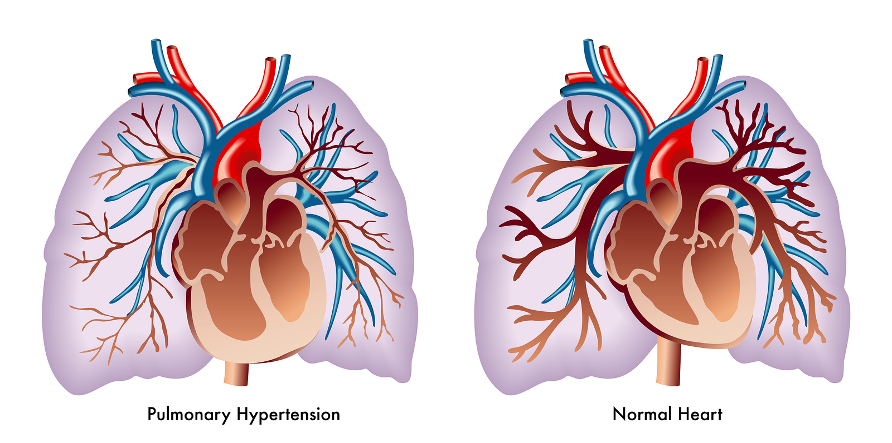
What is pulmonary hypertension?
Increased blood pressure caused by another disease or condition that affects the arteries of the lungs and the right side of your heart.
Mean arterial pressure >20 mmHg
Coons JC, Pogue K, Kolodziej AR, Hirsch GA, George MP. Pulmonary arterial hypertension: a pharmacotherapeutic update. Curr Cardiol Rep. 2019;21(11):141. doi:10.1007/s11886-019-1235-4
Notes:
40% idiopathic in nature
More common among women

Slide 5
Symptoms of PH
Shortness of breath
Fatigue
Dizziness
Chest pressure or pain
Swelling in your ankles, legs, and eventually abdomen
Cyanosis
Racing pulse or heart palpitations
Can lead to right sided heart failure
May also see: limited lung expansion, increased work of breathing, respiratory rate, and inspiratory muscle effort
Mayo Clinic Staff. Pulmonary Hypertension Diagnosis and Treatment- Mayo Clinic. Mayo Clinic. https://www.mayoclinic.org/diseases-conditions/pulmonary-hypertension/diagnosis-treatment/drc-20350702. Published March 20, 2020. Accessed May 9, 2021.
This Photo by Unknown Author is licensed under CC BY-SA

Slide 6
Causes of PH
Often multifactorial
Imbalance of vasoconstrictors/vasodilators which leads to net vasoconstriction of pulmonary smooth muscle. (PAH)
Coagulation disorders cause an increase in clotting -> increase pressures in the pulmonary system
Vascular injury leading to cell dysfunction and smooth muscle proliferation causing pulmonary cell remodeling (thickening)
This progressive disease process can often lead to right sided heart failure (cor pulmonale)
This Photo by Unknown Author is licensed under CC BY
Coons JC, Pogue K, Kolodziej AR, Hirsch GA, George MP. Pulmonary arterial hypertension: a pharmacotherapeutic update. Curr Cardiol Rep. 2019;21(11):141. doi:10.1007/s11886-019-1235-4
Notes:
Going to depend on the subgroup

Slide 7
Pulmonary Artery Hypertension vs PH
Subgroup of pulmonary hypertension- disease of the blood vessels of the lungs causing them to be thickened and narrowed leading to increase in pressure
Defined as:
mPAP >20mmHg
Pulmonary artery wedge pressure </= 15 mmHg
Balloon wedged into pulmonary artery reading pressure from left side of the heart
Pulmonary vascular resistance >/=3 wood units
Galiè N, Humbert M, Vachiery J-L, et al. 2015 ESC/ERS Guidelines for the diagnosis and treatment of pulmonary hypertension: The Joint Task Force for the Diagnosis and Treatment of Pulmonary Hypertension of the European Society of Cardiology (ESC) and the European Respiratory Society (ERS): Endorsed by: Association for European Paediatric and Congenital Cardiology (AEPC), International Society for Heart and Lung Transplantation (ISHLT). Eur Heart J. 2016;37(1):67-119. doi:10.1093/eurheartj/ehv317
Glaus TM. Pulmonary hypertension. s.n. 2012. doi:10.5167/uzh-71342

Slide 8
Classifications of PH
Group 1: pulmonary arterial hypertension
Genetic mutation, prescription diet drugs or illegal drugs, congenital heart problems, liver disease, HIV
Group 2: pulmonary hypertension due to L heart disease
Group 3: due to lung disease, hypoxemia
COPD, pulmonary fibrosis, obstructive sleep apnea, long-term exposures to high altitudes
Group 4: chronic thromboembolic pulmonary hypertension
Chronic blood clots
Group 5: miscellaneous or multifactorial
Blood disorders, inflammatory disease, metabolic disease, kidney disease
Coons JC, Pogue K, Kolodziej AR, Hirsch GA, George MP. Pulmonary arterial hypertension: a pharmacotherapeutic update. Curr Cardiol Rep. 2019;21(11):141. doi:10.1007/s11886-019-1235-4
Notes:
Important to know that it often exists with many other comorbidities.

Slide 9
Treatment Considerations for each subgroup:
Group 1- pulmonary arterial hypertension
New diagnosis- consider the impact of abrupt lifestyle changes for the patient
May require lots of patient education
If more chronic, consider larger care team may already be in place for medical management
Group 2- pulmonary hypertension due to L heart disease
HF symptoms
Likely many comorbidities – HTN, DM
Group 3- pulmonary hypertension due to lung disease, hypoxemia
Low reserve for aerobic activity- chronic deconditioning
May require education on smoking cessation
Consider increased need for supplemental oxygen, cpap machines
Group 4- chronic thromboembolic pulmonary hypertension
Higher risk for PE & DVT- advocate for prevention
Early mobility
Group 5- miscellaneous or multifactorial pulmonary hypertension
Systemic problems
chronic
consider polypharmacy and large care team

Slide 10
Diagnosing PH
Often need to use multiple tools to get an accurate and reliable diagnosis, especially because there is no single indicator of this disease.
Pulmonary function test
Chest x-ray
Echocardiogram
Arterial blood gas
Cardiac MRI
Ventilation/perfusion lung scan
Genetic testing
And more depending on presentation and severity of symptoms.
Hemodynamic measures are most important for grading severity of disease
Galiè N, Humbert M, Vachiery J-L, et al. 2015 ESC/ERS Guidelines for the diagnosis and treatment of pulmonary hypertension: The Joint Task Force for the Diagnosis and Treatment of Pulmonary Hypertension of the European Society of Cardiology (ESC) and the European Respiratory Society (ERS): Endorsed by: Association for European Paediatric and Congenital Cardiology (AEPC), International Society for Heart and Lung Transplantation (ISHLT). Eur Heart J. 2016;37(1):67-119. doi:10.1093/eurheartj/ehv317
Notes:
Much of work around PH is assessing risk factors to try to determine prognosis once diagnosed with PH.

Slide 11
Pulmonary Artery Catheter
Pulmonary artery catheter (RHC) also known as swan-ganz catheter.
In 2015, this was the gold standard for diagnosing PH
Aids in clinical decision making
Monitors cardiac output, pulmonary vascular resistance (PVR), and vasoreactivity
Rosenkranz S, Preston IR. Right heart catheterisation: best practice and pitfalls in pulmonary hypertension. Eur Respir Rev. 2015;24(138):642-652. doi:10.1183/16000617.0062-2015

Slide 12
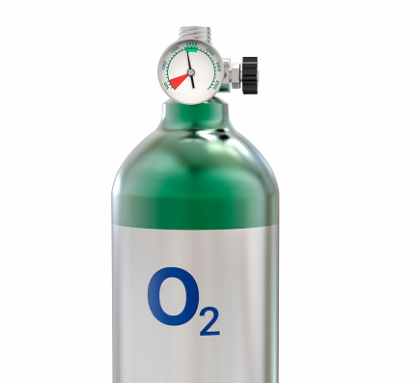
Treatments
The treatment process:
(1) general testing measures, supportive therapy through medication, counseling, and referral to proper care team
(2) more specific pharmacotherapeutic therapies depending on the type of PH.
(3) follow up to the success of the first two steps. Continue with treatment? Change course? Lung transplant?
Examples:
Pharmacotherapeutic therapies
Vasodilators
Diuretics
Supplemental O2
Treatment of underlying condition
Coons JC, Pogue K, Kolodziej AR, Hirsch GA, George MP. Pulmonary arterial hypertension: a pharmacotherapeutic update. Curr Cardiol Rep. 2019;21(11):141. doi:10.1007/s11886-019-1235-4

Slide 13
PH and Acute Therapies
Patients with PH advised to stay as active as they can within their symptom limitations.
Moderately intense activity + stable patient + monitoring of vitals and response to exercise is indicated
One study found improvements in exercise capacity, functional capacity and quality of life in patients with PH who participated in a training program that included aerobic activity and resistance training.^{2,6,7}
Decrease in systolic pulmonary artery pressure
increase in 6MWD
Still lacking enough standardized data on specifics of exercise prescriptions
Babu AS, Holland AE, Morris NR. Exercise-Based Rehabilitation to Improve Exercise Capacity and Quality of Life in Pulmonary Arterial Hypertension. Phys Ther. 2019;99(9):1126-1131. doi:10.1093/ptj/pzz060
Notes:
Limitations: sample size small we are still lacking standardized data on specifics of exercise prescriptions
In general, moderately intense activity is indicated for patients with PH as long as they are stable and you are able to effectively monitor vitals and responses to exercise.⁷

Slide 14
PH and Acute Rehab
Exercise and mobility while undergoing diagnostic tests can provide more accurate hemodynamic measures of differences in cardiac index at rest versus during exercise. (swan-ganz)
Key in grading severity of disease
Outcome measures:
6MWD and other cardiac stress tests along with cardiac monitoring can aid in specific diagnostic results to more accurately describe disease state and progression allowing for more targeted therapies.^{1,6}
Babu AS, Holland AE, Morris NR. Exercise-Based Rehabilitation to Improve Exercise Capacity and Quality of Life in Pulmonary Arterial Hypertension. Phys Ther. 2019;99(9):1126-1131. doi:10.1093/ptj/pzz060
Notes:
Cardiac index is cardiac output from left ventricle to body surface area.

Slide 15
What are some considerations you use currently when working with patients with PH?
Discussion

Slide 16
https://docs.google.com/forms/d/e/1FAIpQLSfs6KcSLmbiD5hzJqJXJ7wZtk5T1VsDOB3D4FquKu1YzHsSIQ/viewform?usp=sf_link

Slide 17
Resources
Bibliography
1. Coons JC, Pogue K, Kolodziej AR, Hirsch GA, George MP. Pulmonary arterial hypertension: a pharmacotherapeutic update. Curr Cardiol Rep. 2019;21(11):141. doi:10.1007/s11886-019-1235-4
2. Galiè N, Humbert M, Vachiery J-L, et al. 2015 ESC/ERS Guidelines for the diagnosis and treatment of pulmonary hypertension: The Joint Task Force for the Diagnosis and Treatment of Pulmonary Hypertension of the European Society of Cardiology (ESC) and the European Respiratory Society (ERS): Endorsed by: Association for European Paediatric and Congenital Cardiology (AEPC), International Society for Heart and Lung Transplantation (ISHLT). Eur Heart J. 2016;37(1):67-119. doi:10.1093/eurheartj/ehv317
3. Glaus TM. Pulmonary hypertension. s.n. 2012. doi:10.5167/uzh-71342
4. Mayo Clinic Staff. Pulmonary Hypertension Diagnosis and Treatment- Mayo Clinic. Mayo Clinic. https://www.mayoclinic.org/diseases-conditions/pulmonary-hypertension/diagnosis-treatment/drc-20350702. Published March 20, 2020. Accessed May 9, 2021.
5. Rosenkranz S, Preston IR. Right heart catheterisation: best practice and pitfalls in pulmonary hypertension. Eur Respir Rev. 2015;24(138):642-652. doi:10.1183/16000617.0062-2015
6. Chaouat A, Sitbon O, Mercy M, et al. Prognostic value of exercise pulmonary haemodynamics in pulmonary arterial hypertension. Eur Respir J. 2014;44(3):704-713. doi:10.1183/09031936.00153613
7. Babu AS, Holland AE, Morris NR. Exercise-Based Rehabilitation to Improve Exercise Capacity and Quality of Life in Pulmonary Arterial Hypertension. Phys Ther. 2019;99(9):1126-1131. doi:10.1093/ptj/pzz060

Slide 18
Thank you!

