Slide 1
Importance of Lab Values for Therapists in the Acute Care Setting
Ryan Rubio SPT

Slide 2
Why is this important?
Easy to forget if not referenced regularly
Patient safety
Quality of care
Notes:
Like we tell patients, our bodies adapt to what we do. Use it or lose it, and that’s what happens with this info.

Slide 3
Objectives
Know important values to search for
Know normal ranges for these values
Use them to paint a
picture of your patient
Predict how it will affect
your treatment
Recognize implications
and contraindications

Slide 4
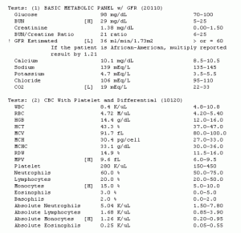
Let’s Narrow it Down
In a chart, the amount of lab results can look overwhelming…

Slide 5
More Common Lab Values
Sodium (Na+)
Potassium (K+)
Ammonia
Platelets (PLT)
Magnesium (Mg+)
Glucose
White Blood Cell (WBC)
Prothrombin Time/ International Normalized Ratio (PT/INR)
D-Dimer
Hematocrit (HCT)
Hemoglobin (Hgb)

Slide 6
Sodium (Na+)
Generates electrical signals needed for communication in several areas of the body, such as the brain, nervous system, and muscles. Helps to regulate fluid levels in the body.
Abnormal levels can indicate kidney dysfunction and increased blood pressure. Patient can present with dehydration and edema.
Levels increased by: excess sweating, diabetes insipidus, respiratory loss, osmotic diuresis
Decreased by: CHF, renal failure, nephrotic syndrome, cirrhosis, adrenal insufficiency, GI or skin loss
Normal Range:
135-145 mEq/L
Levels < 130 mEq/L
Hyponatremia can result in muscle cramps, fainting, disorientation, and altered mental status.
> 150 mEq/L
Hypernatremia can result in thirst, nausea, vomiting, and seizures.

Slide 7
Potassium (K+)
Vital in regulating heartbeat and maintaining proper function of muscles.
Abnormal levels increase risk of developing shock, respiratory failure, or heart rhythm disturbances.
Levels increased by: renal failure, severe dehydration, low blood volume, low mineralocorticoids, acute acidosis, insulin.
Decreased by: hyperglycemia,
vomiting, diarrhea, excess
sweating, cystic fibrosis, eating
disorders, licorice abuse.
Normal level: 3.5-5.0 mEq/L
If < 3.0 mEq/L or > 5.3 mEq/L
PT must justify benefits of treatment.
Hypokalemia can result in nausea, vomiting, altered mental status and risk of arrhythmia or muscle spasms.
Hyperkalemia can result in suppression of the activity of the heart.
Notes:
Mineralocorticoids are a class of steroid hormones characterized by their similarity to aldosterone and their influence on salt and water balances.

Slide 8
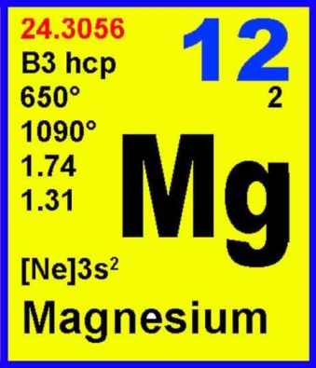
Magnesium (Mg+)
Magnesium levels can be used to evaluate the severity of kidney problems and uncontrolled diabetes.
A low magnesium level can cause low calcium and potassium levels.
High levels can cause irregular heartbeat, low blood pressure, confusion, slowed breathing, coma, and death.
Normal range:
1.2-2.1 mEq/L
Notes:
Large doses might cause too much magnesium to build up in the body, causing serious side effects including an irregular heartbeat, low blood pressure, confusion, slowed breathing, coma, and death.

Slide 9
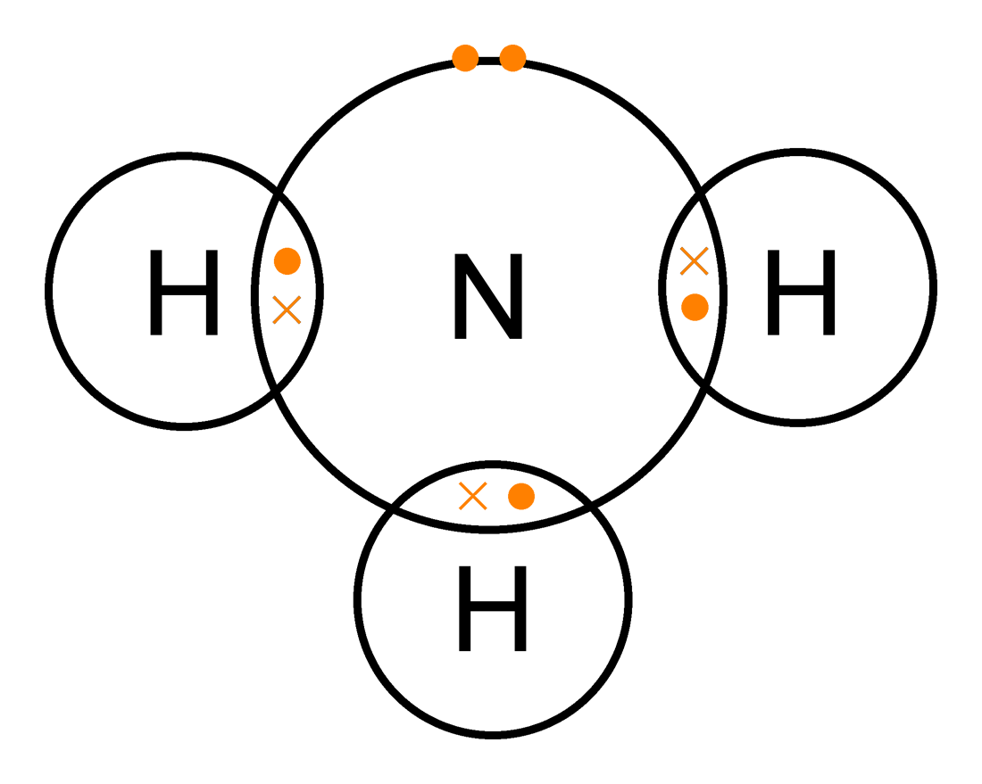
Ammonia
Ammonia is a waste product that is normally transported to the liver, and then excreted in urine by the kidneys.
The ammonia test can help diagnose the cause of a coma of unknown origin, help to determine the cause of changes in behavior and consciousness, and support the diagnosis of Reye's syndrome or hepatic encephalopathy caused by various liver diseases.
Increased levels indicate severe liver disease, GU tract infection, severe CHF, severe GI bleeding, or alcohol abuse.
Decreased levels indicate HTN and drug use.
Normal levels: 11-35 mmol/L
Hepatic encephalopathy causes mental and neurological changes that can lead to confusion, disorientation, sleepiness, and eventually to coma and even death.
Notes:
AMS big implication here

Slide 10
White Blood Cell Count (WBC)
White blood cells, also called leukocytes, are cells that exist in the blood, the lymphatic system, and tissues and are an important part of the body's immune system.
They help protect against infections and also have a role in inflammation, allergic responses, and protecting against cancer.
Normal range:
4,000-11,000/cmm
<500- Patient isolated to room.
500-1,000 – MD approval to ambulate in hallway. Mask required by PT.
>1,000 – Adhere to isolation precautions. Patient may still ambulate in hallway.
Notes:
Reason for precautions is to protect patient. High count indicates active infection. Acute bouts of exercise cause a temporary depression of various aspects of immune function that will usually last for 3 to 24 hours after exercise, depending on the intensity and duration of the exercise bout.

Slide 11
Platelets (PLT)
Contribute to blood clotting.
Various platelet function tests are used to evaluate the ability of platelets to clump together and begin to form a clot.
Patient does not have to have open wounds for excessive bleeding to be a risk. Bleeding can be internal.
Normal values increased by: malignancies, anemia, acute infections, cirrhosis, cardiac disease, chronic pancreatitis
Normal range: 150-450K/cmm
<20K/cmm
Guarded therapy. High risk of bleeding. No exercise permitted.
<35K/cmm
Cardiovascular/endurance exercise contraindicated
20-50K/cmm
Light exercise permitted (AROM)
< 50K/cmm
No MMT or resistive exercise
Notes:
Note that bleeding can be internal. Do not have to be open wounds for bleeding to be a risk.

Slide 12
Hemaglobin (Hgb) Hematocrit (HCT)
Hemoglobin – indicates severity of anemia or polycythemia.
Hematocrit – measures the percentage of RBC in whole blood
sample.
These levels can measure the severity of anemia or polycythemia and help make decisions about blood transfusions. This test can indicate if there is a problem with red blood cell production and/or lifespan, but it cannot determine the underlying cause.
Increased by: dehydration, COPD, CHF, smoking,
chronic lung disease, congenital heart disease
Decreased by: anemia, hemolysis, chronic renal failure,
lymphoma, leukemia, hyperthyroidism, cirrhosis

Slide 13
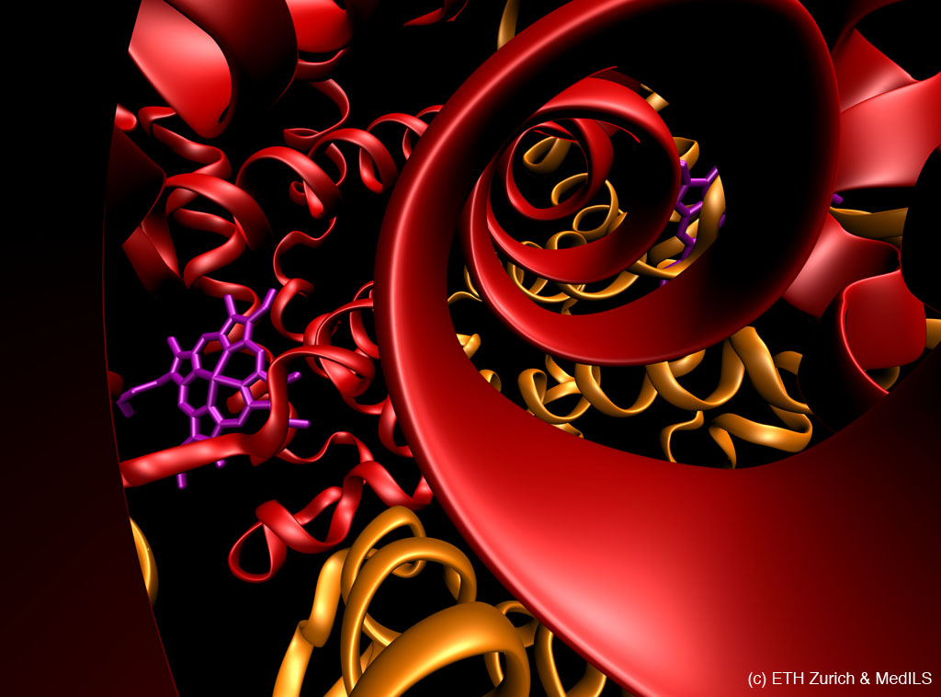
Hemaglobin (Hbg)
< 8 g/dL – no exercise
8-10 g/dL – light exercise
> 10 g/dL – resistive exercise permitted
Hemoglobin ranges:
Female: 12-16 g/dL
Male: 13-18 g/dL
Notes:
When hemoglobin levels are low, your tissues and organs do not receive enough oxygen. This can make you feel tired, weak or short of breath. Anemia can also cause chest pain, tachycardia, irregular heartbeat, difficulty concentrating,

Slide 14
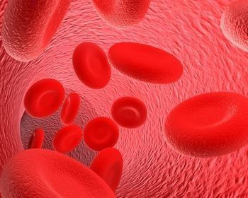
Hematocrit (HCT)
< 25% - no exercise
25 – 30% - light exercise
30 – 32% - add resistive exercise to tolerance
Hematocrit ranges:
Female: 37%-48%
Male: 42%-52%
Notes:
what are changes in pt that make it contraindicated. Or WHY/HOW we modify.

Slide 15
Prothrombin Time/INR
The PT and INR are used to monitor the effectiveness of the anticoagulant warfarin. This drug affects the function of the coagulation cascade and helps inhibit the formation of blood clots.
PT is measured in seconds.
INR is the ratio of the patient’s PT compared to the normal rate.
Levels prolonged by: anticoagulation therapy, DIC, liver disease, coagulation factor deficiencies, biliary obstructions, decreased vitamin K
Decreased by: thrombophlebitis, vitamin K supplementation
Lovenox is an anticoagulant that does NOT affect PT/INR.
Notes:
PT measured in seconds. INR is ratio of PT compared to the normal.

Slide 16
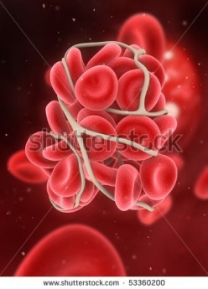
Prothrombin Time/INR
Normal PT ranges:
8.8 – 11.6 s
1.5 – 2.0 times the normal - Therapeutic range for DVT or clot risk patients
> 25 s – Guarded therapy;
High risk of bleeding into tissues
Normal INR ranges: < 1.5 s
2.0-3.0 s - Therapeutic range for DVT or clot risk patients
2.5 – 3.5 s – Therapeutic for mitral valve replacement patients
Notes:
PT measured in seconds. INR is ratio of PT compared to the normal.

Slide 17
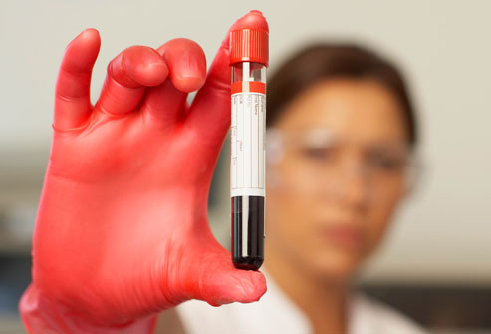
D-Dimer
D-dimer tests are ordered to help rule out conditions such as DVT, PE, Strokes. Alone, a D-Dimer is not a diagnosis.
Levels can be elevated by recent surgery, infection, heart disease, cancer, and liver disease.
Negative result rules out thrombus. A positive result leads to more testing, as the test is not highly specific.
Normal range:
>400-500 ng/ml
(when positive for DVT)
Need anti-coagulation therapy to reduce sensitivity to thrombosis.
Notes:
D-dimers are specific degradation products of cross-linked fibrin that are released into the blood after a clot is degraded.
The absence of a raised concentration of D-dimer implies that there is no fresh thromboembolic material undergoing dissolution in the deep veins or in the pulmonary arterial tree.
Alone, a d dimer is not a diagnosis of thrombus. Need VQ scan, doppler, etc. what else can elevate it.
However, an elevated D-dimer does not always indicate the presence of a clot because a number of other factors can cause an increased level.

Slide 18
Glucose
Glucose is the primary energy source for the body’s cells.
Chronically high blood glucose levels can cause progressive damage to body organs such as the kidneys, eyes, heart and blood vessels, and nerves.
Chronic hypoglycemia can lead to brain and nerve damage.
Normal range:
70-100 mg/dL
> 250 - 300 mg/dL
Risk of ketoacidosis. Patient cannot be exercised.
< 70 mg/dL
Patient needs carbohydrate snack to boost levels in order to tolerate activity.
Notes:
Excess ketones indicate that your body doesn't have enough insulin to control your blood sugar. If you exercise when you have a high level of ketones, you risk ketoacidosis — a serious complication of diabetes that needs immediate treatment. The pathogenesis of DKA is mainly due to acidosis. Excessive production of ketone bodies lowers the pH of the blood; a blood pH below 6.7 is incompatible with life.
Possible effects to avoid: HTN, arrythmia, HR rxn to exercise blunted, silent MI or angina,
hypoglycemia may include hunger, weakness, shakiness, sleepiness, lightheadedness, anxiety and confusion. Some symptoms of severe attack are unconsciousness and seizure that may lead to coma.
Chronically high blood glucose levels can cause progressive damage to body organs such as the kidneys, eyes, heart and blood vessels, and nerves. Chronic hypoglycemia can lead to brain and nerve damage.

Slide 19
Case Study 1
Patient is 49 year old female whose chief complaint is Left Hip Pain. X-rays confirm a large lytic lesion in hip as well as pneumonia.
Patient has history of COPD, HTN, Anemia, Lung Cancer, Pneumonia, and Tobacco Use.
Creat | Glu | Na+ | K+ | Ca | WBC | Hgb | HCT | RBC | PLT
0.5 | 116 | 138 | 2.9 | 7.9 | 11.7 | 7.8 | 24.5 | 3.68 | 433

Slide 20
Case Study 2
Patient is 60 year old male whose chief complaint is generalized weakness. Pt is obese and reports that he sits in his recliner most of the time at home.
Patient has history of diabetes, CHF, COPD, peripheral neuropathy, and HTN.
Creat | Glu | Na+ | K+ | Ca | WBC | Hgb | HCT | RBC | PLT
0.5 | 240 | 150 | 3.0 | 8.5 | 11.o | 8.1 | 26.0 | 4.0 | 300

Slide 21
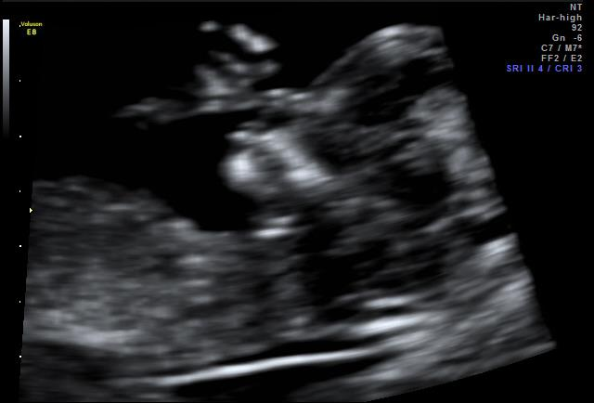
Questions?

Slide 22
References
Wachie, Joanne Cardiovascular and Pulmonary Physical Therapy, 2nd edition. 2010. Saunders/Elsevier.
Ghazinouri et al. Lab Values Interpretation Resources Update 2012. http://www.acutept.org/associations/11622/files/LabValuesResourceUpdate2012.pdf. Published December 2011. Accessed July 20, 2012.
McArdle WD, Katch FI. Exercise Physiology: Nutrition, Energy, and Human Performance. 7th ed. Baltimore, MD: Lippincott Williams & Wilkins; 2010
Riddle D, Wells P. Diagnosis of Lower-Extremity Deep Vein Thrombosis in Outpatients. Physical Therapy. 2004; 84 (8). 729-735.
Adam S, Key N, Greenberg C. D-Dimer Antigen: Current Concepts and Future Prospects. Blood. 2009; 113 (13) 2878-2887.
Tompkins J. Laboratory Reference Values and Therapy Implications. 2006. Mayo Clinic.

