Slide 1
The Effect of Postural Dysfunction on Subacromial Impingement Syndrome
Colleen Johnson PT, OCS

Slide 2
Objectives
At the end of this presentation students will:
Be able to accurately analyze how common postural dysfunctions influence structures of the shoulder complex
When given a case study with history and objective measures, be able to identify 3 potential postural causes of the patient’s shoulder impairment
Be able to accurately determine and describe a specific intervention to address the postural impairment identified

Slide 3
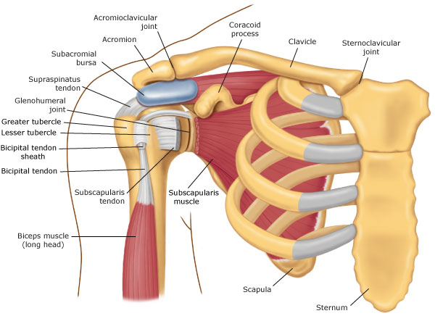
Subacromial Space Anatomy
Image source: http://morphopedics.wikidot.com/shoulder-impingement-syndrome#toc0

Slide 4
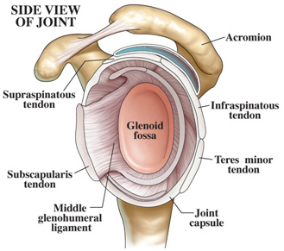
Subacromial Space con’t
Nnnnnnnnnnnnn The space is
The space is ~10 mm
(Petersson, Redlund-Johnell, 1984)
Image source: http://www.snays.com/wp-content/uploads/2012/12/Untitled7.jpg

Slide 5
Subacromial Impingement Syndrome
What is it?
Includes bursitis, calcific and rotator cuff tendonitis and tears.
How is it diagnosed?
Imaging (X-ray, MRI)
Physical Exam (Diagnostic Cluster)

Slide 6
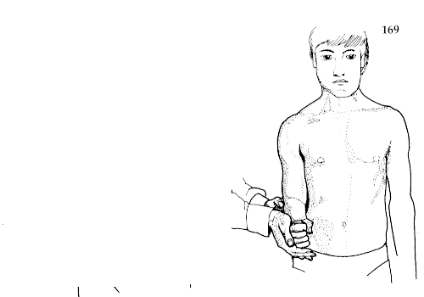
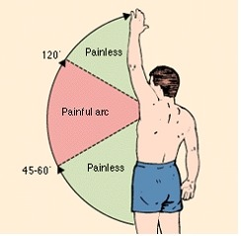
Subacromial Impingment Syndrome con’t
SAIS Diagnostic Cluster
Hawkins Kennedy, Painful Arc, Infraspinatus MMT
+LR 10.56 if all 3 tests are positive (Park et al, 2005)

Slide 7
Subacromial Impingement Syndrome con’t
What is the etiology? (Magee, 2014)
Primary - pinching IS the cause
(hooked acromion, osteophytes, GH hypermobility)
Secondary – dysfunction elsewhere
(abnormal kinematics, muscle weakness, hypomobility, “poor” posture)

Slide 8
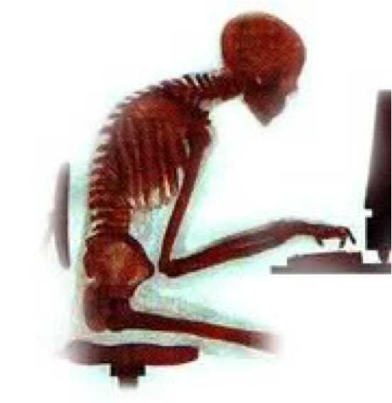
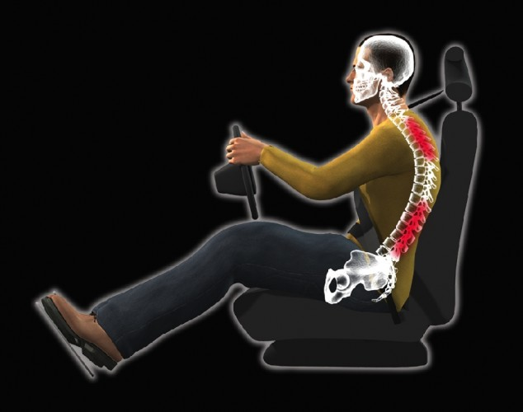
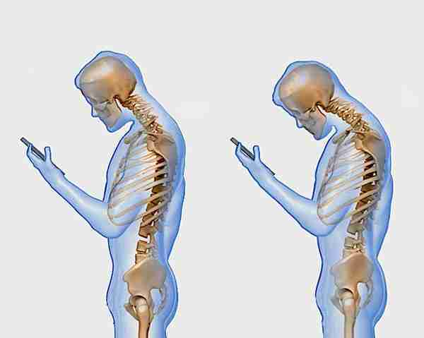
Postural Dysfunction(Saharmann, 2002)

Slide 9
Postural Dysfunction
What is “poor posture”?
Skeletal Implications
- cervical and thoracic spine,
- scapula
- humerus

Slide 10
Postural Dysfunction
Soft Tissue Implications
- “Upper Crossed Syndrome”

Slide 11
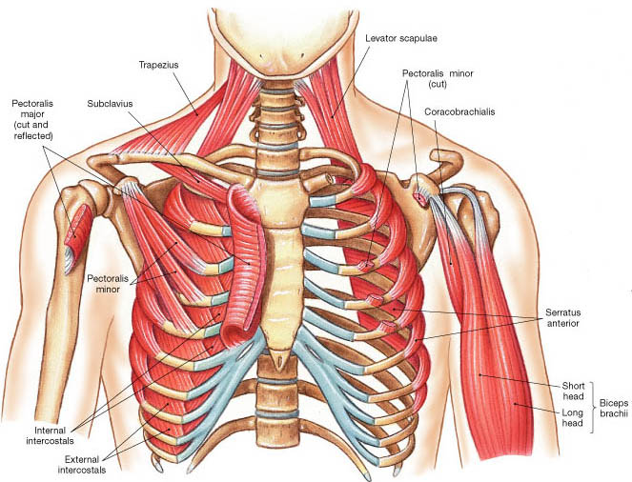
Postural Dysfunction
Tight Anterior Muscles
Image source: http://droualb.faculty.mjc.edu/lecture%20notes/unit%203/muscles%20with%20figures.htm

Slide 12
Postural Dysfunction
Weak Posterior Muscles
Image source: http://images.slideplayer.com/14/4311406/slides/slide_37.jpg

Slide 13
Postural Dysfunction
But where is the connection?

Slide 14
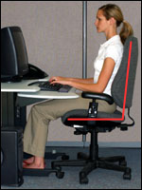
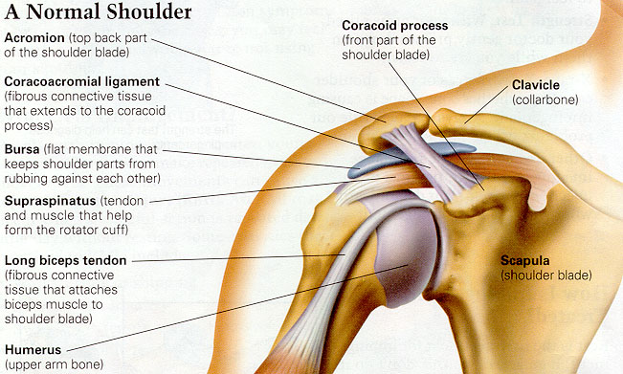
Postural Dysfunction and SAIS
(Solem-Bertoft et al, 1993; Borstad, 2006; Lewis et al,2005;
Kibler et al, 2013; Seitz et al, 2011)
=
?
Does
http://drmichaelegomez.com/wp-content/uploads/2015/09/computer-15812_1280-1024x682.jpg
http://www.guildfordupperlimb.co.uk/images/uploaded/Shoulder%20impingement%201%20copy.jpg
Does
=
?
https://www.osha.gov/SLTC/etools/computerworkstations/images/ref_pos_sitting_upright.jpg
http://www.ortho-md.com/images/proceduresImg/SHOULDER1.jpg

Slide 15
Postural Dysfunction and SAIS
Image from Borstad, 2006

Slide 16
How do we correct postural dysfunction and SAIS?
Case Study
55 y.o. Asian-American female
Imaging: None
Insidious onset 8 weeks prior getting progressively worse
Works from home on computer and seamstress
Pain in right shoulder 0/10 at rest 5/10 with movement – overhead and behind the back activities, difficulty sleeping
Goals: “Do housework & yoga w/o pain”

Slide 17
How do we correct postural dysfunction and SAIS?
Objective

Slide 18
How do we correct postural dysfunction and SAIS?
http://dash.iwh.on.ca/quickdash

Slide 19
How do we correct postural dysfunction and SAIS?
Interventions (First visit)
- Education, Education Education!!!
- Stretch UT, LS, Pec Minor
- Passive ROM
- Strengthen Isometrically or Isotonically
(if pain free)
Goal initially is to decrease pain and inflammation while normalizing motion in proper postural alignment.

Slide 20
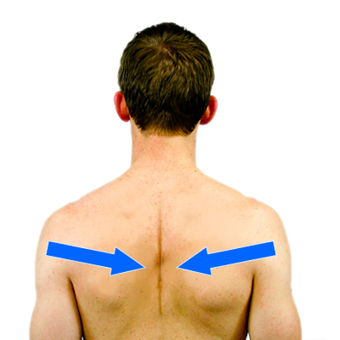
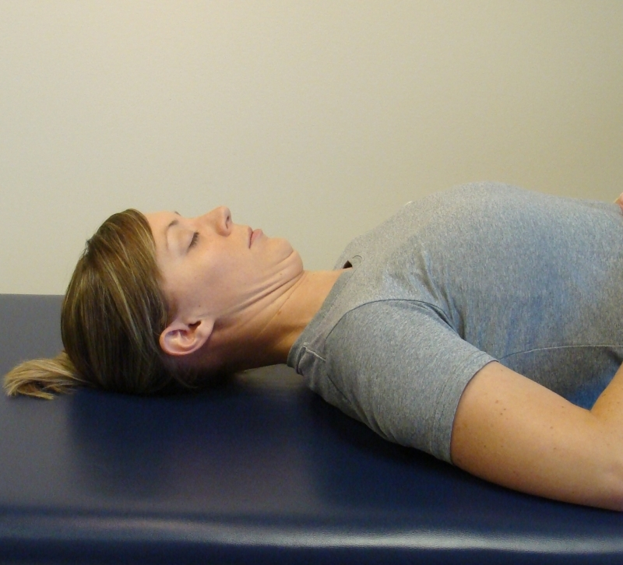
How do we correct postural dysfunction and SAIS?

Slide 21
How do we correct postural dysfunction and SAIS?
Interventions (Subsequent Visits)
- Manual Techniques
Spinal mobilizations
Scapular mobility
GH joint mobilization
Soft tissue mobilization

Slide 22
How do we correct postural dysfunction and SAIS?
Interventions (Subsequent Visits)
-Therapeutic Exercise
Strengthen Rotator Cuff and Scapula Stabilizers
Rhythmic Stabilization
Goal is to restore full non-painful ROM, improve strength and endurance

Slide 25
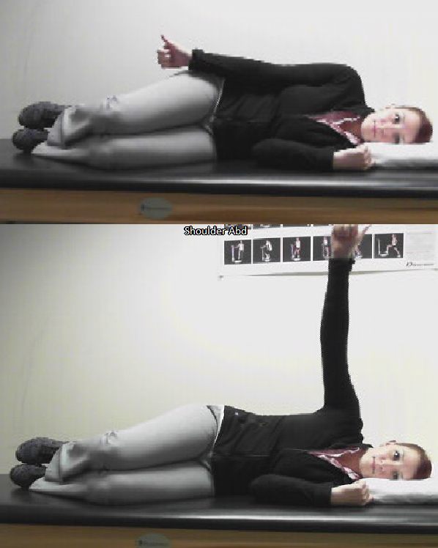
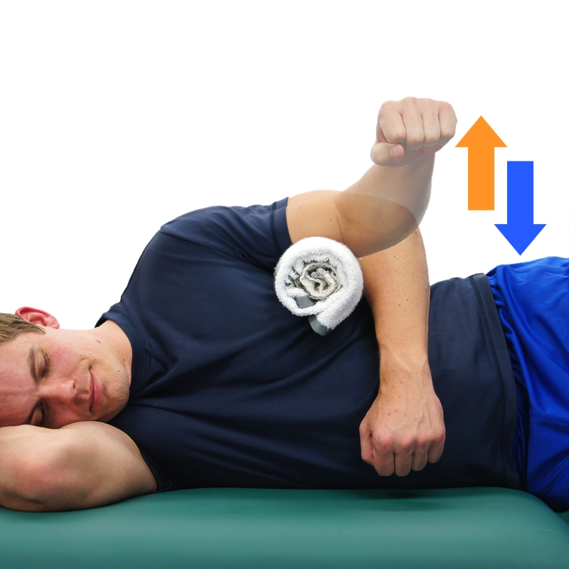

Slide 26
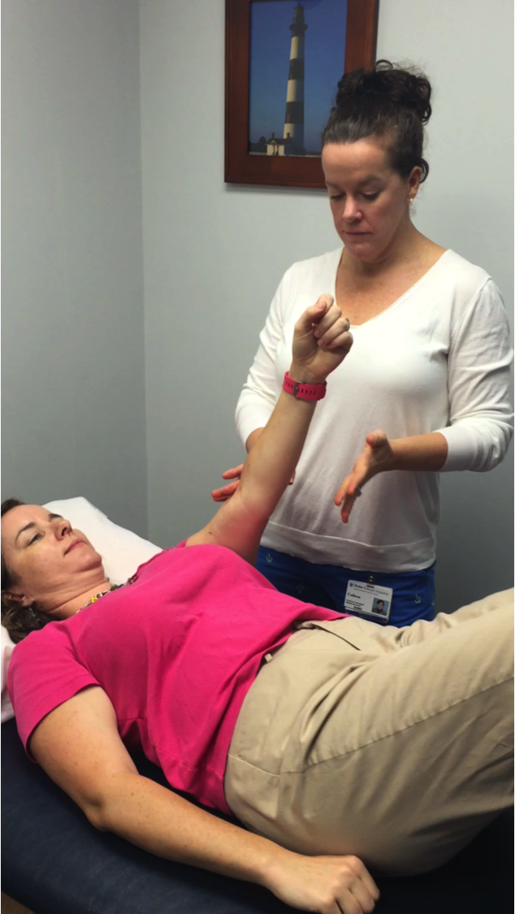

Slide 27
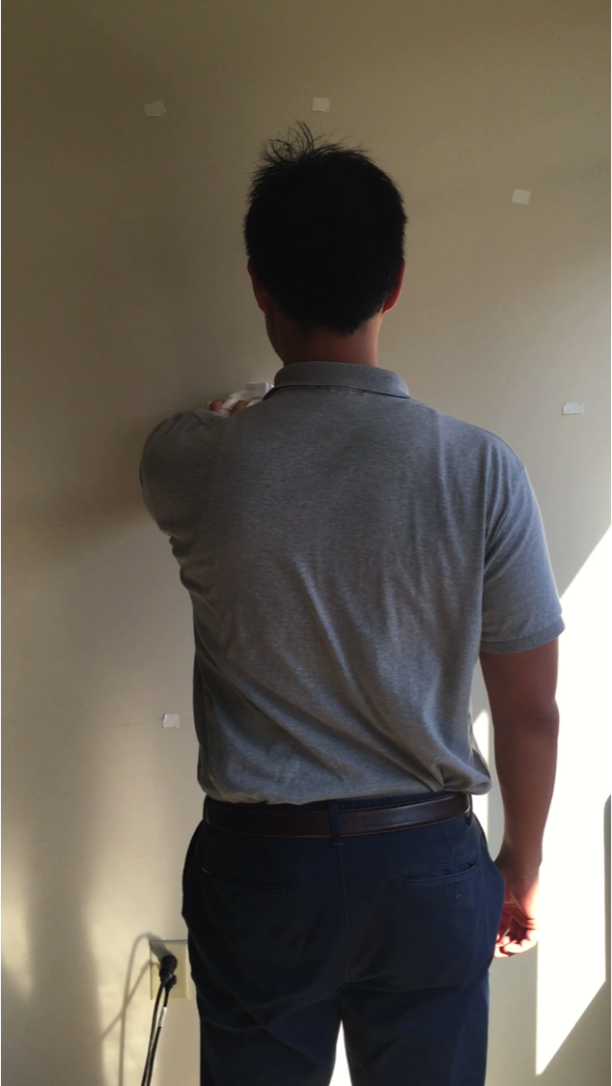

Slide 28
How do we correct postural
dysfunction and SAIS?
Summary of first 7 visits
Visit 1 evaluation/HEP
Visit 2 manual techniques added t-band exs
Visit 3 manual techniques added prone
Visit 4 manual techniques s/l weights
Visit 5 manual techniques added rhythmic stabilization
Visit 6 in pain mostly manual techniques
Visit 7 added standing AROM and ball v wall
step reach

Slide 29
How do we correct postural dysfunction and SAIS?
Interventions (Final visits)
- Return to sport (if needed)
Break down the motions required
- Ensure independence with HEP
Progression
- Review long term prevention and precautions

Slide 30
How do we correct postural dysfunction and SAIS
Case Study
Visit 10 (Discharge - all goals met)
- Reviewed HEP/progression
- Practiced downward dog
AROM flex 165 (135) abd 155 (75)
IR T6 (T10) ER 73 (60)
No pain with movement!
Quick Dash 15.9% (54.5%)

Slide 31
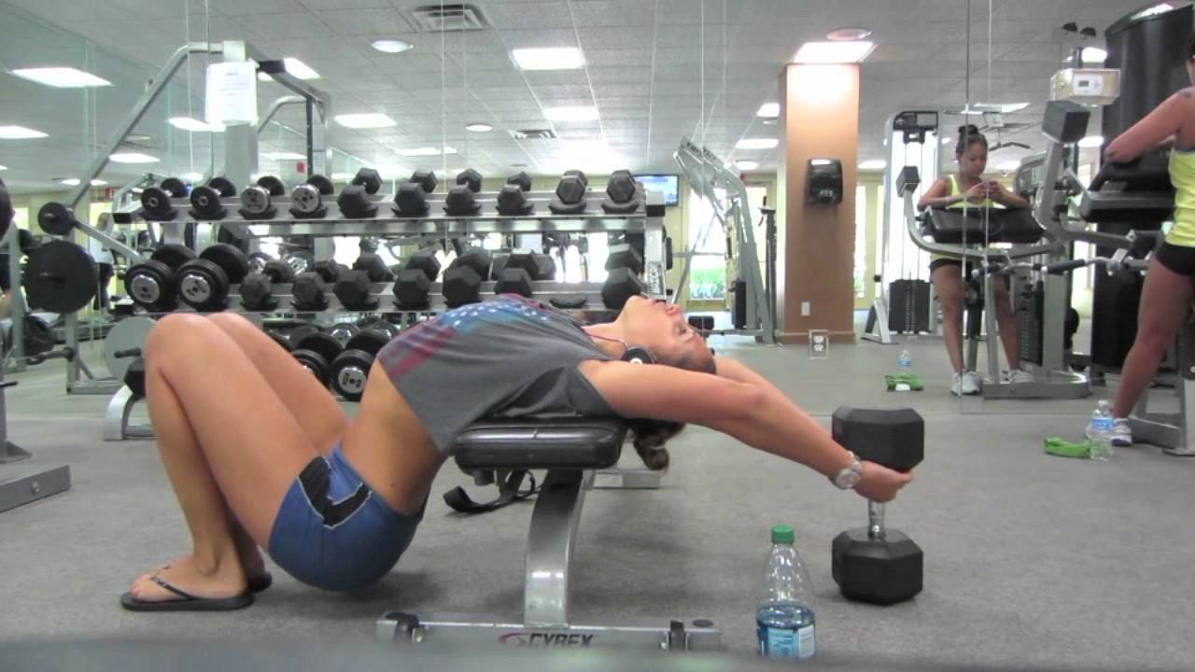
Conclusion
Questions? Comments? Concerns?
Image source: https://i.ytimg.com/vi/lTPdY0iaaUM/maxresdefault.jpg

Slide 32
References
1. Borstad JD. Resting position variables at the shoulder: Evidence to support a posture-impairment association. Phys Ther. 2006;86(4):549-557.
2. Kibler WB, Ludewig PM, McClure PW, Michener LA, Bak K, Sciascia AD. Clinical implications of scapular dyskinesis in shoulder injury: The 2013 consensus statement from the 'scapular summit'. Br J Sports Med. 2013;47(14):877-885. doi: 10.1136/bjsports-2013-092425 [doi].
3. Magee DJ. Chapter 5 Shoulder. In: Orthopedic physical assessment. Sixth ed. W.B. Saunders, 2014:260.
4. Park HB, Yokota A, Gill HS, El Rassi G, McFarland EG. Diagnostic accuracy of clinical tests for the different degrees of subacromial impingement syndrome. J Bone Joint Surg Am. 2005;87(7):1446-1455. doi: 87/7/1446 [pii].

Slide 33
References
5. Petersson CJ, Redlund-Johnell I. The subacromial space in normal shoulder radiographs. Acta Orthop Scand. 1984;55(1):57-58.
6. Sahrmann SA. Does postural assessment contribute to patient care? Journal of Orthopaedic & Sports Physical Therapy. 2002;32(8):376-379.
7. Seitz AL, McClure PW, Finucane S, Boardman ND, Michener LA. Mechanisms of rotator cuff tendinopathy: Intrinsic, extrinsic, or both? Clin Biomech. 2011;26(1):1-12.

Slide 34
The Effect of Postural Dysfunction on Subacromial Impingement Syndrome
Colleen Johnson PT, OCS
colleen_johnson@med.unc.edu

