Slide 1
The Vestibular System: Common Diagnoses, Research-Based Treatments, and Outcome Measures
Notes:
“dizziness” incidence of 5.5% in the US (more than 15 million people)
Patients who experience dizziness report a significant disability that reduces their quality of life
No known vestibular therapist in the area per google

Slide 2
Brief Review:
Primary Functions:
Stabilize visual images during head movements to allow for clear image
Maintain postural stability (especially during head movements)
Provide information used for spatial orientation of the body

Slide 3
Brief Review:
Notes:
3 SCCs for angular motion and two two otolith organs (saccule and utricle) that detect linear movements
Anterior (sometimes called superior), posterior, and horizontal SCCs (horizontal canal at 30 degrees from true horizontal, anterior canal 92 degrees from horizontal with horizontal canal and posterior canal 90 degrees from horizontal with horizontal canal) → thus, angular head rotation stimulates each canal to varying degrees

Slide 4
Brief Review: Semicircular Canals (SCCs)
- Filled with endolymph which flows freely through the canals in response to angular motion of the head
- Enlarge at one end to form the ampulla which contains the cupula
- The Cupula is a gelatinous barrier that contains the hair cells (kinocilia and sterocilia) that provide afferent sensory information. The hair cells are located in the crista ampullaris which acts as the sensory organ of angular rotation.
- Hair cells are activated by movement of endolymph through the semicircular canals.
Notes:
Endolymph = slightly thicker substance than water
Excitation (depolarization) when sterocilia are deflected toward kinocilia, inhibition (hyperpolarization) when sterocilia are deflexted away from the kinocilia

Slide 5
Brief Review: SCC Push-Pull Dynamic
Brain detects head movements by comparing input from both vestibular systems.
SCCs work in coplanar fashion (R and L horizontal, R posterior and L anterior, R anterior and L posterior)
What happens when you turn your head to the right?
Notes:
ANSWER: right horizontal SCC will have increased firing rate while the left horizontal SCC has a decreased firing rate

Slide 6
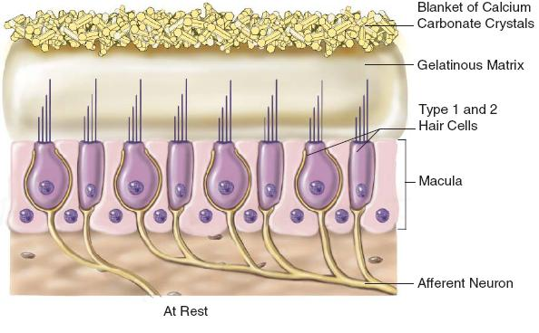
Brief Review: Otolith Organs
Saccule and Utricle respond to linear acceleration and static head tilt.
Utricular excitation occurs during horizontal linear acceleration and static head tilt, Saccular excitation occurs during vertical linear acceleration.

Slide 7
Brief Review: Central Vestibular System
Connections between vestibular nuclei and reticular formation, thalamus, and cerebellum
Evidence points to a “vestibular cortex” at the junction of the parietal and insular lobes
Reticular formation, “vestibular cortex”, and thalamus = enable vestibular system to contribute to arousal, conscious awareness of the body, discriminate between movements of self and movement of environment
Cerebellar connections assist with VOR (stabilization of images during head movements, static and dynamic activities, and coordination of limb movements

Slide 8
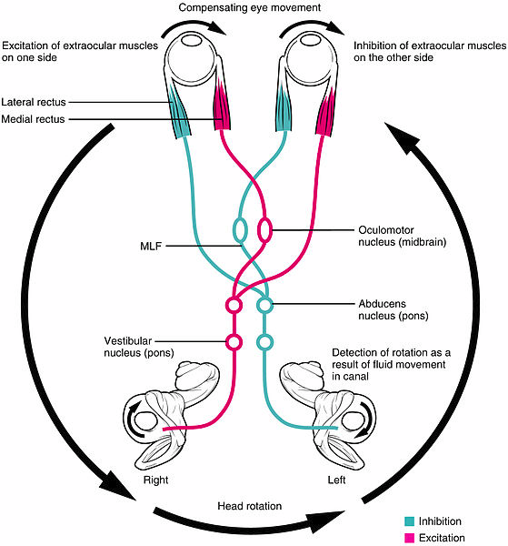
Brief Review: Vestibulo-Ocular Reflex
- Maintains stability of an image on the fovea during rapid head movements
- Rapid compensatory eye movements in the opposite direction of head movements

Slide 9
Classifying Symptoms/Subjective Reports
Vertigo – illusion of movement. Patient may report they see the environment “spinning” though they are stationary
Lightheadedness – feeling faint
Dysequilibrium – feeling “off balance”
Oscillopsia - motion of objects in the environment that are known to be stationary

Slide 10
Classifying Symptoms
Symptom | Probable Cause
Vertigo | BPPV, UVH, unilateral central lesion affecting vestibular nuclei
Lightheadedness | Orthostatic hypotension, hypoglycemia, anxiety, panic disorder
Dysequilibrium | BVH, chronic unilateral vestibular hypofunction, lower extremity somatosensation loss, upper brainstem/vestibular cortex lesion, cerebellar and motor pathway lesions
Notes:
BPPV = benign paroxysmal positional vertigo
UVH = unilateral vestibular hypofunction
BVH = bilateral vestibular hypofunction
Don’t forget to ask about duration and circumstances of symptoms
Seconds to minutes = BPPV
Minutes to hours = Meniere’s disease
Days = vestibular neuronitis or migraine-associated dzziness

Slide 11
Outcome Measures
Visual Analog Scale (VAS)
Dizziness Handicap Inventory
Functional Disability Scale
Motion Sensitivity Quotient
Examination of Eye movements
Observation for Nystagmus
Head Impulse Test
Head – Shaking Induced Nystagmus Test
Positional Testing
Dynamic Visual Acuity Test (DVA)
Examination of Gait and Balance
Vestibular Function Tests (Semicircular Canal Tests and Otolith Tests)
Notes:
BEST: Subjective measure such as DHI or functional disability scale, along with thorough history and positional testing, examination of eye movements

Slide 12
Outcome Measures
Visual Analog Scale
How intense are your symptoms? 0-10cm measured by therapist
Dizziness Handicap Inventory (DHI)
Used to measure self-perceived handicap as a result of vestibular disorders. Excellent test-retest (r = .97)and good internal consistency (r = .89)
Functional Disability Scale
Vestibular Rehabilitation Benefit Questionnaire (VRBQ). Measures benefit from vestibular rehab. Includes questions about avoidance behavior. Four subscales (Dizziness, Anxiety, Motion-Provoked Dizziness, and Quality of Life). Excellent test-retest reliability (r = .92)
Motion Sensitivity Quotient (MSQ)
Subjective score of sensitivity to motion. Involves placing patients into positions requiring head or whole body movements. Intensity on scale of 0-5, time score from 0-3 with 0 = 0-4 seconds, 1 = 5-10 seconds, 2= 11-30 seconds, 3 = greater than 30 seconds.
Examination of Eye Movements
Includes Observation for nystagmus, head impulse test, head-shaking nystagmus test, positional testing, Dynamic visual acuity test (DVA)
Examination of Gait and Balance
Important for function. Dynamic and static balance (BERG, Romberg, TUG)

Slide 13
Observation for Nystagmus
Nystagmus – involuntary eye movement. Primary diagnostic indicator for central and peripheral vestibular lesions
Nystagmus due to peripheral vestibular lesion
Slow and fast movements. Direction of nystagmus is named by the fast component. Direction opposite the quick component of nystagmus is indicative of the side of vestibular reduced firing rate (hypofunction)
Nystagmus due to central vestibular lesion
Often seen after acute unilateral insult. Occurs in the absence of motion due to asymmetry between regularly firing and damaged/absent functioning vestibular systems. Symptoms in light generally resolve in 3-7 days after insult but can last up to 2 months. Symptoms in the dark will likely remain indefinitely.
Nystagmus can be suppressed by light and visual fixation on a target. Ideally, observation for nystagmus would be completed in an environment where the patient cannot see (utilizing Frenzel goggles or infrared camera system)
Notes:
Infrared camera system – use infrared light to illuminate the eyes while the patient remains in complete darkness
Fast and Slow Components – slow component is due to relative excitation of one side of the vestibular system. The fast component is generated from the parapontine reticular formation in the brainstem and repositions the eye to the center of the orbit. In L beating nystagmus, the eyes move slowly to the right (VOR), and the resetting eye movement is to the left (fast component) → therefore, the direction opposite the quick component of the nystagmus localizes the side of vestibular reduced firing rate (hypofunction)

Slide 14
Head Impulse Test (VOR at high acceleration)
Examines SCC function
**Complete Cervical ROM prior to administration** Patient education on why the head must be moved quickly is crucial to build rapport and allow for increased relaxation
To test horizontal canal, perform test in 30 degrees cervical flexion
Procedure:
Have patient fixate on nearby object (therapist’s nose) and manually rotate patient’s head using small-amplitude, moderate velocity, and high acceleration movements. When VOR is intact, patient will remain focused on target. If ventricular hypofunction is present, patient’s eye will exhibit a corrective saccade. Corrective saccade is a rapid eye movement to re-focus eyes on the target. If an individual has ventricular hypofunction, they will be unable to maintain gaze when the head is rotated toward the side of the lesion.
Notes:
Complete cervical ROM prior to administration of this test and educate the patient on the importance of this test and allow for increased relaxation
** if corrective saccade noted when patient’s head is rotated to L, this means hypofunction on the L
More sensitive in patients with complete loss of function and less sensitive in those without complete loss

Slide 15
Head-Shaking Nystagmus Test
To determine unilateral peripheral vestibular defect
Procedure:
Instruct patient to close their eyes and move into 30 degrees cervical flexion. Passively rotate their head for 20 cycles at ~2 cycles per second. At conclusion of movement, instruct patient to open their eyes and watch for nystagmus.
Patients with UVH typically manifest with horizontal HSN with quick phases contralateral to affected side. Not all patients with UVH will exhibit HSN.
Patients with BVH will not exhibit HSN because there is no difference in firing when neither vestibular system is functioning.
Vertical nystagmus following HSN Test is indicative of a central lesion.

Slide 16
Positional Testing
Commonly used to determine if otoconia have been displaced into the SCC causing benign paroxysmal positional vertigo (BPPV). The displaced otoconia in the endolymph makes the SCC sensitive to changes in head position.
The Dix-Hallpike test is the most common positional test used to examine possible BPPV. The patient begins in long sitting with head rotated 45 degrees to either side. Patient is then taken into supine with cervical extension ~30 degrees, maintaining 45 degrees rotation. Therapist then watches for nystagmus . This positional change places each SCC in a gravity-dependent position. Direction and duration of nystagmus can aid in determining whether the patient has BPPV or a central lesion.
An alternate form of the dix-hallpike asks patients to move into sidelying. Regardless of which test is being completed, the ear that is down during testing is the vestibular system being examined.
If you suspect the patient is suffering from horizontal canal BPPV, a roll test can be performed. For this test, the patient is in supine in 20 degrees cervical flexion. Rapid rotations to the sides are completed while the therapist watches for nystagmus.

Slide 17
Dix-Hallpike Maneuver

Slide 18
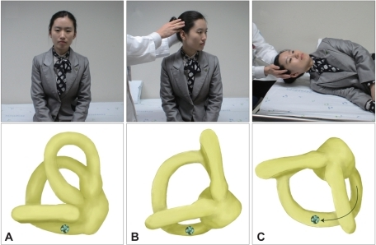
Side-lying Dix-Hallpike Maneuver
Useful when ROM limitations, other medical complications, or apprehension prevent true Dix-Hallpike

Slide 19
Supine Roll Test
Notes:
For horizontal canal BPPV

Slide 20
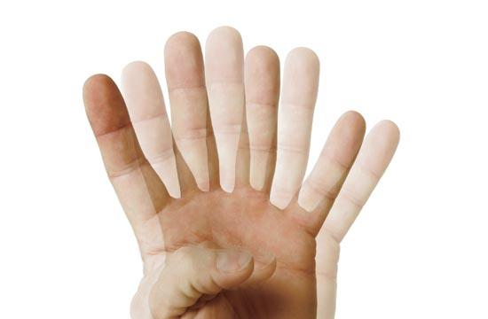
Common Vestibular Disorders
Unilateral ventricular hypofunction (UVH)
Bilateral ventricular hypofunction (BVH)
Benign paroxysmal positional vertigo (BPPV)

Slide 21
Benign Paroxysmal Positional Vertigo: Symptoms
Nystagmus and vertigo with changes in head position, occasionally nausea with or without vomiting, and disequilibrium.
Latency to onset of symptoms after position change is typically 15 seconds.
Duration is usually less than 60 seconds.

Slide 22
BPPV: Mechanism
Otoconia becomes dislodged from the utricle and falls into the SCCs. There are two competing theories cupulolithiasis and canalithiasis
Cupulolithiasis - fragments of otoconia break away and adhere to the cupula of one of the SCCs. When the head is moved into certain positions, the weighted cupula is deflected by the pull of gravity. This abnormal signal results in vertigo and nystagmus. Theoretically, this abnormal signal causing vertigo and nystagmus would persist as long as the patient was in the provoking position which does not explain the short duration of nystagmus associated with BPPV
Canalithiasis - otoconia are freely floating in one of the SCCs. When the patient changes position, the pull of gravity causes the freely floating otoconia to move inside the SCC resulting in endolymph movement and deflection of the cupula

Slide 23
BPPV: Assessment
Dix-Hallpike Maneuver
Sidelying Dix-Hallpike
Supine Roll Test
Pattern of nystagmus

Slide 24
BPPV: Assessment
SCC | Nystagmus
Right Posterior | Transient UBN and right torsion
Left Posterior | Transient UBN and left torsion
Horizontal | Transient geotropic
Right Anterior | Persistent DBN and right torsion
Left Anterior | Persistent DBN and left torsion
Notes:
**Another way to tell: typically beats away from the side that is impaired
Also listen to their symptoms
If they have difficulty looking up to the right, most likely L posterior canal
Treat posterior and superior canals basically the same → only thing you need to be careful of if the horizontal canal

Slide 25
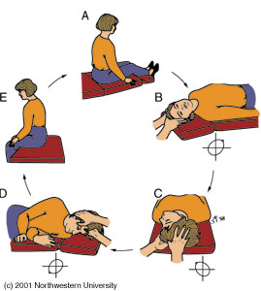
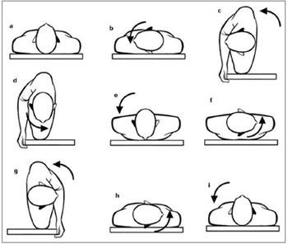
BPPV Treatment: Canalith Repositioning Maneuver (CRM)
Head is moved in a series of positions that will move debris out of the involved SCC and into the vestibule. Once the debris is back in the vestibular, patient’s symptoms should subside. The CRM has also been adapted for the horizontal canal, though horizontal BPPV is uncommon.
Notes:
Vestibule: general term for the location of the utricle and saccule
Turned toward unaffected side first for lateral canal BPPV

Slide 26
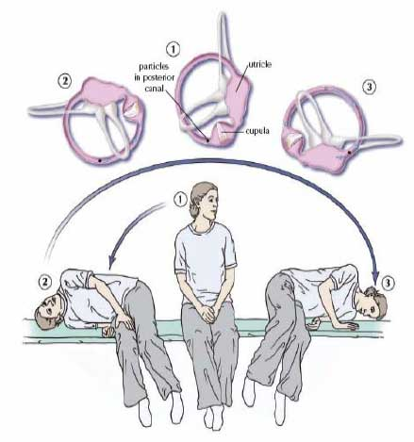
BPPV Treatment: Liberatory (Semont) Maneuver
- Rapidly moving patients through positions to dislodge debris from cupula (cupulolithiasis theory). More difficult for patients to tolerate.
- Rotate head 45 degrees toward unaffected side, assist the patient into affected side side-lying, rapidly move the patient to side-lying on the contralateral side with head in original starting position (nose facing table in final position)

Slide 27
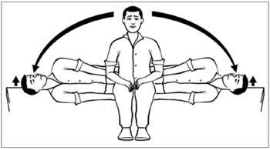
BPPV Treatment: Brandt-Daroff Exercises
Originally used solely for habituation, but research has shown drastic improvements following this exercise with patients suffering from BPPV. Patients should perform 5-10 repetitions 3 times per day until they are vertigo-free for at least two days.
Turn head 45 degrees to the L, move into R side-lying, transfer back to sitting while maintain 45 degrees L cervical rotation, rotate head 45 degrees to the R, move into L side-lying, return to seated position. This is one repetition.

Slide 28
Unilateral Ventricular Hypofunction (UVH)
Assessment: Spontaneous nystagmus, VOR x 1 and x 2 (retinal slip), Head impulse test (HIT), Head Shaking Nystagmus Test (HSN)
Mechanism: most common causes include viral insults, trauma, and vascular events.
Symptoms: vertigo, spontaneous nystagmus, oscillopsia during head movements, postural instability, and disequilibrium. Intense symptoms generally dissipate in 3-7 days due to compensation. If spontaneous nystagmus persists in room light after this period it is a sign of central lesion or unstable peripheral lesion and the patient’s neurologist should be contacted.

Slide 29
UVH Treatment
Gaze Stability Exercises
VOR x 1
VOR x 2
Coordinated body/head movements
Postural Stability Exercises
Habituation Exercises (Motion Sensitivity)
Notes:
Retinal slip – occurs when the image of an object moves off the fovea of the retina, resulting in visual blurring
Diplopia – double vision
**patient education

Slide 30
Bilateral Ventricular Hypofunction (BVH)
Mechanism: most commonly caused by ototoxicity but can also be caused by meningitis, autoimmune disorders, head trauma, tumors on CN VIII, TIAs, neuronitis
Presentation/Symptoms: disequilibrium through oscillopsia, ataxic gait, lack of nausea, vertigo, and nystagmus behavior

Slide 31
BVH: Treatment
Gaze Stability Exercises (VOR x 2 contraindicated due to excessive retinal slip)
Sequenced eye and head movements and use of imaginary targets
Balance exercises to increase enhance use of somatosensory and visual cues
Daily walking program
Pool Exercises
Tai Chi
Notes:
Care must be taken during balance exercises for patients with BVH because they are at a much increased risk for falls
May take up to 2 years to recover function for individuals with BVH
Tai Chi because slow movements that require increased balance

Slide 32
Central Nervous System Pathology
Causes:
CVAs, TIAs, Vertebral Basilar Insufficiency (VBI), TBIs due to labyrinthine or skull fractures, demyelinating diseases such as MS that affect cranial nerve VIII where it enters the brainstem (symptoms consistent with UVH)
Treatment:
Habituation exercises, gait and balance exercises that incorporate somatosensory, visual, and vestibular contributions.
Notes:
VBI symptoms – visual field cuts, unsteadiness/incoordination, drop attacks. Often caused by car accidents but could also be caused by cervical spondylosis

Slide 33
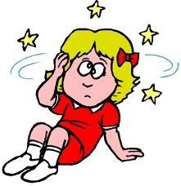
Determining Central vs. Peripheral Pathology
Pure vertical upbeating nystagmus
Pendular nystagmus
Recovery time
Lateropulsion
Head tilt
Visual perceptual difficulties
Oculomotor signs/symptoms
(smooth pursuits, convergence, saccades)
Skew Deviation

Slide 34
Determining Central vs. Peripheral Pathology
One study showed that a combination of Head Impulse Nystagmus and Test-of-Skew (HINTS) was a more sensitive diagnostic measure of stroke than early MRI.

Slide 35
Contraindications to Vestibular Therapy
Change in hearing
Meniere’s Disease (fullness in ear, tinnitus, low-frequency hearing loss, episodic vertigo)
Acute Cervical spine injury
Perilymphatic Fistula
Uncontrolled migraine
Pressure and tinnitus in one or both ears
Discharge from the ears or nose following surgery

Slide 36
References:
O’Sullivan S.B., Schmitz T.J., Fulk G.D. Physical rehabilitation. Sixth Edition. F.A. Davis Company:
Philadelphia; 2014.
Kattah, J.C. et al. HINTS to diagnose stroke in the acute vestibular syndrome: Three-step bedside
oculomotor examination more sensitive than early MRI diffusion-weighted imaging. Stroke
40(11): 3504. 2009.
Marshall L., Russel L., Lillis B., Thommasen A. Benign Paroxysmal Positional Vertigo: Continuing
Professional Development Package. Physiopedia. http://www.physio- pedia.com/Benign_Paroxysmal_Positional_Vertigo:Continuing_Professional_Development_Package#Patterns_of_Nystagmus
Balasouras DG, Koukoutsis G, Ganelis P, Korres GS, Kaberos A. Diagnosis of single- or multiple-canal
benign paroxysmal positional vertigo according the type of nystagmus. International Jounral of
Otalaryngology. 2011; 1-13.
Hanley K and O-Dowd T. Symptoms of vertigo in general practice a prospective study of diagnosis. British
Journal of General practice. 2002; 52: 809-812.
Epley J. The Canalith Repositioning Procedure: For Treatment of Benign Paroxysmal Positional Vertigo.
American Academy of Otolaryngology- Head and Neck Surgery Foundation. 1992; 107(3): 399-
404.
Oron, Y., Cohen-Atsmoni, S., Len, A. and Roth, Y., Treatment of horizontal canal BPPV:
Pathophysiology, available maneuvers, and recommended treatment. The Laryngoscope. 2015.
doi: 10.1002/lary.25138
Porciuncula F., Johnson C., Glickman L.B. The effect of vestibular rehabilitation on adults with bilateral
vestibular hypofunction: A systematic review. Journal of Vestibular Research 22(2012): 283-298.
DOI: 10.3233/VES-120464

