Slide 1
You’re not in OVER your HEAD yet
Patrick McNamara
3rd Year DPT Student – UNC Chapel Hill
ACE Personal Trainer

Slide 2
Outline
Normal shoulder biomechanics
Role of musculature in overhead motion
Common injuries and corrective exercises
Focus on:
Bench Press
Push-ups
Upright row/horizontal row

Slide 3
The problem
The shoulder complex accounts for roughly 1/3rd of all weight-lifting injuries. (3)
Unlike the knees/hips, the shoulder is a non-weight bearing joint. (3)
60% of recreational lifters report shoulder pain in the last year. 28% in the last 3 days! (3)
We train “muscles” not “movement” – exacerbated by machines

Slide 5
Long Term Problem
Shoulder impingement and rotator cuff degradation are implicated in more than half of patients admitted for shoulder pain. (7)
Impingement is a chronic condition, characterized by compression of the RC tendons, bursa, or long head of the biceps beneath the acromion and coraco-acromial arch. (7)
Thought to be due to abnormal scapular and clavicular biomechanics.

Slide 6
Shoulder Anatomy
Adapted from: http://injuredshoulder.com/shoulder-anatomy/

Slide 7
Bony Anatomy
Adapted from: http://www.methodistorthopedics.com/artificial-joint-replacement-of-the-shoulder

Slide 8
Shoulder Mechanics Intro
Adapted from www.mikereinold.com
Notes:
Ideally the clavicle and scapula move in unison to provide a stable base for the humeral head in the glenoid.

Slide 9
Normal biomechanics
Scapula upwardly rotates
Scapula posteriorly tilts
Internal/external rotation not as clear, but appear to need ER at end-range elevation.
Scapular motion maintains ball and socket congruency with humeral head.
Important for length-tension relationships of RC.
Notes:
Impingement syndrome often presents with decreased upward rotation, posterior tilt, and increased internal rotation during elevation.
Humeral head only migrates 1-2 mm superiorly (normally) until 60 degrees of elevation, then remains centered in the glenoid.
From rest to roughly 90 degrees the majority of stabilization is taken care of by the RC. After 90 degrees the capsule increases in tautness, passively limiting motion. In fact at end ranges when one side is tight (the posterior capsule becomes tight with end range IR) the humeral head actually migrates anteriorly.

Slide 10
Scapulohumeral rhythm
Image adapted from http://intranet.tdmu.edu.ua/data/kafedra/internal/sport_medic/classes_stud/en/med/lik/ptn/Medical%20rehabilitation/6/04.%20Medical%20rehabilitation%20of%20locomotory%20diseases.htm
Notes:
Discuss the two phases, the shearing of the deltoid initially, and how the humeral head stays centered in the glenoid.

Slide 11
Mechanics… again
Humeral head only migrates 1-2 mm superiorly (normally) until 60 degrees of elevation, then remains centered in the glenoid.
From rest to roughly 90 degrees the majority of stabilization is taken care of by the RC. After 90 degrees the capsule increases in tautness, passively limiting motion.
At end ranges when one side is tight (the posterior capsule becomes tight with end range IR) the humeral head actually migrates anteriorly.

Slide 12
So what does impingement look like?
Impingement syndrome often presents with:
Decreased upward rotation of the scapula
Decreased posterior tilt of the scapula
Increased internal rotation during elevation
This means the way these individuals move is characteristically different than healthy peers

Slide 13
Humeral head movement
Image adapted from: http://saycoperformance.com/blog/shoulder/the-shoulder-what-every-swim-coachathlete-should-know-%E2%80%93-part-1/
Notes:
Initially the deltoid’s line of force is parallel to the shaft of the humerus, and if unopposed would lead to superior migration of the humeral head. Impinging on the RC and other structures under the coraco-acromial arch. The RC’s primary job is to limit this motion, by creating an inferior line of force, and compressive force.

Slide 14
Rotator Cuff
Image adapted from: http://completesoccertraining.blogspot.com/2012/11/shoulder-joint-part-ii.html
Notes:
Without the RC in cadavers, see superior humeral head migration. RC is important in compression of the humeral head onto the glenoid. Important for stability.
The teres minor and infraspinatus also provide ER of the humerus, allowing the greater tubercle to pass beneath the acromion, and provides more space for other soft tissue structures. The supraspinatus provides a compressive stabilizing line of pull throughout the ROM, while assisting with abduction throughout the ROM. Gravity offsets the superior migration imposed by the line of pull.

Slide 15
RC Net Force
Adapted from www.mikereinold.com
Notes:
Must have an inferiorly and medially directed force from the rotator cuff to provide compression and limit superior migration of the humeral head.

Slide 16
But that’s not all!
SC joint involves clavicular elevation, retraction, and posterior rotation.
AC joint upwardly rotates, posteriorly tilts, and internally rotates.
Humerus – elevates and externally rotates.
Notes:
Impingement also shows increased clavicular elevation, retraction, and humeral head motion. Especially anterior and superior translations. (7) Collectively this leads to decreased space in the coraco-acromial arch for structures like the RC, bursa, and biceps tendon.

Slide 17
SC and AC joint motion
Image adapted from: http://drawingbooks.org/lutz1/index.html

Slide 18
Altered mechanics?
A result of:
Mobility restriction
Strength deficit (weakness)
Muscular imbalance
Neuromuscular activation
Fatigue
Etc.

Slide 19
Scapular Muscle Proposed Activities
Scapular upward rotators – trapezius and lower serratus anterior
Lower trapezius is most substantial upward rotator
Upper trap – clavicular elevation and posterior rotation
Middle/Lower serratus – upward rotators, ERs, and posterior tilters.
Scapular downward rotators – levator scapulae and rhomboids.
Notes:
Serratus produces lateral translation force on the scapula while upwardly rotating. Though to be offset by low levels of levator scap and rhomboid activation.

Slide 20
Glenohumeral muscle activity
Deltoid – (assisted by supraspinatus) provide humeral head elevation.
RC – stabilizes humeral head in glenoid, prevents excessive anterior/superior translation with elevation.
Infraspinatus/Teres minor – provide ER to the humerus throughout elevation
Notes:
Subscap, teres minor, infraspinatus all have inferior direction of pull, to offset superior translation shear forces from the deltoid. Especially important at early ranges of motion, as the deltoid’s line of force is most likely to produce shearing forces – BAD for soft tissues.

Slide 21
Scapulohumeral Rhythm
Adapted from: https://classconnection.s3.amazonaws.com/295/flashcards
Notes:
Discuss Center of motion, lines of pull, and moment arms.As long as there was compression, see stability of the glenohumeral joint – Moseley.

Slide 22
Soft tissue considerations
Pec minor – when contracted can lead to scapular downward rotation, internal rotation, and anterior tilt. (7)
Can restrict upward rotation, ER, and posterior tilt if mobility is restricted!
Upper Trap activity increased, serratus activity decreased (especially btwn 30-120 degrees elevation) in impingement patients
Increased upper and lower trap activity in loaded conditions – in healthy population

Slide 23
Common Lifting Injuries
Anterior Glenohumeral Instability–Damage to the IGHL can lead to excess anterior humeral head movement at 90°abduction. (1)
Rotator Cuff pathologies (3)
Pectoralis major tear/acute injury (3)
Particularly in eccentric/lowering phase of bench press (3)
Long head of biceps pathology (3)
“Osteolysis” in the AC joint – associated with Bench Press (1,3)
Notes:
The IGHL attaches in the anterior, inferior region of the humeral head and to the anterior glenoid/labrum. Limits anterior translation of the humeral head at 90 degrees of abduction.
Osteolysis is a subchondral stress fx and separation of the distal clavicle.

Slide 24
Risk factors for developing anterior GH instability
Humeral extension past the rib cage (3)
90°of abduction and near-maximal external rotation (3)
Important to note that these can occur with improper technique of exercises (ie. Rows, bench press, push-ups, etc.)
Behind the neck lat-pulldowns and shoulder press cited as contributor to RC pathology and anterior GH instability. (3,6)
Pec fly and wide grip bench (6) – Places stress on AC joint
Notes:
Hyperlaxity and instability can develop over time and lead to dysfunction and injury to the RC, due to lengthening and prolonged force demand from the RC.
May want to use DBs instead of BB for incline press.

Slide 25
Additional Risk Factors
Muscular Imbalance (3)
Contra-indicated position = abduction, extreme ER, some horizontal abduction.
Abduction over 80 degrees with IR can lead to impingement. (Like upright rows or empty can exercise)
“Forced movements of flexion, adduction, IR of GH joint – can lead to laxity/impingement.” – Colado et al. (Cable Flyes- after arms cross)

Slide 26
Lumbar Extension
Can check via Scapular Wall Slides
Back to wall shoulder flexion
May be a result of tightness in lats
May be a result of limited T-spine extension
Notes:
https://www.youtube.com/watch?v=N73AnUp3m2w (Scapular wall slide)
https://www.youtube.com/watch?v=QEBqufick-s&list=PL8A636097854DCBDA (Back to wall shoulder flexion)
T-Spine Mobilization
Quadruped extension rotation
Extensions on Foam Roller
Side-lying windmills
Lat Stretches
Thoracic extension and lat stretch on bench
Prayer stretch
Holding onto barbell stretch

Slide 27
Fatigue
Subjects performed Thera-band ER to fatigue. (Tsai et al. 2003)
Significant decreases in scapular posterior tilting (up to 90 degrees elevation)
Significant decrease in scap ER (to 120)
Significant decrease in upward rotation (to 60 degrees)
Notes:
Fatigue defined as a reduction of in torque of 25% or more from baseline.

Slide 28
Fatigue ??
Fatigue protocol (Ebuagh 2005)
Arm elevated to 45 degrees to manipulate object for 2 minutes
Scaption via cable 20 reps at (20% MVIC)
D2 Flexion on Cable 20 reps (20% MVIC)
Significantly increased scapular upward rotation, ER
Humeral ER decreased (up to 10 degrees at end range

Slide 29
Muscular Imbalance
“Relative weakness” ER vs IR and Lower trap vs Upper Trap (3)
In weight trained population significantly stronger abductor, IR, UT than control. No difference in ER strength, and weaker LT. ER/IR ratio lower in WT than control.
Can selectively target lower trap via modified prone cobra, prone row, posterior fly. (Arlotta et al.)
Middle trap – arm raise overhead in line with lower trap fibers. Unilateral row and shoulder horizontal extension with ER. (Ekstrom 2003)
Lower trap – Arm raise in line with lower trap, shoulder ER at 90 degrees abduction, shoulder horizontal extension with ER (Ekstrom 2003)

Slide 30
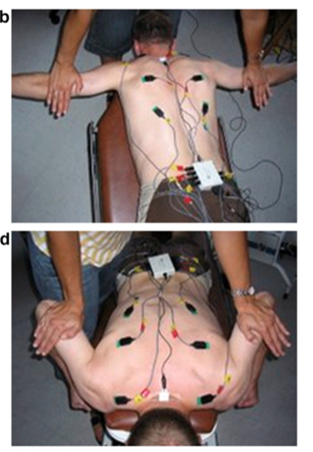
Prone row, posterior fly and prone cobra
Adapted from Arlotta et al.
Notes:
Prone row description - The participant lay prone on a high, flat bench with their shoulders in neutral flexion/extension and their elbows bent to 90° on either side. When instructed, the individual pulled their arms straight up by their sides keeping their elbows tucked in, while squeezing the shoulder blades together at the top of the movement
Prone cobra - The participant lay prone on a wide bench with their arms by their sides and fingers pointing towards their toes. The individual moved into trunk exten- sion, so as to raise their chest approximately 10 cm off the bench. From this position, with their palms turned out so that thumbs pointed up towards the ceiling, the participant pulled their shoulder blades back and down as if reaching their fingertips towards their feet. Manual resistance was applied concurrently in a downward direction on both shoulder blades and in a cephalic direction into their palms, resisting the movement of reaching for their toes. The partic- ipant attempted to hold this position without moving as the researcher increased the force applied until a break force was reached
Posterior fly - he participant lay prone on an elevated bench with their arms hanging down on either side of the bench. Their arms were raised out to the sides keeping the elbows straight, thumbs pointing towards the ceiling and squeezing the shoulder blades together until their arms were level with the trunk.

Slide 31
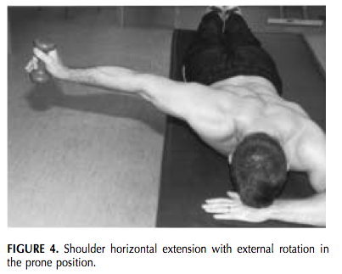
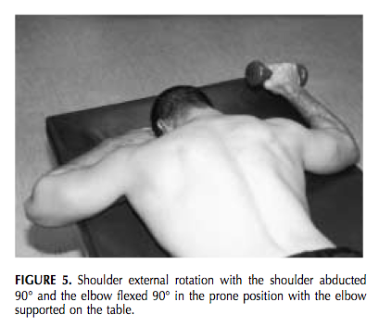
LT/MT Exercises
Images from Ekstrom et al.

Slide 32
Serratus Anterior
Decreased EMG output of SA in impingement, GH instability, etc. (Martins et al.)
Seems that UT substitution is common for SA weakness.

Slide 33
Serratus Exercises
Diagonal exercise with shoulder flexion, horizontal flexion, and ER (100+/-24% MVIC). (Ekstrom et al.)
Shoulder abduction in the plane of the scapula (above 120 (96+/-24% MVIC), and below 80 (62+/-18% MVIC)) Ekstrom
Flexion, abduction, scaption (96-91% MMT) – Moseley (both push-up and with a plus excellent too)
Bench press – optimal for UT/SA ratio (when on stable surface). Maximizes SA compared to wall push up or push-up.
Notes:
Unstable surfaces increased or maintained UT.

Slide 34
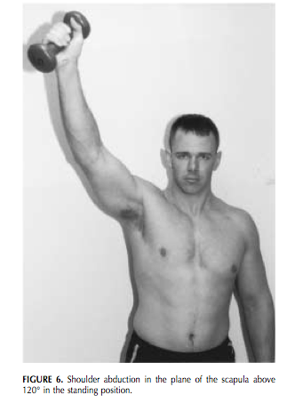
Serratus Exercises
Adapted from Ekstrom et al.

Slide 35
Total Scapular Targeting
Moseley et al. found 4 exercises to effectively target (> 50% MMT over 3 arcs/ranges of the exercise)
Scaption
Rowing
Push-up with plus
Press-up

Slide 36
ER exercises for RC
Standing shoulder ER with towel roll on axilla (8)
Side-lying ER (8)
Horizontal abduction with external rotation. (8)

Slide 37
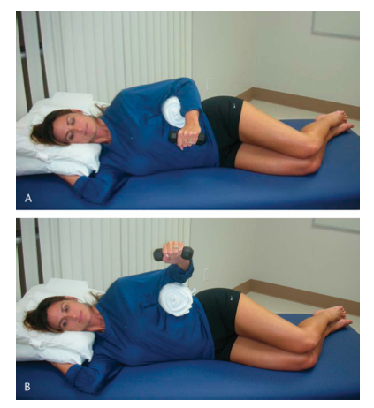
Standing ER and Side-lying ER
Adapted from Kolber et al.

Slide 38
Other problematic exercises
Squats – elbows underneath the bar
Push-ups – elbows flared
Empty Can exercise
Dips – maximal external rotation, elbow significantly behind rib cage

Slide 39
Mobility Imbalance
Excess ER motion (3)
Decreased IR motion (3)
“Posterior Capsular tightness” (3)
A study of 57 women with resistance training history had decreased AROM in IR of the shoulder as well as joint laxity and posterior capscular tightness compared to 31 age-matched peers. (Kolber 2011)
WT population decreased IR, flexion, abduction, and post shoulder tightness compared to control. Increased ER. (Kolber 2009)
Notes:
As most exercises are performed in end-range ER, and not IR – see increased ER, decreased IR, and subsequently tight posterior capsule. (3) The Kolber study was done on the non-dominant arm. More IR strength in resistance training was not statistically significantly higher, but trended towards such.

Slide 40
Picture Form
Adapted from Kolber et al. 2010

Slide 41
Contra-indicated positions
Adapted from Colado et al. 2009

Slide 42
Warm Up Exercises
Medicine Ball Figure 8’s
PNF Chops/Lifts
Side-lying External Rotation (with towel roll)
Standing ER in scapular plane
Prone ER at 90 degrees of abduction
Prone horizontal abduction at 100 degrees with full ER.
Lawnmower (Kibler 2008)
Robbery (Kibler 2008)
Push-up plus (on knees, elbows or standard) – NOT ON WALL (High UT/SA ratio)
Bottoms-up KB Waiter’s Walk- (Eric Cressey)
Progress to Bottom’s-Up KB Military Press
Notes:
We may want to combine both functional and isolated RC exercises into our warm ups, particularly on days when overhead activity is not a primary feature of the workout.
Side lying ER and standing ER in scap plane – high EMG values for Teres minor and infraspinatus. The prone ER and horizontal abduction – high supraspinatus EMG. (Reinold et al. 2004) Side lying forward flexion, side-lying ER, and horizontal abduction with ER had low UT/LT ratios. Scaption with ER, forward flexion in standing, and the high row on a lat pulldown machine all acceptable. (Cools 2007)

Slide 43
Anterior Core Progression
Plank
Exercise Ball Rollout
Barbell Rollouts
Wheel Rollouts
Can also try TRX fallout
Progress to Landmine Pressing – watch Eric Cressey instructional video on YouTube.
Half-kneel vertical pallof press (Tony Gentilcore)
Notes:
This comes from the Mike Boyle book.

Slide 44
Push-Up
Adapted from Kritz et al. 2010

Slide 45
Screening Criteria – Kritz et al. 2010
Neck in neutral
Elbows forming roughly 45 degree angle from the vertebral column (Watch for flared elbows)
Lumbar spine in neutral
Constant distance from shoulders to ears (often an upper trap substitution)
Scapular movement (protraction/retraction/upward rotation)
Do not want IR at the shoulder- increases posterior shearing
Hand underneath elbow at the transition phase

Slide 46
Push-up Variations
Adapted from Gouvali et al.
Notes:
On knees easiest variant. Posterior variant most active for pec major, not as active for triceps.

Slide 47
Push Pattern Progression
Adapted from Kritz et al. 2010

Slide 48
Push-Ups
Narrow Base – “Subjects placed their hands together under the center of their sternum, forming a diamond shape between their thumbs and index fingers”
Shoulder width – middle finger underneath edge of deltoid
Wide – Middle fingers 20cm lateral to shoulder width position
Adapted from Cogley et al.
Notes:
Narrow base increased the activity of both pec major and triceps.

Slide 49
Bench Press
Adapted from Green et al. 2007

Slide 50
Bench Press Width
EMG shows increased triceps and clavicular head of pectoralis if hands narrow (<1.5 shoulder widths) versus wide (>1.5 shoulder widths) (1)

Slide 51
Incline vs. Decline?
15 college age males
Average 5 years of training experience
70% 1RM for 6 repetitions
30 degree incline, 15 degree decline
Similar EMG results for clavicular pec major
Significantly higher EMG in sternal pec major with decline (5)
Decline preferable for anterior shoulder (6)
Notes:
Participants performed significantly more weight during the decline bench.

Slide 52
Power/Force Bench Press/Bench Pull
Peak power in the bench press – 50-60% 1 RM (2)
Peak Force in bench press – 90-100% 1 RM (2)
Peak Power in bench pull 70-100% 1 RM (2)
Peak force in bench pull 90-100% 1 RM (2)
Dramatically higher power outputs in the bench pull, especially at 1RM. (2)
Notes:
This study was done in elite athletes

Slide 53
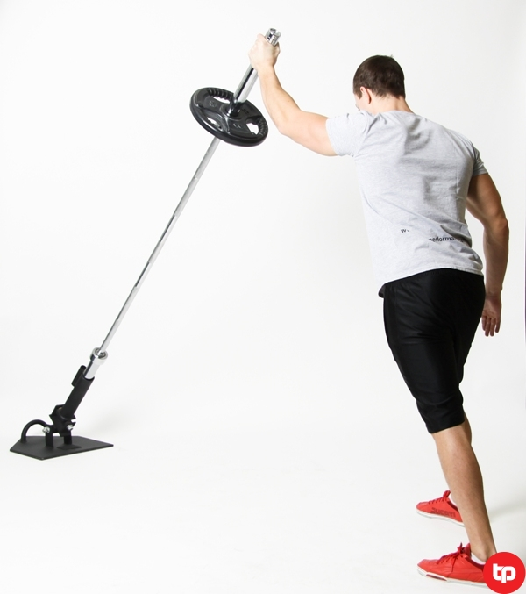
Landmine Press
No research on EMG/Proper technique
Allows for scapular upward rotation
Half-kneeling 1-arm Landmine Press
Image adapted from: www.bobbydattero.com

Slide 54
Typical Upright Row
Image adapted from: Schoenfeld et al.

Slide 55
All things upright row
Targets deltoid and upper trap
Generally performed with elbows coming above shoulders, while arms are IR
Can/should consider modifying to less than 90 degrees of shoulder elevation.
Similar movement with Olympics lifts like the clean – if done improperly.
Notes:
Schoenfeld et al.

Slide 56
Modified Upright Row
Image adapted from: Schoenfeld et al.

Slide 57
Seated Row
Must start and remain in upright posture
Elbows should not go behind rib cage, avoiding anterior capsular stress
Initiate movement by scapular retraction.

Slide 58
Seated Row
Image adapted from Lantz et al.
Notes:
Generally a bad position due to the arm being close to 90 degrees and somewhat internally rotated.

Slide 59
Modified Row
Image adapted from Lantz et al.
Notes:
Elevate seat height and keep arms more in neutral alignment.

Slide 60
Scapular Retraction
Image adapted from Lantz et al.
Notes:
Not strengthening the scapular stabilizers like low, middle traps and rhomboids.

Slide 61
Upper Trap Substitution
Image adapted from Lantz et al.

Slide 62
Finishing Position
Image adapted from Lantz et al.

Slide 63
Summary
Understand that poor movement patterns have long-term negative effects
Ask where clients feel an exercise, you will likely have to modify
Delve into the literature (American Journal of Sports Medicine, Strength and conditioning journal, etc.)
My contact: mcnamara.pa@gmail.com

Slide 64
Yeah Baby!

Slide 65
Gone to Carolina in my mind

Slide 66
Special thanks to:
Nick Mang
Liz Walz
Lauren Mangili
Anthony Bowman
Sophie Baer
Hollis Dameron

Slide 67
References
Green C., Comfort P. The affect of grip width on bench press performance and risk of injury. (2007) Strength and Conditioning Journal. 29(5): 10-14
Pearson S., Cronin J., Hume P., et al. Kinematics and kinetics of the bench-press and bench-pull exercises in a strength-trained sporting population. (2009) Sports Biomechanics. 8(3): 245-254
Kolber M., Beekhuizen K., Cheng MS., et al. Shoulder injuries attributed to resistance training: A brief review. (2010) Journal of Strength and Conditioning Research. 24(6): 1696-1704
Krol H., Golas A., Sobota G. Complex analysis of movement in evaluation of flat bench press performance. (2010) Acta of Bioengineering and Biomechanics. 12(2): 93-98
Glass S., Armstrong T. Electromyographical activity of the pectoralis muscle during incline and decline bench presses. (1997) Journal of Strength and Conditioning Research. 11(3): 163-167
Durall C., Manske R., Davies G. Avoiding shoulder injury from resistance training. (2001) Strength and Conditioning Journal. 23(5): 10-18
Phadke V., Camargo PR., Ludewig PM. Scapular and rotator cuff muscle activity during arm elevation: A review of normal function and alterations with shoulder impingement. (2009) Rev Bras Fisioter. 13(1): 1-9
Tyson A. Rehab exercise prescription sequencing for shoulder external rotators. (2005) Strength and Conditioning Journal. 27(6): 39-41
Findley B. Shoulder warm-up: Integrated versus isolated. (2006) Strength and Conditioning Journal. 28(2): 59-60
Reinold M., Wilk K., Fleisig G., et al. Electromyographic analysis of the rotator cuff and deltoid musculature during common shoulder external rotation exercises. (2004) J Orthop Sports Phys Ther. 34(7): 385-394
Cools A., Dewitte V., Lanszweert F., et al. Rehabilitation of scapular muscle balance: Which exercises to prescribe? (2007) Am J Sports Med. 35(10): 1744-1751
Kibler W., Sciascia A., Uhl T., et al. Electromyographic analysis of specific exercises for scapular control in early phases of shoulder rehabilitation. (2008) Am J Sports Med. 36(9): 1789-1798
Tsai NT., McClure P., Karduna A. Effects of muscle fatigue on 3-dimensional scapular kinematics. (2003) Arch Phys Med Rehabil. 84: 1000-1005
Ebaugh D., McClue P., Karduna A. Effects of shoulder muscle fatigue caused by repetitive overhead activities on scapulothoracic and glenohumeral kinematics. (2006) Journal of Electromyography and Kinesiology. 16: 224-235
Kolber M., Corrao M. Shoulder joint and muscle characteristics among healthy female recreational weight training participants. (2011) Journal of Strength and Conditioning Research. 25(1): 231-241
Arlotta M., LoVasco G., McLean L. Selective recruitment of the lower fibers of the trapezius muscle. (2011) Journal of Elcetromyography and Kinesiology. 21: 403-410
Kolber M., Beekhuizen K., Santore T., et al. Implications for specific shoulder positioning during external rotator strengthening. (2008) Strength and Conditioning Journal. 30(4): 12-16

Slide 68
References Cont.
Schoenfeld B., Kolber M., Haimes J. The upright row: Implications for preventing subacromial impingement. (2011) Strength and Conditioning Journal. 33(5): 25-28
Lantz J., McNamara S. Modifying the seated row exercise for athletes with shoulder injury. (2003) Strength and Conditioning Journal. 25(5): 53-56
Ekstrom R., Donatelli R., Soderberg G. Surface electromyographic analysis of exercises for the trapezius and serratus anterior muscles. (2003) J Orthop Sports Phys Ther. 33: 247-258
Kolber M., Beekhuizen K., Cheng MS., et al. Shoulder joint and muscle characteristics in the recreational weight training population. (2009) Journal of Strength and Conditioning Research. 23(1): 148 – 157
Moseley B., Jobe F., Pink M. EMG analysis of the scapular muscles during a shoulder rehabilitation program. (1992) The American Journal of Sports Medicine. 20(2): 128-134
Martins J., Tucci H., Andrade R., et al. Electromyographic amplitude ratio of serratus anterior and upper trapezius muscles during modified push-ups and bench press exercises. (2008) Journal of Strength and Conditioning Research. 22(2): 477-484
Kritz M., Cronin J., Hume P. Screening the Upper Body Push and Pull Patterns using body weight exercises. (2010) Strength and Conditioning Journal. 32(3): 72-82
Lear J., Gross M. An electromyographical analysis of the scapular stabilizing synergists during a push-up progression. (1998) JOSPT 28(3): 146-157
Gouvali M., Boudolos K. Dynamic and electromyographic variants of push-ups exercise. (2005) Strength and Conditioning Research. 19(1): 146-151
Ludewig P., Hoff M., Osowski E. Relative balance of serratus anterior and upper trapezius muscle activity during push-up exercises. (2004) The American Journal of Sports Medicine. 32(2): 484-493
Colado J., Garcia-Masso X. Technique and safety aspects of resistance exercises: a systematic review of the literature. (2009) The Physican and Sports Medicine. 37(2): 104-111
McGill S. Core training: Evidence translating to better performance and injury prevention. (2010) Strength and Conditioning Journal. 32(3): 33-46

