Slide 1
REVERSE TOTAL SHOULDER ARTHROPLASTY
Jonathan Samuelson

Slide 2
WHY the Reverse TSA?
Painful shoulder arthropathy with deficient and irreparable RTC
RTC tear with pseudoparalysis of elevation/abduction
OA or RA with irreparable RTC tear
Revision of failed TSA d/t:
RTC dysfunction
Instability
Failed RTC surgery
Damage to proximal humerus:
RTC resection d/t tumor removal
Tuberosity malposition and non-union following comminuted fracture of humerus
Deficient RTC seems to be the theme

Slide 3
WHY NOT Reverse TSA?
Insufficient deltoid mm
Axillary nerve damage
Poor glenoid bone quality d/t:
Infection
Osteopenia
Complications R TSA > TSA

Slide 4
SURGERY
Deltopectoral approach used
Superior 1/3 pec major tendon cut- reattached
Subscapularis tendon cut and NOT repaired
LHB tendon cut- not sure if reattached
HH cut- to allow for concave humeral component
Labrum excised
Deltopectoral approach-better access to inferior capsule and ↑ ability to extend distally
Superior transdeltoid approach- avoids subscapularis detachment, but ↑ risk of axillary nerve damage and less access to inferior capsule
Some pts might not have an intact teres minor

Slide 5
SHOULDER MECHANICS?
Prior to surgery joint HH is migrating superiorly d/t RTC insufficiency→ unstable fulcrum for deltoid mm
Grammont helped develop current R TSA design in 1980s
Use of large convex glenoid hemisphere with matching concave humeral component→ more stability and mobility
Reverse TSA:
Joint axis of rotation shifts medially and distally
Humerus is more distal
Deltoid is elongated
What does this do to the moment arm and torque of the deltoid??

Slide 6
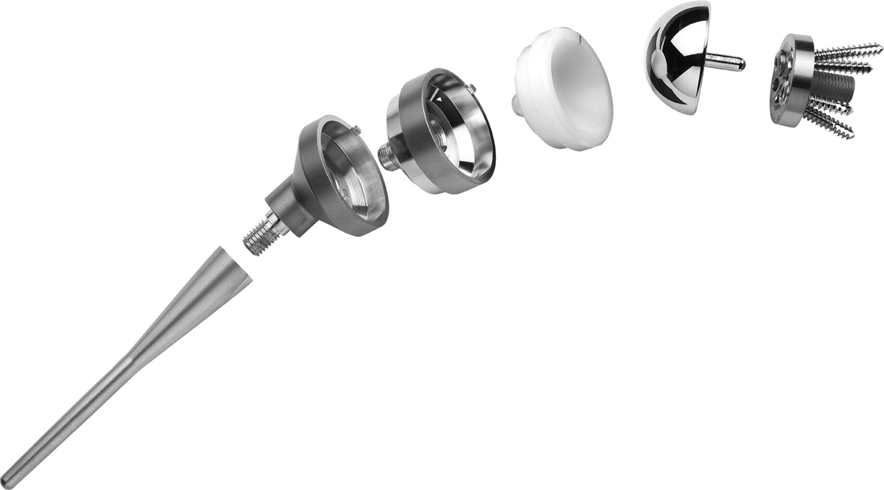
Figure 4. Photograph shows the Aequalis Reversed Shoulder Prosthesis.
Roberts C C et al. Radiographics 2007;27:223-235
©2007 by Radiological Society of North America
Notes:
Figure 4. Photograph shows the Aequalis Reversed Shoulder Prosthesis. (Reprinted with permission from Tornier.)‏
Humeral stem, humeral neck components, cup, glenosphere and glenoid base.

Slide 7
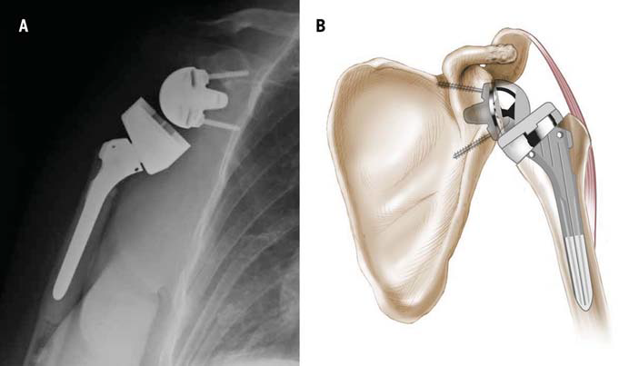

Slide 8
PRE-OP

Slide 9
PRE-OP

Slide 10
POST-OP

Slide 11
POST-OP

Slide 12
APTA PRACTICE PATTERN
4 H- Impaired Joint Mobility, Motor Function, Muscle Performance, and Range of Motion Associated with Joint Arthroplasty.
Goals: decrease pain, improve range of motion and improve strength.
Treatment may include:
Therapeutic Exercise
Manual Therapy
Electrotherapeutic Modalities
Functional Training
Physical Agents and Mechanical Modalities

Slide 13
PATIENT-SUBJECTIVE
67 year old female
Former bus driver
Previous hx R shoulder OA
CC R shoulder pain and weakness past 12 months
Pseudo paralysis R UE last 10 months
2 previous failed RTC repairs

Slide 14
PATIENT- SUBJECTIVE
Pain bw 1-7/10, relieved with percocet PRN and ice. Pain is less than before surgery
She lives with husband, but assisted by daughter who lives nearby
Can perform some tasks independently but needs assistance with bathing and dressing
GOAL: Reduce pain further and be able to regain activity and independence

Slide 15
OBJECTIVE: EXAMINATION
Pt entered therapy wearing sling
Well healing scar with unremarkable bruising, swelling or discoloration
Pt educated on E/W/H and scapular ROM exercises
Sleeping protocol discussed to avoid rolling on R shoulder
Daughter present for instruction on PROM forward elevation and ER stretches
No IR at present

Slide 16
OBJECTIVE: TESTS & MEASURES
Quick DASH Score: 73
Pain ranging from 1-7/10
R Shoulder PROM flexion/scaption: 65 degrees
R shoulder PROM ER: 10 degrees
No pain provocation with end range testing
Anything else??

Slide 17
ASSESSMENT
Pt presents with signs and sx consistent with 2.5 weeks s/p R Reverse TSA
No signs of infection or significant distal neural involvement
Pt and family compliant with R UE NWB status, sleeping precautions and ROM limitations

Slide 18
IMPAIRMENTS
Decreased PROM
Decreased functional AROM/strength R UE
Increased R UE pain
Above results in decreased functionality and QOL

Slide 19
SHORT TERM GOALS- 4 to 6 weeks
Pt will exhibit independence with HEP to facilitate self improvement
PROM R shoulder scaption at least 125 degrees
PROM R shoulder ER 45 degrees
Quick DASH score no greater than 50, indicating increased functionality
Max pain no more than 5/10
Independent bathing and dressing

Slide 20
LONG TERM GOALS- 12 weeks
AROM R shoulder scaption at least 110 degrees to allow for maximization of OH activity
AROM R shoulder ER of at least 45 degrees
Functional IR R shoulder to PSIS, to maximize behind the back function
R shoulder ABD strength of at least 4/5
Quick DASH score no greater than 30, indicating increased functionality
Max pain in R shoulder of no more than 2/10

Slide 21
PLAN OF CARE (POC)
Pt will be seen once per week for 12 weeks with reassessment to follow
Tx plan to include:
Therex
Manual therapy
Local modalities PRN
Pt education
HEP

Slide 22
1st SESSION- THERAPEUTIC EXERCISE
Therex
Family assisted:
PROM scaption x 2’
PROM ER x 2’
Pt performed:
Pole ER x 2’
Scapular retraction/rolls x 10 reps
Shoulder shrugs x 10 reps
Step Backs 3 x 30

Slide 23
1st SESSION- MANUAL THERAPY
PT performed PROM scaption to about 120 degrees x 12 minutes
PT performed PROM ER in ABD up to 30 degrees x 12 minutes

Slide 24
1st Session Daily Note- ASSESSMENT
Pt tolerated therapy well
Very compliant
Understands importance of progressing at appropriate pace
Pt shows motivation and capability to progress towards STG/LTG

Slide 25
HOME EXERCISE PROGRAM
Scapula- Adduction
10 reps, 2-3 sets, 2-3 sessions/day
Scapula- Composite Rotation
10 reps, 2-3 sets, 2-3 sessions/day
A little later on
Step-Back Exercise for Shoulder Flexion
15 sec, 5 reps, 1x/day
ER Stretch with Cane
15 sec, 5 reps, 1x/day
Supine Passive Forward Elevation
30 sec, 5 reps, 2x/day
Supine Passive ER
30 sec, 5 reps, 2x/day

Slide 26
SHORT TERM GOALS- REVISTED
Pt will exhibit independence with HEP to facilitate self improvement→ Yes
PROM R shoulder scaption at least 125 degrees→143 degrees
PROM R shoulder ER 45 degrees→46 degrees
Quick DASH score no greater than 50, indicating increased functionality→23
Max pain no more than 5/10→Achieved
Independent bathing and dressing→ Yes

Slide 27
LONG TERM GOALS- REVISITED
AROM R shoulder scaption at least 110 degrees to allow for maximization of OH activity→ Yes
AROM R shoulder ER of at least 45 degrees→ Not met as of D/C
Functional IR R shoulder to PSIS, to maximize behind the back function → L5-S1
R shoulder ABD strength of at least 4/5→ Yes
Quick DASH score no greater than 30, indicating increased functionality→ 23
Max pain in R shoulder of no more than 2/10- Yes
SPADI taken at D/C was 2

Slide 28
OUTCOME MEASURES
Quick DASH- upper extremity pain & disability
0-100, 0 indicates no pain; MDC12.5
SPADI-shoulder pain and fx
0-100%; 0 indicates no pain; MDC 13
What are other ones that could have been used?
Simple Shoulder Questionnaire- shoulder pain and disability; 0-12; 12= full fx
ASES-shoulder pain & function; 0-100; 100= full fx; MDC≈10

Slide 29
DIFFERENCES WITH REGULAR TSA and COMPLICATIONS?
Dislocation/instability more of an issue vs TSA
R TSA- more dislocation risk in ADD, IR, EXT
Conventional TSA-more dislocation risk with ER in ABD
Scapular notching- humeral component bumping up against scapular neck. So component is now being shifted distally during surgery to avoid contact.
Deterioration of components
Movement into soft tissue

Slide 30
PUBLISHED PROTOCOL
Boudreau et al.
JOSPT Dec 2007; Vol 37; Number 12 734-743

Slide 31
Shoulder Dislocation Precautions
Precautions should be implemented for the first 12 wk postoperatively
unless surgeon specifically advises patient or therapist differently:
No shoulder motion behind lower back and hip (no combined shoulder adduction, internal rotation [IR], and extension)
No glenohumeral (GH) joint extension beyond neutral
Progression- criteria based as well as time.

Slide 32
Phase I: Postsurgical Phase, Joint Protection (Day 1 to Week 6)
Goals
Patient and family independent with:
Joint protection, (PROM),
Donning/Doffing sling/clothes
Assisting with home exercise program (HEP)
Cryotherapy
Promote healing of soft tissue/maintain the integrity of the replaced joint
Enhance PROM
Restore active range of motion (AROM) of elbow/wrist/hand
Independent (ADLs) with modifications

Slide 33
Phase I
Days 1-4
PROM forward flex and scaption while supine to 90
PROM ER in scapular plane ~20-30
No IR
AAROM c-spine, E/W/H
Periscapular isometrics
Frequent cryotherapy

Slide 34
Phase I
Days 5-21
Continue previous exercises and cryotherapy
Commence submax deltoid isometrics in scapular plane

Slide 35
Phase I
Weeks 3-6
Progress previous exercises, continue cryotherapy
PROM
Flex and scaption to 120
ER in scapular plane to tolerance
PROM IR to tolerance
Slightly resisted E/W/H exercises

Slide 36
Phase II: AROM, Early Strengthening Phase (Weeks 6 to 12)
Goals
PROM progression
Gradually restore AROM
Control pain and inflammation
Allow continued healing of soft tissue/do not overstress healing tissue
Re-establish dynamic shoulder stability

Slide 37
Phase II
Weeks 6-8
Continue PROM
ROM/AROM forward flex and scaption progresses to sitting/standing
Gentle GH IR/ER isometrics
Supine rhythmic stabilization and alternating isometrics of periscapular and deltoid mm
Progress E/W/H strengthening
Gentle joint mobilizations
Begin using operative UE for eating/light ADLs

Slide 38
Phase II
Weeks 9-12
Exercise progression with function as goal
Supine flex and scaption with light wts (1-3 lbs), progressing to inclined position and sitting/standing
Gentle GH IR/ER isotonic strength exercises

Slide 39
Phase III: Moderate Strengthening (Week 12+)
Goals
Enhance functional use of operative UE
functional activities
Enhance shoulder mechanics, muscular strength, power, and endurance
Precautions
No lifting of objects heavier than 2.7 kg (6 lb) with the operative upper extremity
No sudden lifting or pushing activities

Slide 40
Phase III
Weeks 12-16
Continue prior exercises
Gentle resisted flex in standing

Slide 41
Phase IV: Continued Home Program (Typically 4+ Months Post-op)
HEP performed 3-4 x/wk, focusing on
Strength gains
Progression towards functional/recreational activities based on progress during rehab and outlined by surgeon and PT
Criteria for discharge from skilled therapy
Pain-free shoulder AROM, proper shoulder mechanics (typically 80°-120° of elevation, with functional ER of about 30°)

Slide 42
RESEARCH
Reverse Total Shoulder Arthroplasty: A Review of Results According to Etiology
Wall et al.
Between 1995-2003
186 pts with 191 Reverse TSA followed over ~40 months
Average age 72.7 years

Slide 43
RESULTS
Overall high level of satisfaction
Greatly improved elevation: 140+ degrees
Slight improvements in IR: L3-L2
Slightly higher ER in 90 degrees ABD: 26-63 degrees
Pts with posttraumatic arthritis or undergoing revision arthroplasty had less improvement and higher complication rates

Slide 44
RESEARCH
Problems, complications, reoperations and revisions in reverse total shoulder arthroplasty: A systematic review
Zumstein et al.
Studies from 1995-2008
783 RSA in 761 pts- minimum avg 24 month follow up
Age range 23-89, 77% female, 23% male
Indications: Cuff tear arthroplasty 40.7%, Revision of previous hemi or TSA 27.6% and massive RTC tear 17.3%
Other indications-OA, RA, fx’s and tumors

Slide 45
RESULTS
Problems 44%- ie. Scapular notching, though rarely significant
Complications 24%- instability, infection, glenoid loosening/disassembly, humeral loosening/disassembly
Reoperations 3.5%
Revisions 10%- d/t instability and infections

Slide 46
SUMMARY
This is a last ditch effort to restore/reserve shoulder function
RTC deficiency is key indication
Deltoid will be prime mover
Change in biomechanics-moment arm increased as well deltoid tension→ ↑ deltoid function
Rehab- protection→ROM→strength →function; supine→inclined→sitting→standing; isometric→isotonic
Somewhat different rehab from TSA
More risk of dislocation
Avoid ADD, IR, EXT (behind the back) early in rehab

Slide 47
REFERENCES
1. Boileau P, Gonzalez J, Chuinard C, Bicknell R, Walch G. Reverse total shoulder arthroplasty after failed rotator cuff surgery. Journal of Shoulder and Elbow Surgery. 2009;18(4):600-606. doi: http://dx.doi.org.libproxy.lib.unc.edu/10.1016/j.jse.2009.03.011.
2. Boudreau S, Boudreau ED, Higgins LD, Wilcox RB,3rd. Rehabilitation following reverse total shoulder arthroplasty. J Orthop Sports Phys Ther. 2007;37(12):734-743. doi: 10.2519/jospt.2007.2562; 10.2519/jospt.2007.2562.
3. Gerber C. Reverse total shoulder arthroplasty. J Am Acad Orthop Surg. 2009;17(5):284.
4. Sanchez-Sotelo J. Reverse total shoulder arthroplasty. Clinical Anatomy. 2009;22(2):172-182. doi: 10.1002/ca.20736.
5. Seebauer L, Walter W, Keyl W. Reverse total shoulder arthroplasty for the treatment of defect arthropathy. Oper Orthop Traumatol. 2005;17(1):1-24. doi: 10.1007/s00064-005-1119-1.
6. Wall B, Nove-Josserand L, O'Connor DP, Edwards TB, Walch G. Reverse total shoulder arthroplasty: A review of results according to etiology. J Bone Joint Surg Am. 2007;89(7):1476-1485. doi: 10.2106/JBJS.F.00666.
7. Wilcox RB, Arslanian LE, Millett P. Rehabilitation following total shoulder arthroplasty. J Orthop Sports Phys Ther. 2005;35(12):821-836.
8. Zumstein MA, Pinedo M, Old J, Boileau P. Problems, complications, reoperations, and revisions in reverse total shoulder arthroplasty: A systematic review. Journal of Shoulder and Elbow Surgery. 2011;20(1):146-157. doi: http://dx.doi.org.libproxy.lib.unc.edu/10.1016/j.jse.2010.08.001.

Slide 48
QUESTIONS?

