Slide 1

Managing and Treating Patients with Ventricular Assist Devices in the Acute Rehabilitation Setting
Laura Rapp, SPT
UNC– Chapel Hill
Division of Physical Therapy

Slide 2
Objectives
Upon completion of the in-service participants will:
Have an understanding of the types, function, and goals of ventricular assist devices
Be aware of the indications and precautions/contraindications for patients with VADs
Have an understanding of the clinical considerations and the role of physical and occupational therapy in patients with VADs
Be able to instruct other health practitioners/staff in VAD handling in the event of an emergency situation

Slide 3
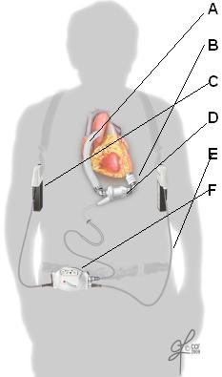
What is a VAD?
Cannula (input/output)
Ventricular assist device - also called ventricular assist system or VAS - is a mechanical pump implanted to help the heart’s weakened ventricle pump blood throughout the body
  i.e. heart failure patients
Components of a VAD: pump, cannula, driveline, power source, & controller
Power source
Pump
Driveline
(External) Controller

Slide 4
How do VADs work?
Blood flows from the ventricle into the pump (which may be internal or external).
LVAD - receives blood from the left ventricle and delivers it to the aorta.
RVAD - receives blood from either the right atrium or right ventricle and delivers it to the pulmonary artery.
Both? BiVAD

Slide 5
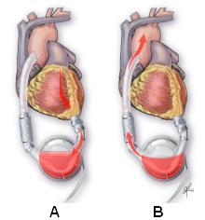
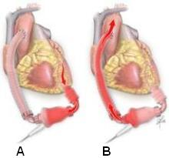
Types of VADs
Pulsatile
  Internal or external
  Diastolic and systolic stages
  Used for 1-2 or 2+ years
Non-pulsatile
  Internal
  Long-term (destination)
  Short-term (bridge for up to 2-3 weeks)
Notes:
Pulsatile – not as common d/t larger size, lower durability, higher complication rates
Non-pulsatile – driveline exits through right abdominal wall…. Move blood via axial flow or centrifugal force

Slide 6
Who gets a VAD?
Indications
  Bridge to transplantation
  Bridge to candidacy
    Allows for time to reach eligibility for cardiac transplant (e.g. to reach appropriate BMI, cancer-free period, financial support)
  Destination therapy
    Not transplant candidates… usually older or more comorbidities
  Bridge to recovery
    Assist the native heart until sufficient recovery
    Or RVAD to support new LVAD… Short-term (see next slide)

Slide 7
Short Term VAD
Larger short-term VAD supporting the right ventricle in the presence of HeartMate II supporting the left ventricle.
Goal of VADs?
  Ultimately, to relieve stress on the heart before other organ dysfunction due to ineffective SV
Notes:
Temporary support R ventricle when R heart failure develops due to unstable ventricular septum following nonpulsatile LVAD… Occurs in up to 40% of patients receiving LVAD.

Slide 8
Inclusion Criteria
Generally speaking, VAD patients must have:
  Cardiac output <2 L/min
  Reversible organ dysfunction
  Ability to restore physical function

Slide 9
Clinical Considerations

Slide 10
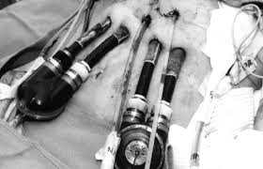
Managing VADs
Pulsatile VADs - External
Be aware:
  Pump & cannula positioning so outflow is not obstructed
    →Can lead to thrombosis formation in the pump
  Cannula site healing
  Max estimated pump output
    →May limit activity tolerance in higher functioning patients
PT should:
  Inspect pump after mobilizing to ensure proper emptying w/ no obstructions
  Collaborate with VAD team for anchoring cannulas/external pump when mobilizing against gravity
  Instruct patient/caregivers in importance of anchors to protect cannula sites for healing
Notes:
Effects of gravity and movement may cause pain and ventricular arrythmias

Slide 11
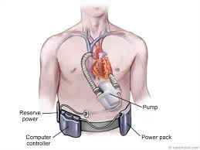
Managing VADs
Pulsatile VADs - Internal
Avoid:
  Thoracolumbar flexion
    May obstruct cannulas and blood flow
PT should…
  Address patient posture/body mechanics
  Collaborate with VAD team for anchoring driveline when mobilizing against gravity
  Again, be mindful of max estimated pump output
    →May limit activity tolerance in higher functioning patients

Slide 12
Managing VADs
Non-Pulsatile
Be aware:
  Palpable pulse and ausculatory BP may not be present d/t lack of true diastole/systole with non-pulsatile LVAD
  Red blood cells may damaged in non-pulsatile pumps, causing hemolysis, hematuria, and decreased exercise tolerance
  Sternal precautions may be necessary with early mobilization
PT should:
  Obtain BP using Doppler techniques as an estimate of MAP - which tends to be higher than average (75-85 mmHg)
  Assess hemoglobin/hemocrit
  Monitor pump function
  Use patient report to assess activity tolerance
    Borg RPE
    Dyspnea Scale
Notes:
Arterial pressure tracing will show a dampened waveform, narrow pulse pressure, and higher than normal MAP (75-85 mmHg)

Slide 13
Notes:
MAY have palpable HR and BP if speed is low… More blood being pumped by actual heart than going through VAD.

Slide 14
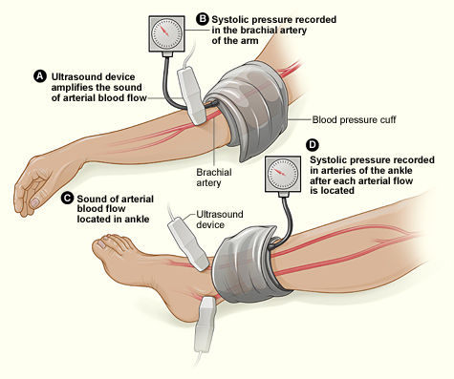
Doppler Technique
Systolic blood pressure can be indirectly determined using ultrasound.
Blood flow reflects sound waves, which cause a change in frequency that is detected by the Doppler.
http://xlpad.org/education.html

Slide 15
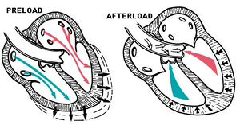
Managing VADs… in general
PRELOAD
  VADs require sufficient blood volume to fill pump and support failing ventricle
  Hypovolemia can increase risk of thrombosis & stroke
Monitor CVP, which will decrease if insufficient filling
  Should be between 12-15 mmHg
Signs/Symptoms:
  Decreased CVP
  Pt report of dizziness
  Insufficient filling alarm on VAD

Slide 16

Managing VADs… in general
PRELOAD
  PT management of preload…
    Reduce orthostatic hypotension by slowing upright progression and increasing muscle activity
    Return patient to supine immediately if signs/symptoms persist

Slide 17
Managing VADs… in general
SUCKDOWN
  When a collapsed ventricle prevents pump from filling
  →Decrease/loss of cardiac output
  CRITICAL SITUATION
  Occurs in non-pulsatile pumps, more likely during PT w/ reduction in venous return d/t decreased muscle mass, vascular tone, and mechanical ventilation
Signs/Symptoms
  Hypotension
  Ventricular tachycardia
  Recently adjusted VAD speed
  Irregular VAD sounds such as knocking or beating

Slide 18
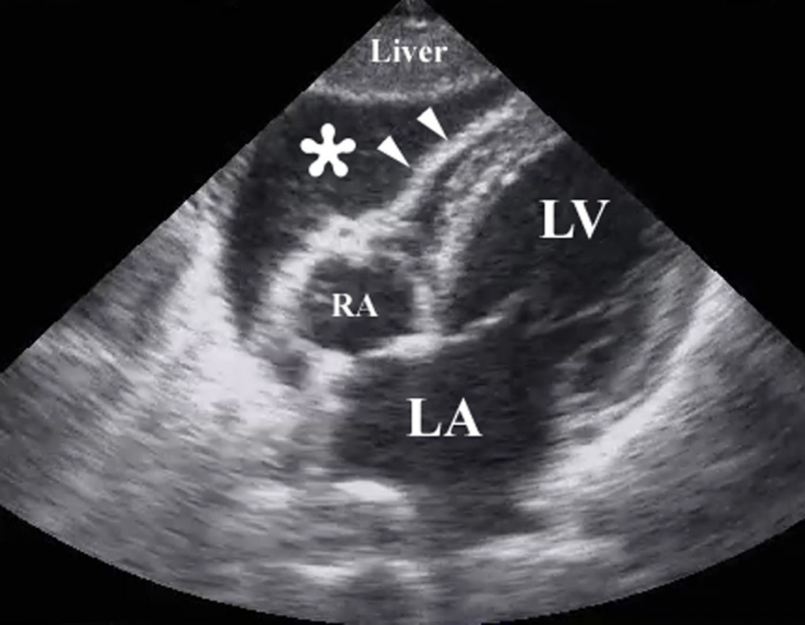
Managing VADs…in general
SUCKDOWN
  PT management of suckdown…
    If vital signs change, immediately return patient to supine and elevate LEs
    Contact VAD team IMMEDIATELY to decrease VAD speed
Right Ventricular Collapse →

Slide 19

Managing VADs…in general
AFTERLOAD
  Resistance to circulation (i.e. hypertension) affects all kinds of VADs
  Can lead to decreased cardiac output
Signs/Symptoms:
  Hypertension
  Decreased exercise tolerance
  Dizziness
  Syncope

Slide 20
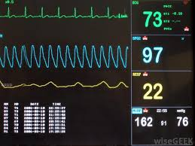
Managing VADs…in general
AFTERLOAD
  PT management of afterload…
    Monitor vital signs
    Adjust exercise program to decrease BP response
    Contact VAD team

Slide 21
Managing VADs…in general
ARRHYTHMIA
  Can change ventricle or pump filling and lead to other complications
  E.g. In a patient with an LVAD:
    Low CVP + a-fib → impaired R ventricle contraction → insufficient filling of LVAD → decreased CO and/or suckdown.
  Irrelevant in BiVADs
Signs/Symptoms:
  Dizziness
  Decreased exercise tolerance
  Filling alarm, low output alarm, suckdown
  May be asymptomatic
Notes:
With RVAD: arrhythmia prevents L ventricle from ejecting sufficient blood volume → decrease in preload and insufficient R ventricle filling → suckdown and further decrease CO

Slide 22
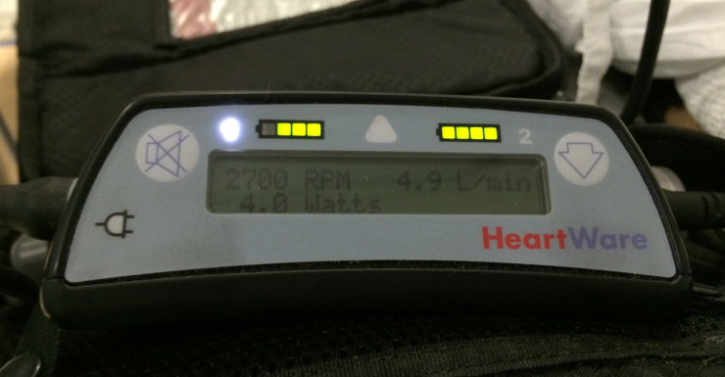
Managing VADs… in general
ARRHYTHMIA
  PT management of arrhythmia…
    Monitor vital signs and pump function
    In case alarm goes off, return patient to sitting or supine and contact VAD team immediately

Slide 23
Managing VADs… in general
THROMBUS
  VAD recipients are typically prescribed anticoagulants and antiplatelet protocol d/t risk of thrombus
  May be caused by poor pump placement or insufficient pump speed to allow aortic valve to open
Signs/Symptoms:
  Grinding sound from VAD
  DVT, TIA, bruising, hematomas
  Hematuria
  Increase in VAD power reading
  Decrease in hemoglobin/hematocrit

Slide 24
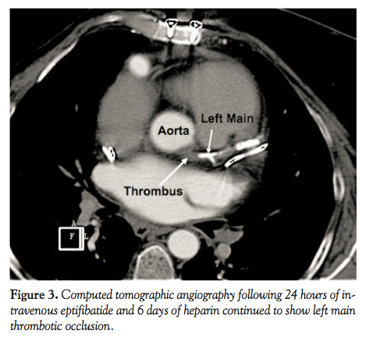
Managing VADs… in general
THROMBUS
  PT management of thrombus…
    Routinely monitor power the device uses at a given speed and output
    Be familiar with VAD sounds
    Contact VAD team for management and guidelines to proceed with rehabilitation

Slide 25

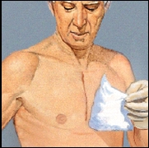
Managing Infection
Driveline infection can migrate to pump and result in removal from transplant list, VAD removal, and death
PT’s role?
  Secure driveline prior to mobilizing
  Use hand hygiene
  Patient positioning to prevent decubitus
  Airway clearance

Slide 26
Mobility with VADs
REMEMBER:
  Sternal precautions
  Secure cannulas and driveline
  Instruct patient in modifying rolling, supine-to-sit, etc.
  Management of external equipment during mobility
  Prevent obstruction of blood flow → during spinal flexion and with posterior pelvic tilt
Watch vitals whenever possible:
  Inspiratory rates
  Dyspnea
  O2 desaturation
  Decreased cardiac output with decreased exercise tolerance

Slide 27
Post-op Therapy
  POD #1
    Airway clearance, positioning, skin care, joint function
  ICU
    Monitor vital signs, self-report scores
    VAD function - specifically MAP in nonpulsatile VADs because hypertension = difficult to circulate blood and hypotension = suckdown).
  Progress based on general cardiac rehab guidelines
  See Table as modified by Thompson et al. (2010) on next slide

Slide 30

Questions? Comments? Concerns?

Slide 31
References
Drakos SG, Janicki L, Horne BD, et al. Risk factors predictive of right ventricular failure after left ventricular assist device implantation. Am J Cardiol. 2010;55:1826-1834.
Miller LW. Patient selection for the use of ventricular assist devices as a bridge to transplantation. Ann Thorac Surg. 2003;75(6 suppl): S66-S71.
Multi-Center Registry For Peripheral Arterial Disease Interventions & Outcomes. Picture retrieved June 10, 2014 from http://xlpad.org/education.html
Slaughter MS, Meyer AL, Birks Ej. Destination therapy with left ventricular assist devices: patient selection and outcomes. Curr Opin Cardiol. 2011; 26: 232- 236.
Stahl MA, Richards NM. Ventricular assist devices: developing and maintaining a training and competency program. J Cardiovasc Nurs. 2002;16(3):34-43.
Thompson WR, Gordon NF, Pescatello L. ACSM Guidelines for Exercise Testing and Prescription. 8th ed. Baltimore,MD: Lippincott Williams & Wilkins; 2010.
Ventricular Assist Devices: Cleveland Clinic. Retrieved June 10, 2014 from http://my.clevelandclinic.org/heart/disorders/heartfailure/lvad_devices.a spx
Wells, CL. Physical therapist management of patients with ventricular assist devices: key considerations for the acute care physical therapist. Phys Ther. 2013; 93: 266-278.

