Slide 1
Platelet Rich Plasma in the Treatment of Orthopaedic Injuries
Presented by Lauren Diamond
Doctor of Physical Therapy Candidate 2014
Notes:
In today’s world, we see medicine advance at a remarkable rate. With healthcare cost growing and discoveries being made so quickly that we are unsure of their potential adversities, the researchers are beginning to look more into autologous methods of intervention.¹¹ The use of autologous products is a rapid growing field focused on manipulating growth factors and secretory proteins to maximize healing of bone and soft tissues.²

Slide 2
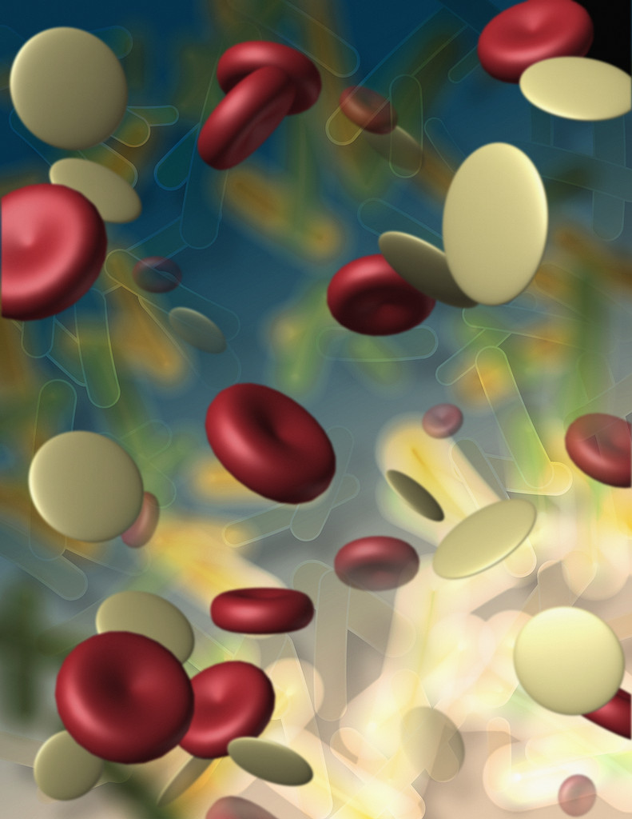
What is Platelet Rich Plasma?
Platelet Rich Plasma (PRP) is defined as plasma with enriched levels of platelets in relation to the patient’s whole blood¹
Increased growth factors
Notes:
Platelet rich plasma is harvested from a patient’s own blood, centrifuged to obtain and concentrate the amount of platelets, then placed in a small amount of plasma, and readministered to the site of injury.¹¹
With the increase of platelets comes a linear increase of powerful growth factors, including transforming growth factor beta and vascular endothelial growth factor.¹¹
Image from: http://thirdspacemedical.com/services/muscular-skeletal/testing-treatments/regenerative-orthopedics-platelet-rich-plasma/

Slide 3
What is Platelet Rich Platelet?
Hypothesis: PRP will enhance recruitment, proliferation, and differentiation of cells involved in tissue regeneration²
With growing interest, comes great controversy³
Notes:
Despite the growing interest in this product, little is known regarding the specifics of preparation or the devices used in production.³

Slide 4
Outline
History
Preparation & Application
Literature Review
Legal Issues
Billing
Controversy
Future Studies
Mesenchymal Stem Cells

Slide 5
History of Platelet Rich Plasma
1970s→1990s→today
In 2009 the market was valued at $45 million dollars and expected to increase to more than $120 million by 2016¹
2009 Super Bowl publicity
Notes:
Platelet rich plasma has been recognized as a powerful adhesive and hemostatic agent since the 1970s, but only since the 1990s has it been associated as a potent source of autologous growth factors.⁴
In 2009 The New York Times published an article detailing PRP’s positive effects being responsible for an American professional football player’s accelerated return to play and subsequent victory in the 2009 Superbowl.⁵
Image from: http://www.money-top10.com/make-money.aspx

Slide 6
Uses for PRP
Maxillofacial surgery (bone healing)
Postoperative wound healing
Healing of muscle, ligaments, and tendons
Intraoperative application
Sports Medicine
Critical recovery time and return to play⁴
Notes:
The increase in growth factors associated with this concentration is reported to promote healing. As mentioned previously, science is expanding at incredible rates and this recent explosion has resulted in the clinical use of PRP outpacing evidence-based research.⁵ There are many applications of PRP at this time including bone healing in maxillofacial surgery, postoperative wound healing, and healing of muscle, ligaments and tendons.⁴ The positive effects seen in the intraoperative applications have lead to the use of PRP in sports medicine outpatient settings⁵ and even though PRP gained its popularity in dentistry and maxillofacial surgery, the area with greatest current interest is sports medicine. This is credited to the importance and critical consideration of recovery time and return to play.⁴

Slide 7
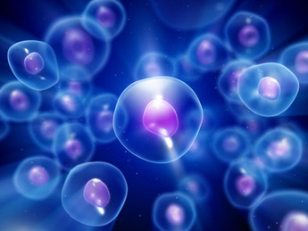
Components of PRP
Understanding growth factor function and standard timeframe of healing
Steps of healing⁵
Clot formation
Platelet activation
Release of growth and differentiation factors
Notes:
A major part of research with PRP is the understanding of each growth factors function once applied and how that intertwines with the standard timeframe of healing.⁵ In normal tissue healing, the first step is clot formation and platelet activation. Once the platelets are activated, the growth and differentiation factors are released from alpha-granules.
Within the first 10 minutes, ninety five percent of the factors present are released. The remaining five percent are released over the next several days.
Image from: http://www.zeitnews.org/life-sciences/biology/origin-life-emerged-cell-membrane-bioenergetics

Slide 8
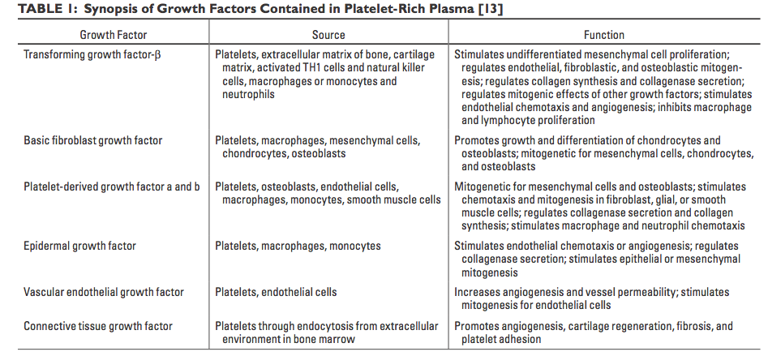
Components of PRP
5
Notes:
Figure⁵
Platelet rich plasma is defined as a platelet concentration that is higher than the physiologic platelet concentration found in whole blood (150,000-350,000 platelets per μL).5 Therapeutic levels seen in PRP are considered to range from 200,000-1,000,000 platelets per μL.3 Therefore, the potential benefit of PRP is the interplay of the increased growth factors. Some of the most important growth factors associated with this process are platelet derived endothelial growth factor, transforming growth factor-β, vascular endothelial growth factor(VEGF), fibroblast growth factor, epidermal growth factor, and insulin-like growth factor-1. Table 1 shows the source and function of each of these growth factors.5 Along with adhesive protein factors, the growth factors are said to be responsible for healing response, promoting the long regenerative process of chemotaxis, cell proliferation, removal of tissue debris, angiogenesis, extracellular matrix formation, osteoid production, and collagen synthesis.5

Slide 9
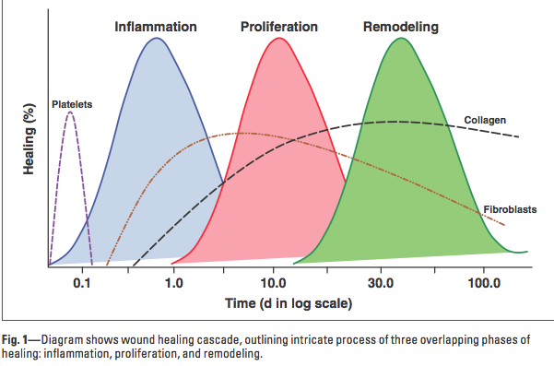
Healing Cascade
Notes:
Within the healing cycle, platelets are responsible for bleeding cessation and hemostasis. Once the platelets are activated by mediators at the site, they undergo degranulation and release the growth factors as well as bioactive proteins.⁵ This conglomeration of growth factors works together to promote healing and the formation of new tissue.¹
The wound-healing cascade is an overlapping process that is composed of three phases: inflammation, proliferation, and remodeling. Figure 1. shows these overlapping phases and how they progress over time.
Once injury has occurred, a hematoma forms at the site of damage and platelets adhere to the exposed collagen.⁵ This creates a clot and the activation of platelets which will ultimately release growth, bioactive, and hemostatic factors. This is the beginning of the inflammatory phase. Neutrophils and macrophages access the wound within hours and serve as phagocytes. The proliferative phase begins a few days after injury and is characterized by angiogenesis, collagen deposition, granulation tissue formation, epitheliazation, and wound contraction. Collagen maturation and apoptosis of excess cells indicate the remodeling phase and can span from several weeks to months post-injury.5
Figure⁵

Slide 10
Preparation of PRP
Lack of set procedure
Separation systems⁵
Gravitational platelet sequestration
Cell separator
Small compact office system
Leukocyte rich vs. Leukocyte poor^{4,6}
Activation process²
Component Concentration
Application technique
Notes:
One of the most noticeable differences in the literature is the lack of standardization across the preparation of PRP. As the literature continues to develop, the researches are noticing the lack of set procedure. The variability in the research may be a direct result from these differences across the spectrum.3 For example, if places that apply PRP clinically obtain their systems from different companies, it is likely that the preparations will be different with potentially varying volumes and concentrations of platelets, as well as red and white blood cells.9 This vast centrifugation market is the reason that standardization is so challenging.5
Currently, there are three common centrifuge methods:5 the gravitational platelet sequestration technique, which only takes 30 minutes and requires only a tabletop system; the cell separator, which requires a full unit of blood; and the small compact office system. These different systems will likely have different capabilities such as separating RBCs from platelets (which would directly affect concentration), separating leukocytes from platelets, as well as shearing the platelets, which would lead to premature activation and degranulation of the platelets.5 An article published in 2011 states that the use of different separation systems and lack of characterization of product “makes it difficult to compare the results of studies, (and) perpetuates the lack of standardization in PRP dosing, which further complicates the ability to interpret the literature and compare clinical findings.”
Depending on the method of preparation, PRP can be leukocyte-rich or leukocyte-poor. Studies suggest that leukocytes are responsible in producing VEGF and have antimicrobial properties. While these leukocytes may have a role in enhancing tissue repair, it may also lead to increased, unwanted local inflammation.4 Companies that concentrate white blood cells in PRP argue that the leukocytes assist in creating an antibacterial response and have the ability to debride dead tendon tissue to jump start healing. However, the companies who purposefully eliminate WBC from PRP argue that leukocytes have detrimental effects on healing tissues. They claim that this is due to the enzymes from the matrix metalloproteinase family that are released by neutrophils and potentially increase the local inflammation.4,6 This is just one of many contradictions found in the literature. As one spends more time looking at the available resources, one will find multiple questions left unanswered.
One must also consider activation processes, component concentration, as well as application techniques. When preparing PRP, citrate is often added to whole blood to bind the ionized calcium and inhibit the clotting cascade.2 Depending on the use of PRP, it may be necessary to activate the platelets. When PRP is applied with a needling application, thombin is the clotting factor that is naturally activated. Then, once in the tissues, exposure to collagen will further promote activation. It is important to understand that clotting leads to platelet activation and furthermore the release of growth factors.2 In the intraoperative setting however, bovine thrombin, calcium, or soluble type I collagen is often used to activate platelets. This step is associated with a great amount of controversy.5 Several risk factors are stated when using bovine thrombin as an exogenous activator such as undesirable immune responses and inhibition of cell proliferation and viability, which consequently limits its clinical use.8 An alternative for these side effects has been established to use calcium chloride for activation. The addition of calcium chloride initiates the formation of autogenous thrombin from prothrombin and results in a dense fibrin matrix.2 The intact platelets are then subsequently trapped in the dense matrix. The small amount of natural thrombin present is not enough to activate the platelets. This results in a slow release of growth factors over a 7-day period.2

Slide 11
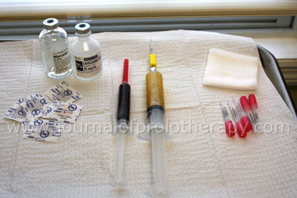
Application of PRP
Common Methods
Questions left unanswered
Time of PRP application
Number of injections needed
Notes:
Image from: http://www.journalofprolotherapy.com/index.php/platelet-rich-plasma-grafts-in-musculoskeletal-medicine/
Researchers are concerned about applying PRP to a tendon in the acute phase of injury in comparison to applying PRP to a degenerative tendon as they have very different cellular and molecular processes.2 The cytokines and biologic environment are ever changing across the time frame of injury and there is thought to be a potential to exacerbate inflammation (and furthermore increase pain) if the application is performed in the acute setting.2

Slide 12
Corticosteroids vs. PRP
Side effects of corticosteroids and PRP
Lateral Epicondylitis
“Ongoing positive effect of platelet-rich plasma versus corticosteroid injection in lateral epicondylitis: A double-blind randomized controlled trial with 2-year follow-up.”⁶
Plantar Fasciitis
“A study to compare the efficacy of corticosteroid therapy with platelet-rich plasma therapy in recalcitrant plantar fasciitis: A preliminary report.”⁷
Notes:
One treatment that PRP is often compared to is the infamous corticosteroid injection. While corticosteroids do have an important role in medicine, we are constantly reminded of its long list of risk factors

Slide 13
Corticosteroids vs. PRP
Lateral Epicondylitis⁶
Outcome measures: Visual Analog Scale (pain) and Disabilities of the Arm, Shoulder and Hand
“Successful intervention”: 25% reduction in VAS or DASH
At two year follow up, PRP group continued to improve while corticosteroid group returned to baseline
No complications with the use of PRP
Notes:
. A study by Gosens compared PRP to corticosteroids for a two-year follow up in patients with lateral epicondylitis.6 The outcome measures used were the Visual Analog Scale (VAS) pain score and Disabilities of the Arm, Shoulder, and Hand (DASH). All patients received an injection in the common extensor tendon. The two groups were said to be statistically similar in terms of demographics and clinical characteristics, however the PRP group did have significantly higher scores on the DASH compared the corticosteroid group. Successful intervention was defined as a 25% reduction in VAS or DASH without reintervention after 2 years.6 While both groups significantly improved over the first year, those treated with corticosteroids had a return to baseline level of the DASH at 2 year follow up while those treated with PRP continued to significantly improve. It was also noted that there were no complications related to the use of PRP.
Gosen goes on to explain that while corticosteroids may be the best treatment for the short term, poor results are often seen after 12 weeks of follow-up. The percentage of success after a single corticosteroid injection drops from 51% at 1 year to 40% after 2 years follow-up.6

Slide 14
Corticosteroids vs. PRP
Plantar Fasciitis⁷
Outcome measures: VAS pain scale, Foot & Ankle Disability Index (FADI), American Foot and Ankle Score (AFAS)
Inclusion criteria: symptoms lasting ≥ 3 months and failed conservative treatment
Both groups showed significant improvement
Corticosteroids referred to a “quick fix for pain relief”
Notes:
In a prospective non-randomized study focused on corticosteroids verses PRP in the treatment of plantar fasciitis, Shetty found that PRP should be considered an attractive alternative to recalcitrant plantar fasciitis.7 They compared individuals who had symptoms for at least 3 months and had tried and failed with conservative treatment. One group was given a steroid injection and the other PRP. Both groups had significant improvements in the outcome measures (VAS, Foot & Ankle Disability Index (FADI) and American Foot and Ankle Score (AFAS)), however the PRP group scored better in comparison to the steroid group. Shetty refers to corticosteroids as a “quick fix for pain relief” during the acute phases and has limited effects in chronic cases with a high rate of relapse and recurrence.7 Something that is prevalent in the research and that is stated in the Shetty article is that PRP has sustained improvements over time and continues to have no report of complications.7

Slide 15
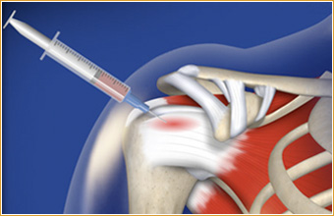
PRP Used for Tendon Injury
PRPs reversal effects on tendinopathy²
Chronicity in Athletes⁸
Achilles tendinopathy and the controversy of response²
Notes:
A study done by Charousset looked at PRP injections for patellar tendinopathy in professional and semiprofessional athletes.8 It was found in a previous study that chronic patellar tendinopathy commonly leads to athletes abandoning their profession. It may even lead to long-lasting symptoms that are apparent long after their careers.8
Foster also considered PRP in the use of tendon injury. He states that PRP is hypothesized to reverse the effects of tendinopathy by stimulating revascularization and enhancing healing at a microscopic level.2 However, they do bring up an important point for pathologies such as Achilles tendonopathy which can be classified into three different categories. Depending on the injury (paratendinitis, paratendinitis with tendinosis, and pure tendinosis) the response to PRP could change. Foster gives an example rehabilitation protocol for post PRP injection when treating Achilles pathology. They suggest the patient be protected with a brace and removed from athletic activity. An immediate protocol of active and active assisted range of motion strictly in the plantarflexion-dorsiflexion plane is initiated. Then, the patient is gradually progressed with a standard protocol for strength and functional recovery. A gradual return to activities should be spread out over six to eight weeks depending on the size and severity of the lesion.2
Image from: http://blog.tarlowknee.com/2013/08/prp-shown-not-to-improve-rotator-cuff.html

Slide 16
PRP Used for Tendon Injury
Charousset, Zaoui, Bellaiche, Bouyer (2014)
Chronic (> 4 months) patellar tendinopathy in 28 professional and semi-professional athletes who had failed alternative treatments⁸
Repeated injections (average of three) followed by progressive training⁸
Outcome measures: VAS (pain), Victorian Institute of Sports Assessment-Patella, Lysholm knee scale, and MRI
Prospective study outcomes
Notes:
Patellar tendinopathy The Charousset study included 28 athletes who had failed non-operative treatment for at least 4 months. These alternative treatments included relative rest, nonsteroidal anti-inflammatory drugs (NSAIDs), formal eccentric exercises, peritendon corticosteroid injections, laser therapy, and extracorporeal shockwave therapy. Their theory for why PRP is used in tendinopathy treatment is due to the autologous growth factors, which stimulate tendon healing through collagen regeneration and well-ordered angiogenesis. On average, the subjects were given three injections. Charousset claimed that since most growth factors are short lived, then repeated administration is often needed. Their injections were ultrasound guided and patients received the same post-procedure protocol. The program began with warm up exercises, stretching, and eccentric exercise on a flat board (as described by Stanish et al), followed by progressive training such as cycling and mild pool activity with buoy, and lastly, running was allowed at postoperative week six and return to sport was allowed as tolerated after week eight.8
Charousset chose to use Victorian Institute of Sport Assessment-Patella (VISA-P) score, visual analog scale (VAS) for pain, and the Lysholm knee scale for clinical evaluation and MRI was performed at 1 and 3 months to evaluate tendon healing.8 The clinical scores were assessed at 4 weeks, 3 months, and every 6 months with a 2-year minimum follow up. All patients significantly improved in terms of VISA-P, VAS, and Lysholm. However the MRI found that only 57% returned to normal structural integrity, 43% deemed partial healing, and 20% showed treatment failure.8 At the two year follow up, 75% of the athletes returned to their pre-symptom sporting level after a mean period of 3 months post PRP injection, 10% returned to sport at a lesser level, 4% changed their sport activity (for other reasons), and 10% required surgical intervention.8 They conclude in their prospective study that with application of three consecutive ultrasound guided PRP injections, the athletes showed significantly improvement of symptoms and function.8

Slide 17
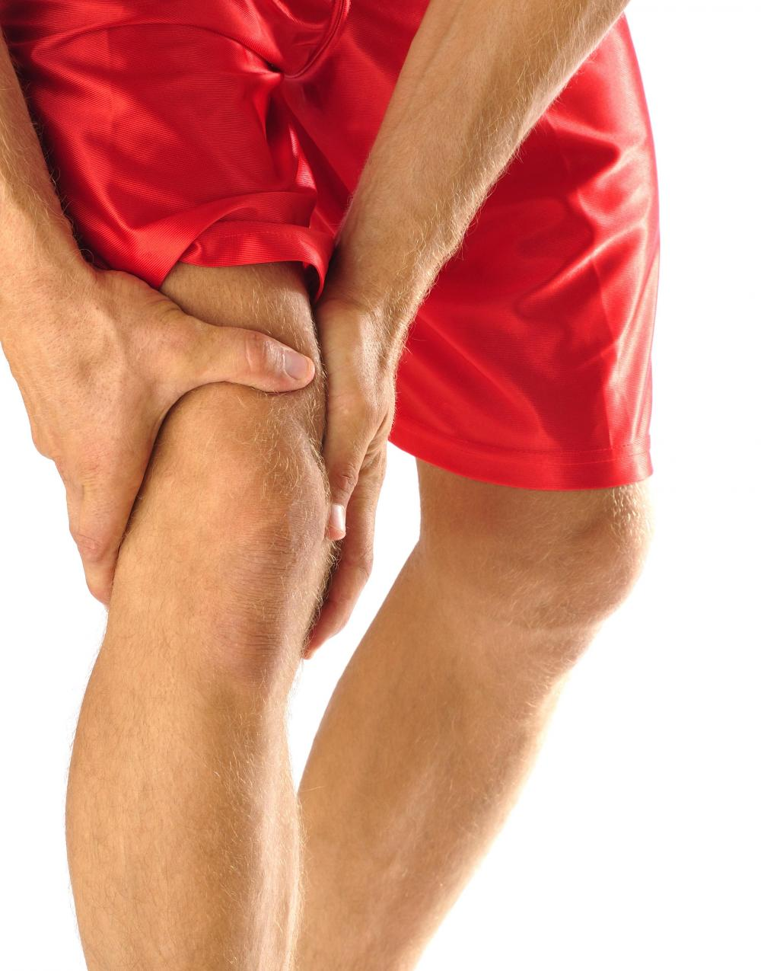
PRP in Muscle Pathology
Acute muscle strains are the most common cause for missed practice and games in elite athletes²
Injury often caused by direct trauma or decompensation of eccentric load
PRPs role
Supply growth factors
Angiogenesis
Notes:
Platelet rich plasma is not only being used to treat injury to tendon units, but also direct application to muscle lesions. These lesions are commonly caused by direct trauma or decompensation of the eccentric load during muscle contraction.9 Acute muscle strains are the most common injuries that account for the majority of missed days of practice and games in elite athletes.2 The speed of recovery is often directly linked to the severity of injury, the postinjury treatment, and the patient’s inherent ability to heal.2 Muscle regeneration processes rely heavily on the presence of growth factors and cell interaction.9 Therefore, PRP has been suggested as a potential intervention for athletes with acute muscular injuries.2 Not only does PRP supply the injury with growth factors, but it is also known to be an active participant in the angiogenesis process.9
Even with the discrepancies in PRP being used for muscular injuries, the theory holds steady across the board. The rationale is substantiated by the fact that the release of growth factors is linked to acceleration of tissue recovery. Once PRP acts in proliferation of muscle precursors, vascularization improvement, reduction of infectious processes and symptoms of pain, it should lead to functional improvement and rapid return to sport.
Image from: http://www.cycling360media.com/common-cycling-injuries/

Slide 18
PRP in Muscle Pathology
Eight professional athletes with moderate lesions⁹
Treated three days after injury with PRP⁹
Results⁹
Reduced edema
Reduced bleeding
Full functional recovery in two weeks
Concerns with PRP⁹
Acute application?
TGF-β
Notes:
While the research on muscular injuries and PRP are limited, there are a few clinical studies that suggest positive effects. A review published in 2014 discusses three studies that addressed muscular lesions in elite athletes.9 The first study had eight professional athletes with moderate lesions that started PRP treatment 3 days after injury. Results led to the reduction of edema and bleeding in the treatment group and full functional recovery in just two weeks. This two-week time frame represented half of the expected time for regeneration of this type of lesion.
Another reviewed study also showed recovery time reduced in half after ultrasound guided PRP percutaneous injections aimed directly to the injured area. However, not all studies show positive effects with this type of injury. Marques reviews another article in which PRP was applied with arthroscopy to the rotator cuff and showed no significant difference in outcome scores. However, the same article suggests that PRP may be more beneficial in bigger sized lesions as opposed to small and medium sized.9
However, there are some hypotheses that shall warrant concern. It is hypothesized that PRP can have no therapeutic effect when applied in the first 24 hours after injury.9 There has also been concern of the growth factor, TGF-β, being released from platelet granules. This growth factor has shown to stimulate fibrosis and there is a chance that this fibrotic healing may lead to increased incidence of reinjury.2 Marques argues that these extensive conflicting results in the literature show the need for additional studies.
These studies shall be more strict in standardization in relation to size and location of lesion, age of patients studied, methodology used to obtain PRP, leukocyte and platelet count in order to obtain a product having adequate concentrations, and searching for routine clinical application of a therapy that is highly effective and minimally invasive.9

Slide 19
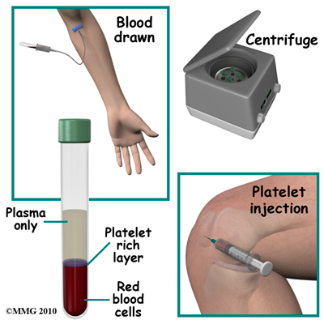
Other Clinical Applications
Bone healing
Ligament injuries
Cartilage lesions
Intraoperative application
Notes:
While these are just a few examples of clinical applications, the list continues. Studies are showing great interest in cartilage and ligament lesions as well. However many of these are case studies with excellent outcomes but making it difficult to draw conclusions that may or may not have controls, have small sample sizes, and do not define standard preparation of PRP.2 Another category that is still of great interest is PRP in the treatment of bone lesions. This was one of the first uses of PRP studied in the 1990s and has continued to be an area of interest. However, it too still has inconclusive results. Researchers are concerned with the lack of standardization and the importance that is needed to emphasize the exact concentration of each growth factor to validate therapeutic properties.9
Image from: http://www.sandiegohealthclinic.com/services/platelet-rich-plasma-prp.html

Slide 20
Sheth et al. Meta-Analysis
Vast differences leads to vast inclusion¹
Topics considered¹
Type of injury
Outcome measures
Activating agents
Volume of product
Separation system
Presence of leukocytes
Funding sources
Notes:
As the list of controversies within the literature continues to grow, we do see a similar approach to the set up. Sheth et al. published a meta-analysis in 2012 and focused their eligibility criteria on the fact that the study had to use a PRP product (or one similar) to a control such as placebo, corticosteroid, or some other standard procedure.1 Due to the vast differences noticed across the literature, this meta-analysis had to take multiple topics into consideration: orthopedic injury/implication, outcome measures reported, activating agents, volume of product used, separation system, presence of white blood cells, as well as studies that received funding from the manufacturer.1
In a meta-analysis published in 2012, after reviewing 23 randomized trials and ten prospective cohort studies, on the basis of GRADE criteria, the overall quality of evidence was graded low for thirteen of the fourteen indications for which PRP was used.1 They conclude their study by stating that the current literature is complicated by lack of standardization of study protocols, platelet separation techniques and outcome measures.

Slide 21
Rules of Sport
World Anti-doping Agency
2009 ruling²
Platelet derived products would be prohibited unless declared use was in compliance with the International Standard for Therapeutic Use Exemptions
2011 ruling⁸
Deemed all musculoskeletal PRP injections legal with no notification required
Notes:
As research continues to better understand PRP in sports medicine, we must also be aware of the biosafety of this product as well as any anti-doping concerns.10 On September 19, 2009 the World Anti-Doping Agency Executive Committee addressed the topic of PRP use and decided that platelet derived products would be prohibited when administered by an intramuscular route and that all other routes must require declaration of use that is in compliance with the International Standard for Therapeutic Use Exemptions.2 PRP injections were considered equivalent to an injection of growth factors and consequently was prohibited under S2 Hormones and Related Substances.2
In July 2011, The World Anti-Doping Agency deemed all musculoskeletal PRP injections legal with no notification required.

Slide 22
Rules of Sport
What changed from 2009-2011?
Understanding of IGF-I¹⁰
Below therapeutic threshold
500-1000x less than the amount needed for anabolic action
Half-life of 10 minutes
Only 1% is unbound and available for activation
Olympic affiliation, international anti-doping governing bodies and professional sports in USA²
Notes:
This decision brought up great amounts of distress among sports medicine practitioners and a detailed analysis was performed.10 The results indicated that only Insulin like growth factor-I (IGF-I) would have a possible connection with the platelet rich therapies described by the articles. They found that there were multiple compelling reasons to eliminate any anti-doping concerns from the use of PRP. They go on to explain that the dose of IGF-I released by platelet rich growth factors is below the therapeutic threshold. In terms of inducing a systemic anabolic action, it is below the needed value of amounts that range by a factor of 500-1000. Secondly, IGF-I is modulated by a binding protein. In PRP only 1% of the total IGF-I is unbound and available and active to induce biological outcomes. Lastly, the half-life is very short at approximately 10 minutes, which makes the possibility for alteration in systemic levels very unlikely.10
It is important to understand that Olympic affiliated and international anti-doping governing bodies do not have jurisdiction over professional sports leagues in the United States. Each league (professional baseball, football, soccer, hockey, and basketball) are not specifically governed by WADA rules and instead governed by the provisions of their respective leagues and unions. As of 2009, PRP was not specifically addressed by these organizations. To date there is no suggestion that PRP has a systemic effect or would provide any type of performance advantage.2

Slide 23
Billing for PRP
CPT code: 0232 T (Injections, platelet-rich plasma, any tissue, including image guidance, harvesting, and preparation when performed)
Netherlands billing study⁸
Notes:
An additional issue with regard to the use of PRP is related to billing and the potential lack of reimbursement for the procedure.7 As of July 2010, the CPT code used for PRP is 0232 T (Injections, platelet-rich plasma, any tissue, including image guidance, harvesting, and preparation when performed). This category is a temporary code that is used for emerging technologies so that data may be collected to document for Food and Drug Administration approval.
Patients should be aware that PRP may not be fully reimbursed and they may be held responsible for the procedure.5 A study done in the Netherlands found that PRP costs twice as much as corticosteroids and surgery costs twice as much as PRP.6 They found that regarding costs, PRP is not as cost efficient compared to corticosteroids in the short term, but if the costs of the patients who fail on corticosteroids go on to receive surgery are taken into account, the differences in cost effectiveness levels out.6 It should also be noted that their cost analysis does not take into account socioeconomic costs of recurrence, time off of work, and the extra efforts reinterventions required from doctors and patients.8 Patients should be educated to take all of these incidents into account and be educated that there is a chance that PRP may actually be cheaper in the long run.6
Image from: http://www.uscmed.com/wp-content/uploads/2013/04/medical-billing.jpg

Slide 24
Controversies
Separation systems
Protocol
Activating agents
Follow up timeframe
Outcome measures
Ultrasound guided vs. pain report guided
Billing and reimbursement
Pros/cons/contraindications
Notes:
The indications stated for PRP clinical use had serious methodological limitations, unexplained heterogeneity, variability in study characteristics, and uncertainty of the precision of results. Other considerations that must be addressed are the use of activating agents, follow up timeframe, and ultrasound verses pain report guided injections.1

Slide 25
Mesenchymal Stem Cells
Where are they found?¹¹
Bone marrow, muscle, skin, and adipose tissue
What can they do?¹¹
Differentiate into a variety of tissues and certain cell types
Release trophic factors
Secrete bioactive factors
What is hypothesized?¹¹
Alter tissue repair (including angiogenesis and secretion of neuroregulatory peptides and cytokines)
Current FDA standings¹¹
Notes:
The interest of regenerative strategies offers extraordinary promise to transform patient experience in numerous conditions. Along with PRP, mesenchymal stem cells (MSC) are also being investigated for injuries and pathology associated with bones, joints, tendons, and skeletal muscle.11 Mesenchymal stem cells can be found in bone marrow, muscle, skin, and adipose tissue and have the ability to differentiate into a variety of specific tissues. The increased interest of MSCs is due to its in vivo role of tissue repair. First, MSCs have the ability to differentiate into certain cell types. Additionally, they release trophic factors that are capable of altering the local environment and facilitate replacement by local progenitors. MSCs also secrete bioactive factors that influence precursor cells to undergo differentiation. These factors are what lead researchers to believe MSCs have the ability to alter tissue repair, including angiogenesis and secretion of neuroregulatroy peptides and cytokines, which have a critical role in inflammation.
However, in 2012 the FDA ruled MSCs to be a “drug” which then means it is subject to all of the rigorous standards to such classification. Current FDA standings are preventing the expansion of MSCs for therapeutic application unless they are performed at facilities that have been proven to follow Good Manufacturing Practice guidelines. Along with that, the use in human subjects would require further approval such as an institutional review board application.11

Slide 26
Where are we going with PRP?
Future studies must consider¹:
Sample size
Outcome measures
Optimal preparation and dosage
Values of platelet concentration
Separation techniques
Activating agents
Number of applications
Inclusion of leukocytes
Understand PRP in acute injury
Notes:
In addition to the complications listed above that have created low level evidence, there are many more suggestions for the future of PRP studies. In the 2012 meta-analysis, articles ranged from ten to 165 patients; however, the detection of minimally important difference in patient outcomes such as pain and function require sample sizes that are at least fourfold larger.3 In future studies there should be standardization of validated, disease-specific and patient-important outcomes that can be applied to specific populations. Clarification is needed in terms of the optimal preparation and dosage of autologous concentrates. Addressing the need for and specific values for platelet concentration, platelet separation technique (use of activating agents), volume of concentrate, number of applications and inclusion of leukocytes are needed to further improve this research platform. Lastly, another suggestion for future trials is the understanding of PRP function in early phases of acute injury and the duration of interventional effects.3 Overall, large and carefully designed randomized clinical trials are needed to draw conclusions on the potential risks and benefits of PRP in orthopedics.

Slide 27
Notes:
As seen in platelet rich plasma and mesenchymal stem cells, the use of these therapies continues to grow as patients seek out novel therapies to treat conditions with few alternatives or previous failed attempts.14 The future of this rapidly growing field relies heavily on technological advancements as well as the continued efforts of organized clinical trials to determine efficacy and safety.11
Discussion: How will PRP affect physical therapy? Should we be concerned of masked pain with insignificant healing? Will our treatment protocols be hastened as a result of a quicker recovery?
Image from: http://strategy.healthaffairs.uci.edu/

Slide 28
References
Sheth U, Simunovic N, Klein G, et al. Efficacy of autologous platelet-rich plasma use for orthopaedic indications: A meta-analysis. The Journal of Bone & Joint Surgery. 2012;94(4):298-307.
Foster TE, Puskas BL, Mandelbaum BR, Gerhardt MB, Rodeo SA. Platelet-rich plasma: From basic science to clinical applications. Am J Sports Med. 2009;37(11):2259-2272. doi: 10.1177/0363546509349921; 10.1177/0363546509349921.
Mazzocca AD, McCarthy MB, Chowaniec DM, et al. The positive effects of different platelet-rich plasma methods on human muscle, bone, and tendon cells. Am J Sports Med. 2012;40(8):1742-1749. doi: 10.1177/0363546512452713; 10.1177/0363546512452713.
Castillo TN, Pouliot MA, Kim HJ, Dragoo JL. Comparison of growth factor and platelet concentration from commercial platelet-rich plasma separation systems. Am J Sports Med. 2011;39(2):266-271. doi: 10.1177/0363546510387517; 10.1177/0363546510387517.
Lee KS. Musculoskeletal applications of platelet-rich plasma: Fad or future? American journal of roentgenology (1976). 2011;196(3):628; 628-636; 636.
Gosens T, Peerbooms JC, van Laar W, den Oudsten BL. Ongoing positive effect of platelet-rich plasma versus corticosteroid injection in lateral epicondylitis: A double-blind randomized controlled trial with 2-year follow-up. Am J Sports Med. 2011;39(6):1200-1208. doi: 10.1177/0363546510397173; 10.1177/0363546510397173.
Shetty VD, Dhillon M, Hegde C, Jagtap P, Shetty S. A study to compare the efficacy of corticosteroid therapy with platelet-rich plasma therapy in recalcitrant plantar fasciitis: A preliminary report. Foot Ankle Surg. 2014;20(1):10-13. doi: 10.1016/j.fas.2013.08.002; 10.1016/j.fas.2013.08.002.
Charousset C, Zaoui A, Bellaiche L, Bouyer B. Are multiple platelet-rich plasma injections useful for treatment of chronic patellar tendinopathy in athletes?: A prospective study. Am J Sports Med. 2014. doi: 10.1177/0363546513519964.
Marques LF, Stessuk T, Camargo IC, Sabeh Junior N, Santos LD, Ribeiro-Paes JT. Platelet-rich plasma (PRP): Methodological aspects and clinical applications. Platelets. 2014. doi: 10.3109/09537104.2014.881991.
Sánchez M. Platelet-rich therapies in the treatment of orthopaedic sport injuries. Sports medicine (Auckland). 2009;39(5):345; 345-354; 354.
Bashir J. Mesenchymal stem cell therapies in the treatment of musculoskeletal diseases. PM & R. 2014;6(1):61; 61-69; 69

