Slide 1

RSI Fall Reduction
Staff Training
By Cathryn Ghena, SPT
University of North Carolina-Chapel Hill
Department of Physical Therapy
Carolina Institute for Developmental Disabilities

Slide 2
Objectives
Display ability to answer the following questions about falls:
  What CAUSES a client to fall?
  What are the RISKS associated with falling?
  How can we PREVENT a fall from happening?
Display understanding of Otago Exercise Program protocol
Demonstrate all exercises of the Otago Exercise Program, including ability to recognize common errors
Display understanding of how/when to use patient exercise folder

Slide 3
Why do falls matter?

Slide 4
The numbers
30% of adults >65y.o. fall annually¹
50% of adults >80y.o. fall annually¹
67% of adults who fall, will fall AGAIN within 6 months¹
Every year, ~2 million adults go to the hospital after a fall¹
Every 29 minutes, an elderly adult dies because of a fall²
Adults with IDD experience 35-55% more falls than their peers³
Notes:
First four bullets refer to typically developing adults.

Slide 5
What CAUSES a fall?
Weakness
↓ Balance
Unsteady gait
Seizures
Low blood pressure
Seizures
Wet floors
Tripping
Pushing
Agitation
Inattention
3, 4, 5, 6

Slide 6
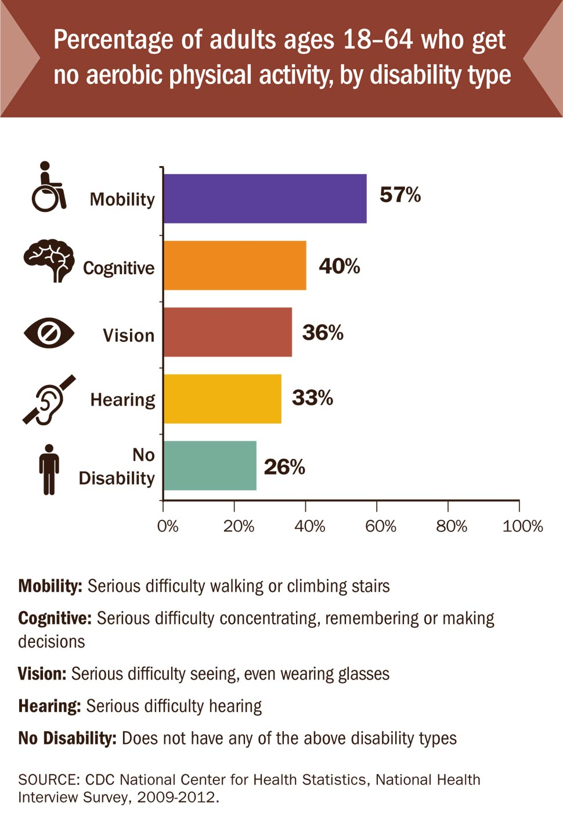
Physical inactivity trends
Adults with IDD are less likely to be active.
↓activity = ↑ fall risk
7
Notes:
2008 Physical Activity Guidelines for Americans 2008; Exercise is Medicine, 2014, http://exerciseismedicine.org.
40% of adults with cognitive disabilities engage in no physical activity

Slide 7
What are the Risks?
Injury
Hospital
Death
Fear

Slide 8
Risks
INJURIES:
  50-60% of injuries in adults with IDD^{3, 8}
  1.7-3.3x more likely to fracture a bone ⁹
  95% of hip fractures¹
  1 out of 5 injuries result in head trauma or brain injury¹
HOSPITALIZATION:
  $55 billion annual costs are secondary to falls²
DEATH:
  Decreased independence increases risk of early death¹⁰
  21,000 older adults die from accidental falls¹
  Every 29min, an older adults dies from a complication related to falls²
FEAR:
  Fall occurs⇨ fear of falling again⇨ limits activity⇨ decrease strength/balance⇨ greater risk of falling
  2-3x more likely to fall again¹
Notes:
Falls are the leading cause of injury, death, and hospital admission for adults >65y.o.
Osteoporosis from medications and inactivity.
Fractures.
Stats

Slide 9
How to prevent falls
Notes:
40% of adults with cognitive disabilities engage in no physical activity

Slide 10
Strategies to limit falls
Physical
Strengthen
Balance training
Assistive devices
Environment
Night lights
Non-skid socks/shoes
Bed alarms
Rearrange furniture
Grab bars/railings
Carpeting
Remove throw rugs
Separate those who often fight
Separate multiple agitated clients
Resident ‘bonding’
Social
Regular toileting
Address seizures
Control BP
Calcium/Vitamin D supplements
Monitor medications
Health

Slide 11
Spring Glen
15 residents
Average age: 63 years old.
Diagnoses: seizure disorder, cerebral palsy, Down syndrome, anxiety, depression, incontinence, vision loss, obesity
13 falls in 8 months
Injuries: broke ribs, punctured lungs,
  broken arm, stitches

Slide 12
Staff Role
INCREASES
- Physical activity
- Motivation
- Participation
DECREASES
- Number of falls
11, 12

Slide 13
Questions/Concerns

Slide 14
The modified otago Exercise program
What is it?
13
Notes:
Traditional OEP protocol has a duration of 52 weeks. After performing a thorough assessment of the client’s strength and balance, the therapist will develop an individualized exercise program from a preselected group of exercises; the program will then be progressed over the year to ensure moderate challenge for making gains. Progression is determined by a combination of follow-up visits and phone calls. Clients are also to participate in a walking program as able.
Mortality:
Not only does the OEP decrease falls, it is also associated with decrease mortality. A 2010 systematic review by Thomas et al. found that adults who participated in the OEP not only had less falls, but also became more physically active. These findings were then associated with a significant reduction in mortality rate (p=0.007).¹⁹ The CDC reports that annually, as of 2010, more than 21,000 older adults die from accidental falls. The same source states that every 29 minutes, an elderly adult passes away as the result of a fall.^{7,20} A program that can decrease these numbers should clearly be considered when choosing a falls prevention program.

Slide 15

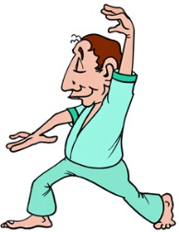
OEP Overview
One year exercise program
  Warm up
  Strengthening
  Balance
  Walking
WARM UP
STRENGTH
BALANCE
WALKING

Slide 16
Timeline
Initial assess-ment
Develop client programs
Start exercise program
6 mos. re-assessment
8 mos. re-assess-ment
10 mos. reassess-ment
12 mos. final assess-ment

Slide 17
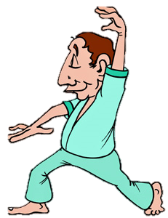
The Exercises
WARM UP
STRENGTH
BALANCE
WALKING
Notes:
Pull up exercise deviations document

Slide 18

Is there enough time???
Notes:
This program is not meant to consume all of your time or all of the resident’s time.
It should be done in place of their current exercise program.
Remember, the time you guys invest as a team will significantly increase the resident’s long term functional abilities.
If you are feeling overwhelmed or frustrated, please contact one of the lead therapists and express your concerns.
As previously mentioned, having the staff’s support makes a world of difference.

Slide 19
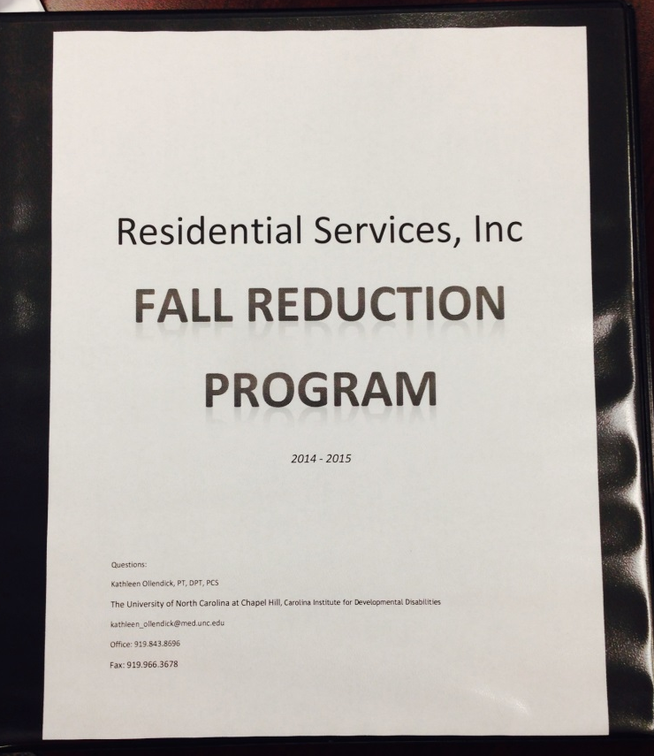
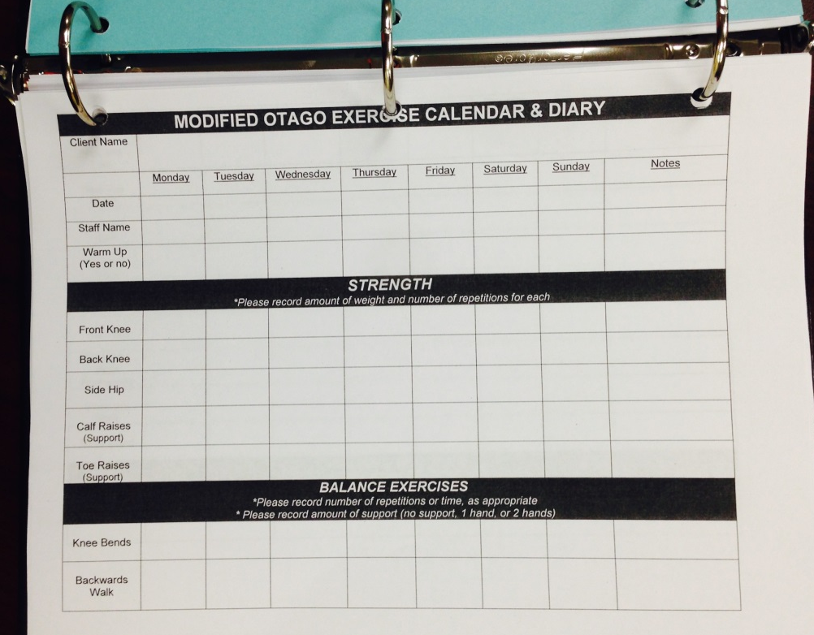
The Exercise Folder
Notes:
The folders are placed in a cabinet in the exercise room.
Please use them on a daily basis to record exercise participation.
Each folder should be equipped with the following material:
Resident’s specific exercise program
Weekly log for recording exercises
Welcome to the OEP/health concerns.

Slide 20

We are here to help you and the client.
Notes:
http://highachieversnetwork.com/wp-content/uploads/2012/05/TEAMWORK.jpg
We NEED to work together for the good of the residents. Please use the therapists as a support network, going to them with ANY questions or concerns. We truly want to help!
Overall, this should be a good experience for YOU and the residents.
The work we are doing here has the potential to change care plans for adults with IDD around the world.

Slide 21
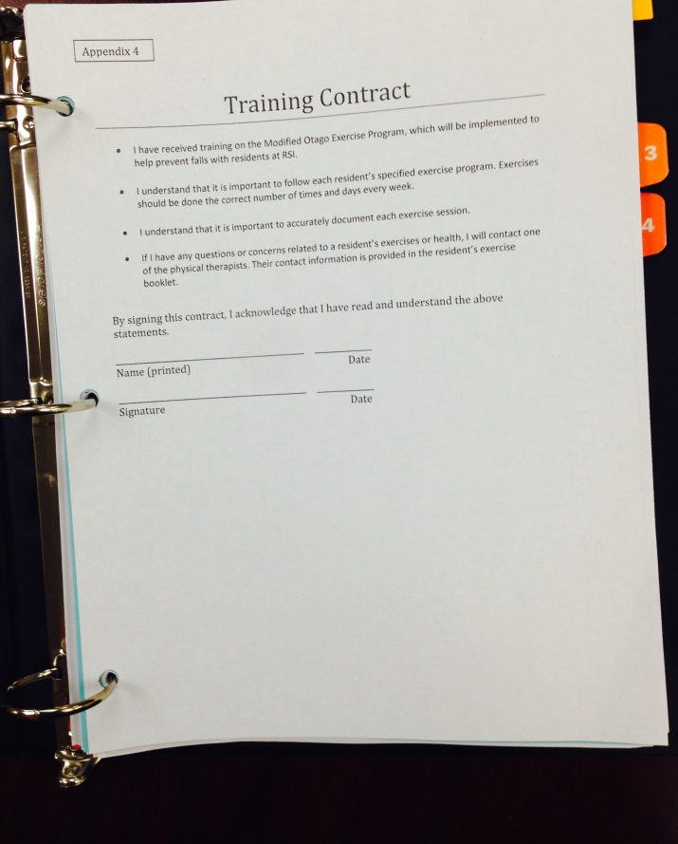
Training Contract

Slide 22
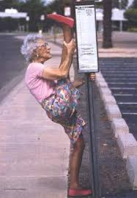

Questions?
Notes:
http://www.innovative-results.com/wp-content/uploads/2011/04/funny_granny.jpg
http://www.sweatlikeapig.com/wp-content/uploads/2011/10/old-288x260.jpg

Slide 23
References
1. Falls among older adults: An overview. Centers for Disease Control and Prevention Web site. http://www.cdc.gov/HomeandRecreationalSafety/Falls/adultfalls.html. Published 2013. Updated 2013. Accessed March 3, 2014.
2. Cost of fall injuries in older persons in the united states. Centers for Disease Control and Prevention Web site. http://www.cdc.gov/homeandrecreationalsafety/Falls/data/cost-estimates.html. Published September 26, 2011. Updated 2011. Accessed May, 2014.
3. Smulders E, Enkelaar L, Weerdesteyn V, Geurts AC, van Schrojenstein Lantman-de Valk H. Falls in older persons with intellectual disabilities: Fall rate, circumstances and consequences. J Intellect Disabil Res. 2013;57(12):1173-1182. doi: 10.1111/j.1365-2788.2012.01643.x; 10.1111/j.1365-2788.2012.01643.x.
4. Hale L, Bray A, Littmann A. Assessing the balance capabilities of people with profound intellectual disabilities who have experienced a fall. Journal of Intellectual Disability Research. 2007;51(4):260-268. doi: 10.1111/j.1365-2788.2006.00873.x.
5. Cox CR, Clemson L, Stancliffe RJ, Durvasula S, Sherrington C. Incidence of and risk factors for falls among adults with an intellectual disability. J Intellect Disabil Res. 2010;54(12):1045-1057. doi: 10.1111/j.1365-2788.2010.01333.x; 10.1111/j.1365-2788.2010.01333.x.
6. Ollendick, K.; Wilfley, L.; Noonan, C.; Scales, M; Scow, S.; Brown, L. Identification of Incidence, Risk Factors, and Causes of Falls in Individuals with Intellectual and Developmental Disabilities. Division of Physical Therapy and Carolina Institute for Developmental Disabilities, University of North Carolina-Chapel Hill. Poster Presentation at: Combined Sections Meeting of the American Physical Therapy Association; February 4, 2014; Las Vegas, Nevada.

Slide 24
References (Cont
7. Vital signs: Adults with disabilities. Centers for Disease Control and Prevention Web site. http://www.cdc.gov/vitalsigns/disabilities/index.html?s_cid=cdc_homepage_whatsnew_002. Published May 2014. Updated 2014. Accessed May, 2014.
8. Finlayson J, Morrison J, Jackson A, Mantry D, Cooper SA. Injuries, falls and accidents among adults with intellectual disabilities. prospective cohort study. J Intellect Disabil Res. 2010;54(11):966-980. doi: 10.1111/j.1365-2788.2010.01319.x; 10.1111/j.1365-2788.2010.01319.x.
9. Browner WS, Pressman AR, Nevitt MC, Cummings SR. Mortality following fractures in older women. the study of osteoporotic fractures. Arch Intern Med. 1996;156(14):1521-1525.
10. Thomas S, Mackintosh S, Halbert J. Does the 'otago exercise programme' reduce mortality and falls in older adults?: A systematic review and meta-analysis. Age Ageing. 2010;39(6):681-687. doi: 10.1093/ageing/afq102; 10.1093/ageing/afq102.
11. Bonner A, MacCulloch P, Gardner T, Chase CW. A student-led demonstration project on fall prevention in a long-term care facility. Geriatr Nurs. 2007;28(5):312-318. doi: 10.1016/j.gerinurse.2007.04.014.
12. Podgorski CA, Kessler K, Cacia B, Peterson DR, Henderson CM. Physical activity intervention for older adults with intellectual disability: Report on a pilot project. Ment Retard. 2004;42(4):272-283. doi: 2.
13. Tools to implement the otago exercise program: A program to reduce falls. In: First ed. Center for Disease Control and Prevention.

