Slide 1
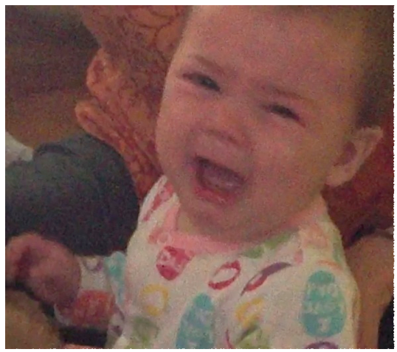
Infant Crying Behaviors
& Interventions
Notes:
Crying is a primary means of infant communication for infants up to 3 months of age, and it continues to serve as a means of expression and communication in varying degrees throughout the life span. It is often the first sound we hear from a baby when it makes its way into the world. Although in the past an initial infant cry was thought to be necessary at delivery to oxygenate the lungs, this fortunately has been proven otherwise and the baby is no longer prompted to cry.

Slide 2
Crying cycle
strain phase - inspiration
sigh phase - exhalation
pause
quick gasp
infant cry¹
(click on icon and left arrow)
Notes:
Typically, a cry has four movements:¹
A strain phase (inspiration): a sigh phase (exhalation or expiratory) – this is when you hear the cry; a pause; and then a quick, short inspiratory gasp. Click on the icon to hear a variety of cries and listen for these phases.

Slide 3
Physiological effects
↑ HR & BP
↓ O₂
↑ stress response
↓ energy reserves
↑wbc association
BABY
Notes:
Physiologic effects of crying for the baby may include: increased heart rate and blood pressure, reduced oxygen levels, increased cortisol levels as a stress response that is proportional to the duration of crying, and depleted energy reserves. A decrease in white blood cell count has also been associated with vigorous crying, which may affect immunity.

Slide 4
CAREGIVER
Cry = natural irritant, designed for quick response
↑ BP
Quality of response influenced by:
stress coping mechanisms
post partum depression
mental illness
fatigue
degree of social support
Notes:
Infant crying may also cause physiologic effects for the caregiver, Crying is natural irritant – designed to get immediate response. The caregiver(s) response to crying can be influenced by the individual’s personal ability to deal with stress, by post partum depression or other mental illness, and by the degree of social support that is available.

Slide 5
Why?
Baby is upset
Cues and reasons not always clear
Problem-solving/strategies may not be successful
Notes:
Crying signals that the baby is upset, and the intensity of the crying may give CUES to the reasons, but the problem solving and strategies to help calm or soothe a crying baby are not always simple or effective.

Slide 6
1st 3 days - 6.7 hrs/day
6 wks - Mean duration of crying/day = 43-120 min
13 wks- ↓ mean duration of 29 min
Crying mainly in late afternoon/early evening
Innate maturation - similar among many cultures
Early Infant Crying Patterns
Notes:
The above slide shows the early Infant crying patterns of healthy term infants. For the first 3 days, the mean time for crying is 6.7 hours/day! By 6 weeks, this decreases to a mean of 43-120 minutes/day. Generally, there continues to be a reduction of crying behaviors until at 13 weeks the mean duration of crying is down to 29 minutes/day. Infant crying behaviors occur mainly in late afternoon/early evening. This crying pattern has been found to be similar among many cultures, which indicates that this may be a process of innate maturation. In premature infants, the crying patterns are similar at their adjusted age.

Slide 7
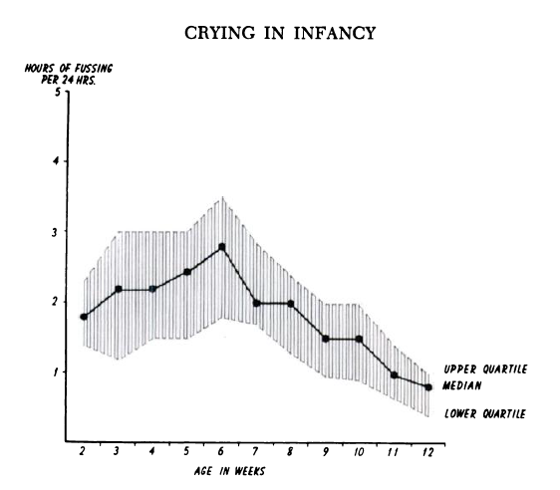
Normal crying behaviors
Source: Brazelton T. Crying in Infancy. Pediatrics. 1962; 29:582.
Notes:
Dr. T Berry Brazelton was one of the first pediatricians to report on a trend of normal crying behaviors, based upon a study of the data that parents recorded in crying dairies of their infants. The results showed a “n-shaped” developmental curve starting at 2-3 weeks, peaking at 5-6 weeks and then decreasing through the first year. This chart was taken from his seminal 1962 article on infant crying, and subsequent studies have found this trending to be similar.

Slide 8
Up to 3 months of age:
► 25% of infants will cry for > 3 ½ hours day.
► 10-20% of infants may be what is termed “excessive” or “colicky” criers.
- Colic due to GERD estimated at only 5% for infants <3 mos
► Rule of 3’s: crying >3 continuous hours/day @ least 3 days/wk
► Possible symptoms for advised prompt contact with healthcare provider:
• weight loss
• blood in vomit or stools
• fever
• persistent diarrhea
Notes:
Taking a look at the upper end of this spectrum of this “n-curve” of crying it is estimated that, for infants up to 3 months of age, 25% of infants will cry for > 3 ½ hours day. 10-20% of infants may be what is termed “excessive” or “colicky” criers. Colic is a term used for digestive issues, but this may not be a factor for the majority of excessive criers. It is estimated that only 5% of infants <3 mos that were described as colicky had associated gastro-esophageal reflux. Current guidelines for defining colic or excessive cryers is by following the “Rule of 3’s” - crying >3 continuous hours/day @ least 3 days/wk. Immediate contact with the child’s healthcare provider is recommended for weight loss, blood in vomit or stools, fever, or persistent diarrhea.

Slide 9
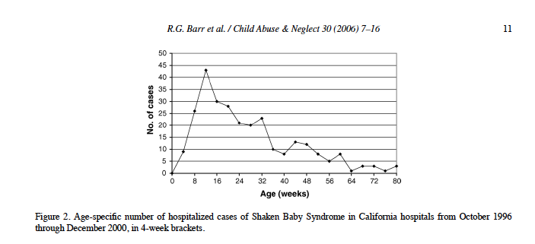
Association of infant crying behaviors and abusive head trauma (AHT)
Source: Barr R, Trent R, Cross J. Age-related incidence curve of hospitalized Shaken Baby Syndrome cases: Convergent evidence for crying as a trigger to shaking. Child Abuse & Neglect. 2006; 30:11.
Notes:
There is higher incidence of abusive head trauma, also more popularly called “shaken baby syndrome” with the babies <1 year. This has been tied to responses by shaking the children in attempts to quiet them. In a study comparing the data of the duration of crying behaviors in normal infants and the frequency of AHT, a correspondence was found between these two curves. As shown previously, normal crying behaviors show a “n-shaped” developmental curve starting at 2-3 weeks, peaking at 5-6 weeks and then decreasing through the first year. The incidence of AHT starts at 2-3 weeks, peaks at l0-13 weeks, shows a gradual incline into 36 weeks, plateaus at 36-52 weeks, then continues to show a decline after the first year. Both curves show a similar starting point and a similar curve, but with a later peaking of the SBS curve. This is thought to be possibly related to the later diagnosing that would follow the cumulative damage of shaking episodes, or due to the delayed response time of the caregivers in seeking help for the child

Slide 10
Education & Intervention
Period of Purple Crying®
Early Infant Crying: A Guide for Parents & Caregivers - Johnson & Johnson Pediatric Institute
REST routine
Notes:
There are several educational efforts for parents and caregivers to help improve understanding of the patterns of early infant crying, providing strategies to help calm both the baby and caregivers, and the prevent the danger of shaking babies to quiet them. These strategies will be discussed in the next slides.

Slide 11
Period of Purple Crying® CryingCrying®
Sources: http://purplecrying.info & www.dontshake.org
Notes:
The Period of Purple crying is an educational program, consisting of a short booklet and DVD that is geared to parents of newborns to provide information on the patterns of early infant crying and the dangers of shaking their baby as a way to quiet them. It is being used in over 800 hospitals and organizations, and available in l0 languages and close captioned for the hearing impaired. For more information about program, refer to the links at the bottom of this slide

Slide 12
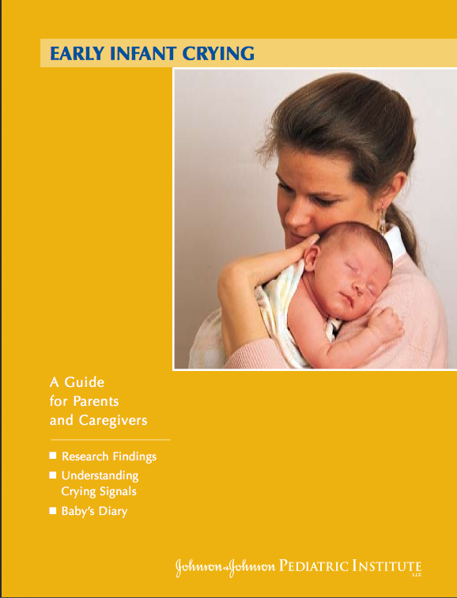
Johnson & Johnson Pediatric Institute
Source: Barr R, James-Roberts I, Keefe M. Early Infant Crying: A Guide for Parents and Caregivers. Johnson & Johnson Pediatric Institute. 2007. http://www.baby.com/jjpi/baby-care/Early-Infant-Crying-A-Guide-to-Parents-and-Caregivers.pdf
Notes:
The Johnson & Johnson Pediatric Institute has a library of resources for both professionals and parents. This booklet is available on Early Infant Crying is available for download, and contains a diary in the appendix which may be a useful way for parents to obtain more objective data on crying and other infant behaviors to share with other caregivers, doctors, or other service providers.

Slide 13
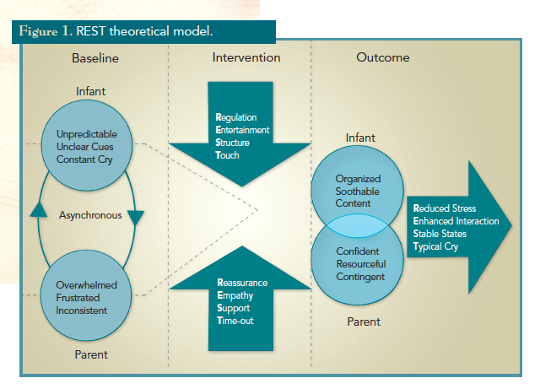
The
REST
Routine
Source: Keefe M, Barbosa G, Froese-Fretz A, Kotzer A, Lobo M. An Intervention Program for Families with Irritable Infants. The American Journal of Maternal/Child. 2005; 30(4): 232.
Notes:
The REST theoretical model was described by Keene et al as a useful framework for providing intervention services to infants and parents to promote better infant self-regulation behaviors and improve the parent’s ability to develop strategies to help calm and soothe their babies without become overwhelmed in the process.
In looking at the middle “Intervention” column of this slide.
For the Infant, it is important to provide the parent education and means for improved:
Regulation = prevent over-stimulation & over-fatigue by improving the parent’s sensitivity to early infant cues of overload, and to observe and reinforce the infant’s sleep/wake cycles and patterns
Entertainment = provide age appropriate support for infant social, emotional, and motor development.
Structure – includes scheduling & providing a ritual to reinforce regular sleep & waking states, as well as providing a supportive environment by varying light and noise levels based upon the function of either awake or resting state.
Touch –firm hold, good support, rocking and gentle vestibular, sensorimotor stimulation tailored to the infant
For the parent, interventions by the home nursing provider would be to provide:
Reassurance – helping to rule out if there are medical concerns contributing to the problems, monitoring the babies weight
Empathy, and I would also add here, Education
Support –assisting the to parent obtain effective social and emotional support, and
Time-Out – helping the parent to problem solve ways to de-stress and have time outside of infant care.
This schematic speaks to importance of addressing infant and parent behaviors and responses in tandem and gives a sense of the complexity or multiple steps and strategies that may be involved towards getting to a better outcome.

Slide 14
Crying and Disabilities
persistent crying associated w/ sleeping & feeding problems >4 mos of age may be associated with multiple parental psychosocial risk factors & can be a predictor of poor infant social & emotional development
exposure to neurotoxic substances in utero may increase hyperirritability, particularly when undergoing withdrawal postnatally
delay of communication skills may prolong use of crying behaviors as means of functional communication.
signs of crying may or may not be typical due to disability
Notes:
Moving on from looking at infants with excessive crying behaviors, let’s look at the association of crying and other disabilities.
• First off, it’s important to know that if a child continues to cry for prolonged periods of time, to the point of affecting sleeping and eating, after the age of 4 months that it may be an indicator of poor infant social and emotional development in the future. This has also been associated with dysfunctional parenting skills or support.
• exposure to neurotoxic substances in utero may increase hyperirritability, particularly when undergoing withdrawal postnatally
• delay of communication skills may prolong use of crying behaviors as means of functional communication.
• It is also important to realize that, for some babies, the typical signs of crying may not be present - the following slide will give an example of this situation.

Slide 15
ATYPICAL CRYING EXAMPLE
View videoclip of:
Matthew*
► Tracheostomy
► Mobius syndrome
* Name changed
Notes:
Please view the videoclip on Matthew.. He is 11 months old. His crying cannot be heard because he has a tracheostomy which limits his ability to produce sounds. He also has significant hypotonia and Mobius syndrome, which is a rare congenital neurological disability involving paralysis of the 6th & 7th cranial nerve. As a result, he has partial facial paralysis and therefore cannot demonstrate the usual facial responses of crying. When providing physical therapy services for Matthew, I would rely upon the input from his parents or nurse to help ensure he was not getting too upset during therapy – this change was usually noted by a change in his respiration pattern. His parents were gracious enough to provide this clip of Matthew, taken when he was tired and fussy.

Slide 16
References
1. Crying sounds audioclip. Audio Productions YouTube. http://www.youtube.com/watch?v=NjkNNDuAb9A. Accessed December 10, 2013.
2. Ludington-Hoe S, Cong X, Hashemi. Infant Crying: Nature, Physiologic Consequences, and Select Interventions. Neonatal Network. 2002,; 21(2): 29-36.
3. Synthesis on crying behavior. Encyclopedia on Early Childhood Development. http://www.child-encyclopedia.com/pages/PDF/Crying_behaviour.pdf. Updated November 4, 2008. Accessed online July 21, 2013.
4. Brazelton T. Crying in Infancy. Pediatrics. 1962; 29:579-588.
5. Barr R, Trent R, Cross J. Age-related incidence curve of hospitalized Shaken Baby Syndrome cases: Convergent evidence for crying as a trigger to shaking. Child Abuse & Neglect. 2006; 30:7-16.
6. Treem W. Assessing Crying Complaints: The interactions with Gastroesophageal Reflux and Cow’s Milk Protein Intolerance. In: Barr R, James-Roberts I, Keefe M. New Evidence on Unexplained Early Infant Crying: Its Origins, Nature, and Management. Johnson & Johnson Pediatric Institute. 2001: 165-176. http://www.baby.com/jjpi/for-professionals/New-Evidence-on-Unexplained-Early-Infant-Crying-Its-Origins-Nature-and-Management.pdf.
7. National Center on Shaken Baby Syndrome. The Period of Purple Crying. Accessed Online July 22, 2013. http://purplecrying.info/sub-pages/what-is-the-period-of-purple-crying/components-of-the-program.php.
8. Barr R, James-Roberts I, Keefe M. Early Infant Crying: A Guide for Parents and Caregivers. Johnson & Johnson Pediatric Institute . 2007. Accessed Online July 22, 2013. http://www.baby.com/jjpi/baby-care/Early-Infant-Crying-A-Guide-to-Parents-and-Caregivers.pdf.
9. Keefe M, Barbosa G, Froese-Fretz A, Kotzer A, Lobo M. An Intervention Program for Families with Irritable Infants. The American Journal of Maternal/Child. 2005; 30(4): 230-237.
10. Douglas P, Hill P. The crying baby: what approach? Current Opinion in Pediatrics. 2001; 23:523-529.
11. Hemmi M, Wolke D, Schneider S. Associations between problems with crying, sleeping and/or feeding in infancy and long-term behavioral outcomes in childhood: a meta-analysis. Arch Dis Child. 2011; 96:622-629.
Notes:
In closing, here are the references that I used to create this program; perhaps these can be a resource for you in the future. I hope that this presentation has you thinking a little more about the complexity of crying behaviors for infants and some of the supports and strategies that are being used to help support and expand the infants’ capacity for self-regulation and to further their social and emotional development. I look forward to reading about your experiences with infant crying and your strategies with promoting positive interactions and play in your Discussion Board posts. Please refer back to the syllabus with instructions on how to continue along with this module.

