Slide 1
A Novel Approach To Parkinson’s Disease Treatment
A Case Study
By Nick Camilleri

Slide 2
Why this project?
Notes:
Hi, I’m Nick Camilleri and I chose to focus on a specific treatment program for Parkinson’s disease for my capstone project. PD has always been a diagnosis of particular interest for me and as we learned more detailed information about the disease during my DPT, I became more and more curious about different intervention strategies. I realized that our current model for treating this disease focused mostly on trying to bypass the affected pathways and systems. With all of the information we now have on neuroplasticity, I wondered when we would come up with ways to actually retrain these faulty systems. During one of my second year clinicals, I worked with a CI who was very familiar with the LSVT BIG program, and as I spent time working with her I learned more and more about this treatment program and the more I learned about it the more it really made sense to me as a treatment option. As I searched the current literature for more information on this topic, I came to realize that there is very little published information out there on the effectiveness of the program. I helped the PT to use many of the aspects of this program in treating one patient in particular, and decided to formally write up the case as a way of establishing more evidence and information for this intervention. I’ve now turned my case report into a presentation for you all to highlight some of the key points. My hope is that this will help you to approach treatment for Parkinson’s disease in a new way and perhaps spark an interest in a new area.

Slide 3
Parkinson’s Disease
2nd most prevalent neurodegenerative disease
Approximately 1million Americans
Prevalence: 1-2/1000 people
Notes:
Parkinson’s disease (PD) is the second most common neurodegenerative disease in the United States. The disease affects 2-4% of the population over 60 years old and incidence increases with age. Onset can be earlier at times, with an estimated 4% of cases diagnosed before 50 years of age.

Slide 4
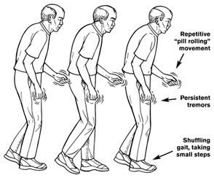
Signs and Symptoms
Bradykinesia
Tremor
Rigidity
Postural instability
“Shuffling gait”
Notes:
The clinical presentation of PD is highly variable, however, it typically consists of cardinal symptoms including tremor, rigidity, bradykinesia, and postural instability^{1,2,4}. Tremor is the first symptom of the disease in 70% of patients and is typically referred to as a “resting tremor,” in reference to shaking that is present at rest but lessens or subsides with voluntary movement⁴. Rigidity refers to increased resistance to passive movement described by patients as “heaviness” and “stiffness” of the limbs⁴. As PD severity progresses, rigidity worsens leading to decreased ease of mobility demonstrated by loss of bed mobility or loss of trunk motion and arm swing during gait⁴. Bradykinesia typically refers to slowness and difficulty maintaining voluntary movement and results in decreased speed, range, and amplitude of movement⁴. Symptoms of bradykinesia can sometimes progress to the point where episodes of sudden “freezing,” or stopping of movement mid-task occur which can be very disabling and potentially dangerous.
As PD progresses, increased postural instability develops. Patients experience increased difficulty maintaining balance during activities such as walking, reaching, and recovering from losses of balance also becomes more difficult⁴. Patients lose the ability to anticipate adjustments needed by postural muscles during voluntary movements as well as the ability to adapt to changing sensory conditions⁴. Over time, patients develop a flexed, stooped posture with increased flexion of neck, trunk, hips, and knees combined with a short, shuffling or festinating gait secondary to increased rigidity, bradykinesia, weakness, and postural instability⁴.

Slide 5
Risk Factors
78% of cases idiopathic. But…
Age
Gender
Ethnicity
Secondary Parkinsonism
Notes:
the exact cause of PD is unknown, there are numerous risk factors for developing the disease. Age is the primary known risk factor as the disease affects 2-4% of the population over 60 years old and incidence increases with age. The majority of cases are diagnosed between the ages of 50 and 79 years of age. Gender and ethnic background also impact risk for PD with slightly more men affected by the disease and slightly more Caucasians than African-Americans.
Secondary Parkinsonism is another category of the disease that occurs as a direct result of identified causes such as viruses, poisons, drugs, tumors, and some metabolic cause.

Slide 6
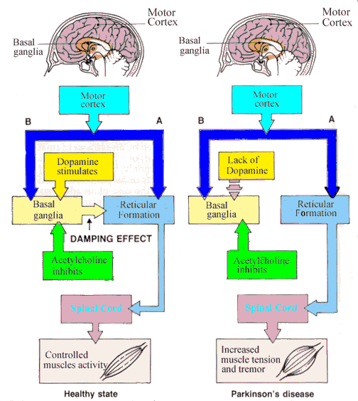
Pathophysiology
Notes:
PD is characterized by a slow, progressive degeneration of dopaminergic neurons in the basal ganglia. This dopamine deficiency results in the classic symptoms that we have already discussed. I’m sure you’ve been over the exact pathways and processes that are affected by Parkinson’s disease in great detail, but let’s go over them very briefly as a reminder.
The basal ganglia (BG) is connected to the cortex via complex direct and indirect pathways. The direct pathway facilitates the BG output to the thalamus and motor cortex. This results in increased movement. The indirect pathway results in the inhibition of certain movements^{1,4}. Balancing of these opposing pathways allows the BG to play a crucial role in planning and programming voluntary movements by organizing specific motor plans, translating thought into movement, and regulating levels of kinetic activity, muscle tone and muscle force^{1,4}.
Dopamine is essential for proper functioning of the BG pathways, so when these dopaminergic cells die off with PD, this creates an overactive indirect pathway and an underactive direct pathway⁴. The overall effect of this imbalance inhibits thalamic activity, which slows signals to the cerebral cortex and results in less cortical activity. The result is slowed movement generated by the musculoskeletal system.

Slide 7
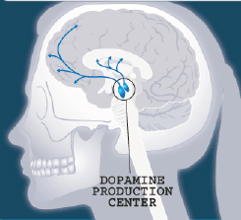
Management of the disease
Pharmacological
Levodopa: “gold standard”
Short half-life
Physical therapy
Exercise stimulates dopaminergic cells
Notes:
Management of Parkinson’s disease typically involves a combination of medications, physical therapy, and in some cases surgery. Typically, motor symptoms of PD develop when 60% or more of the dopamine producing cells in the substantia nigra are destroyed²
Since the 1970’s, levodopa has been the “gold standard” drug used to treat bradykinesia and rigidity in PD.² However, nearly 70% of oral levodopa breaks down in the periphery and does not cross the blood-brain barrier leading to possible side effects such as orthostatic hypotension, hallucinations, nausea, and vomiting. To avoid these side effects and improve the ability of levodopa to cross the blood-brain barrier, the drug Carbidopa is added to the mix^{2,6}. This drug combination is known by the trade name Sinemet® and is commonly prescribed along with other classes of drugs to treat PD symptoms². Levodopa is highly effective at the correct dosage, however, a short half-life of 60-90 minutes means it must be given multiple times per day⁶. Care should be taken to schedule physical therapy sessions around the time of peak effectiveness or “on phase” which is typically one hour after administration^{2,6}.
Physical exercise has been found to stimulate remaining dopaminergic cells to produce dopamine thereby reducing symptoms³.

Slide 8
Introducing LSVT® BIG
http://www.youtube.com/watch?v=fk4Xw8PW7bk
Click on the link above for an informative video about LSVT BIG
Notes:
This video explains some of the concepts of the LSVT BIG program, where it came from, the idea behind it, as well as giving you a look at what some patients with Parkinson’s disease look like while performing these movements.

Slide 9
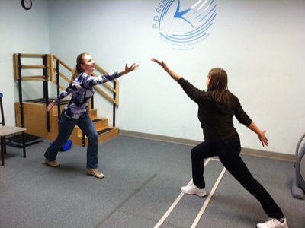
LSVT BIG
High amplitude, high intensity, repetitive movements
Improve movement perception
Restore normal amplitude during tasks
Damaged basal ganglia loop
Improper scaling of amplitude
Notes:
A relatively new and promising treatment technique for treating bradykinesia and hypokinesia is a program called LSVT®BIG. The program is derived from LSVT®LOUD (Lee Silverman Voice Treatment) which is a speech therapy program for treating PD related hypophonia with substantial clinical evidence to support its use. LSVT®BIG focuses on performing high-amplitude, high intensity, complex, repetitive movements in order to improve movement perception and restore normal amplitude movements during tasks^{13,14}. The basic principle behind this program is that damaged BG feedback loops result in improper scaling of movement and so movements with insufficient speed and amplitude are selected regardless of the speed and amplitude required for the task^{13,14}. In other words, there is a mismatch between the movement amplitude perceived by the patient and the movement amplitude produced by the patient. This damaged sensorimotor processing system produces decreased motor commands for selecting and reinforcing correct movement amplitude resulting in small, slow, and low amplitude movements^{13,14}. The theory behind LSVT®BIG is that focusing training on increasing movement amplitude may enhance activation of BG pathways to a level that will allow for bigger, faster, and more normal movements with functional carryover. Unlike many physical therapy protocols that aim to bypass deficient BG function through the use of external cueing and compensatory movement strategies, LSVT®BIG is a “task-specific,” repetitive, high intensity protocol aimed at producing neuroplastic changes in the BG pathways^{13,14}

Slide 10
LSVT BIG
Randomized controlled trial
Compared LSVT BIG protocol with Nordic walk and standard PT protocol
8 weeks, 16 sessions
Significantly greater improvements in:
United Parkinson’s Disease Rating Scale (UPDRS)
TUG score
Gait speed
Notes:
One major randomized controlled trial by Ebersbach et al compared treatment following the standardized LSVT®BIG protocol with a group that performed Nordic walking and a control group that performed unassisted home exercises. The standard LSVT protocol consists of 16 individual one hour PT sessions (4x/week for 4 weeks) that require intensive motivation and feedback from the therapist¹³. The Nordic walking group received the same number of PT contact hours during treatment but only twice weekly for 8 wks which is more consistent with standard care in the OP setting and has been shown to be effective for patients with PD^{12,13}. Fifty percent of LSVT treatment sessions consist of standardized multidirectional whole-body movementsthat are repetitive and performed with maximal effort and amplitude¹³. The second half of treatments typically include practice of patient chosen, goal directed ADL tasks depending on the needs or desires of the patient, which are performed using high amplitude “BIG” movements¹³. Patients are encouraged to give at least 80% maximal effort and to practice bigger movements with daily activities. The results of the comparative intervention study showed that LSVT®BIG led to significantly improved motor performance on the United Parkinson’s Disease Rating Scale (UPDRS), TUG score, and gait speed¹³. PDQ-39 quality of life score also increased from LSVT BIG interventions¹³. These positive effects were found to be significantly greater than the effects of the Nordic walking intervention in patients with PD¹³.

Slide 11
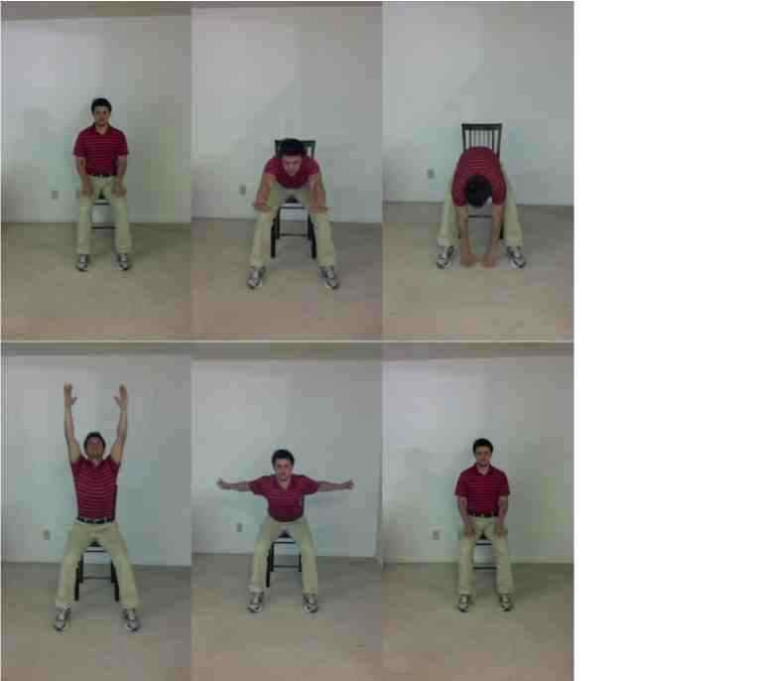
LSVT® BIG
Multidirectional Sustained Movements
1) Floor to Ceiling

Slide 12
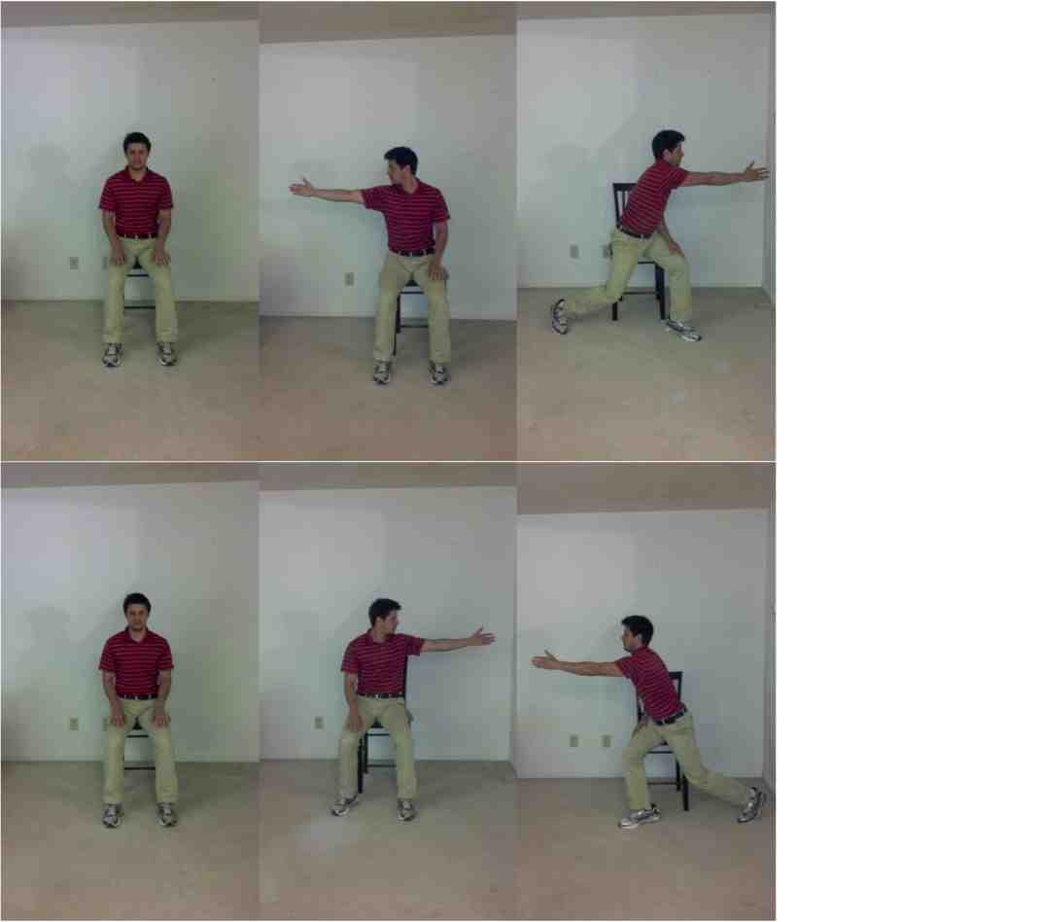
#2: Side to side

Slide 13
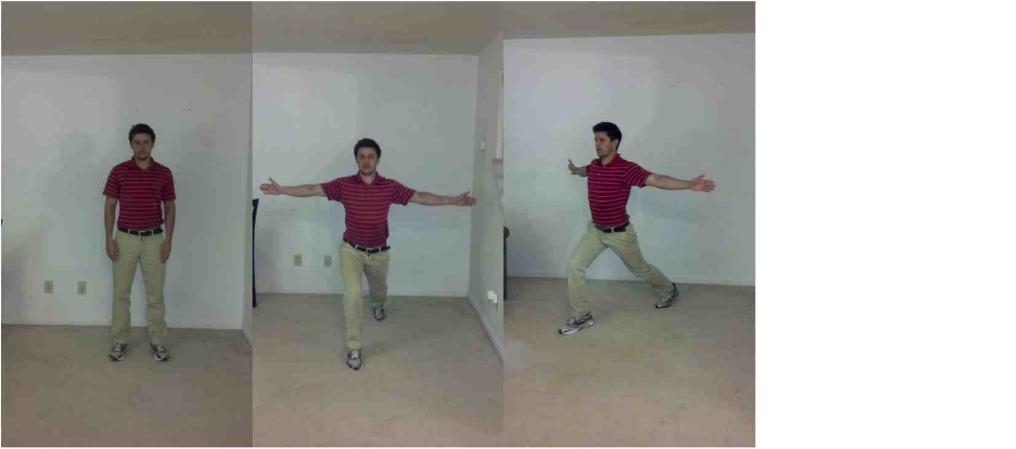
Multidirectional Repetitive Movements
3) Step forward and reach (repeat on each leg)

Slide 14
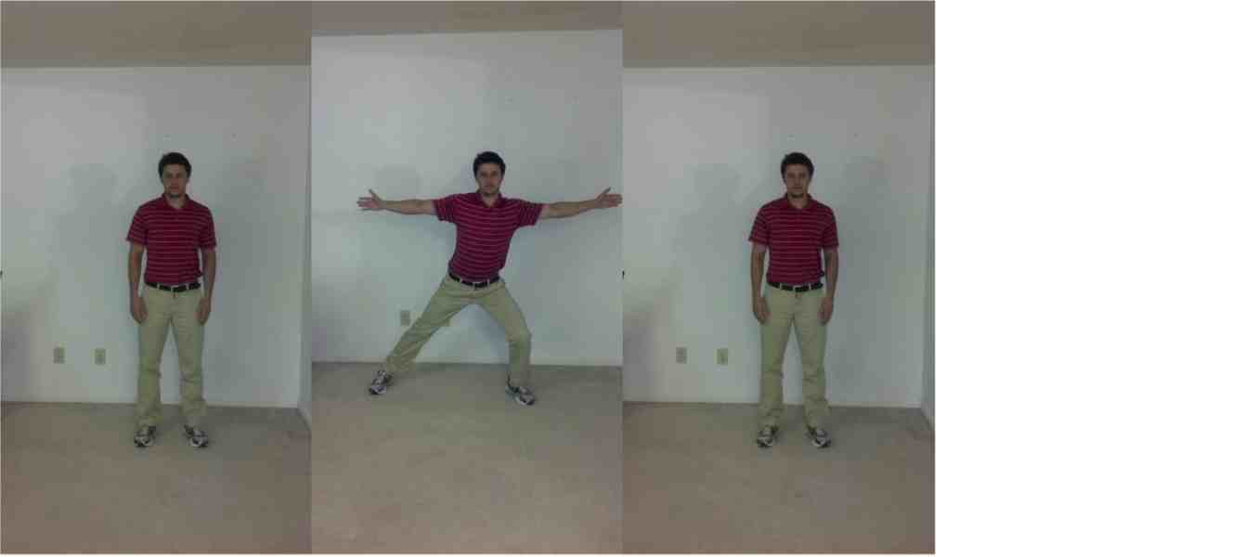
Step sideways and reach (each direction)

Slide 15
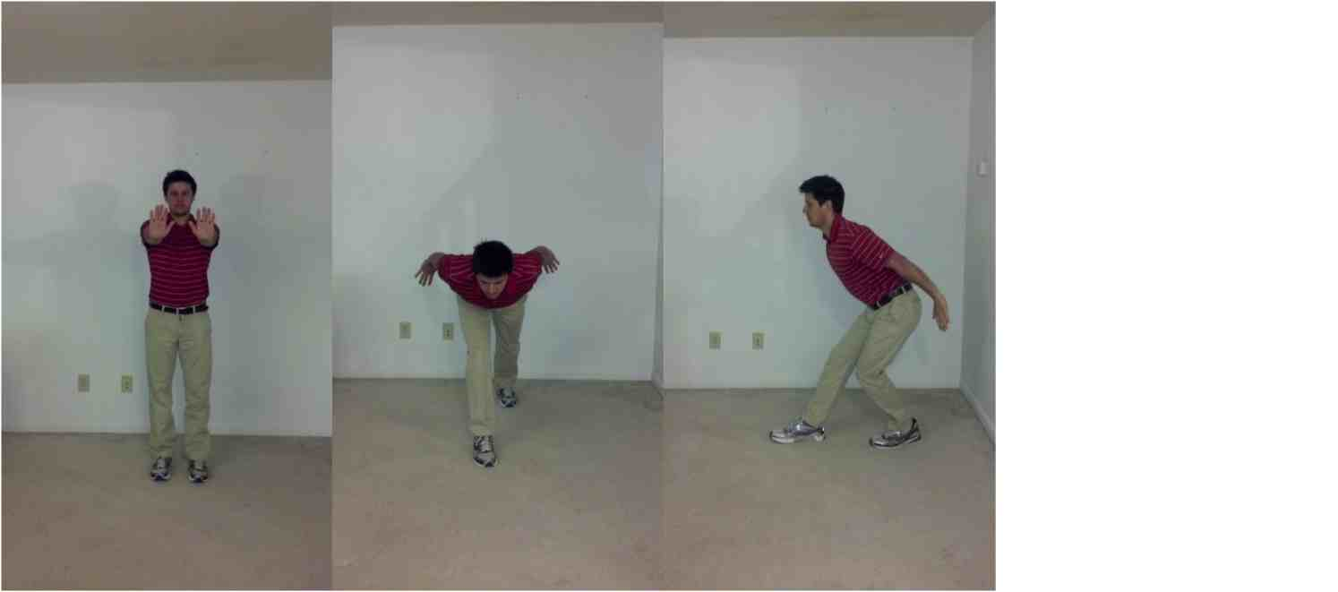
5) Step backward and press arms back (repeat on each leg)

Slide 16
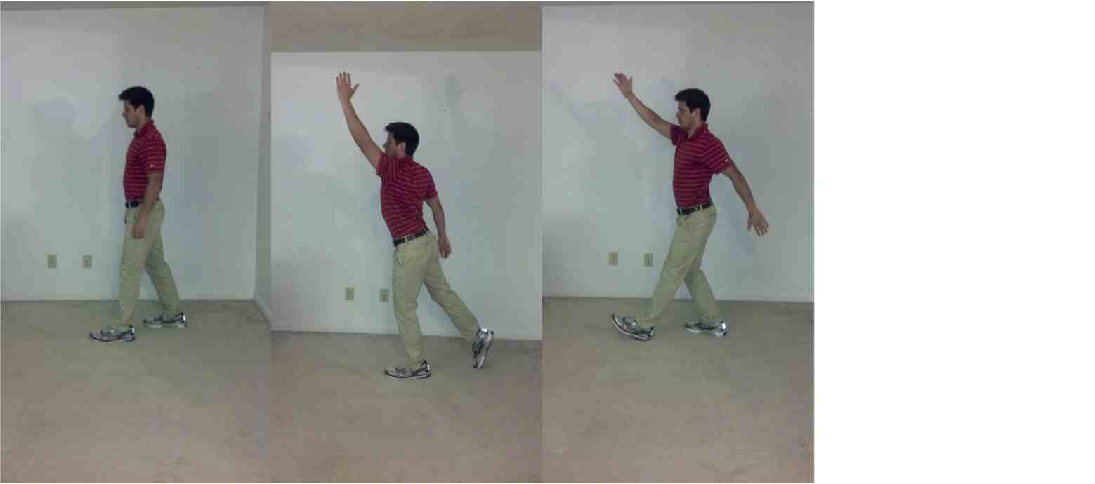
6) Rock and reach- forward and backward

Slide 17
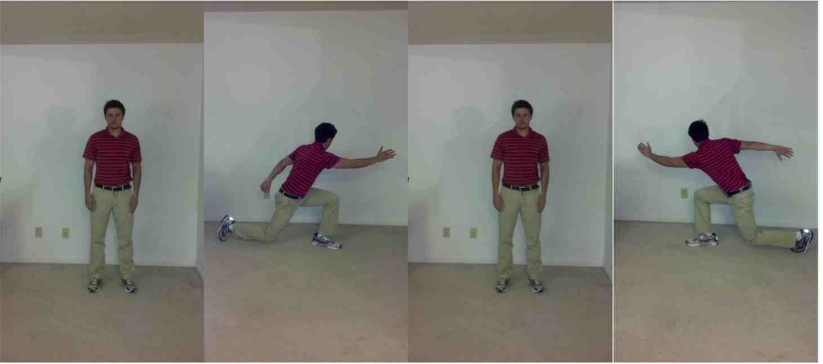
7) Reach and twist- side to side

Slide 18
The Patient
Mrs T
78yo Female
Chronic mid-stage PD: 14 years
Guide to Physical Therapy practice pattern 5E: Impaired Motor Function and Sensory Integrity Associated with Progressive Disorders of the Central Nervous System¹⁵
Hoehn and Yahr Classification of Disability score of 3
Notes:
Hoehn and Yahr Classification of Disability score of 3 is described as mild to moderate bilateral disease; some postural instability but physically independent

Slide 19
Examination
History
Prior PT for 2.5 years
Assisted living facility
No significant health problems
Medications
Sinemet®
Notes:
At the time of evaluation, she was an existing patient undergoing physical therapy at the geriatric specialty clinic connected to the assisted living facility. This was a fairly specialized setting; the clinic was in a retirement community that had independent residents in apartments as well as an assisted living facility and a health care center. At this time the patient was living in the assisted living facility, and being see by physical therapy twice per week. She lived fairly independently with daily nursing checks.
She noted that in the past when she had stopped PT for a few weeks she would notice a decline in her function.
The patient reported she enjoyed the exercises she had been doing for PT but that she hadn’t noticed any improvement lately. After the PT gave her an explanation about a new program (LSVT BIG), she gave consent to incorporate the program into her plan of care.
The only medication Mrs T was currently taking was Sinemet 5x/day to help control her PD symptoms.

Slide 20
Systems review
Cardiopulmonary
BP: 138/78 mmHG
HR: 63bpm
Integumentary: Normal
Musculoskeletal
Neuromuscular:
Impaired gait, balance, motor control
Notes:
Integumentary system: The patient’s integumentary system was grossly normal with no apparent scars and or other signs of injury. The skin had normal pliability, color and integrity.
Musculoskeletal system: The patient’s musculoskeletal system was grossly intact. Active range of motion appeared within normal limits for upper and lower extremities. Gross strength was mildly impaired for bilateral upper and lower extremities. She appeared to have grossly symmetrical musculature in standing and sitting.
Neuromuscular system: The patient’s neuromuscular system was impaired showing gross deficits in balance, gait, transfers, and ability for motor control and motor learning. Her sensory systems were intact but she did require eyeglasses for sufficient vision.

Slide 21
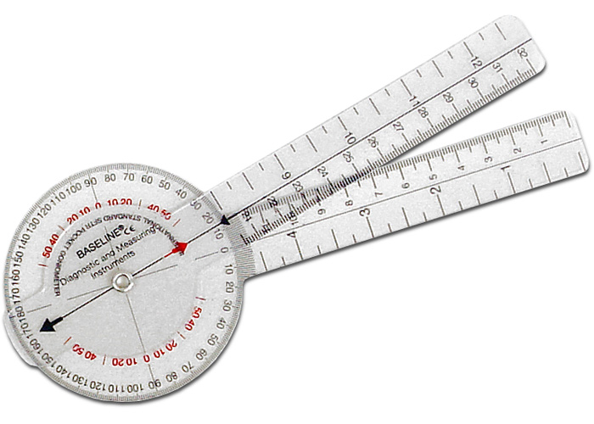
Tests and Measures
Pain: 0/10
ROM:
UE & LE grossly WNL
Trunk movements limited
Strength:
MMT difficult due to tremors
Grossly 4-/5 to 4+/5
Notes:
Range of Motion: Lower extremity and upper extremity ROM was within normal limits. Trunk flexion, extension, and rotation ROM were decreased approximately 50-75% of normal but were not formally measured.
Strength: Patients with disorders of the central nervous system who demonstrate deficient or variable voluntary muscle control are typically difficult patients on which to perform detailed muscle testing¹⁶. It was difficult to assess minor differences in strength due to the patient’s resting tremor, but all muscle groups tested were rated between 4- to 4+/5.

Slide 22
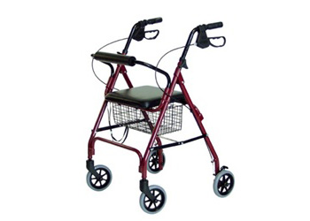
Tests and Measures
Gait:
4 wheeled walker with flexed kyphotic posture
Slow gait speed
TUG & 10m walk test revealed limitations in functional mobility and increased fall risk
Notes:
Mrs T ambulated with a 4-wheeled walker and maintained a kyphotic, forward-flexed posture throughout the gait cycle. She had slow gait but maintained a relatively fluid step through gait pattern. Gait speed was measured using the 10 meter walk test which has been shown to be predictive of falls, declines in function, hospitalization, and even survival in older adults¹⁷. The Timed Up and Go test (TUG) is another standard test for measuring functional mobility and gait speed and has also been shown to identify fall risk in patients with PD^{17,18} Mrs T’s results from these tests in on the next slide.

Slide 23
Examination cont.
Functional mobility
Independent for all transfers
Unable to ambulate stairs
Able to ambulate around most obstacles
Psychosocial
PDQ-39: 16.7% disabled
Notes:
She demonstrated good ability to ambulate over flat ground with the use of her walker. She was able to navigate narrow areas and avoid most obstacles when using her walker. She needed no physical assistance to complete sit to stand transfers. However, she was unable to climb steps due to balance difficulties without moderate assistance. Mrs T was only able to tolerate approximately 15 minutes of continuous standing activity without a break and with no AD.
Mrs T was in general very pleasant and engaged during the physical therapy exam and treatment sessions. On occasion she seemed slightly confused or forgetful but reported no history of diagnosed dementia. Her quality of life was assessed using the Parkinson’s Disease Questionnaire 39 (PDQ-39) which is a 39 item, self-administered test for assessing functional status, well-being, and overall health related quality of life in patients with PD.²⁰

Slide 24
Outcome measure scores
Outcome Measure | Patient’s Baseline Score | Cutoff Score for Low Fall Risk
Timed Up & Go (TUG) | 18.06s | 13.50s
Gait Speed | 0.71 m/s | >0.80 m/s
Tinetti Mobility Test (TMT) | 20/28 (8/12 gait; 12/16 balance) | >25/28
Notes:
The Timed Up and Go test (TUG) is another standard test for measuring functional mobility and gait speed and has also been shown to identify fall risk in patients with PD^{17,18} The range of 19-24 is associated with moderate fall risk and <19 is associated with high fall risk in the elderly¹⁹. A study of the reliability and validity of the TMT for assessing fall risk in patients with PD was performed by Kegelmeyer et al. and found that the best cutoff score for high fall risk was <20 for the PD population¹⁹. Mrs T’s TMT score (Table 2) placed her at moderate fall risk and was very close to the cutoff point indicating the need for physical therapy intervention.

Slide 25
Diagnosis and Prognosis
Parkinson’s disease
Hoehn and Yahr stage 3
14 years since diagnosis
Fits criteria for good prognosis
Likely to benefit from PT
Notes:
There do not appear to be clear predictors for who will likely benefit from physical therapy intervention, but the majority of studies reviewed had specific inclusion criteria. Most studies included patients with Hoehn & Yahr⁴ classifications ranging from I to IV with the majority classified as stages I-III indicating independent mobility. Patients were also typically included if they had no significant cognitive impairment or severe co-morbidities. Many studies have already shown that patients with PD can make significant improvements in muscular strength, endurance, gait speed, and balance following exercise interventions^{3,7-12,18}. The patient fit the basic inclusion criteria and had a good prognosis for improving her functional mobility thereby reducing her risk of falls through the use of a LSVT®BIG exercise program coupled with functional strengthening and balance training.

Slide 26
Goals
In 6 weeks:
Improve Tinetti Mobility Test score to to ≥ 25/28 indicating low fall risk.
Improve TUG score to <13.50s indicating low fall risk
Increase gait speed to >0/8 m/s for safe community abulation
Notes:
In order to demonstrate improved functional mobility and decreased fall risk, within 6 weeks:
1.) The patient will improve her Tinetti Mobility Test score to ≥ 25/28 indicating low fall risk.
2.) The patient will decrease her Timed Up and Go time to <13.50 seconds indicating low fall risk. .
3.) The patient will increase gait speed to >0.8 m/s indicating safe, full community ambulatory status.

Slide 27
Goals
Improve PDQ-39 score by >7.74% (MCID)
Improve PDQ-39 items #1-16 indicating improved mobility and ADL management
Improved posture and endurance for physical activity for increased participation in community programs
Notes:
In order to improve physical perception of her condition and enhance HRQOL, within 6 wks:
4.) The patient will improve her total PDQ-39 score by >7.74%, which is the MCID for this tool²³.
5.) The patient will improve PDQ-39 items #1-16 corresponding to improved mobility and ADL management.
6.) The patient will demonstrate improved posture and endurance for physical activity in order to increase participation in community programs at her ALF.

Slide 28
Intervention
2x weekly at 1pm: 1 hour after PD medication
Neuro re-education
Therapeutic exercise
Therapeutic activity
LSVT BIG standardized high amplitude movements comprised 50% of each session
Other 30mins
Strength, balance, obstacle negotiation, functional activites

Slide 29
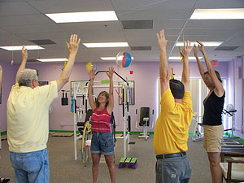
Session 1
Big exercises #1-4
10 repetitions of each
Visual modeling and simultaneous performance of exercises
No LSVT BIG at home
Notes:
Following evaluation during the first treatment, Mrs T was educated on BIG exercises #1-4, completing 10 repetitions of each in order to introduce her to the principles of this treatment technique and instruct her on the level of intensity that was expected during therapy. Standing exercises were performed with the patient wearing a gait belt and the aid of an assistant for maintaining balance and safety as these exercises maximally challenged her balance. The therapist visually modeled the exercises and simultaneously performed them. The full LSVT®BIG program encourages patients to practice the standard exercises at home as part of a home exercise program, but it was determined that this would be unsafe for the patient since she lived alone and didn’t have someone available who could assist her with maintaining balance. She was however given the exercise pictures and instructions to mentally rehearse the routine.

Slide 30
Session 2
10 repetitions of exercises #1-6
Patient education
BP: 158/60 mmHg
HR: 87 bpm
Cone weaving
Toe taps
Stepping activities
Notes:
At the second treatment, the patient worked through 10 repetitions of exercises #1-6. She struggled with form initially, but this improved with verbal and tactile cueing along with visual modeling. She was also given education on how amplitude and intensity are more important than textbook correct form. During these exercises, her BP was measured at 158/60 mmHg with a HR of 87 bpm indicating that the exercise placed a level of stress on the cardiovascular system that was not excessive. Following the BIG protocol, she completed various balance/coordination activities such as cone weaving, 4 directional cone foot taps, forward/backward/sideways marching, and a 4 square stepping activity similar to the 4 square step test used for identifying multiple falling older adults²⁴. All of these exercises were initiated with the goal of challenging the balance control systems as well as working on turning and transitioning which are typically most difficult in patients with PD¹⁹.

Slide 31
Sessions 3 & 4
Addition of exercise # 7
Balance and coordination tasks
Mini squats
Repeated sit-to-stand

Slide 32
Sessions 5 & 6
Added UE strengthening exercises
Fell out of bed at home
No major injuries
No change in performance

Slide 33
Sessions 7,8,9
Added physio ball throw and catch
Anticipatory reactions
Postural control
Coordination
Increased to 12 reps of each BIG exercise
Increased back strengthening
Notes:
The seventh treatment included the same basic regimen of exercises with the addition of a standing Physioball throw-catch exercise to work on anticipatory postural control and coordination. For the eighth and ninth visits, repetitions for BIG exercises were increased to 12 for all exercises. During both interventions, standing exercises were increased as well as exercises targeting the back extensors to promote improved upright posture and endurance for standing.

Slide 34
Session 10: Reassessment
12 reps of each BIG exercise
BP measured at 132/78 mmHg and HR 64 bpm
Full re-assessment was performed
Notes:
The tenth treatment once again included 12 repetitions of the standard LSVT®BIG exercises followed by balance and functional strengthening tasks. The patient’s vitals were once again recorded with BP measured at 132/78 mmHg and HR 64 bpm. This treatment also included reassessment of the patient.

Slide 35
Outcomes
Outcome Measure | Baseline Score | Final Score
Timed Up & Go (TUG) | 18.06s | 13.37s
Gait Speed | 0.71 m/s | >0.71 m/s
Tinetti Mobility Test (TMT) | 20/28 (8/12 gait; 12/16 balance) | 21/28
PDQ-39 | 16.7% Disabled | 8.97% disabled
Notes:
The improvement in her TUG score was significant based on the MDC value (3.5s). She fell below the cutoff level of 13.50s, which delineates fall risk in adults¹⁹.
No change in gait speed following intervention, which remained at 0.71 m/s.
TMT score improved but not enough to change her fall risk.
The PDQ-39 self-assessment for Parkinson’s disease related quality of life was also re-administered and this final value was significantly lower than the patient’s initial value. More specifically for the PDQ-39, the patient’s raw score improved numerically on questions 1-16 that involved mobility and ADLs from a total of 8 initially to 6 following intervention. This suggested that her self-perceived mobility may have improved.

Slide 36
Re-assessment
Improved coordination of BIG exercises
Increased postural control
Improved endurance and exercise tolerance
30 mins of exercise without break
Met 4 of 6 goals for therapy
Still room to improve from PT
Notes:
From a qualitative standpoint, the patient was observed to demonstrate improved coordination for BIG exercises as well as some improvement for postural control during balance exercises aimed at destabilization. She also demonstrated improve tolerance for participating in standing activities with no AD following 6 weeks of therapy as she was able to complete the ~30 min set of BIG exercises without requiring a rest break.
the patient met 4 of the 6 initial goals set for therapy. Of these goals, only one of the functional mobility/fall risk assessment goals (#2) was met but all of the HRQOL and participation goals (#4, 5, 6) were met. Since not all of the goals were met and the patient still demonstrated limitations in motor performance and mobility that put her at increased risk of falls, it was determined that the patient would benefit from continued physical therapy care to determine if further gains in outcome scores could be made following a longer period of intervention.

Slide 37
Discussion
Improvement in HRQOL
Mixed mobility results
Fall risk?
Differences from the literature
Frequency of treatment
Home component
Notes:
When looking at the overall results related to the physical therapy goals set for this patient, it is interesting to point out that only one of the functional mobility/fall risk assessment goals (#2) was met but all of the HRQOL and participation goals (#4, 5, 6) were met. These results pointed to the possibility that the patient may have benefitted more from the intervention in this case report in the areas of health related quality of life than for improved motor performance, functional mobility, and decreased fall risk. This result was somewhat unexpected since quality of life outcomes were the least improved scores in the “BIG” study, but this may actually be a more significant outcome for the patient in this case than any dramatic change in functional outcome measures as she was largely independent with daily activities required for her life. For example, the patient had a longstanding diagnosis of PD and lived at an assisted living facility. She also used a wheeled walker for mobility outside of the therapy clinic which supplied her with the stability she needed for her functional mobility requirements, which were relatively low when compared to a younger patient, perhaps with a family. The patient even rated her perceived level of disability prior to the intervention quite low using the PDQ-39 (16.7%). This value is quite low compared to the average pre-intervention scores reported in two studies that used the PDQ-39 with similar patients (average range 29.5 – 31.2%) and could have made it more difficult to show real improvement due to a ceiling effect^{7,13}. Her improved PDQ-39 score in spite of the relatively low initial rating pointed more strongly toward a significant quality of life improvement for the patient following the intervention. The patient also stated that she felt better physically having completed physical therapy.
These inconsistent results suggested that from a motor functioning and fall risk standpoint, the intervention applied in this case may not have had a significant effect. It was thought based on literature review that these functional measures might have all improved with the intervention described in this case, but there are many possible explanations for why the patient may have shown limited change.

Slide 38
Conclusion
No strong conclusion of effectiveness but…
No decline in function throughout this time
Positive improvements in outcome measures
Significant promise as a neuroplasticity model
More comparative research needed

Slide 39
LSVT® BIG Information
http://www.lsvtglobal.com/
Workshops
Certification
Notes:
LSVT Global is the company that runs both the LSVT BIG and LSVT LOUD certification programs. There are 2 day courses offered around the country to become certified in this treatment, but if that’s not something you’re interested in, you definitely don’t have to be certified to incorporate the ideas and strategies of the program into your treatment sessions!

Slide 40
References
1. Bartels AL, Leenders KL. Parkinson's disease: The syndrome, the pathogenesis and pathophysiology. Cortex. 2009;45(8):915-921.
2. Spitzer AL, Hakim EW. Parkinson's disease: The interplay of medical and surgical treatment options with physical therapy. ACUTE CARE PERSPECT. 2008;17(4):8-15.
3. Goodwin VA, Richards SH, Taylor RS, Taylor AH, Campbell JL. The effectiveness of exercise interventions for people with parkinson's disease: A systematic review and meta-analysis. MOVEMENT DISORD. 2008;23(5):631-640.
4. O'Sullivan S, ed. Physical rehabilitation. 5th ed. FA Davis; 2007. O'Sullivan S. and Schmitz T., eds.
5. Goodman C, Fuller K, eds. Pathology: Implications for the physical therapist. 3rd ed. St. Louis, Missouri: Saunders Elsevier; 2009. Goodman CC and Fuller KS, eds. Pathology: Implications for the Physical Therapist.
6. Poulopoulos M, Waters C. Carbidopa/levodopa/entacapone: The evidence for its place in the treatment of parkinson's disease. CORE EVID. 2010;5(1):1-10.
7. Georgy E, Barsnley S, Chellappa R. Effect of physical exercise-movement strategies programme on mobility, falls, and quality of life in parkinson's disease. INT J THER REHABIL. 2012;19(2):88-96.
8. Smania N, Corato E, Tinazzi M, et al. Effect of balance training on postural instability in patients with idiopathic parkinson’s disease. Neurorehabil Neural Repair. 2010;24(9):826-834.
9. Li F, Harmer P, Fitzgerald K, et al. Tai chi and postural stability in patients with parkinson's disease. N Engl J Med. 2012;366(6):511-519.
10. Mehrholz J, Friis R, Kugler J, Twork S, Storch A, Pohl M. Treadmill training for patients with parkinson's disease. Cochrane Database Syst Rev. 2010(1).

Slide 41
11. Nieuwboer A, Rochester L, Jones D. Cueing gait and gait-related mobility in patients with parkinson's disease: Developing a therapeutic method based on the international classification of functioning, disability, and health. TOP GERIATR REHABIL. 2008;24(2):151-165.
12. van Eijkeren F, Reijmers RS, Kleinveld MJ, Minten A, Bruggen JP, Bloem BR. Nordic walking improves mobility in parkinson's disease. MOVEMENT DISORD. 2008;23(15):2239-2243.
13. Ebersbach G, Ebersbach A, Edler D, et al. Comparing exercise in parkinson's disease -- the berlin LSVT(R)BIG study. MOVEMENT DISORD. 2010;25(12):1902-1908.
14. Farley BG, Fox CM, Ramig LO, McFarland DH. Intensive amplitude specific therapeutic approaches for parkinson's disease: Toward a neuroplasticity principled rehabilitation model. Topics in Geriatric Rehabilitation. 2008;24(2):99.
15. American Physical Therapy Association. Guide to physical therapist practice 2nd ed. Alexandria, Virginia: ; 2003.
16. Palmer LM, Epler ME. Fundamentals of musculoskeletal assessment techniques 2nd edition. Philadelphia, PA: Lippincott-Raven Publishers; 1998.
17. Viccaro L, J., Perera S, Studenski S, A. Is timed up and go better than gait speed in predicting health, function, and falls in older adults? J Am Geriatr Soc. 2011;59(5):887-892.
18. Dibble LE, Lange M. Predicting falls in individuals with parkinson disease: A reconsideration of clinical balance measures. J NEUROL PHYS THER. 2006;30(2):60-67.
19. Kegelmeyer DA, Kloos AD, Thomas KM, Kostyk SK. Reliability and validity of the tinetti mobility test for individuals with parkinson disease. Phys Ther. 2007;87(10):1369-1378.
20. Jenkinson C, Peto V, Fitzpatrick R, Greenhall R, Hyman N. Self-reported functioning and well-being in patients with parkinson's disease: Comparison of the short-form health survey (SF-36) and the parkinson's disease questionnaire (PDQ-39). Age Ageing. 1995;24(6):505-509.

Slide 42
21. Jenkinson C, Fitzpatrick R, Peto V, Greenhall R, Hyman N. The parkinson's disease questionnaire (PDQ-39): Development and validation of a parkinson's disease summary index score. Age Ageing. 1997;26(5):353-357.
22. Kerr GK, Worringham CJ, Cole MH, Lacherez PF, Wood JM, Silburn PA. Predictors of future falls in parkinson disease. Neurology. 2010;75.
23. Winter Y, Lubbe D, Oertel W, Dodel R. Determining minimal clinically important difference for health-related quality of life scales in parkinson's disease. MOVEMENT DISORD. 2012;27.
24. Dite W, Temple VA. A clinical test of stepping and change of direction to identify multiple falling older adults. Arch Phys Med Rehabil. 2002;83(11):1566-1571.
25. Huang S, Hsieh C, Wu R, Tai C, Lin C, Lu W. Minimal detectable change of the timed "up & go" test and the dynamic gait index in people with parkinson disease. Phys Ther. 2011;91(1):114-121.
26. LSVT global. www.lsvtglobal.com. Accessed February 2nd, 2013.
27. Qutubuddin AA, Pegg PO, Cifu DX, Brown R, McNamee S, Carne W. Validating the berg balance scale for patients with parkinson's disease: A key to rehabilitation evaluation. Arch Phys Med Rehabil. 2005;86(4):789-792.

