Slide 1

Practical
Wound Care
Strategies
Created by L. Michelle O’Neill as part of an independent study with
the Physical Therapists at WakeMed Wound Care Clinic

Slide 2
Special Thanks to:
Christina Young, PT
Cindy Wulffhaver, PTA
Tara Marshall, PT

Slide 3
Objectives
To understand evaluation procedures, treatment techniques and dressing options
To understand management of compounding factors
To understand indications for various modalities
To understand documentation of wound care

Slide 4
It’s simple!
Address the cause of the wound
Manage compounding factors
Choose the appropriate dressing
Notes:
2 things have to happen to heal a wound: remove the cause/perform wound care; patient has to manage compounding factors

Slide 5
1. The Cause
Swelling → Compression
Necrotic →Debride
Venous Insufficiency → Decrease swelling via compression
Arterial Insufficiency → Re-establish blood flow
Pressure/Diabetic → Offload
Notes:
Venous insufficiency can cause darkening of the skin, this is called hemosiderin staining.
-Often, the patient will also have lymphedema. The back up of veins leaves blood byproducts in the interstitial spaces, therefore the lymphatic system tries to take over and move that fluid away, but eventually it gets overworked and forfeits and the result is lymphedema.
-with venous insufficiency you usually see weeping wounds and pitting edema.
-swelling balloons and is squishy; lymphedema can pit or even be hard. Pitting is caused by proteins in interstitial spaces.
Lymphedema= +1,+2=rebounds quickly. +3=takes longer to rebound. +4=hard.
-don’t wrap patients with CHF, this will push fluid to the heart.
2. For pressure ulcers to heal, have to relieve pressure. This means the patient must be in bed all the time to stay off the wound in pressure-relieving mattress. They may sit in their chair less than 1 hr/day. This is a big part of patient education. Depends on the goal: if goal is to heal wound, must stay out of chair. If goal is to live out the rest of their life, can continue to participate in life in the chair. Pressure wounds die from the inside out and often get a lot bigger after debridement before they get better.
Crucial: protein and offload.
Pelvic pressure ulcers need Roho cushion (not Jay)
Replicare good for excoriated periwound

Slide 6
2. Compounding Factors
No Smoking
Controlled Blood Sugar
Controlled Blood Pressure
Adequate Protein Intake
Compliance is crucial!

Slide 7
Prealbumin
Indicates past 3 days level of protein
Should be >20
Normal 18-38 mg/dL
Albumin
Gives a longer indicator of protein
Need extra protein to heal the wound AND
Drainage from wound leaks out protein
Notes:
-Require 1 gram of protein for every kilogram of body weight to sustain current body function without a wound.
-Double the intake to 2 grams of protein for every kilogram of body weight when there is a wound.
-The body will not redirect the available protein to meet the demands of the wound; the patient must take in additional protein.
-Plastic surgeon will not consider flap coverage if Prealbumin consistently below 25-30. (If bone is exposed with a pressure ulcer, must cover with muscle flap).
Nutrition:
-Vitamin C is important in collagen synthesis in the formation of bonds between strands of collagen to provide strength.
-Increased requirement during injury, stress, and sepsis
-Vitamin K for the formation of thrombin, deficiency could lead to hematoma
-Vitamin A is also involved in cross-linking collagen and the proliferation of epithelial tissue.
-Zinc- for protein synthesis, increased demand for zinc during cell proliferation and protein secretion
-also has an inhibitory effect on bacterial growth
-SUPPLEMENTATION of above is probably not necessary, unless pt is deficient, the ideal way to meet the requirement is by eating normal foods in adequate amounts, now is not the time to diet!
-ADEQUATE hydration: at least 8 glasses of water a day!

Slide 8
A1C
3 month indication of sugar level
Bacteria feeds off sugar
  → Leads to infection!
Ankle-Brachial Index
ABI should = 1.0
ABI should be triphasic
Notes:
Procedure to take ABI: cuff on ankle, pump up sphygmomanometer, the pulse will be silent, take reading when you hear the pulse return. Systolic on brachial. Ankle Doppler on dorsalis pedis/ Systolic brachial=ABI. Should be 1. In diabetics, calcification causes ABI to be falsely higher.
-ABI should be triphasic (not mono or biphasic).
-ABI needs to be normal for profore 4 layer wrap. May need OK from vascular surgeon.
-If patient doesn’t have good dorsalis pedis pulse, need to refer to vascular surgeon before applying compression.
-Do not debride someone with arterial disease—creates a bigger wound with no way to heal it.
-consult vascular- that’s why you check dorsal pulse (dorsalis pedis)

Slide 9
3. Dressing Options
This part is a little trickier…

Slide 10
Wet-to-dry dressing
Gauze with Normal Saline
Inexpensive
  Great for wounds changed daily
Commonly Used For: packing abscesses or deep cavity wounds
Notes:
Procedure: Pack dressing into wound with finger or wooden end of qtip (so cotton doesn’t come off into dressing). Use only one roll of gauze so you know how many pieces you put into the wound and do not leave any dressing behind when it is changed. Pack the wound to prevent re-epethialization over the wound before the depth is filled with granulating tissue. Promotes healing from the inside out instead of the outside in- which is breeding ground for infection. Packing also helps prevent pus from forming in the cavity and helps with drainage.
Can just pack with dry gauze if drains a lot. Drainage will maintain a moist wound bed without the need for saline. This method will allow the gauze to absorb more drainage.

Slide 11
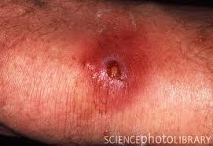
Look out for signs of infection!
Fever
Spreading erythema of periwound
  ….. GO TO ER!
Notes:
Abscesses usually have periwound induration from the infection. Treatment is usually I&D and antibiotics. Induration indicates infection, may have to cut more out if it doesn’t soften, but it should soften as infection clears. Also consider if fever is going away.

Slide 12
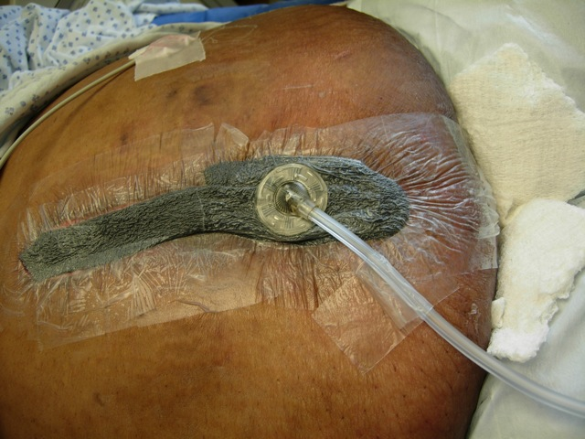
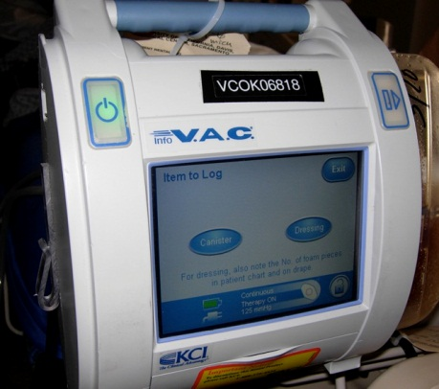
Wound Vac
Great for cavity wounds
Wound must be free of necrotic tissue before a wound vac can be applied
Negative Pressure creates angiogenesis, removes drainage, and assists in achieving wound closure
Notes:
--Procedure for placing wound vac: irrigate wound with NS, debride if necessary. i.e. clean the wound.
-cut sponge to appropriate size and depth (sponge can be black, silver, or white foam. There is also silver foam. white foam is more dense for tunnels, black would fall apart. Black absorbs more drainage). May need to cut size in half to reduce thickness, do not want to overfill the wound, want the wound to close down.
-abdominal wounds need reservoir with wound vac- they tend to drain a lot. Ex: dehisced c-section. Approximate the edges of the wound to promote wound closure. can put silicone over staples to protect from drape.
-spray skin prep around wound on healthy skin to increase contact of drape.
-cover whole area with drape. Cut hole smaller than a nickel but bigger than a dime in the center. Place track pad (round suction piece) over hole. Trick to cutting hole- hold drape with forceps, twist, then cut.
-May need to use bridge if placement is over bony prominence or weight bearing surface—do not want to create an area of increased pressure that may lead to a pressure ulcer. Apply drape under foam on intact skin. Be sure to position the tube in a way that is comfortable for that patient-ask!
-Turn machine on to designated pressure- usually 125mmHg. 150 for larger wounds. Ranges from 75-200mmHg. Readout will turn green when there are no leaks. If there are leaks, need to listen for its location and press to secure drape or apply second piece of drape.
-Replicare, mepilex one, or mepilex border to excoriated periwound
--example: necrotizing faciitis of bilateral upper chest and one entire arm. Used two suction tubes connected to one woundvac- called “Y” connectors.
--wound vac can be utilized for outpatients, they carry it with them at all times and never turn the machine off. They come to clinic 3x/wk for dressing change.

Slide 13
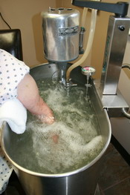
Whirlpool
Must consider: location of wound, if heavily bleeding, venous stasis, enteric isolation, suture lines, in ICU, intact dry eschar, mulitple wounds.
Indicated for lymphedema!
Notes:
98 degrees x 10 minutes
Venous stasis- do not need to put in a dependent position and warm water
-Can do cool water whirlpool one time to loosen necrotic tissue for debridement in venous insufficient patients.
If contraindicated, can do pulse lavage instead. If MD order is for whirlpool and you’re not sure, can simply irrigate with NS. Change dressing, pics, measurement.
For lymphedema: 1-2 treatments at 92degrees for initial clean up and softening of dry crusty skin. Need to remove callouses because these form points of increased pressure that can lead to a wound.

Slide 14
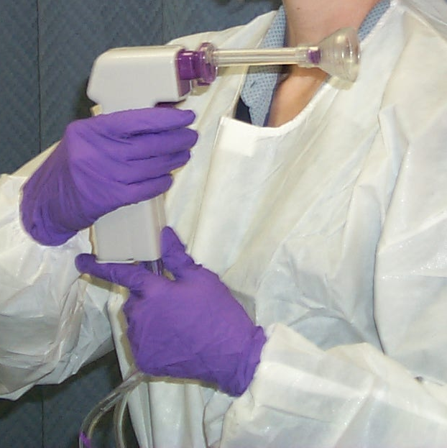
Pulsatile Lavage
Loosens tissue to enable more effective debridement
Indicated in wounds with odor
Notes:
1000mL bag of NS, 2 different tips: suction diverter and irrigation; change gun weekly, charge PL kit every time
This can help patients avoid OR, which is especially important for high-risk patients.
-patient with stage IV pressure ulcer with VERY low protein was being assessed by MD for possible need of muscle flap or at least surgical debridement because of the vast amount of necrotic tissue. Very smelly. “Breathe out of your mouths people!” But with a few days of pulsatile lavage, the wound was cleaned up.

Slide 15
Hyperbaric Oxygen
4 Medicare approved Dx’s for OP setting
  Diabetic Foot Ulcers meeting 4 criteria
  Chronic Refractory Osteomyelitis
  Preparation and preservation of comprised skin grafts and flaps
  Late Radiation Tissue Injury
Notes:
INDICATIONS FOR HBO from medicare:
-failed flap (can be for pressure ulcer of from amputation sx), DFU (must be 4 wks of conventional treatment first to qualify for HBO and be Wagner 3 or worse); chronic osteomyelitis-failed 6 weeks antibiotic therapy; acute blood loss; necrotizing fasciitis; decompression sickness; gas gangrene; gas embolism; acute carbon monoxide poisoning; late radiation tissue issues- CA patient has wound that won’t heal b/c of scarring from radiation
-oxygen toxicity can cause toxicity- breathing air at pressure can cause decompression sickness
-LCD=local coverage determination for Medicare, must preauthorize

Slide 16
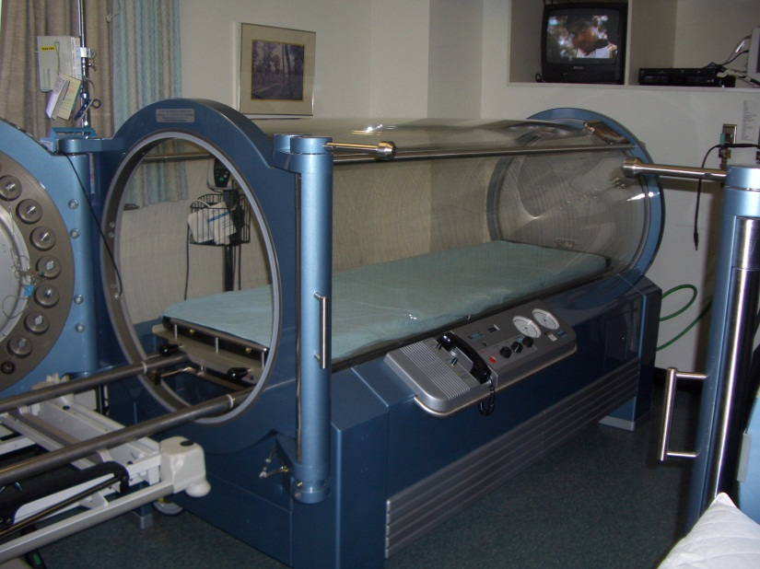
Hyperbaric Oxygen
Mechanism of Action:
  Direct Pressure
  Hyper-oxygenation
  Angiogenesis
  Anti-microbial Effects
  Vasoconstriction
  Reduction Ischemia-Reperfusion Injury
Notes:
Test Tcomp to see if HBO is indicated, this is an objective measure to document. Put on 02 mask to see if pt responds to oxygen, Tcomp measured again after 10 minutes, should measure over 200mmHg=hyperoxygenated.
The pressure liquefies the oxygen so that it does not need to bind to hemoglobin. Instead, the oxygen can go directly to the wound independently in the bloodstream without hemoglobin.
Hemoglobin has 4 binding sites for oxygen, this is what you’re checking when you check 02 sat’s.
For a reperfusion injury, decompression occurs in the bloodsteam. This means nitrogen bubbles in the bloodstream expand as the pressure decreases (such as when a diver surfaces). If this nitrogen bubble expands in the heart or brain, it is fatal. The pressure of HBO shrinks the nitrogen bubble. This therapy was first used for divers with decompression sickness.

Slide 17
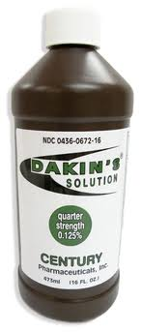
Dakins Solution
Diluted Bleach
Use on foul smelling, highly necrotic wounds
Is non-selective… do not use on patients with healthy granulating tissue!!!

Slide 18
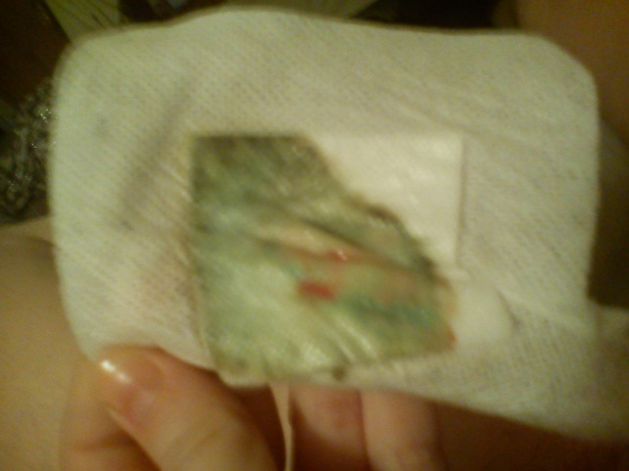
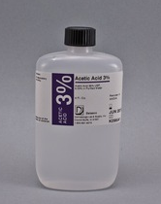
0.25% Acetic Acid
Use for wounds infected with pseudomonas
  Sweet odor, BRIGHT GREEN/blue drainage
Use both Dakins and Acetic Acid for 5-7 days or longer depending on drainage, odor, and appearance

Slide 19
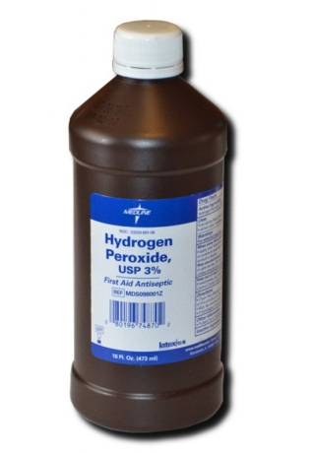
Hydrogen Peroxide
Use on 1-2 times on wounds with heavy, adherent biofilm
Is non-selective… do not use on patients with healthy granulating tissue!!!
Notes:
HP will kill re-epithealizing cells. Consider cytotoxicity vs. need to clean wound and revive healing process.

Slide 20
Silver
Antimicrobial
Use on green or brown necrotic wounds
Silvasorb- slight debridement
Silvadene- contains sulfar and silver, keeps wound bed moist, helps dead tissue to slough off, not a debriding agent, good for burns, removes from wound easily
Notes:
There are silver choices for any type of dressing.
If a wound is covered by stable eschar, do not remove it. Stable eschar is not smelly, not mushy, and there is not puss around the edges. This acts as a biological bandaid that protects the underlying tissue until it can heal. Be especially careful with an arterial wound, this will make a bigger wound with no way to heal it.
-black, necrotic tissue would not form if the wound wasn’t dry. In this case, you need to add a gel to keep the wound bed moist—add silvasorb gel. You could also add a hydrogel to add moisture, but silvasorb controls bacteria.

Slide 21
Silver
Acticoat Absorbant Silver- silver alginate, becomes a gel that absorbs drainage, cleans wound, can stay applied for 1 week to absorb drainage
Some people react to silver… if it burns, take it off!!!
Alginate
Turns gelatinous as it soaks up drainage
Cannot use in patient’s allergic to seaweed!!!

Slide 22
Acticoat _______=
Silver Impregnated ______
Acticoat Flex= silver impregnated fabric.
  Stretchy, can stay in place 7 days max
Acticoat Absorbant= silver impregnated calcium alginate
  Can in stay in place 7 days
  Good to put under a cast

Slide 23
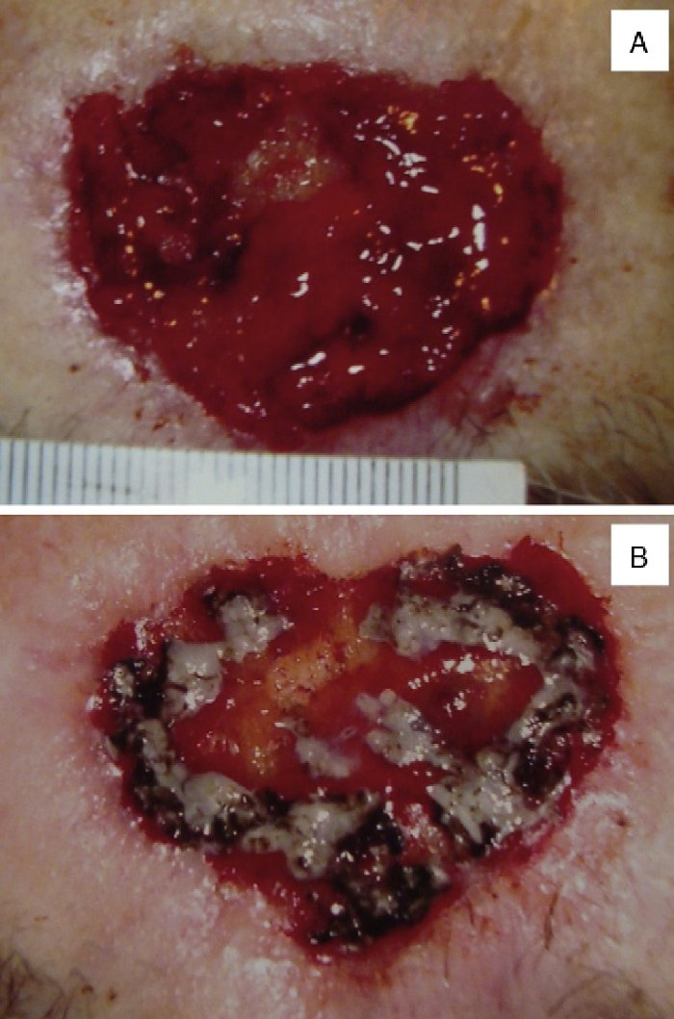
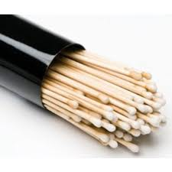
Silver Nitrate
Cauterizes hypergranulation tissue buds to enable skin to cover evenly
Notes:
Hypergranulation- treatment is silver nitrate to cauterize buds. Large ridges make it harder for epithelial cells to cover over. Also use foam- does not stick to wound bed so when you remove it, it doesn’t bleed. Bleeding will impede healing, ripping off epithelial cells. Pressure from foam keeps hypergranulation at bay. Example of foam is Allevyn gentle border, changed PRN every 3-4 days. Can be removed, take shower, put back on.

Slide 24
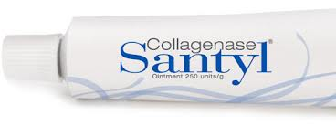
Santyl Collagenase
Debriding agent for necrotic wound
This is an expensive dressing
Does the patient have insurance to cover the cost???
Notes:
Or would mesalt be more appropriate

Slide 25
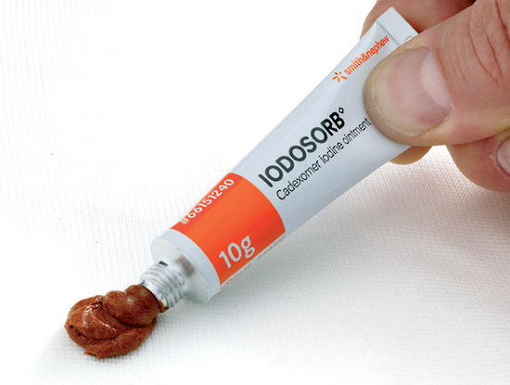
Iodosorb
Decreases infection
Absorbs drainage
Debriding agent

Slide 26
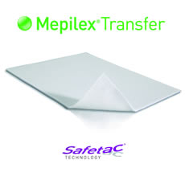
Transfer Foam
Wicks drainage away to foam
  Foam is a reservoir
If changing dressing daily, use wet-to-dry and ABD pad instead!!!!!
  More cost-effective

Slide 27
Impregnated Gauze
Mesalt-salt “ “
  Inexpensive debriding agent
Xeroform- Iodine “ “
  Does not stick to skin, great for skin tears
  Toxic to healthy tissue
Adaptic- vaseline “ “
Notes:
In an inpatient setting, best to use a cost-effective dressing since it is getting changed at least daily, if not more frequently. I.e. wet-to-dry or mesalt for debriding

Slide 28
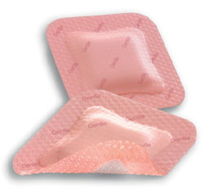
Allevyn
Silicon-covered foam
Meant to be able to lifted to check wound and stuck back down
Meant to stay on for several days

Slide 29
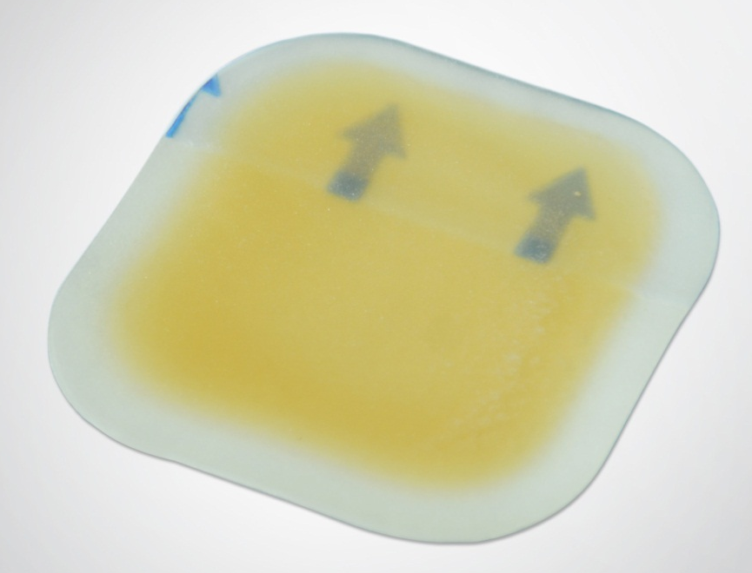
Hydrocolloid
Protects and offers minimal amount of absorbency
Good for stage II pressure ulcer, denuded periwound skin, or skin tear

Slide 30
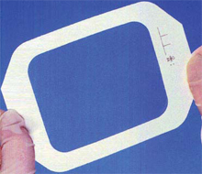
Tegaderm
Film, offers no absorption
Good for skin tears and to protect graft donor sites
Notes:
For an epidermal graft, device causes donor site to blister, MD shaves off that skin, places it on tegaderm, places that on the wound and staples it in place. PT removes staples and provides follow-up wound care. PT also does initial referral to plastic surgeon for skin graft.

Slide 31
Think…
What is the cause of the wound?
Is the wound bed wet or dry?
Does it need cleaning/removal of necrotic tissue?
Use silver (antimicrobial) for chronic wounds with light odor/light yellow biofilm
Use debriding agent for a large amount of necrotic tissue
Use non-selective topical solution if FOUL SMELLING and MAX amount of necrotic tissue
Notes:
3. i.e. Use Dakins for 5-7 days to help with debridement and odor
Think when entering a room: What side is the wound on? (R) Which way will patient roll? (L) What are we gonna do? (PL, wet-to-dry)

Slide 32
During an eval…
History of the wound
How has the patient been treating it at home
Ask and then EDUCATE about barriers to healing
Who will do dressing changes at home
Notes:
Barriers to healing: smoking, nutrition, pressure, etc.
If patient cannot do dressing changes at home, this will determine frequency of visits/week

Slide 33
Documentation
Drainage (amount, color, and odor)
Wound bed (% amount of granulation tissue vs necrotic tissue/fibrin/slough)
Location
Measurements
Presence of tunneling/tracts/undermining (described by position as it relates to a clock, with patient in anatomical position)

Slide 34
Documentation
Borders
Periwound
  Denuded= raw
  Macerated= wet
  Indurated= hard, woody
Edema (with girth measurements if needed)
Notes:
Induration- hard, woody area surrounding an infection such as an abscess

Slide 35
Documentation
What you tissue was debrided, why, what tools you used
Ex: “debridement of scab, peeling skin, and yellow slough with forceps”
Always document how many pieces of gauze are applied
  How many pieces of foam for wound vac
Notes:
What tissue was debrided: biofilm, callus, eschar, slough, bone chip
What tools were used: scissors, forceps, hemostat

Slide 36
Documentation
When describing drainage, consider how long dressing has been on and how big the wound is/where it is
If too much drainage, need more absorptive drainage
If no drainage, need to keep wound bed moist with gel
Notes:
Abdominal/venous wounds will have more, larger will have more, longer dressing has been on will have more drainage.

Slide 37
Documentation
Example
Assessment: __ year old _(male/female)_ with _(decub s/p I&D)_. Describe wound. What you did. What he will need/why he would benefit from skilled therapy services. POC. D/C.

Slide 38
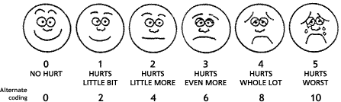
Documentation
“Per FACES scale”= for pain scale when the patient cannot or do not rate pain

Slide 39
Documentation
Charges:
  Eval
  WD vac< or > 50 cm²
  SD < or > 20cm2
  WP, MT, SC
  PT multi-layer wrap
  PL kit
  Supplies- from database picklist

Slide 40
Other Techniques…

Slide 41
Total Contact Casting
Use on plantar wounds, most often for Diabetic Foot Ulcers
Off-loads wounds to evenly distribute pressure

Slide 42
How to Apply a Contact Cast
Cotton between toes
Stockinette- cut out top of ankle crease
Pad top of foot/toes, malleoli, and anterior tibia
Roll on Webril, pad bottom of foot and Achilles
Plaster- 1st heel, 2nd toes, (2) 3 inch rolls
Blue fiberglass- (3) 4 inch rolls. Cover all plaster. Go up leg and reinforce weak parts; i.e. back of ankle and toes
Notes:
For patient’s with neuropathy: make sure not driving with R foot, work out wrinkles with plaster. Start with 5th met head. Must order post-op shoe. Keep ankle in neutral; less DF during casting will cause hyperextension at knee during gait. Cure for at least 45 minutes before allowing pt to weight bear. Silver alginate will absorb moisture and kill bacteria. Tape is not necessary to cover alginate. Change cast weekly.

Slide 43
Other Off-loading Devices
Forefoot off-loading shoe
Heel off-loading shoe
NWB with AD
Cam Walker boot, post-op shoe
Pelvic Pressure ulcers; limit OOB
Foot/Plantar/Toe wound; limit weight bearing
Notes:
Forefoot off-loading shoe= such as Darco; need P&O consult.
Pelvic Pressure ulcers; limit OOB, need Roho in W/C

Slide 44
Considerations for off-loading:
What is the goal?
Mobility or wound healing

Slide 45
Compression Wrapping
Use on heavily draining wounds
Profour= 4 layer wrap
  ABI > 0.8
  cotton layer, 1 short stretch, 2 long stretch
Profour Lite= 3 layer wrap
  ABI between 0.6-0.8
  cotton layer, 1 short stretch, 1 long stretch
Notes:
Cotton layer is padding; purpose is to make leg columnar instead of bottle-shaped.
For patient’s with a big calf and small ankle, use cutting technique.
--Long stretch= Low working pressure, high resting pressure. When the patient is up and walking, the wrap is loose. When lying down, the wrap is a tourniquet. An ace wrap is an example of a long stretch wrap. When wrapping a patient, pull 50% of stretch and overlap 50%. This is called 50/50.
--Short stretch= High working pressure, low resting pressure. When muscles are working against the wrap, it pushes fluid up. Does not get tighter when lying down. Put it on in full stretch.
Both covered with Coban.
Do not wrap leg in a dependent position.

Slide 46
Compression Wrapping
Coban 2 and Coban 2 Lite= for patient’s with lymphedema and venous leg ulcers
Indicated for:
  Irregularly shaped legs
  Morbidly obese patients
  Active patient that needs to wear shoes
  Patient with latex allergy/sensitivity
Notes:
Lymph nodes are a network just under the skin that collect in regional nodes (inguinal, axillary, and in the neck). All collect in thoracic duct that pierces through the diaphragm. Deep breathing milks the thoracic duct so that lymph fluid is dumped into the subclavian veins, therefore entering the circulatory system, and is then carried to the kidneys and excreted through urination.
Debride crusty skin, then moisturize intact skin. Dry skin must be moisturized as cracks will allow an area for bacteria to harbor.
-Complete Decongestive Therapy includes skin and wound care; manual lymph drainage; compression; and exercise in compression. Remember whirlpool for 1-2 treatments can be helpful for softening of crusty dry skin.
-Contraindications for MLD and/or bandaging: acute infections, cardiac edema, acute DVT, Arterial disease in the extremity to be wrapped
Decreases edema by increasing venous return.
Padding layer and a compressive coban layer.

Slide 47
Compression Wrapping
Coban 2
  ABI > 0.8
  2 short stretch layers
Coban 2 Lite= for patients less tolerant of compression
  ABI between 0.5-0.8
  Short stretch, apply at full stretch
Notes:
Coban 2 all short stretch, do not put on tight. Heel hook is important for anchoring the wrap. Edges of Coban 2 wrap can cause blister if they roll up. Check for this. May warrant change to compressogrip and ACE wrapped in Fig 8- straight across makes a tourniquet.
Coban 2 Lite= Leave no gaps with 50% overlap. Foot dorsiflexed in 90 degrees, foot supported so no muscle tension. Start at 5th metatarsal head and come over foot- do circle then come around heel; edge should just touch the floor. Not too much tension with comfort layer. Mold comfort layers together. Figure 8 ankle, spiral up leg on both layers. End just above fibular head, outer layer even with comfort layer. Applying at full stretch, reduces guess work of applying at 50%. This standardizes application to increase consistency. Not a primary dressing.
Dressings to use under compression:
-Consider silver impregnated or Iodosorb dressing next to wound for initial wraps
-transfer foam or foam
-adaptic or Profore veil next to shallow wounds or recently applied Apligraf
-vaseline/moisturizer on entire intact skin
When removing wrap, cut at great toe and behind medial malleolus.

Slide 48
Compression Wrapping
Kerlix and Coban
  For heavily draining wounds that need frequent dressing changes
  Wounds contaminated with pseudomonas needing acetic acid dressings
  Patients needing mild compression, unable to tolerate other wraps

Slide 49
Like all other areas of PT….
  Use clinical reasoning AND
  COMMON SENSE!!!!
Identify the cause and address it
Patient education for barriers to healing
Choose your dressing and treatment method

Slide 50
All Information was gathered during an independent study at WakeMed Wound Care Clinic and was provided by Christina Young, PT; Cindy Wulffhaver, PTA; and Tara Marshall, PT
Questions???

