Slide 1
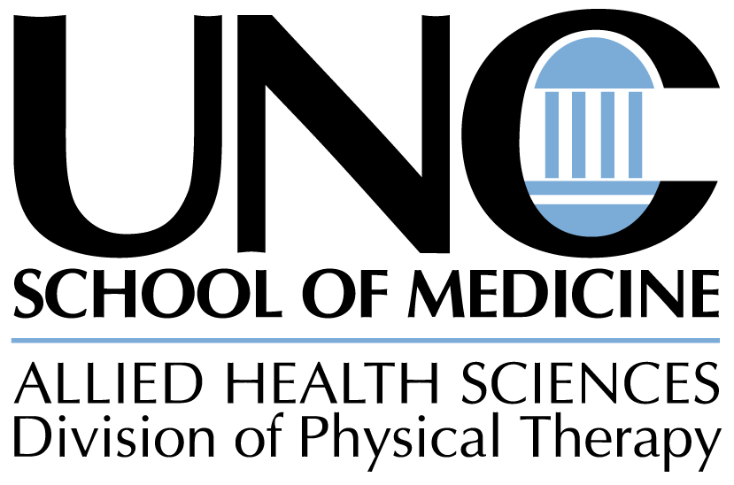
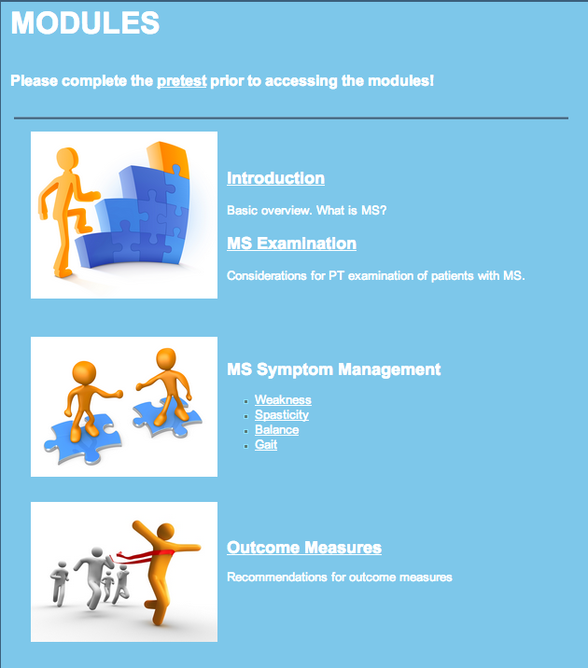
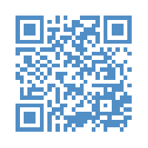
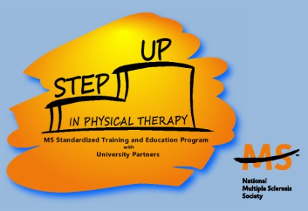
Online Educational Modules
To Increase Multiple Sclerosis Knowledge
For Physical Therapists
Division of Physical Therapy, University of North Carolina Chapel Hill
A. Rosenberg PT, DrPH; J. Tooher SPT; L. Waddell SPT; K. McCulloch PT, PhD, NCS
INTRODUCTION
Research aims to identify best practices for patients with MS. However, limited continuing education programs exist specifically related to PT for MS.
Barriers to continuing education include: travel costs, limited access to research databases, time constraints, and low EBP self-efficacy.
Online educational resources offer a flexible, inexpensive, and convenient opportunity for PTs to access continuing education.
NEEDS ASSESMENT
An initial needs assessment survey was sent to PTs to guide the development of the online modules.
Survey Results:
Over 70 physical therapists completed the survey.
90% had a strong interest in learning more about MS.
71% indicated an interest in receiving the educational modules.
METHODS: Online Educational Modules
http://sites.google.com/site/MSmodules
OBJECTIVES
RESULTS
AKNOWLEDGEMENTS
To enhance the knowledge of PTs who treat PwMS through the creation of online educational modules.
To highlight evidence-based research related to PT evaluation and interventions for MS.
To increase PT knowledge when treating PwMS, for both PTs who specializes in neurology or the PT who only periodically sees patients with MS.
A total of 6 evidence-based modules are available online. Content is primarily presented in video format. Each video is 6-12 minutes in length. Handouts corresponding to each video are available. Additional supplementary resources are provided including a comprehensive resource list, evidence tables, and links to outcome measure recommendations. Modules are free to access, but will also be available for CEUs at www.AHEConnect.com for a small fee.
Module content was evaluated with pretest and posttest assessments. 15 PTs completed the pretest. 5 of the PTs also viewed the online educational modules and completed the post-test. The average pre-test score was 48%, and the average post-test score was 78%.Thus quantitative data suggests an increase in knowledge after viewing the modules.
Thank you to the National MS Society, Greater Carolinas Chapter and the UNC Division of Physical Therapy for their support of the program.

