Slide 1
Good blood?
BAD BLOOD?
Cassie Short, SPT/UNC DPT/4-19-12

Slide 2
overview
Case Study Examples
Blood Transfusions
Process
Implications
Adverse events
Physical Therapy
Contraindications
Indications
New Hanover Regional Medical Center Actions

Slide 3
Case Study Examples
Mr. “A+”
Mrs. “0+”
Notes:
First, let’s take a look at two case study scenarios:

Slide 4
Case #1: Mr. “A+”
Past Medical History:
HTN, COPD, Ulcer Disease, ETOH, Hepatitis B, Smoker
Admit Date: 04/02/2012
Diagnosis: Melena
Hemoglobin at time of admit: 9.7g/L

Slide 5
Yes?
NO?

Slide 6
Yes?
NO?
Notes:
Was it the right decision to transfuse this patient?

Slide 7
Mr. “A+”
Day 1: 5 Units *last measured Hb: 9.3g/L
Day 2: 5 Units *Hb: 8.2g/L
Day 3: 2 Units *Hb: 8.5g/L
Day 4: 1 Unit *Hb: 9.5g/L
___________________
= 13 UNITS
*Total hospital stay = 13 days
Notes:
In the first 4 days
50% per unit increase for risk of infection!

Slide 8
Case #2: Mrs. “O+”
PMHx:
SOB, COPD, HTN, DM, CAD, L TKA
Admit Date: 03/04/12
Diagnosis: COPD exacerbation
Hemoglobin at time of admission: 10.2g/L

Slide 9
Yes?
NO?

Slide 10
Yes?
NO?
Notes:
Was it the right decision to transfuse this patient?

Slide 11
Mrs. “o+”
Day 1: 2 units *Last measured Hb: 11.1g/L
Day 2: 0 units *Hb: 10.5g/L
Day 3: 2 units *Hb: 10.9g/L
Day 4: 1 unit *Hb: 11.6g/L
Day 5: 0 units *Hb: 11.3g/L
__________________________
= 5 UNITS
*Total hospital stay = 9 days

Slide 12
Fact or Myth?
Blood is safer than it’s ever been.
A blood transfusion will get the patient home sooner.
Blood transfusions improve healing.
Blood is stored up to 42 days.
Autologous blood (pre-donated) is risk-free.
Blood transfusion is free.
There is a 50% increased risk for infection per 1 unit of RBC’s.

Slide 13
Blood transfusions
Process
Implications
Adverse Events

Slide 14
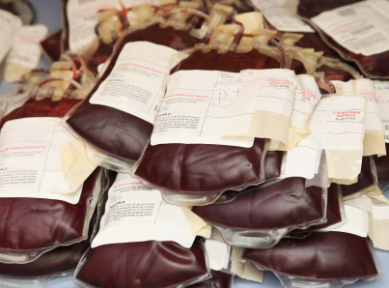
Blood transfusions
Process
Autologous or Allogenic
Separated into components
Tested for infections
Leukoreduction
Pathogen Reduction Treatment
Compatibility Testing
Donor cross-match testing
Delivery for transfusion
Notes:
One’s own, or someone else’s
Separated into blood components by centrifugation: RBCs, plasma, platelets, albumin protein, clotting factor concentrates, cryoprecipitate, fibrinogen concentrate, and immunoglobulins (or antibodies).
Current protocol tests donated blood for HIV, Hepatitis, Syphilis, Chagas disease, West Nile Virus. Cytomegalovirus-for immunocompromised recipients (organ transplant or HIV)
Removal of WBCs by filtration; less likely to develop antibodies against specific blood types, febrile non-hemolytic transfusion reactions, CMV infections, and platelet-transfusion refractoriness.
Addition of riboflavin with exposure to UV light; effective in inactivating pathogens (viruses, bacteria, parasites, and WBCs) in blood products.
Aka. Packed Cells, Red Cells, Packed Red Blood Cells, RBCs
AS-1 and AS-3 are appropriate for nearly all patient types
AS-1*, AS-3*, AS-5: Hematocrit 50-60%
CPDA-1, CPD, CP2D: Hematocrit 65-80%
Depending on the hemoglobin level of the donor, the starting whole blood collection volume, and the collection methodology or further processing- when leukoreduced, RBC units must retain at least 85% of RBCs in the original component.

Slide 15
ONE UNIT of RBCs
42.5-80 g of Hemoglobin (128-240 mL of pure RBCs)
147-278 mg of Iron (mostly in form of Hemoglobin)
Increase hemoglobin level by ~1g/dL, Hematocrit by 3%
Stored (refrigeration) 35-42 days; half life ~30 days; Frozen up to 10 years
Notes:
In non-bleeding or hemolyzing average sized adult*
½ life of 30 days in absence of other processes that would result in red cell loss or premature removal

Slide 16
Blood transfusions
Indications:
Significant, life compromising, blood loss (trauma, surgery)
Severe burn victims
Women in childbirth and newborn babies (certain cases)
Bleeding disorder or illness that causes anemia
Contra-indications:
Anemia that can be corrected with a non-transfusion therapy
Source of blood volume, or oncotic pressure
Improve wound healing
Sense of well-being
*Avoid over-or under-transfusion
*Based on clinical assessment and NOT lab values alone
Notes:
Why or when do we get them?
Illness causing anemia- kidney disease or cancer
Bleeding disorder- hemophilia or thrombocytopenia
Anemia-iron therapy
Each patient should be evaluated individually to determine proper transfusion therapy!

Slide 17
Blood transfusions
How can they go wrong?
TRALI (transfusion-associated acute lung injury)
TACO (transfusion associated circulatory overload)
Acute/Delayed hemolytic reactions
Febrile, non-hemolytic reactions
Allergic reactions
Transmissible viruses (HIV, Hepatitis, or CMV))
Bacterial contaminations
Incompatibility reactions
Transfusion inefficacy (storage lesion)
Volume overload
Hypothermia
Notes:
For recipients at particular risk from these transfusion related complications, use of CMV reduced-risk (ie seronegative or LR-RBC), gamma-irradiated and leukoreduced preparations should be considered.

Slide 18
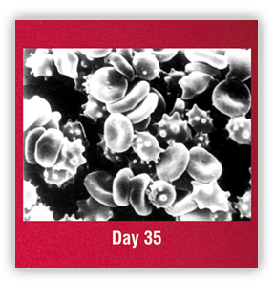
Blood transfusions
Blood Storage Lesion
Less volume, flexibility of RBCs; increased adherance
Release of free Hb
Formation of microparticles
Nitric oxide interactions
All of the above may be pro-inflammatory or pro-thrombotic- ultimately affecting delivery of 02 to tissues
Progresses over time

Slide 19
Blood transfusions
Objections to Blood Transfusions
Personal, Medical, or Religious
Jehovah’s Witnesses
Believe blood is sacred, the Bible says “abstain from blood” (Acts 15:28,29)
Highlighted possible complications associated with transfusion
DO accept non-blood alternatives to blood transfusion
Other Options:
Iron IV (for anemia) or supplement
Changes in diet
Volume expanders
Growth factors
Blood Salvaging or Hemodilution
Blood substitutes

Slide 20
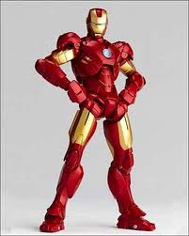
Blood transfusions
Case Study on Iron Deficiency Anemia*
Randomized 459 patients with CHF and iron deficiency to receive either placebo or IV iron
50% or treatment group reported, through Patient Global Assessment tool, NYHA functional class, and 6-minute walk test, being much or moderately improved
IV iron patients showed improved functional status regardless of Hb > or < 12g/dL prior to treatment

Slide 21
Physical therapy
Indications
Contraindications

Slide 22
Physical Therapy
Indicated if patient is asymptomatic of:
Fatigue
SOB
Chest pain
Headache
Dizziness
Pale skin
Nausea
Vomiting
Contra-indicated if patient is symptomatic of:
Fatigue
SOB
Chest pain
Headache
Dizziness
Pale Skin
Nausea
Vomiting

Slide 23
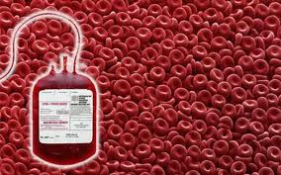
Physical therapy
What can we do as therapists?
Be aware
Check hemoglobin prior to working with patient
Monitor signs & symptoms of patients (before, during, or after transfusion) throughout your session
Communicate with their nurse
Educate others
Ask questions!

Slide 24
New hanover regional medical center
Taking Action!

Slide 25
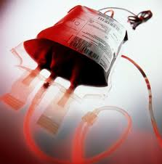
NHRMC
~15,000 blood transfusions per year
Currently working with Strategic Blood ManagementTM
~20 transfusion safety officers throughout U.S.
Educate, interact, provide tools for improvement
Largest area noted for improvement with transfusion rate: Orthopedics
2-3 year process

Slide 26
nhrmc
Good ‘ol Epic!
New order set for MD use for transfusions
Option to request
Last recorded hemoglobin
Drop box choices for reasoning
Transfusion “Triggers”
Hemoglobin < 7g/L
Active blood loss

Slide 27
nhrmc
Transfusion Committee
Oversee if policies/procedures in place are being implemented
Trends
Chart audits for transfusion patients
Monthly Continuing Education
Nursing staff on floors
Webinars
Any staff member of NHRMC

Slide 28
nhrmc
Adverse Event Prevention/Treatment
Nursing education on TACO & TRALI
1 recorded in 2011
Accuracy?
Patient Education
Consent, risks, benefits
Choices

Slide 29
nhrmc
QUESTIONS!?
Tommy Barham, MT (ASCP) SM
Manager- Blood Bank, Microbiology, Immunology
910-343-2776 or tommy.barham@nhrmc.org

Slide 30
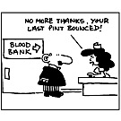
QUESTIONS?
Thank you!

Slide 31
References
http://www.bloodmanagement.com
http://www.thebloodytruth.com/
http://www.cms.hhs.gov/HospitalAcqCond/
http://www.jointcommission.org/PerformanceMeasurement/PerformanceMeasurement/Blood+Management+-+Utilization.htm
Boucher BA, Hannon TJ. Blood management: a aprimer for clinicians. Pharmacotherapy 2007: 27: 1394-411.
Collins TA. Packed red blood cell transfusions in critically ill patients. Critical Care Nurse 2011; 31: 25-34.
Dzik WH. Emily Cooley Lecture 2002: transfusion safety in the hospital. Transfusion 2003; 43: 1190-9.
Goodnough LT. Risks of blood transfusion. [Review][124 refs]. Critical Care Medicine 2003; 31: S678-S686.
Lion N, Crettaz D, Rubin O, Tissot JD. Stored red blood cells: a changing universe waiting for its map(s). J Proteomics. 2010. 73(3): 374-85.
Roback J. Vascular effects of the red blood cell storage lesion. Hematology: Transfusion Medicine: adverse Complications of Stored Blood, Amer Soc Hematol, 2011.
Stiller, K. Safety issues that should be considered when mobilizing critically ill patients. Crit Care Clin 2007. 23;35-53.
Taylor RW, Manganaro L, O’Brien J et al. Impact of allogenic packed red blood cell transfusion on nosocomial infection rates in the critically ill patient. Crit Care Med 2002; 30: 2249-54.

