Slide 1
ASD and Toe Walking
Christina Lanzone, SPT
UNC Chapel Hill, DPT 2013

Slide 2
Presentation Outline
Toe walking definition
Incidence in children with ASD
Theories on cause of toe walking in children with ASD
Possible outcomes of untreated toe walking
Treatment options for toe walking
Plan of action

Slide 3
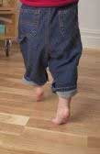
What is toe walking
The failure of the heel to contact the floor at onset of stance during gait
Can be a problem if it persists after 6 months after beginning to walk
Can present with a variety of pediatric diagnoses
Neuromuscular diagnoses
Orthopedic conditions
Myopathies
Idiopathic Toe Walking
Notes:
Neuromuscular: CP, tethered cord, various encephalopathies
Orthopedic: leg length discrepancy, DDH
Myopathies: DMD
Idiopathic: can be associated with autism and language disorders

Slide 4
ASD: common motor deficits
Hypotonia
FM deficits
GM deficits
History of delayed motor milestones
Toe walking
Apraxia
Impaired balance
Impaired equilibrium reactions

Slide 5
Toe Walking and ASD
Incidence reported to be between 20-63%
Characteristics:
Bilateral
May be able to walk with heels down briefly when requested
May increase when barefooted
May increase when excited, tired…
May or may not have limited DF ROM
Notes:
Barrow et al: also reported decreased incidence of toe walking in children with Asperger Syndrome compared with ASD; ASD 20% (and 12% for tight heel cords), Asperger 10% (and 3% for tight heel cords)
Study of 954 ambulatory children presenting for initial evaluation to a university developmental pediatrician were reviewed for the prevalence of persistent toe walking and associated tight heel cords (did not reduce past neutral)
Reports that 20 years ago, the diagnostic criteria for ASD was more stringent and the incidence of toe walking was 62.9% (reflecting that they are now including more children in ASD and incidence of toe walking and ASD therefore appears to be lower than originally thought)

Slide 6
Possible Causes of Toe Walking in Children with ASD
Sensory issues
Decreased proprioception
Hypotonia
Vestibulo-visual issues

Slide 7
Sensory Issues
Tactile hypersentivity
Tactile hyposensitivity
In sensory integration theory, proprioception is credited with being modulating, calming input

Slide 8
Decreased Proprioception
Toe walking increases proprioceptive input
Again, can be a modulating, calming input

Slide 9
Hypotonia
Can cause ankle instability
Toe walking provides increased ankle stability

Slide 10
Vestibulo-Visual Issues
Many children with autism have adequate focal vision, but impaired ambient vision
Theory that they have either tunnel vision or alternating vision
Results in difficulty seeing in three dimensions and correctly detecting the movement and distance of objects
toe walk to subconsciously increase their awareness of where they are in space to accommodate for these visual deficits

Slide 11
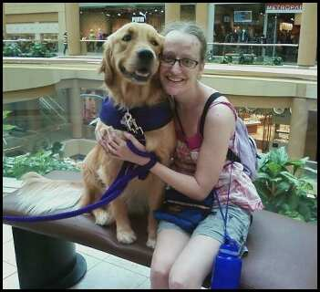
From their perspective
“When autistic people walk on their toes, it is because it provides a greater sense of feeling your body and knowing where it is in space” and “helps balance and feeling like you’re not going to tip over” and “helps relieve some dizziness if any occurs with vestibular problems”
Kristina DesJardins
author of Autism: Life in the Prism
creator of the website “Autism and its World”
Notes:
Seems to support both the proprioceptive theory and the vestibulo-visual theory (if you cannot rely on vision to tell you where you are in space, helpful to have your body better tell you where you are in space)
Wrote it when she was 22 years old

Slide 12
Possible Issues of Untreated Toe Walking
Increased risk of falls
Foot and ankle deformities
Triceps surae contractures
Decreased function
Increased risk of ankle injury
Limited DF ROM leads to foot compensations which can cause foot and knee problems
Can require surgery
Notes:
Decreased ability to climb stairs, squat
(incidence of toe walking in children with ASD 20%, incidence of tight heel cords 12%)

Slide 13
Treatments for toe walking in children with ASD
PT
OT
Therapeutic optometrist
Orthotics
Serial Casting
Surgery

Slide 14
Physical Therapy Evaluation
PMH
Birth history
Medical history
Developmental history
GM skills
Balance concerns
Onset of toe walking
Family history of toe walking?
Review current and past therapy

Slide 15
Physical Therapy Evaluation…
Systems Review
Pain assessment
Integumentary assessment
Speech and language screen
Sensory processing screen
Consider referring for screening for language delay and for autism spectrum disorders

Slide 16
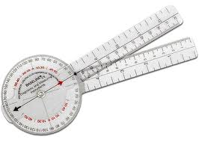
Physical Therapy Evaluation…
Physical Assessment
Neurological exam
Musculoskeletal exam
Gait exam
Gross motor skills assessment
Notes:
Neurological exam: assess muscle tone (MAS for plantarflexors and knee flexors and check clonus and babinski)
Musculoskeletal exam: ankle DF PRON in STN with knee flexed and extended, ankle DF AROM with knee extended, LE alignment, standing posture, LE strength (anterior tibialis, gastrocnemius), trunk strength
Gait exam: observation gait scale, parent report of % of time toe walking
GM skills: squatting (position of foot in squatting), transition floor to stand, stairs, balance (static and dynamic standing balance, single limb stance, balance beam), jumping/hopping, coordination

Slide 17
Physical Therapy Treatment
Can include:
Stretching the ankle plantarflexors
Strengthening the anterior tibialis and other LE and trunk muscles
Parent education and HEP
Orthotic intervention
Shoe modification
Gait training
Night splinting
Serial casting

Slide 18
Orthotics
Inserts
Braces
Day braces
Night braces
Shoe modifications

Slide 19
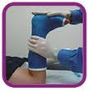
Serial Casting
Can be accompanied by Botox injections

Slide 20
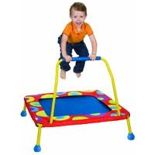
Occupational Therapy Treatment
Therapeutic brushing
Graded desensitization to tactile input
Providing other proprioceptive input:
Jumping on a trampoline
Stomping feet
Walking in the sand
Providing traction
Other activities that provide compression and traction

Slide 21
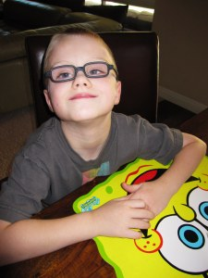
Therapeutic Optometrist
Vision training program developed by Melvin Kaplan, OD
Uses ambient prism lenses “to actually alter perception in ways that cause patients to reorganize their visual processes”
Reports immediate short term effects, long term effects can take up to a year
Notes:
Prism lenses displace the person’s field of vision up, down, left or right; have developed nonverbal assessment procedures to determine the correct direction and degree of displacement of the prism lenses; changes in attention and behavior are observable immediately after the person begins to wear the lenses; the use of prism lenses is part of a vision training program; this program typically lasts for one year and involves wearing the lenses and performing daily visual-motor exercises; after the program is complete, the person no longer needs to wear the prism lenses

Slide 22
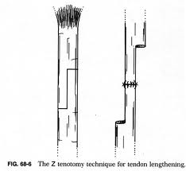
Surgery
Lengthening Achilles tendon or gastrocnemius
Recession of part or all of the gastrocnemius
Notes:
For older children whose toe walking has not resolved with conservative treatment and have significant decrease in DF ROM

Slide 23
Plan of Action!
Refer children who have been toe walking for more than 6 months after beginning to walk for physical therapy evaluation!
Consider apparent cause of toe walking
Work as a team to provide the best care
Thank you for your time!

Slide 24
Works Cited
Barrow, W. J., Jaworski, M., & Accardo, P. J. (2011). Persistent toe walking in autism. Journal of Child Neurology, 26(5), 619-21. doi: 10.1177/0883073810385344
Collmer, K. (2011, November 7). [Web log message]. Retrieved from http://community.advanceweb.com/blogs/ot_8/archive/2011/11/07/toe-walking-and-vision-unlikely-companions-that-we-need-to-see-to-believe.aspx
DesJardins, K. (2010, February 20). [Web log message]. Retrieved from http://chat1autism.wetpaint.com/page/Autism and tip-toeing..why?
Edelson, S. M. (2011). Toe walking. Autism Research Institute, Retrieved from http://www.autism.com/index.php/symptoms_toe_walking
Gregory, G. (2009, March 01). [Web log message]. Retrieved from http://www.helium.com/items/1360205-autism-and-toe-walking

Slide 25
Works Cited…
Kaplan, M. (2006). Visual management: a physiological approach to rehabilitating autism spectrum disorders. Autism research review international, 20(2), 3. Retrieved from http://www.autisticvision.com/cvmUpdateInfo/articles/vismgt.PDF
Ming, X., Brimacombe, B., & Wagner, G. C. (2007). Prevalence of motor impairment in autism spectrum disorders. Brain Development, 29(9), 565-70. Retrieved from http://www.ncbi.nlm.nih.gov/pubmed/17467940
Le Cras S., Bouck J., Brausch S., Taylor-Haas A.; Cincinatti Children’s Hopsital Medical Center: Evidence-based clinical care guideline for Management of Idiopathic Toe Walking. Guideline 040, pages 1-17, February 15,2011 http://www.cincinattichildrens.org/service/j/anderson-center/evidence-based-care/occupational-therapy-physical-therapy/
Yoell, C. (2011, March 06). Toe walking in children with autism. Retrieved from http://ebookbrowse.com/toe-walking-handout-doc-d75647361
Zimbler, S. (2010). Idiopathic toe walking: current evaluation and management. Orthopedic Jounral at Harvard Medical School, Retrieved from http://www.orthojournalhms.org/volume9

Slide 26
Questions?

